Slide 1

Project overview
WEBINAR
Tackling plastic pollution in the Atlantic area:
Moving forward in the implementation of the EPR for fishing gear
13th November 2025
Marisa Fernández, CETMAR

Slide 2
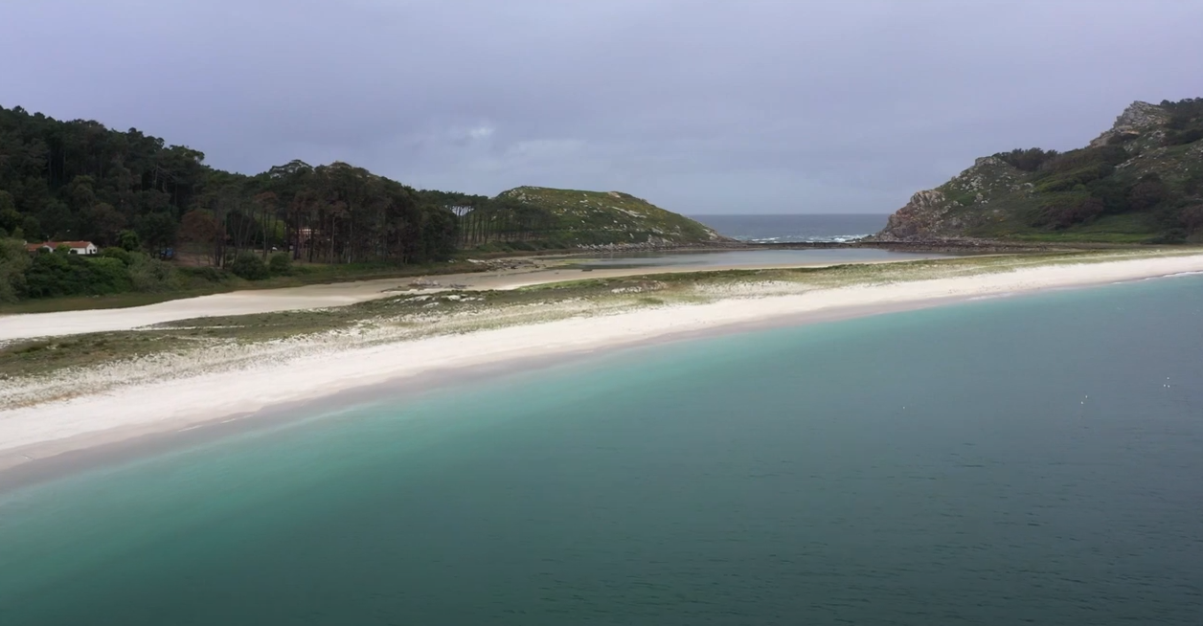





Free LitterAT in a nutshell
Background: CleanAtlantic & Indigo projects
Programme: INTERREG Atlantic Area (2021-2027)
Priority: 2.4 Enhancing protection and preservation of nature, biodiversity and green infrastructure, including in urban areas, and reducing all forms of pollution
General objective: To advance on achieving litter-free coastal communities by developing, testing and implementing innovative approaches for prevention, location and reduction of marine litter, with special emphasis on top litter items such as ALDFG and microplastics.
Start date: 1st November 2023
End date: 31st October 2026
Total budget: 3,626,336.22 € (75% ERDF)
Partnership: 23 organisations as partners and associated partners

Slide 3

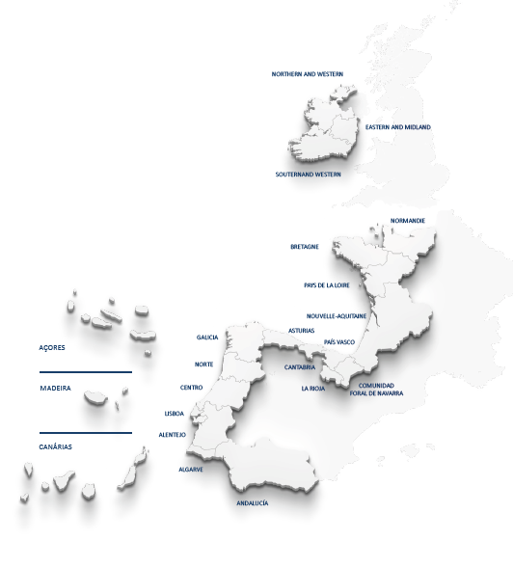
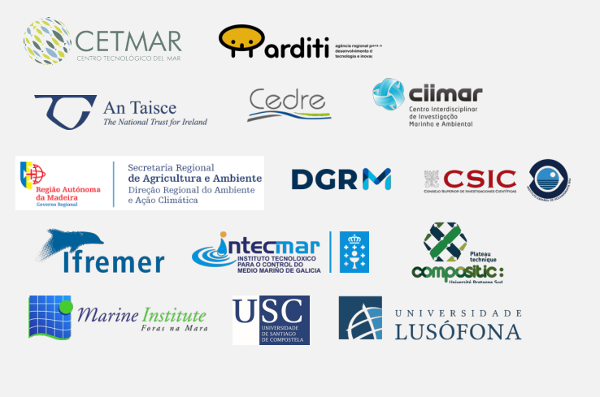
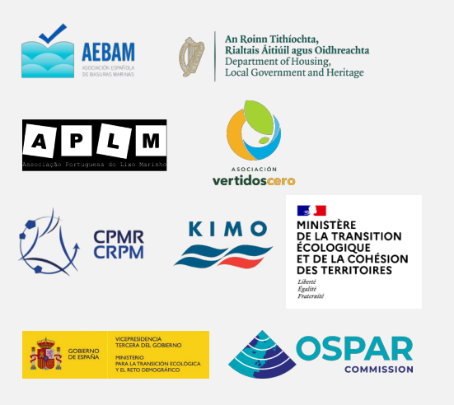

Partnership
14 partners from 4 countries:
France, Ireland, Portugal and Spain
9 Associated partners
-Advisory Board-

Slide 4





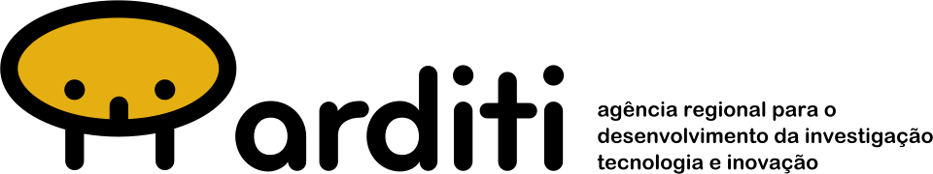
Objectives & Work Packages
Coordination and management
O1: Preventing marine litter by improving waste management and recycling and facilitating the implementation of SUP and PRF
O2: Understanding the origin, abundance and location of litter accumulation by identifying major sources, pathways and hotspots of marine litter (by monitoring and modelling)
O3: Reducing and removing marine litter and associated risks
Communication and capitalisation
WP1
WP2
WP3
WP4
Prevention by improving waste management and recycling
Assessing and Monitoring micro and macro litter
contamination
Modelling approaches from micro and macro litter: from modelling outputs to sources and hotspots
Reducing marine litter and associated risks
O4: Promotion of litter-free local communities by developing pilot actions and awareness raising activities
(WP1, WP2, WP3, WP4)

Slide 5
Objectives & Work Packages
Coordination and management
O1: Preventing marine litter by improving waste management and recycling and facilitating the implementation of SUP and PRF
O2: Understanding the origin, abundance and location of litter accumulation by identifying major sources, pathways and hotspots of marine litter (by monitoring and modelling)
O3: Reducing and removing marine litter and associated risks
Communication and capitalisation
WP1
WP2
WP3
WP4
Prevention by improving waste management and recycling
Assessing and Monitoring micro and macro litter
contamination
Modelling approaches from micro and macro litter: from modelling outputs to sources and hotspots
Reducing marine litter and associated risks
O4: Promotion of litter-free local communities by developing pilot actions and awareness raising activities
(WP1, WP2, WP3, WP4)

Slide 6
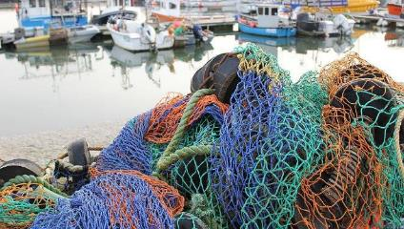
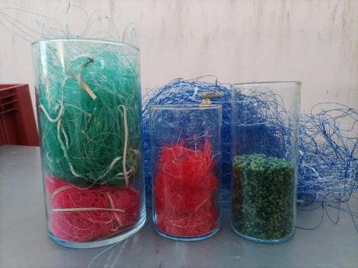
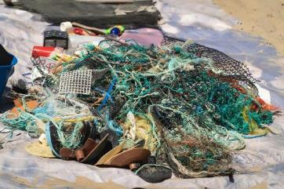
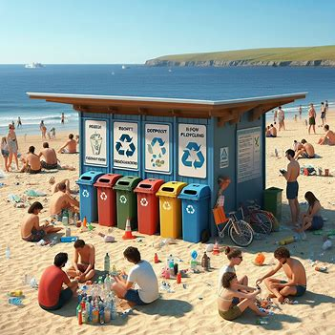
WP1: Prevention by improving waste management and Recycling
Activity 1
Analysis of relevant aspects for SUP and PRF implementation and current practices for waste management in different ports
Activity 2
Management and Recycling of End-of-Life Fishing gears
Activity 3
Management of Waste Incidentally Fished and ALDFG
Activity 4
Socio-economic analysis

Slide 7

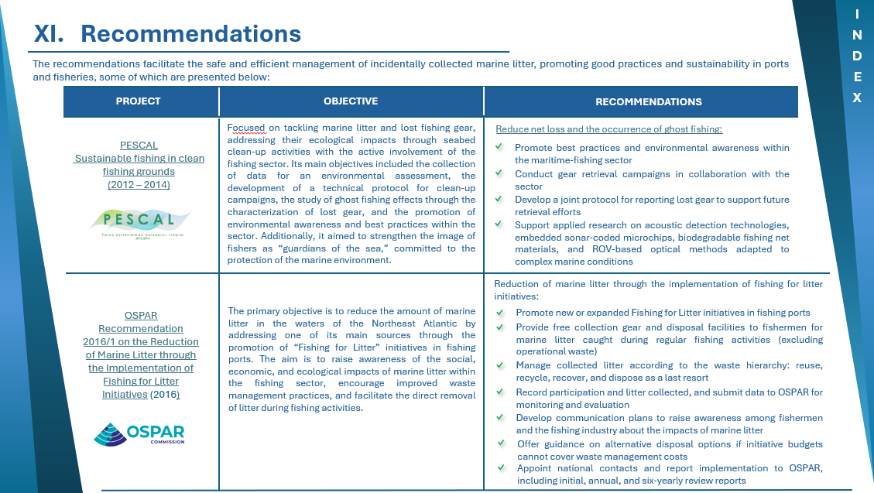
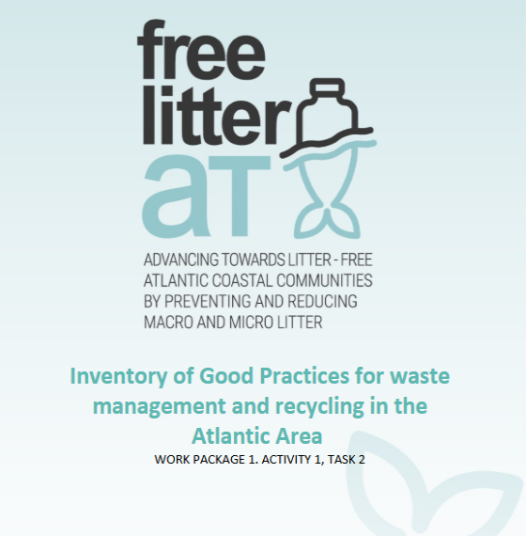
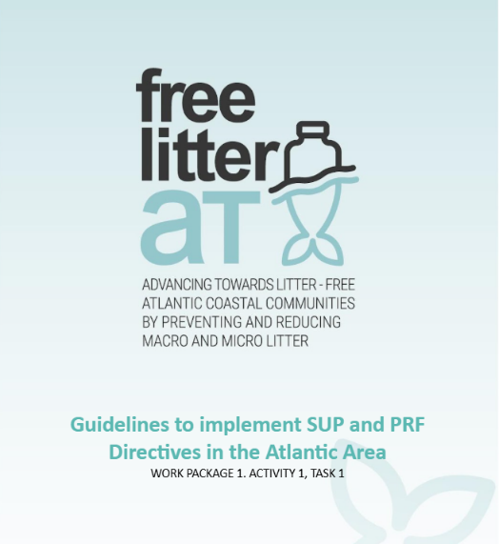
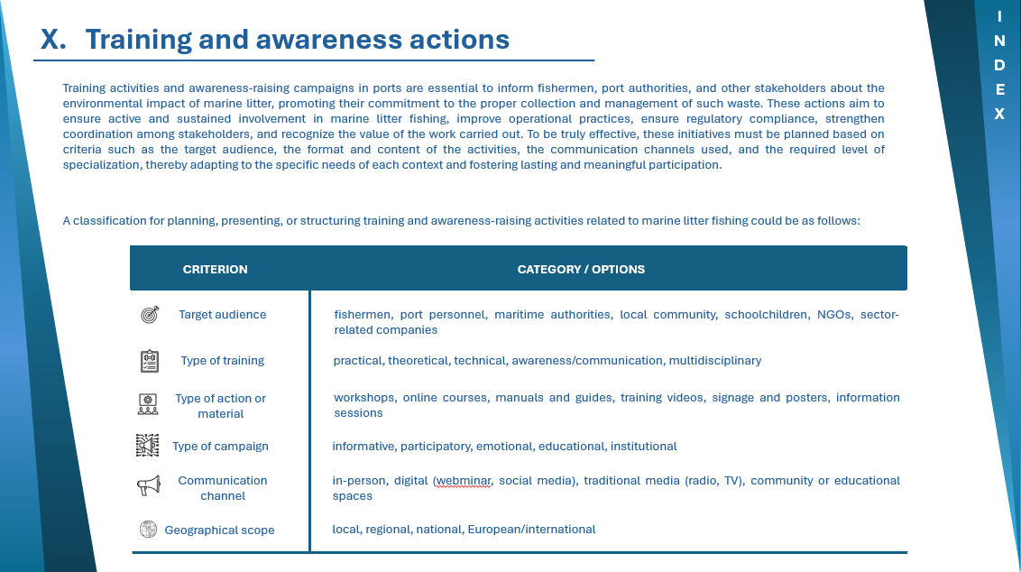
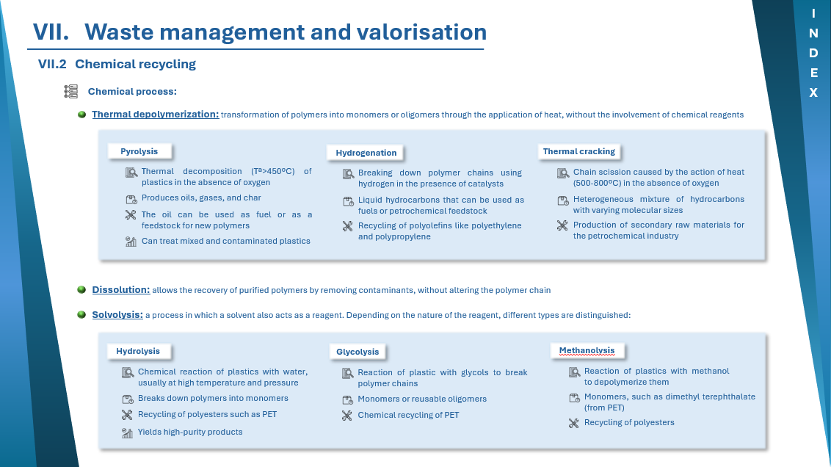
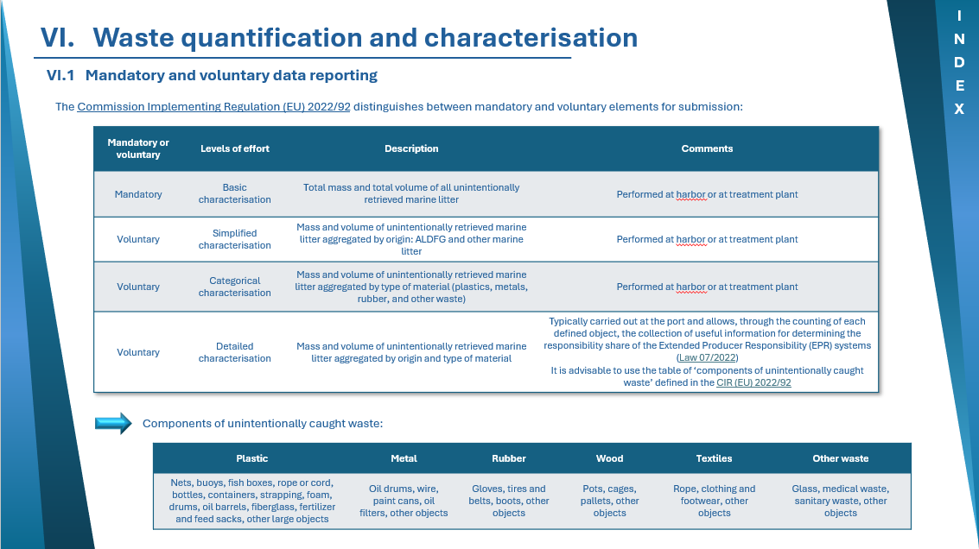
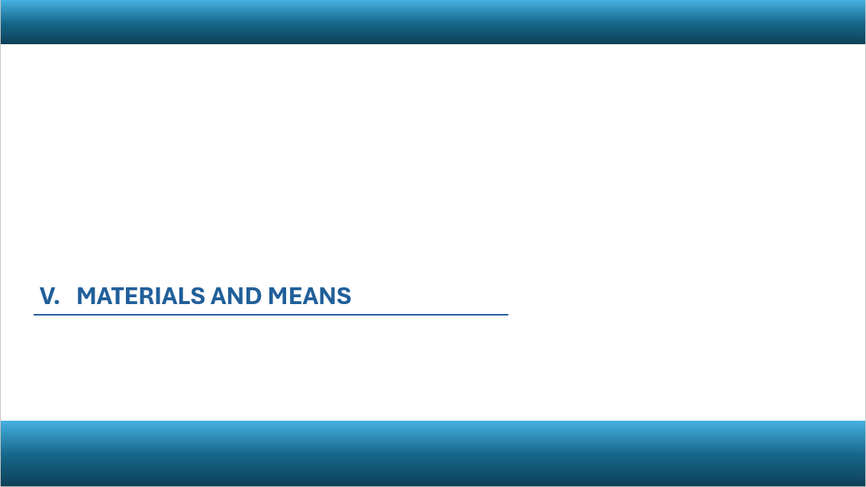
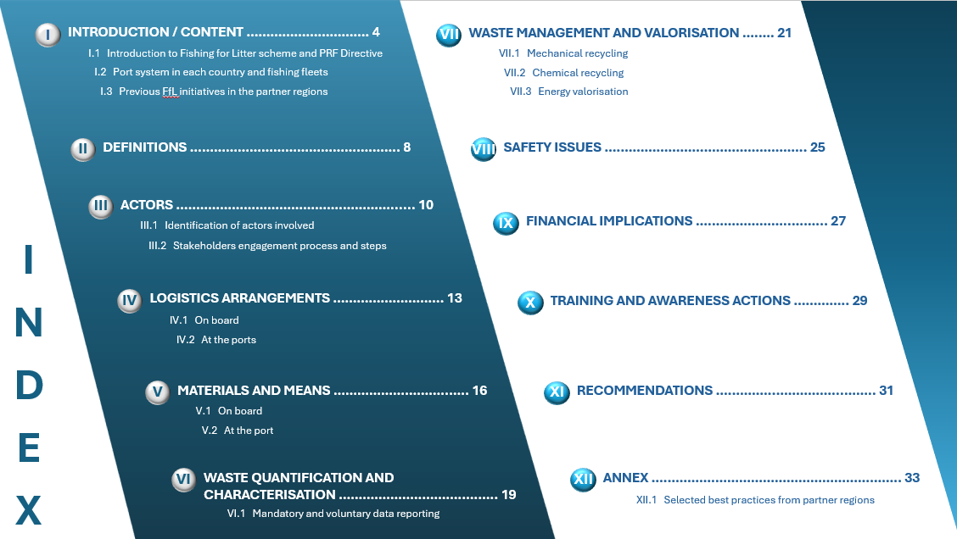
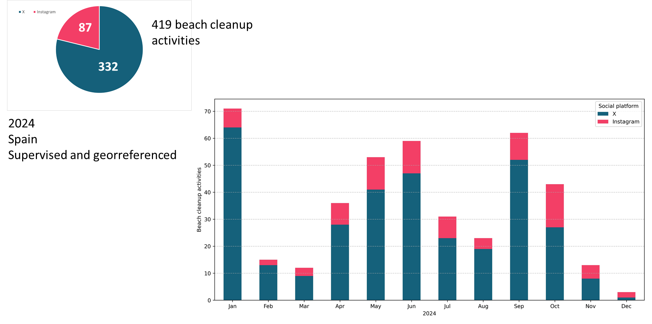
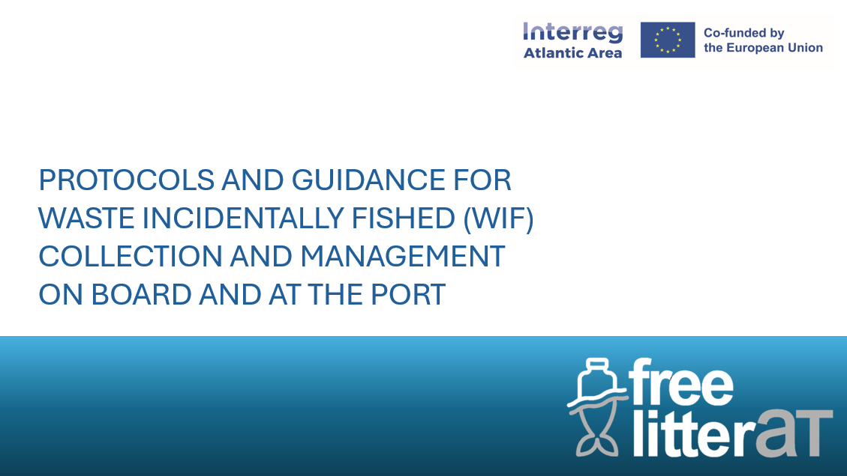

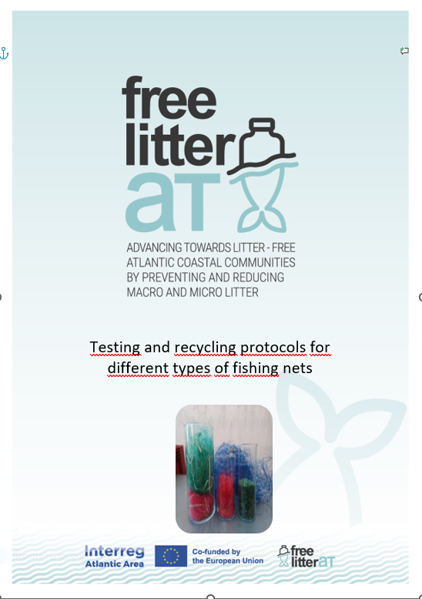
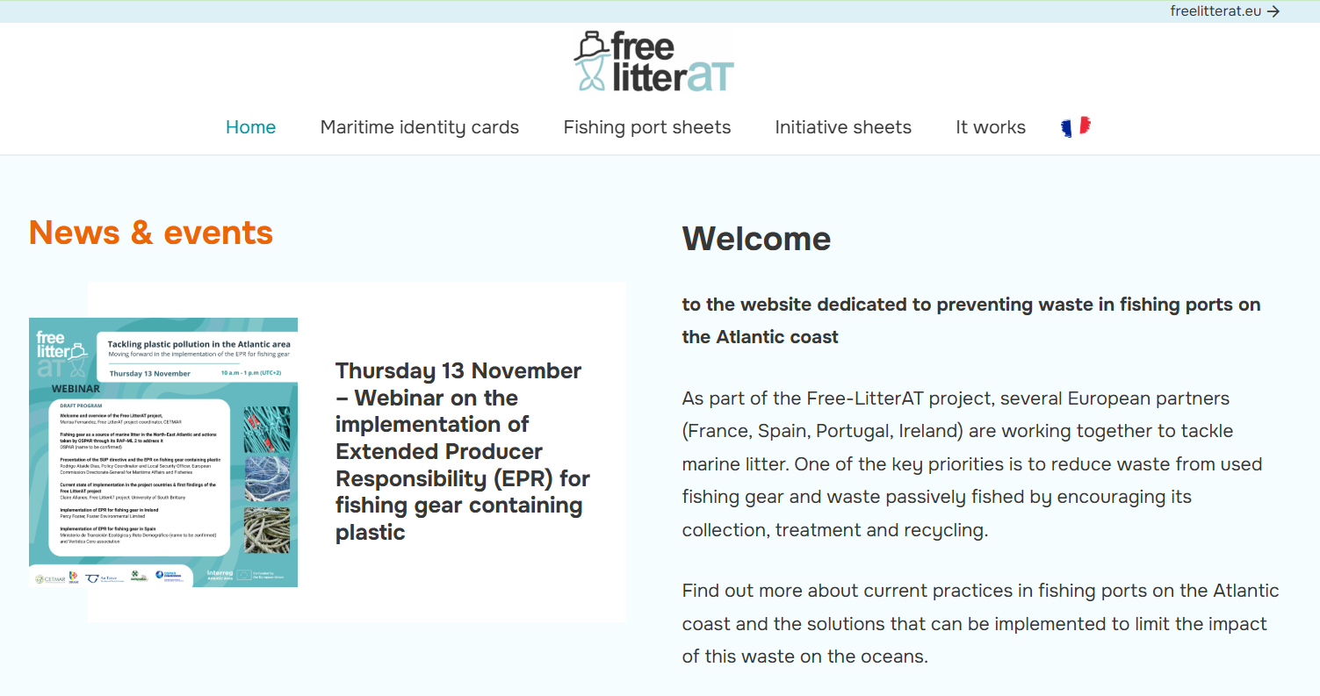
WP1: Prevention by improving waste management and Recycling
Socio economic study
SUP
2 webinars (SUP & EPR; PRF & FfL)
4 Local Workhops (2026)
Pilot actions to test waste management practices
SUP & EPR
PRF & FfL
Notes:
D1.1.1 Guidelines to implement SUP and PRF Directives in the Atlantic Area
D1.1.2 Inventory of Good Practices for waste management and recycling in the Atlantic Area.
D 1.2.1. Fishing gear life cycle studies.
D.1.2.2. Testing and recycling protocols for different types of fishing nets
D 1.2.3 Report on pilot actions and/ awareness raising activities
D 1.2.4. Summary report of key outcomes of the Activity to be presented at OSPAR ICG-ML meetings.
D 1.3.1 Guidance to implement management of waste incidentally fished in line with PRF requirements
D 1.3.2 Summary report of outputs to be considered as the OSPAR Fishing for Litter Recommendation
D 1.4.1 Study on how to encourage the reduction of marine litter and recycling of marine plastics
(focus on recreational fishing)

Slide 8
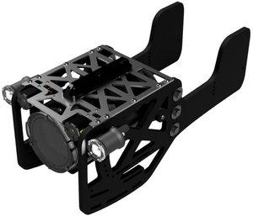
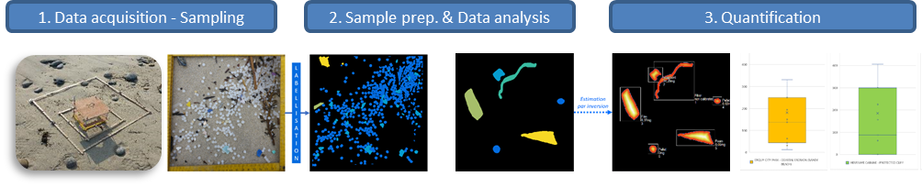
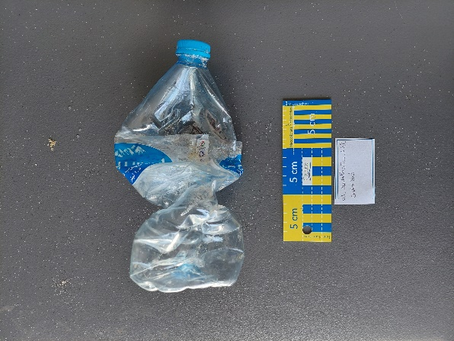
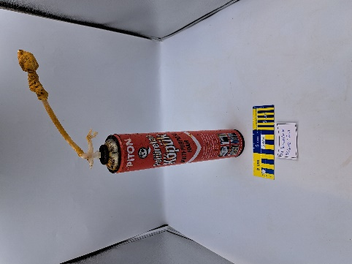
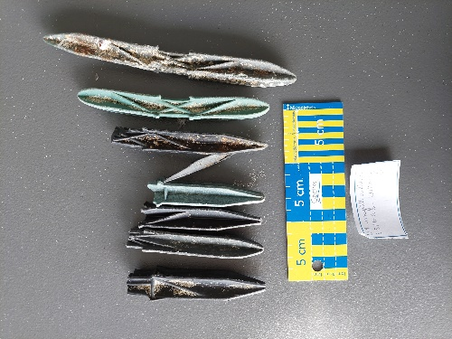
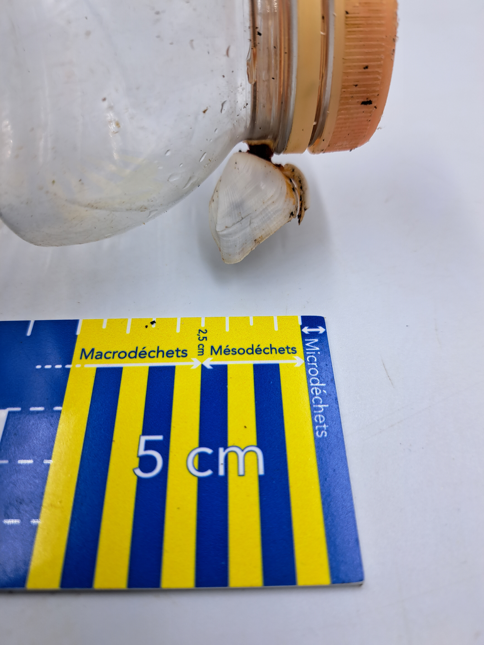
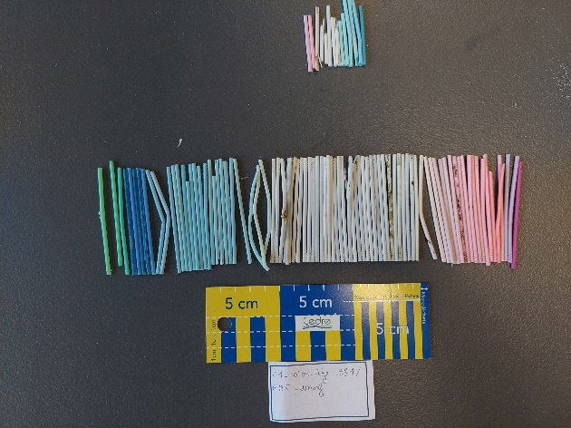
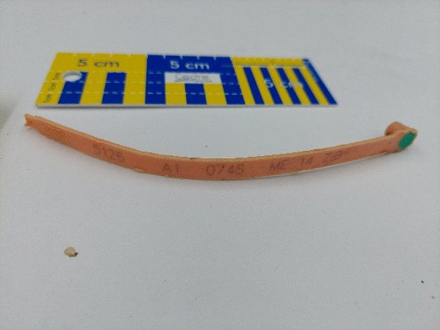
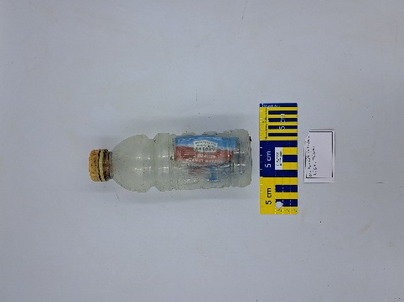
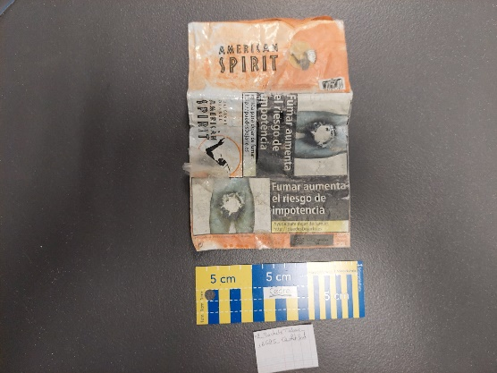
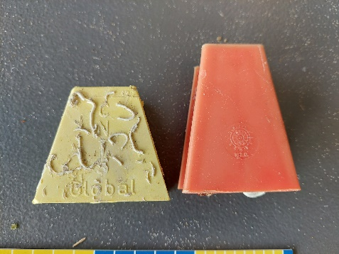
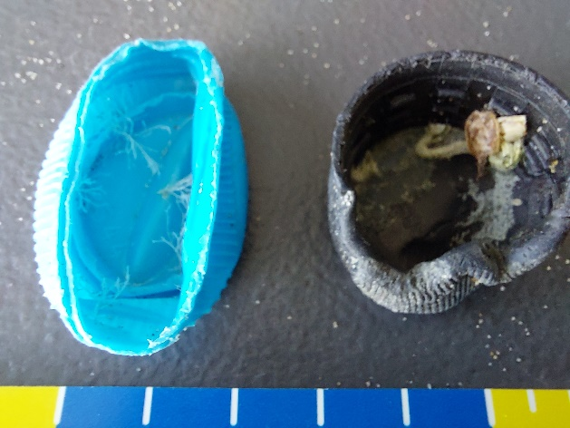
WP2: Assessing and Monitoring micro and macro litter contamination
Activity 1
Advancing new methods and tools to survey and monitor macro marine litter
Activity 2
Improved microplastics monitoring
Activity 3
Identification of activity and geographical sources of marine litter
Activity 4
Comprehensive assessment of macro and microlitter pollution in the Atlantic Area

Slide 9
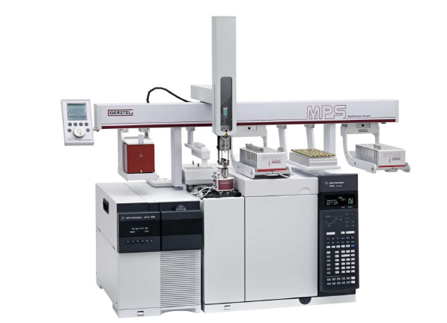
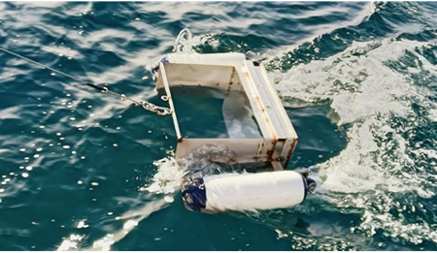
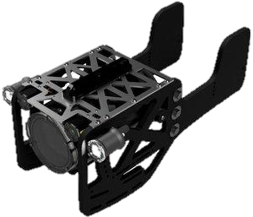
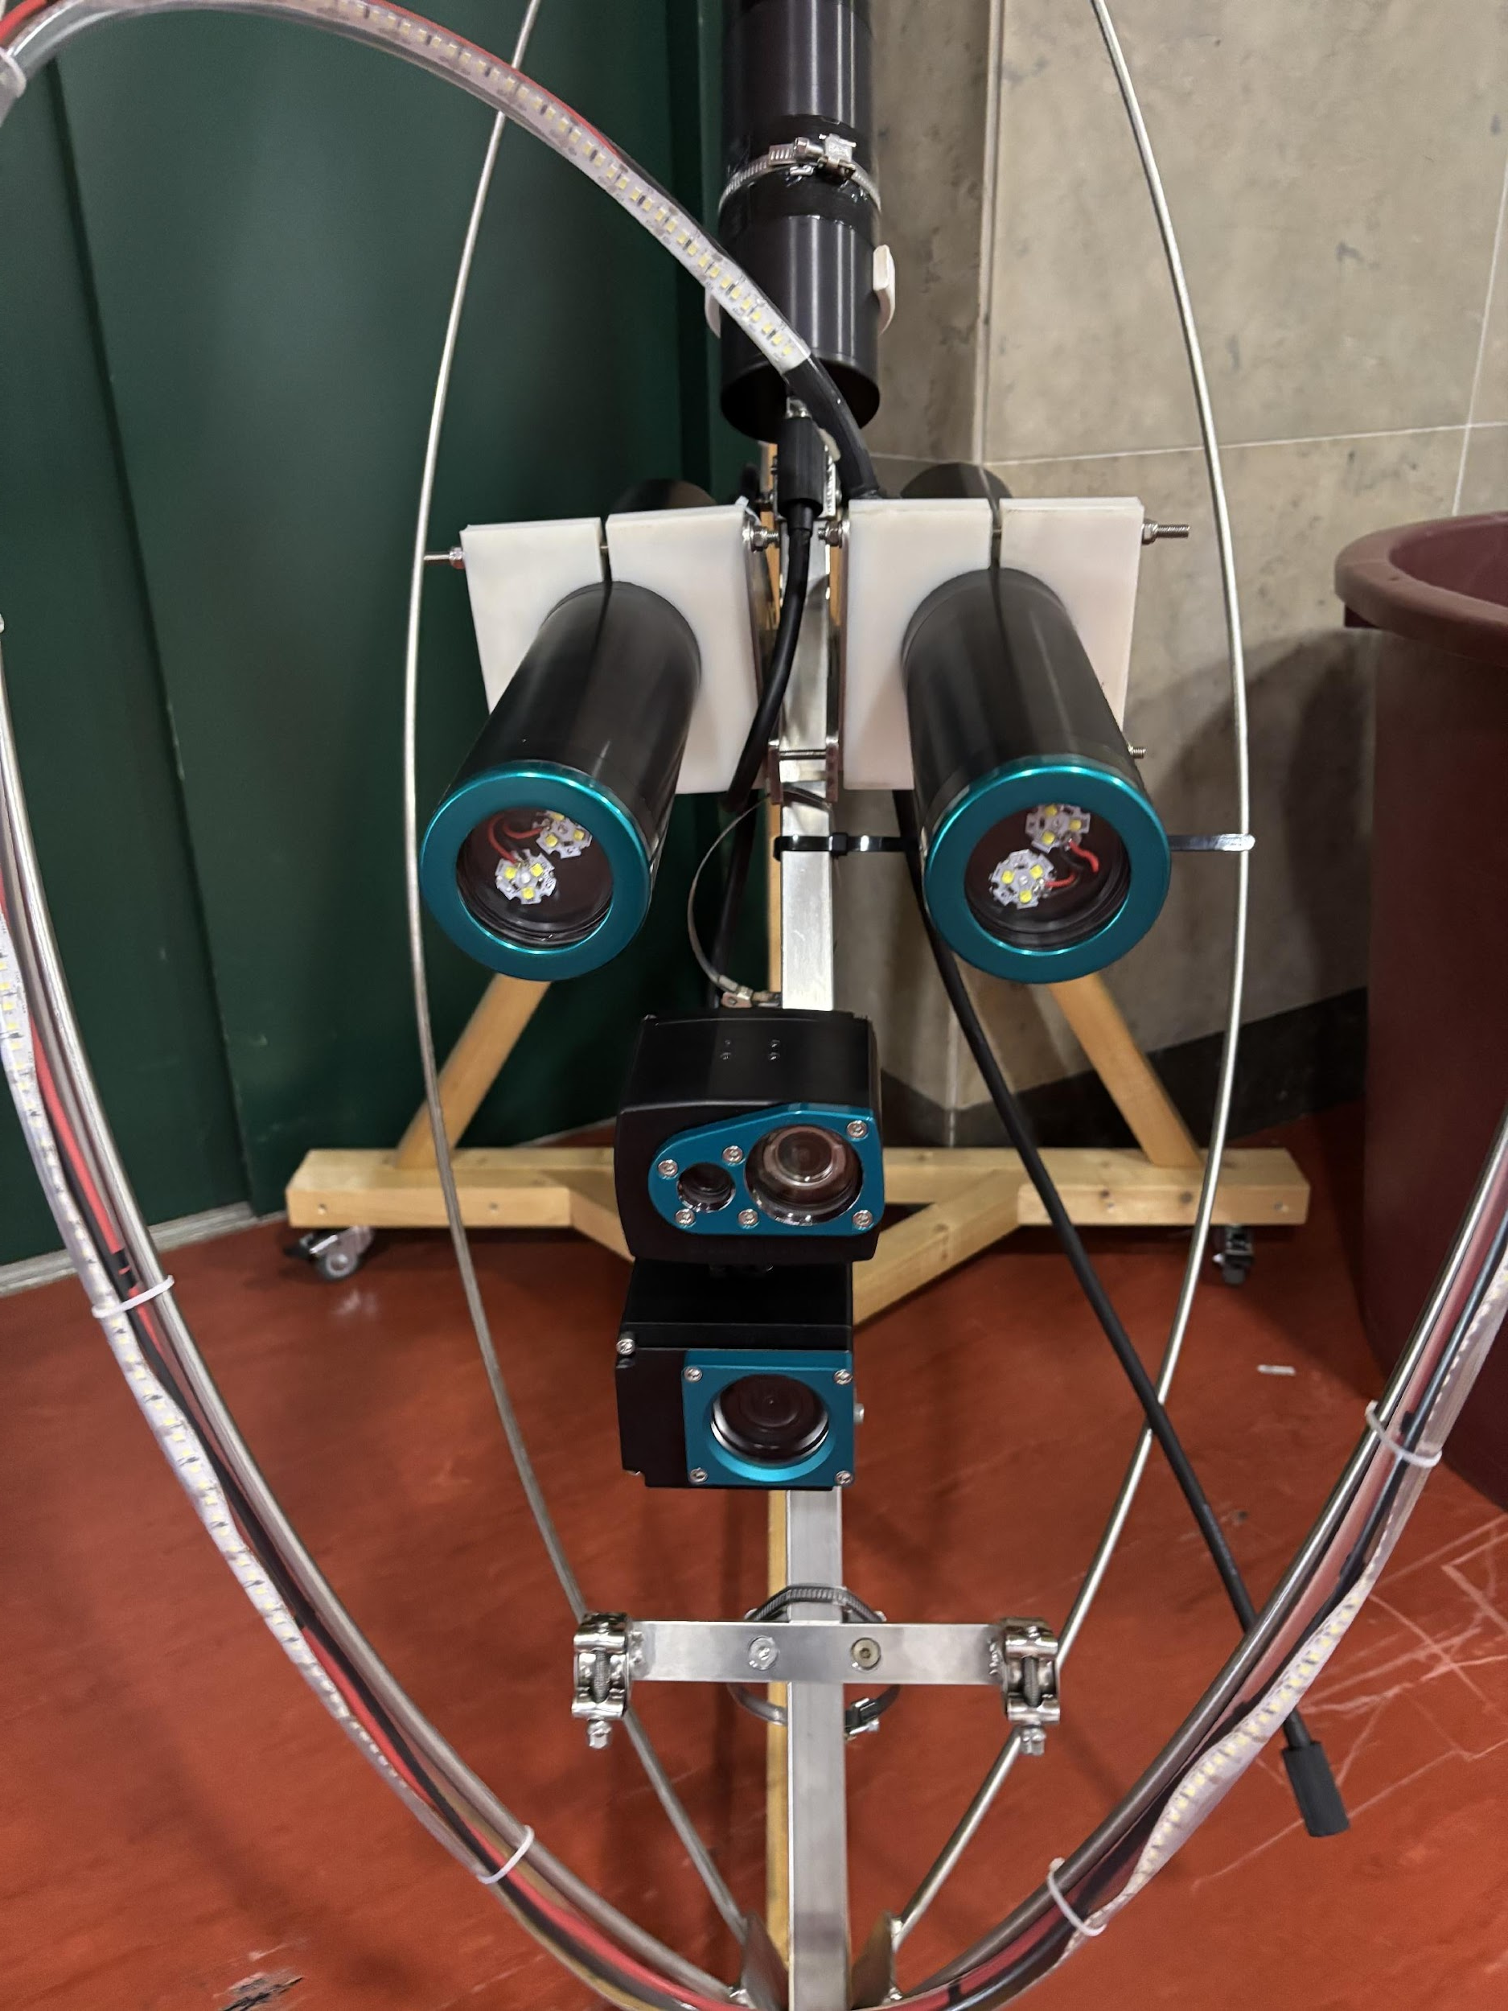
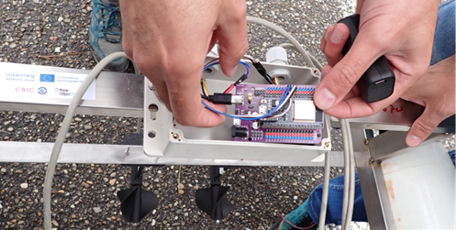
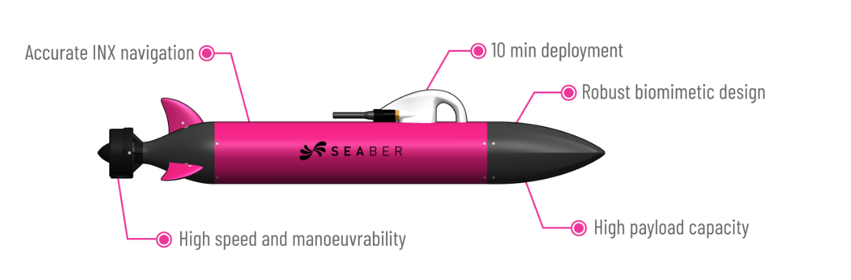
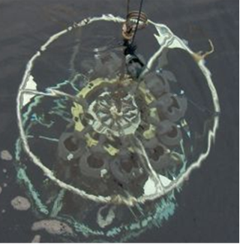


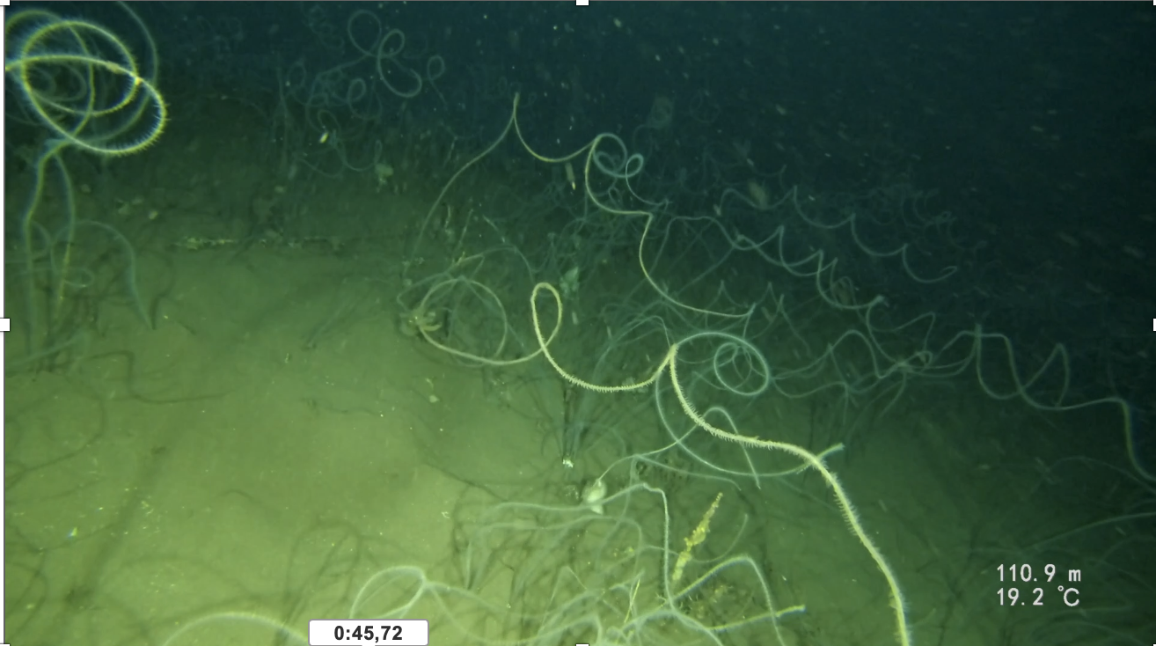
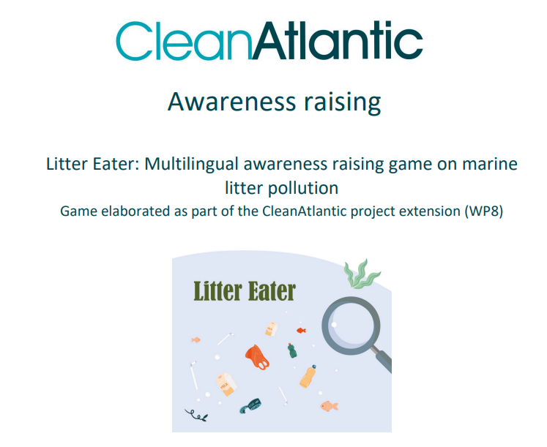
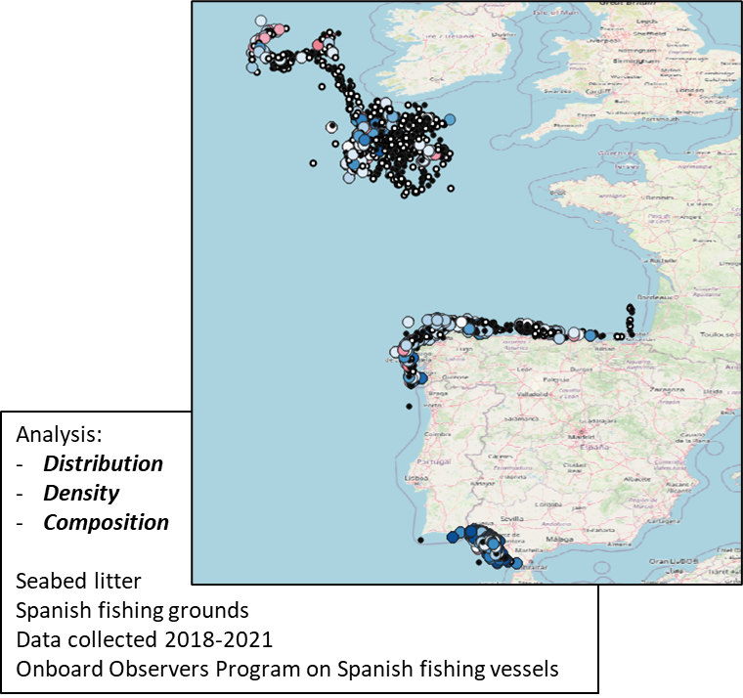
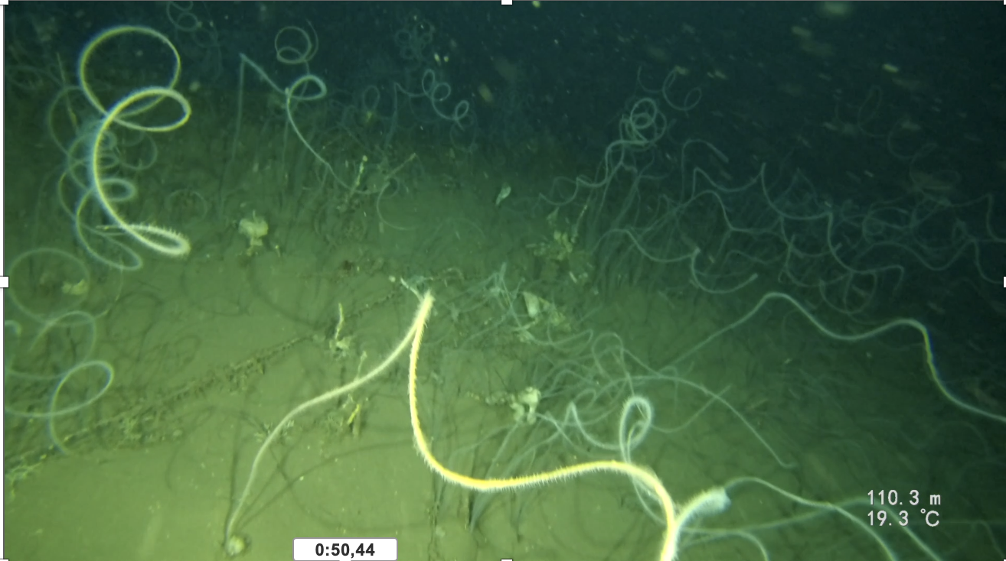
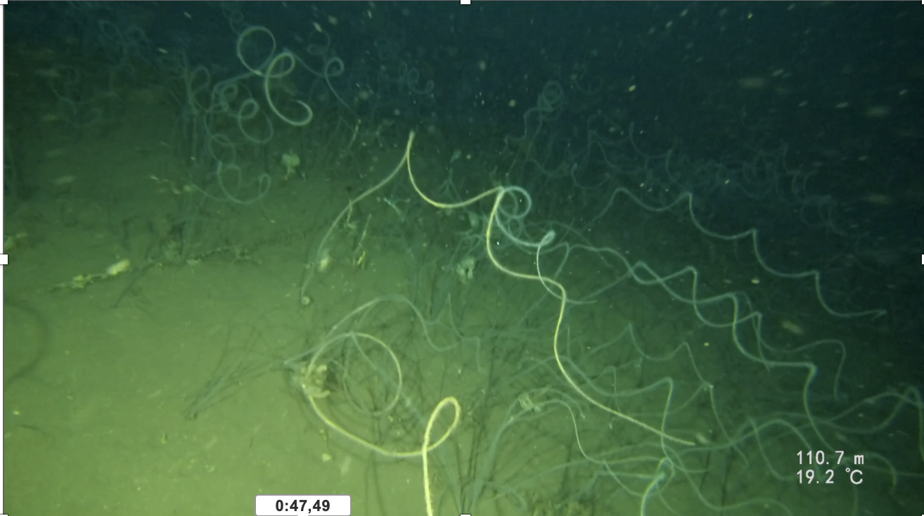
WP2: Assessing and Monitoring micro and macro litter contamination
Seafloor litter data acquisition methods and collaborative tool for image annotation
Low-cost methodology developed for microplastic sampling in water
Analytical methods to quantify small microplastics in sediment matrices
Methods based on imagery coupled with artificial intelligence to quantify large microplastics (1-5 mm)
Manta trawl
Coupling real-time water volume sampler to surface particle sampling systems
Methodology for identification of activities and geographical sources of marine litter sources
OSPAR Regions (III and IV) (2 WORKSHOPS)
Harmonised guidelines for microplastics monitoring (sampling, sample preparation…)
Organisation of Workshop in Lisbon (March-April 2026) !!

Slide 10
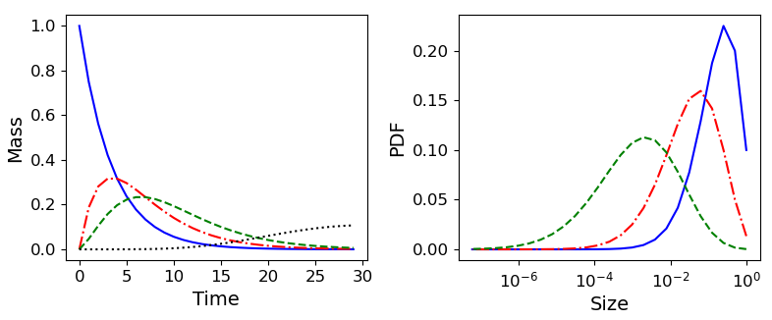
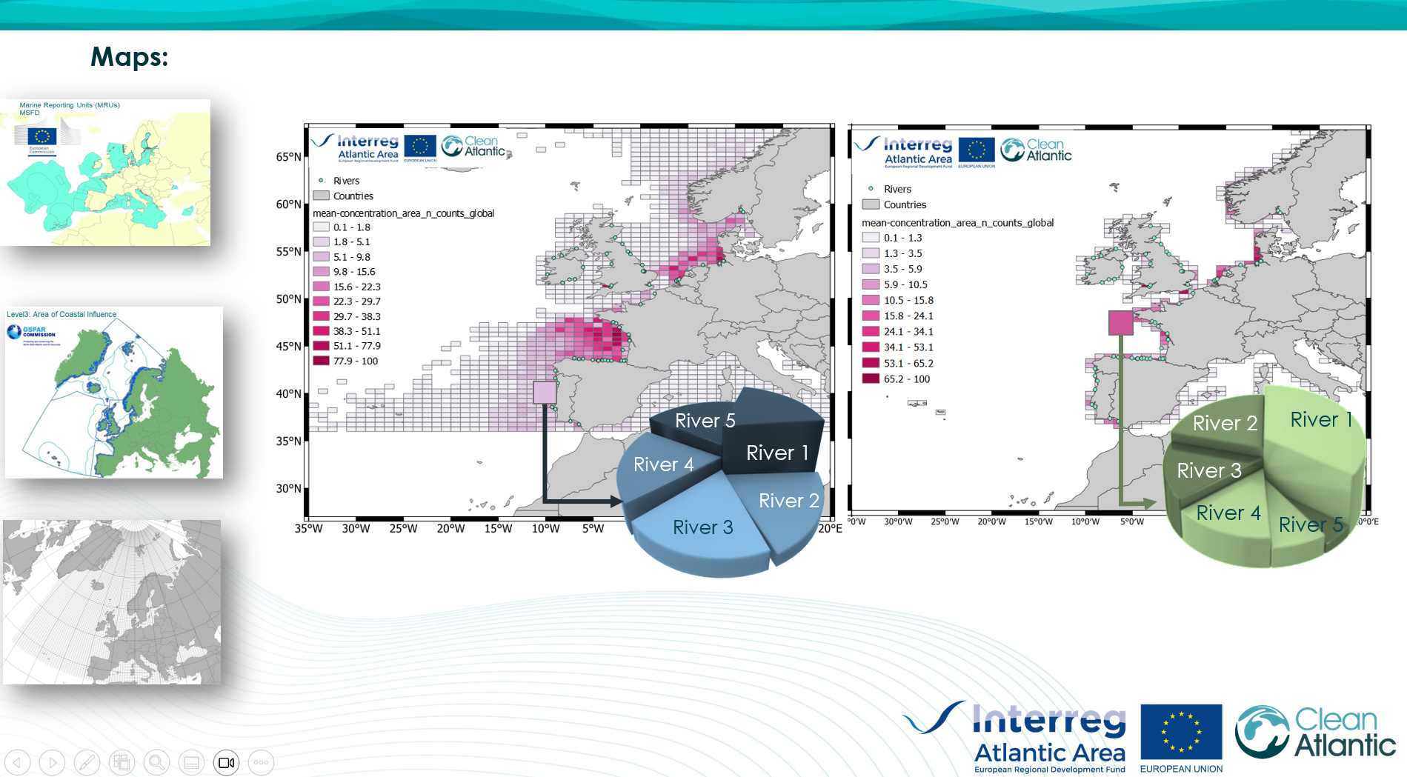
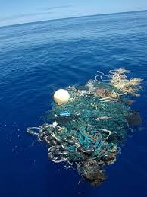
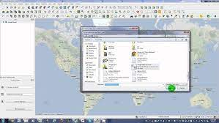
WP3: Modelling approaches from micro and macro litter: from modelling outputs to sources and hotspots
Activity 1
Increased knowledge regarding the degradation mechanisms of plastics
Activity 2
Improved modelling of macro and microplastics
Activity 3
Modelling drift behaviour of nets, ropes and fishing tools
Activity 4
Improving the usability of Marine Litter Lagrangian model by end-user and stakeholders.

Slide 11
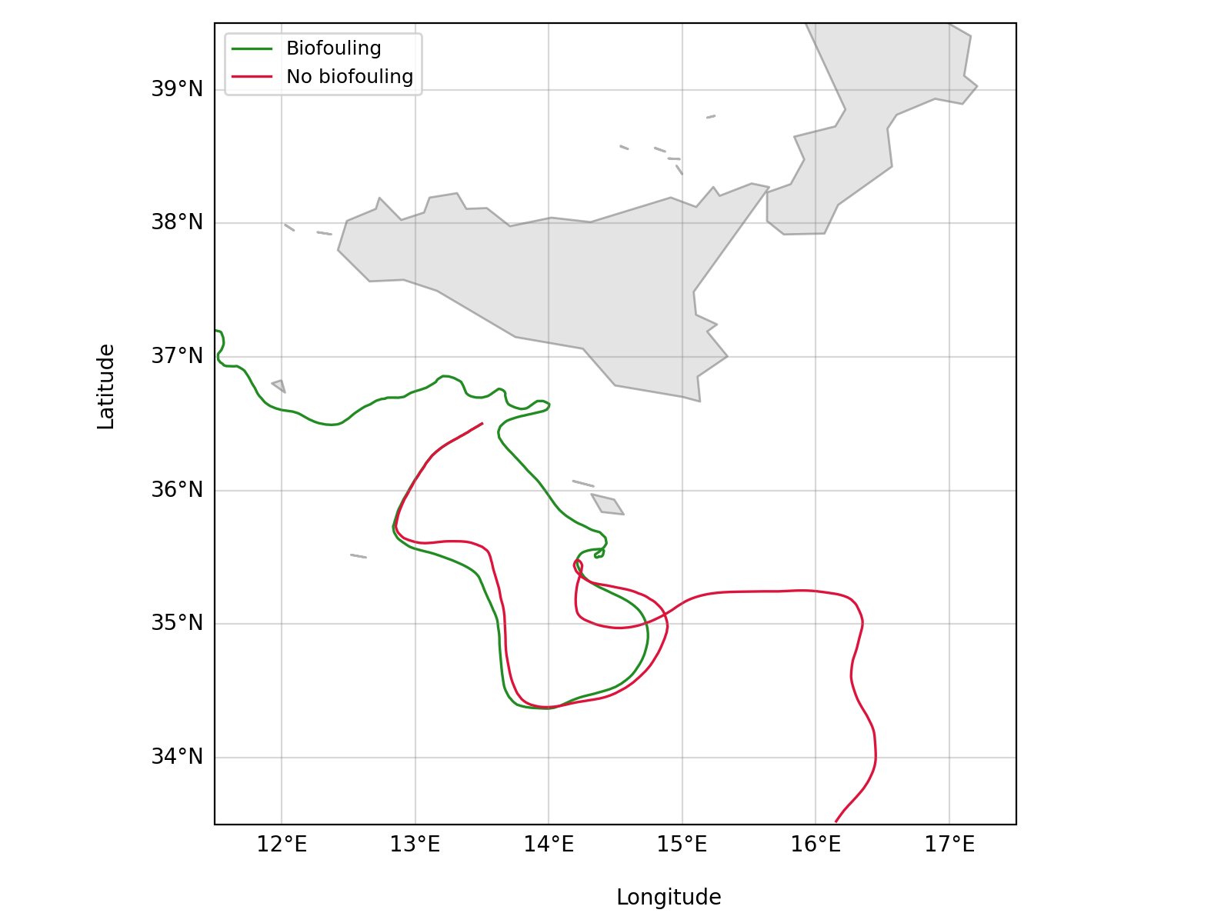









WP3: Modelling approaches from micro and macro litter: from modelling outputs to sources and hotspots
Experimental work on degradation (equations)
Biofouling study
Updated version of the MOHID-Lagrangian model including degradation and beaching, and developing Connection matrices between plastics located in the coastal areas and the most likely sources
Platform

Slide 12





WP4: Reducing marine litter
Activity 1
Development and testing of actions plan for ALDFG detection, mapping and retrieval
Activity 2
Testing of WP1 outcomes on Fishing for Litter by developing pilot actions
Activity 3
Marine litter removal in coastal accumulation sites, including remote areas
Activity 4
Removal of microplastics

Slide 13









WP4: Reducing marine litter
Pilot actions & laboratory work
Fibers and microplastics
Removal and clean up
FfL
ALDFG

Slide 14












Work Packages & Deliverables & Pilot Actions & WSs
WP1
WP2
WP3
WP4
54 Deliverables
Guidelines, manuals, good practices, lifecycle studies
Tools, protocols, solutions and action plans
Monitoring and modelling (micro, macro, ALDFG)
Marine litter sources and hotspots identification
Waste management best practices
End of life fishing gears recycling
ALDFG mapping and retrieval
Fishing for litter
Clean-up and removal
Socio economic studies
Testing and implementation
Pilot actions
Workshops
Awareness raising and knowledge transfer

Slide 15





Communication
X: @FreeLitterAT
Web domain: www.freelitterat.eu
Instagram: @freelitterat

Slide 16




Capitalisation
First results:
Main capitalisation activities:
  Interactions with OSPAR ICG-ML
  Interactions with MSFD-TG ML
  Interactions with the Atlantic Strategy (Pillar IV)
  Interactions with CPMR
✓
Toolkit
Released: February 2025
Online document

Slide 17
Many thanks for your attention!
CONTACT US
Project Coordination team
Centro Tecnológico del Mar – Fundación CETMAR
Email: freelitterat@cetmar.org; mfernandez@cetmar.org
www.freelitterat.eu (in construction)
FOLLOW US
Twitter: @Clean_Atlantic https://twitter.com/Clean_Atlantic
Instagram:@cleanatlanticproject https://www.instagram.com/cleanatlanticproject/

