Slide 1
Port Reception Facilities Directive
- the frame
Webinar “Fishing for Litter in the frame of PRF directive: Experiences and Challenges in the Atlantic Area”
Anna Marczak,
European Commission, DG MOVE

Slide 2
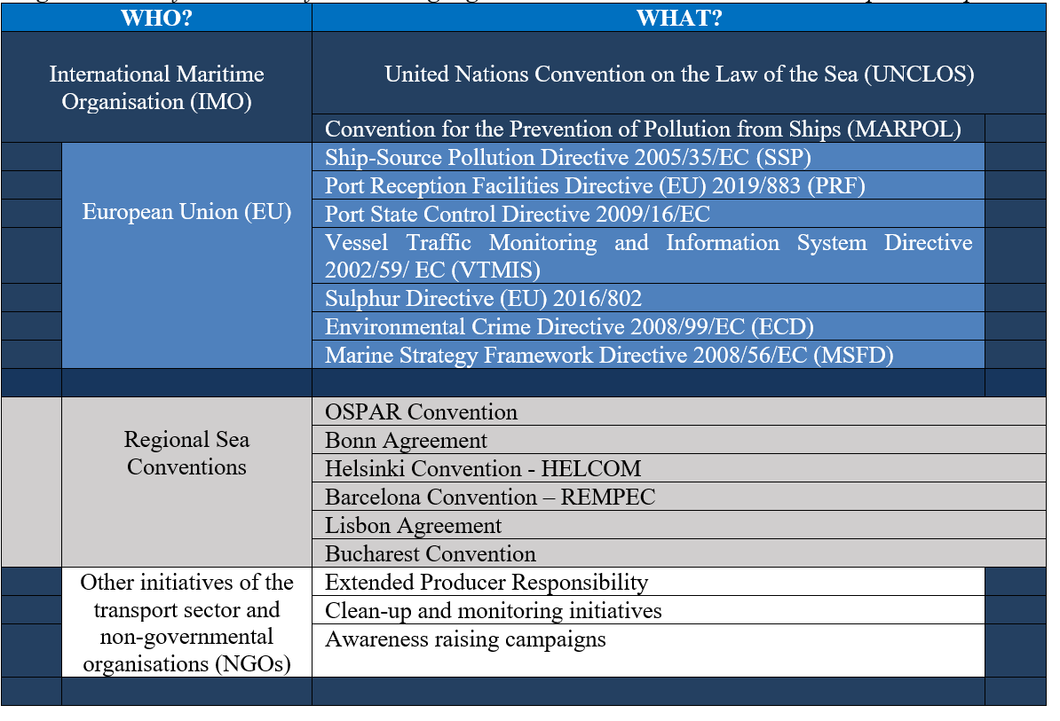

Slide 3
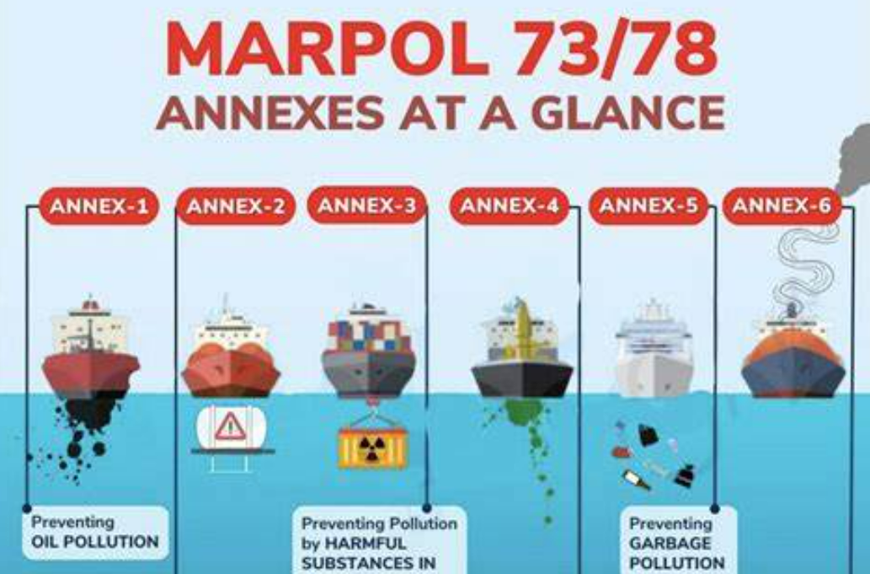
MARPOL
The International Convention for the Prevention of Pollution from Ships (MARPOL) is the main international convention covering prevention of pollution of the marine environment by ships from operational or accidental causes.

Slide 4
Content
What is the directive about?
Recent reports about the implementation of the directive
  Report concerning activities of the ESSF Waste from Ships sub-group
  European Maritime Transport Environmental Report
Next steps

Slide 5
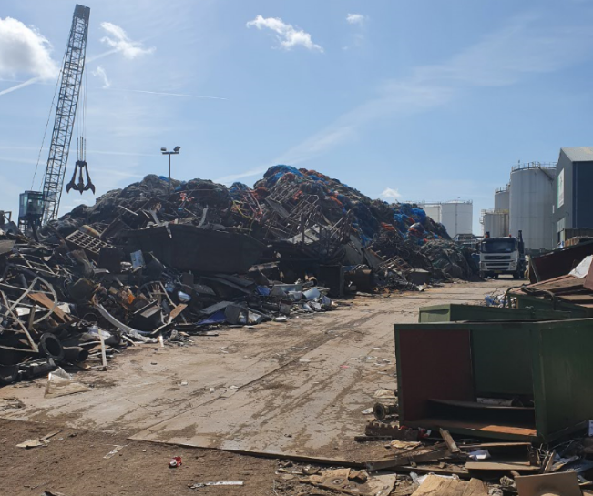
Port Reception Facilities Directive (EU) 2019/883
EU provisions on the availability and use of adequate port reception facilities and the delivery of waste to those facilities.
Pollution prevention by offering solutions in ports.
Less waste discharged into the sea

Slide 6
What is the directive about?
  Adequacy of port reception facilities: requirements on operational and environmental conditions, waste reception and handling plans
  Delivery of waste from ships:
    mandatory delivery and notifying about waste
    economic incentives (cost recovery system, indirect fee for Garbage)
    inspections
    exemptions (e.g. small non-commercial ports are exempted from having a Waste Reception and Handling Plan)
  Administrative provisions

Slide 7
Implementing acts under PRF Directive
Calculation of sufficient storage capacity
  Commission Implementing Regulation (EU)2022/89
Criteria for demonstrating that a ship produces reduced quantities of waste, and manages its waste in a sustainable and environmentally sound manner
  Commission Implementing Regulation (EU)2022/91
Risk-based targeting mechanism for inspections
  Commission Implementing Regulation (EU)2022/90
Methodology for reporting passively fished waste
  Commission Implementing Regulation (EU)2022/92 amended by (EU) 2024/917
https://transport.ec.europa.eu/news/commission-adopts-rules-delivery-waste-ships-eu-ports-2022-01-24_en

Slide 8
Report on the implementation of the PRF Directive
REPORT concerning activities of the ESSF Waste from Ships sub-group (2024)
1. Assessment of the implementation of the PRF Directive
2. Recommendations on the four implementing acts under PRF Directive
Source: https://circabc.europa.eu/ui/group/5d1959d1-aaed-49cd-b156-d5a42523f212/library/ba43e940-15c4-4d78-817c-351a6004f29d/details

Slide 9
Report on the implementation of the PRF Directive
The PRF Directive has added value because more waste is delivered by ships to EU ports and the port reception facilities in the EU are getting upgraded to become more adequate. More waste-related information is also available for ship masters and national authorities. However, based on a preliminary assessment of implementation the following areas for improvement were identified:
more inspections of ships’ waste management are needed to reach the 15% target;
clearer information on waste fees and waste plans is needed in some ports to ensure that ships deliver their waste efficiently;
more notifications, exemptions and waste receipts are needed to ensure a meaningful information flow between ships, ports and authorities.

Slide 10
Report on the implementation of the PRF Directive
REPORT concerning activities of the ESSF Waste from Ships sub-group (2024)
1. Assessment of the implementation of the PRF Directive
2. Recommendations on the four implementing acts under PRF Directive
Specifically, on passively fished waste:
  EU ports are encouraged to collect data on passively fished waste in mass (and not in volume) because mass is a more reliable unit of measure for passively fished waste and does not depend on the type of container the waste is collected in.
  Data collected in mass [tonnes] can be converted to values in volume [m³] by optionally using an estimated density of 700 kg/m³.
Source: https://circabc.europa.eu/ui/group/5d1959d1-aaed-49cd-b156-d5a42523f212/library/ba43e940-15c4-4d78-817c-351a6004f29d/details

Slide 11
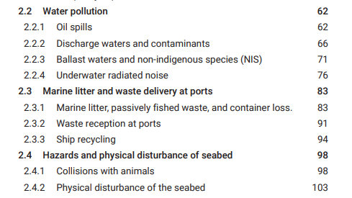
European Maritime Transport Environmental Report (EMTER 2025)
https://emsa.europa.eu/emter.html

Slide 12
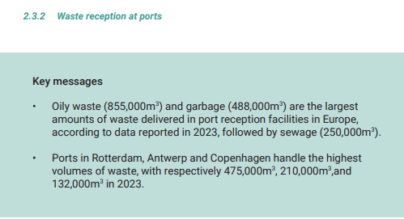

Slide 13
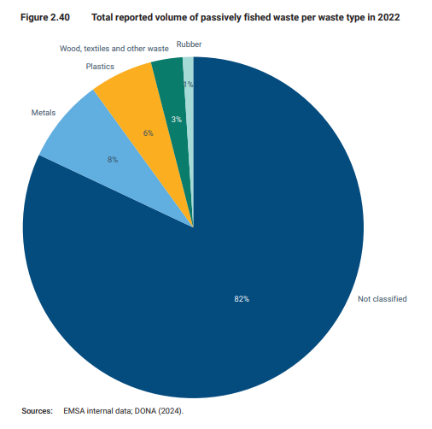

Slide 14
Summary of latest data reported on passively fished waste [tonnes]

Slide 15
Next steps
Member States to
report data on passively fished waste by 31 December 2026 the data for 2024 and 2025 in mass and volume. Possibility to use the harmonised conversion factor (p = 700 kg/m³)
Encouraging to collect data on passively fished waste in mass [tonnes]
Consider possible changes to Commission Implementing Regulation (EU) 2022/92:
  Simplification by reporting in mass [tonnes] -> deleting obligation for reporting volume
  Reporting of ALDFG (abandoned, lost or otherwise discarded fishing gear) to become obligatory instead of voluntary to avoid double reporting in the Single-Use Plastic Directive (EU 2019/904)

Slide 16
Thank you
© European Union 2023
Anna MARCZAK
Policy Officer
anna.marczak@ec.europa.eu

