Slide 1
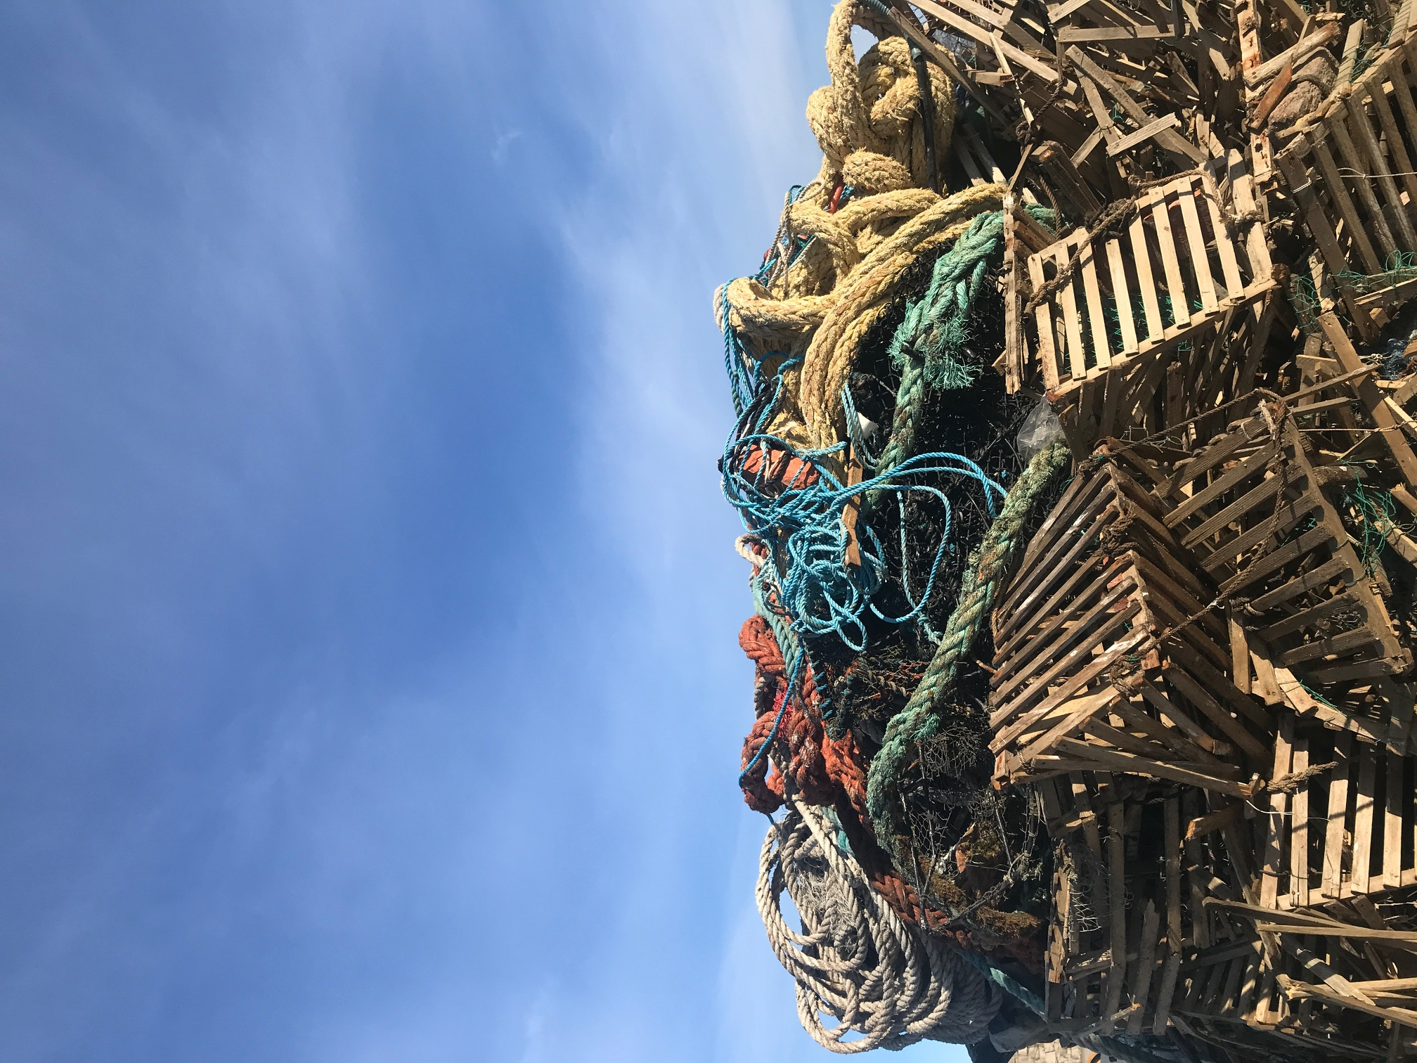


The Sotenäs Marine Recycling center
From marine waste to marine responsibility

Slide 2

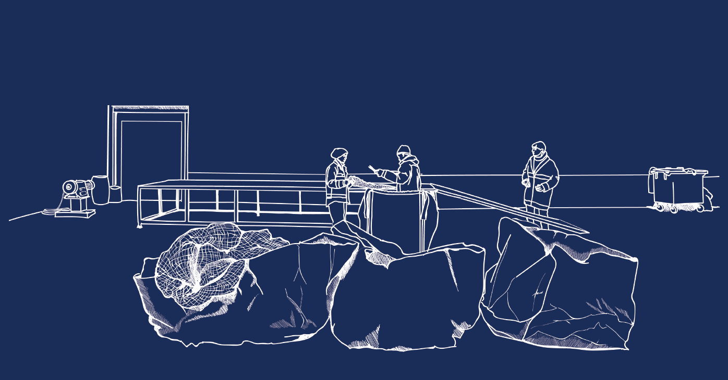
INDUSTRIEL AND SOCIAL SYMBIOSIS
We drive sustainable development through collaboration
– for new green jobs and a resource-efficient society.
Notes:
Socialt företagande
Kunskapsplattform för cirkulär ekonomim och hållbar omställning

Slide 3
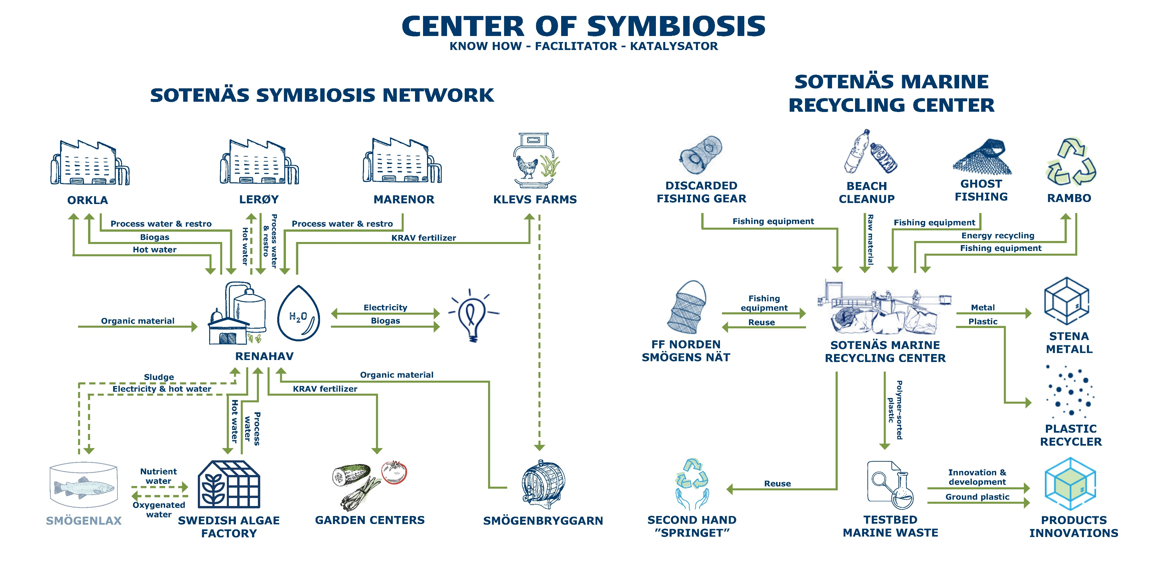

Slide 4
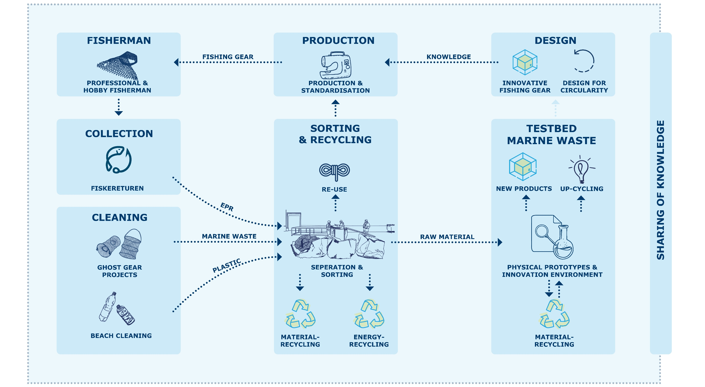
MAP OF THE MARINE SYMBIOSIS

Slide 5
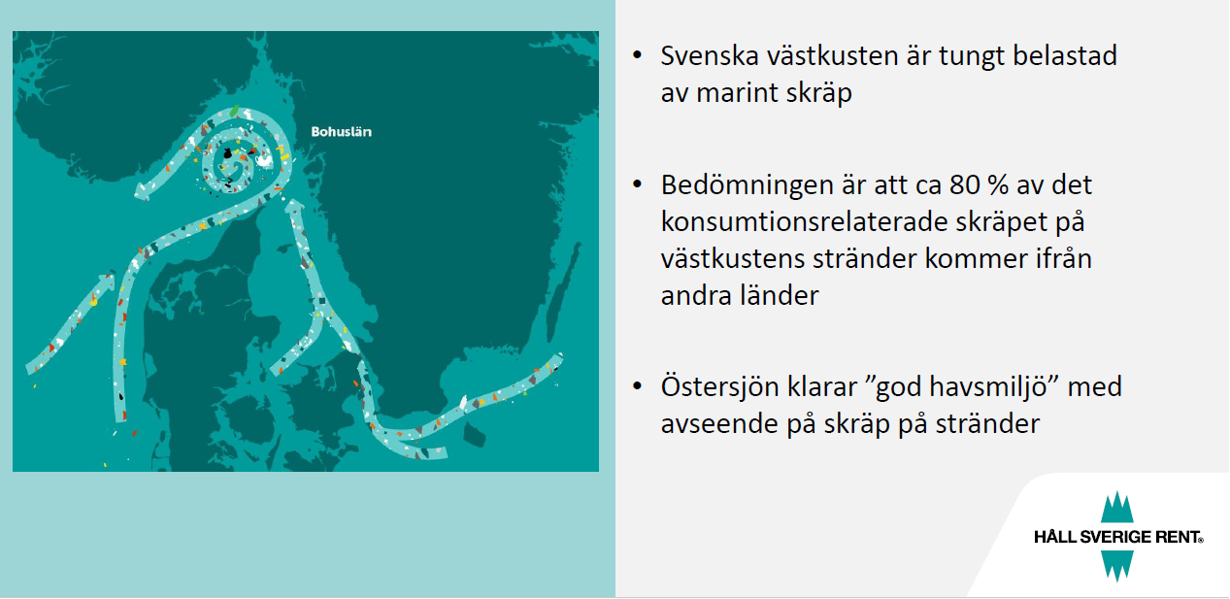
The Swedish west coast is heavily affected by marine litter.
It is estimated that around 80% of the consumer-related litter found on the west coast beaches originates from other countries.
around 99% is plastic
around 30% is fishing industry related
99 % är plast

Slide 6
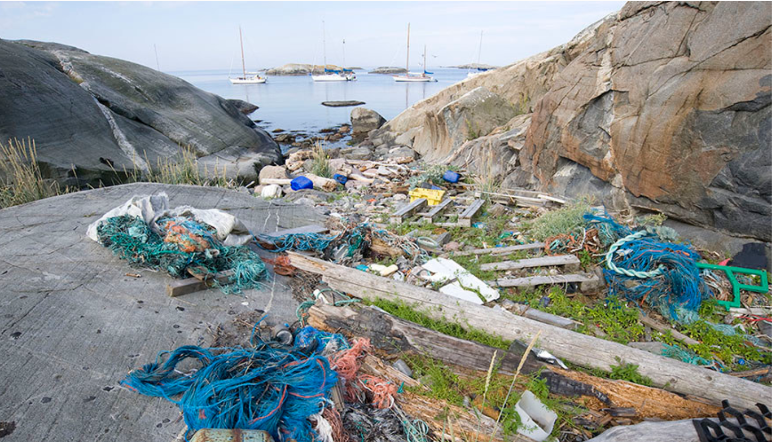

Slide 7
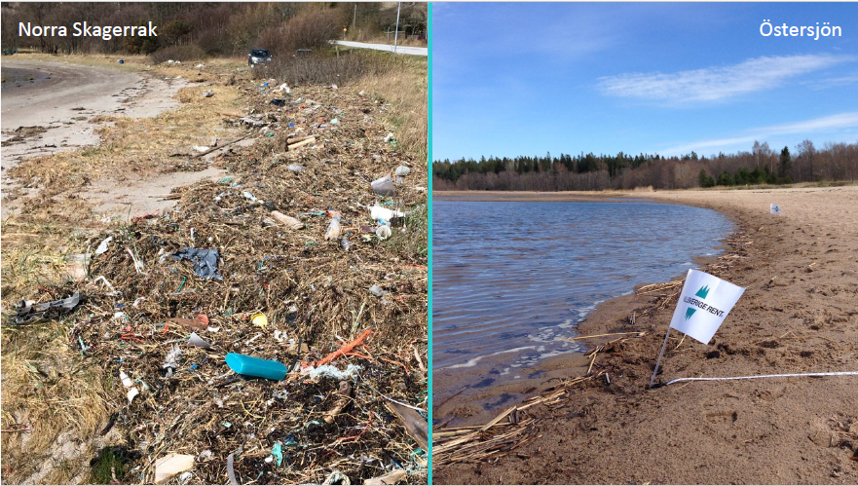
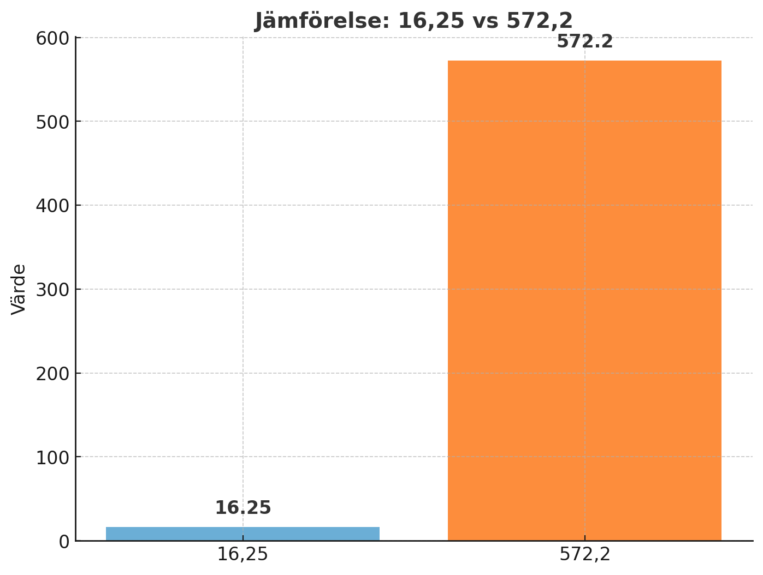
The Baltic Sea
16.25 pieces of litter per 100 metres
35 ggr mer
The North Sea
572.2 pieces of litter per 100 metres

Slide 8
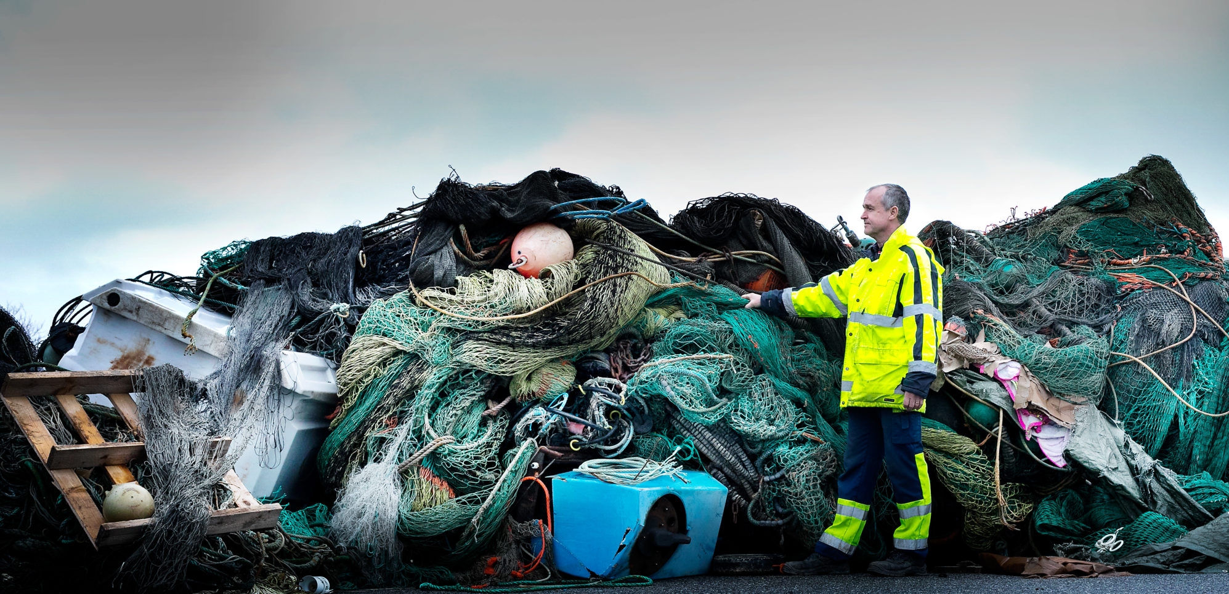
Landfill
In many EU member states, landfill is still used extensively.
A bulky and complex fraction, with a large share of historical waste remaining in harbours, on land areas, and in nature.
Foto:
Maja Kristin Nylander
Kommunal

Slide 9
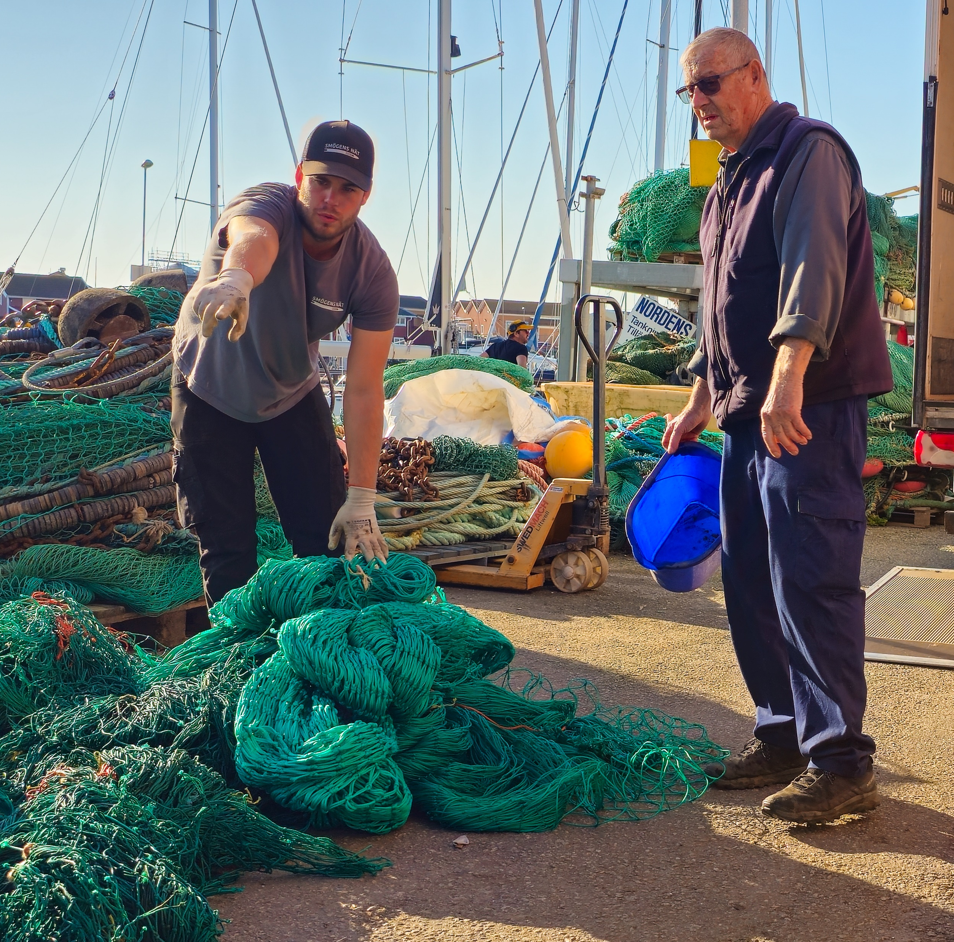
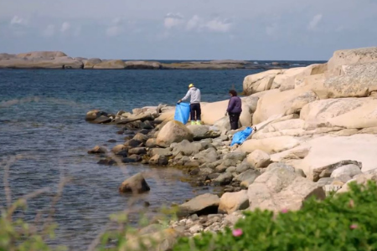
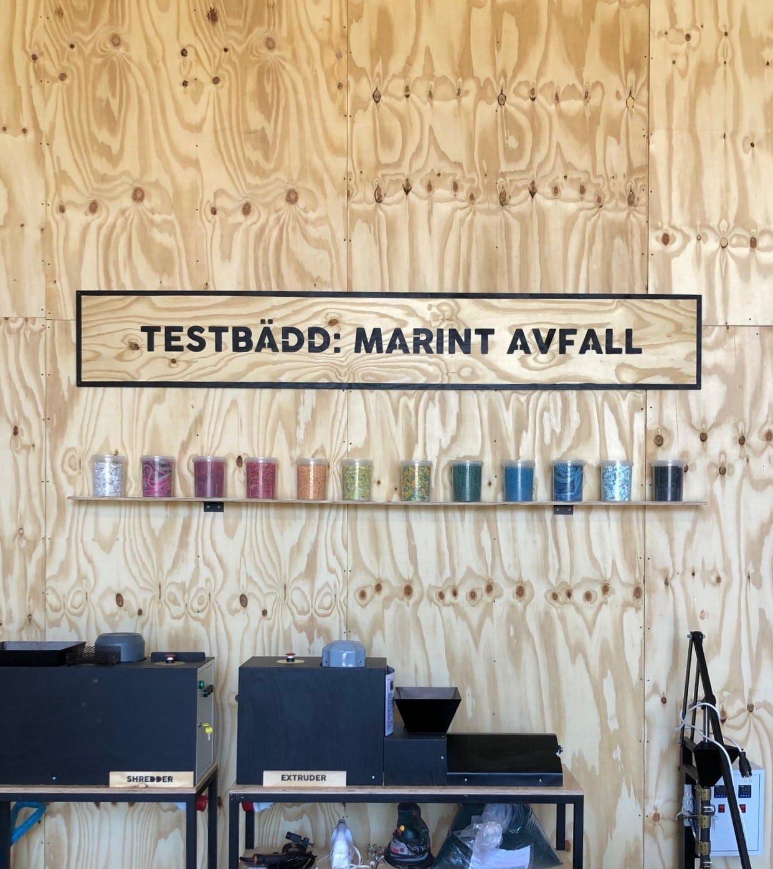
Everything is based on collaboration and resource efficiency.

Slide 10
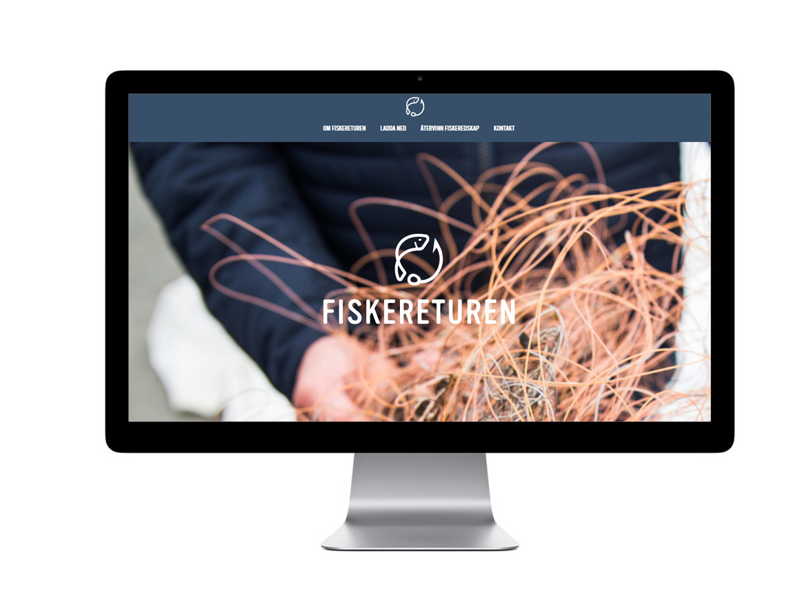





National collection system since 2019
Notes:
Fiskereturen – Nationell insamling
Fasta insamlingsplaster, aktiv insamling från fiskare, åker och hämtar.

Slide 11
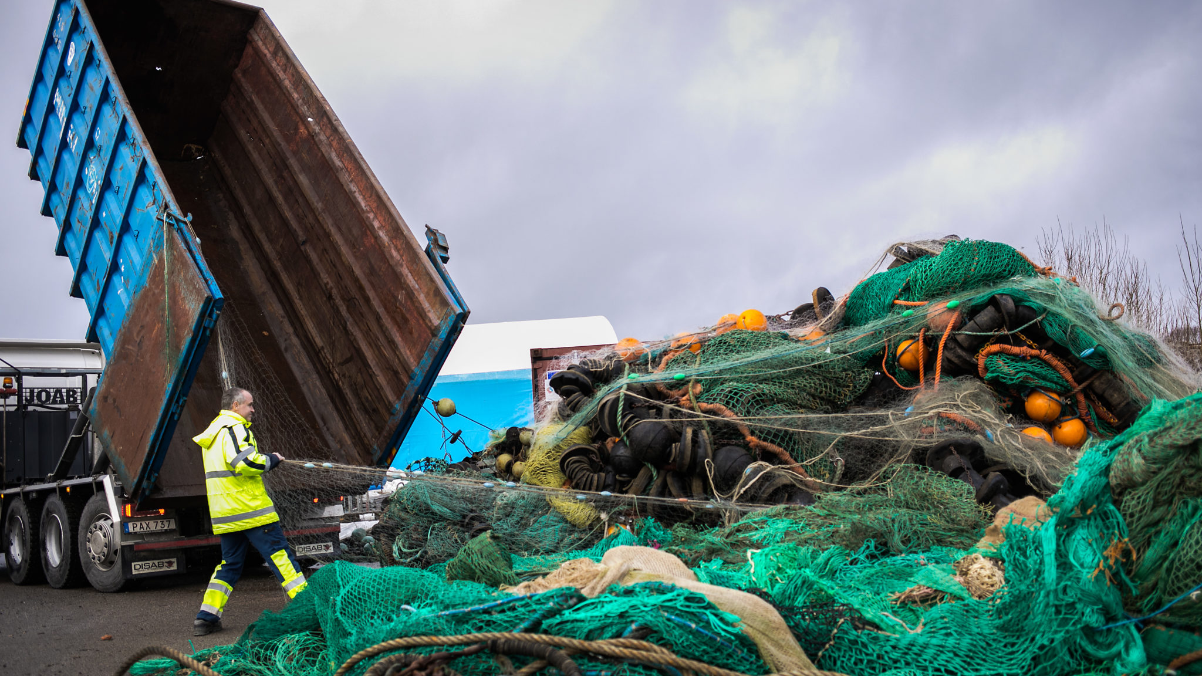
Used fishinggear, ghostgear
& beach litter
Foto:
Maja Kristin Nylander
Kommunal

Slide 12
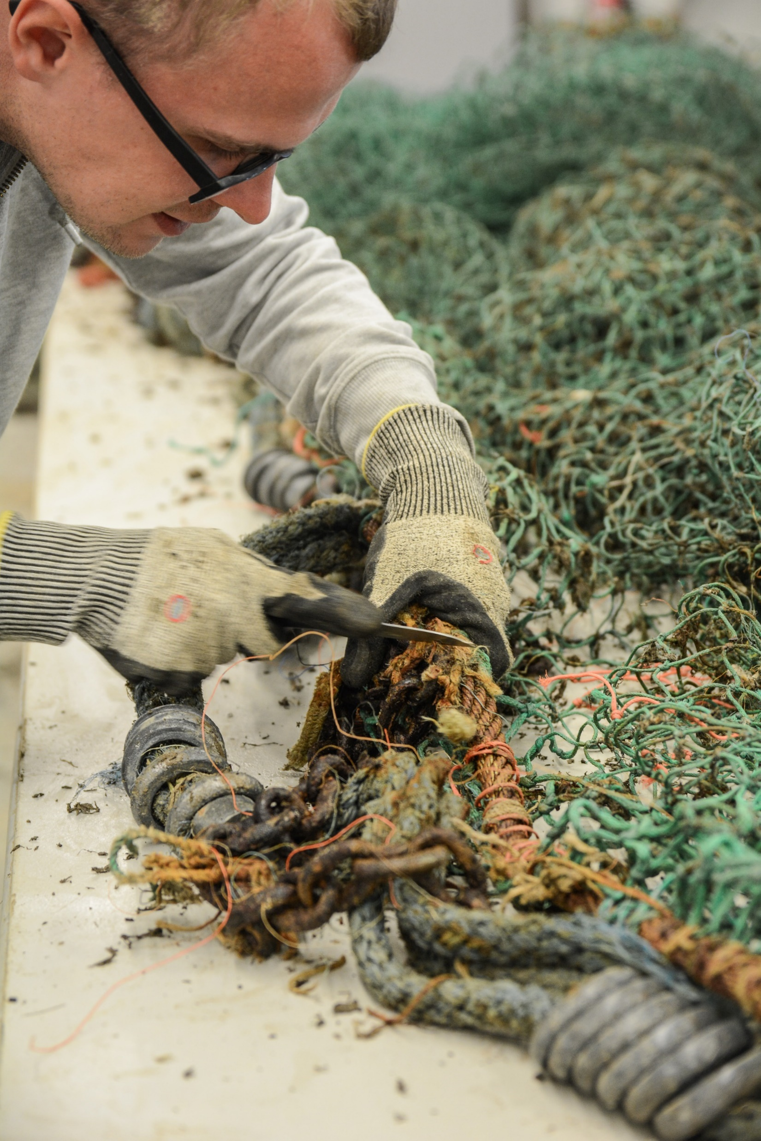
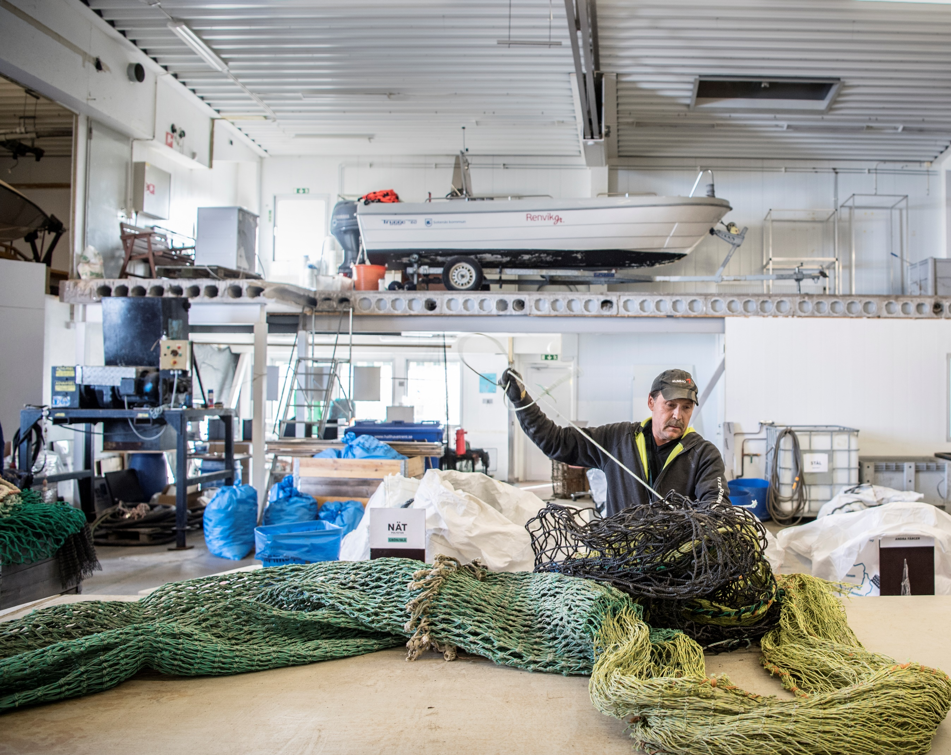
Separating
& sorting
Reuse or recycle
Foto: Andreas Bardell / Aftonbladet

Slide 13
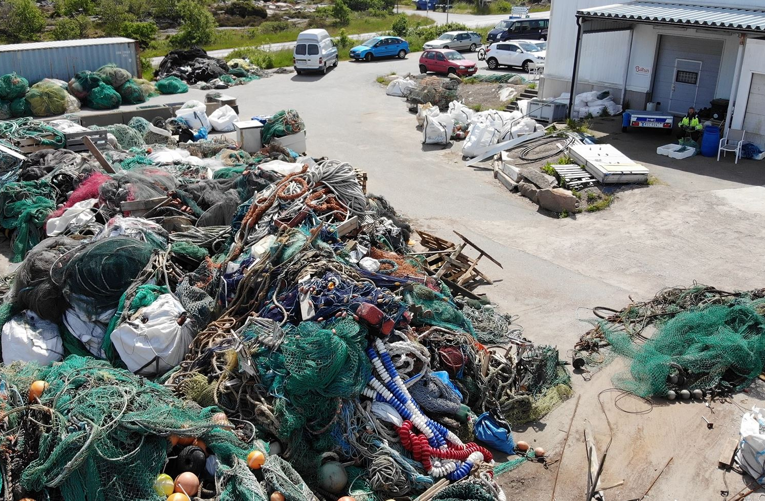
2020-2024 collected
approx. 1090 ton
Fishing gear
approx.77 ton
Beach litter
2024 collected:
approx. 318 ton
Fishing gear
approx. 16 ton
Beach litter
2021 collected:
approx. 207 ton
Fishing gear
approx. 12 ton
Beach litter
2022 collected:
approx. 152 ton
Fishing gear
approx. 16 ton
Beach litter
2023 collected:
approx. 237 ton
Fishing gear
approx. 15 ton
Beach litter
2020 collected:
approx. 176 ton
Fishing gear
approx. 18 ton
Beach litter

Slide 14
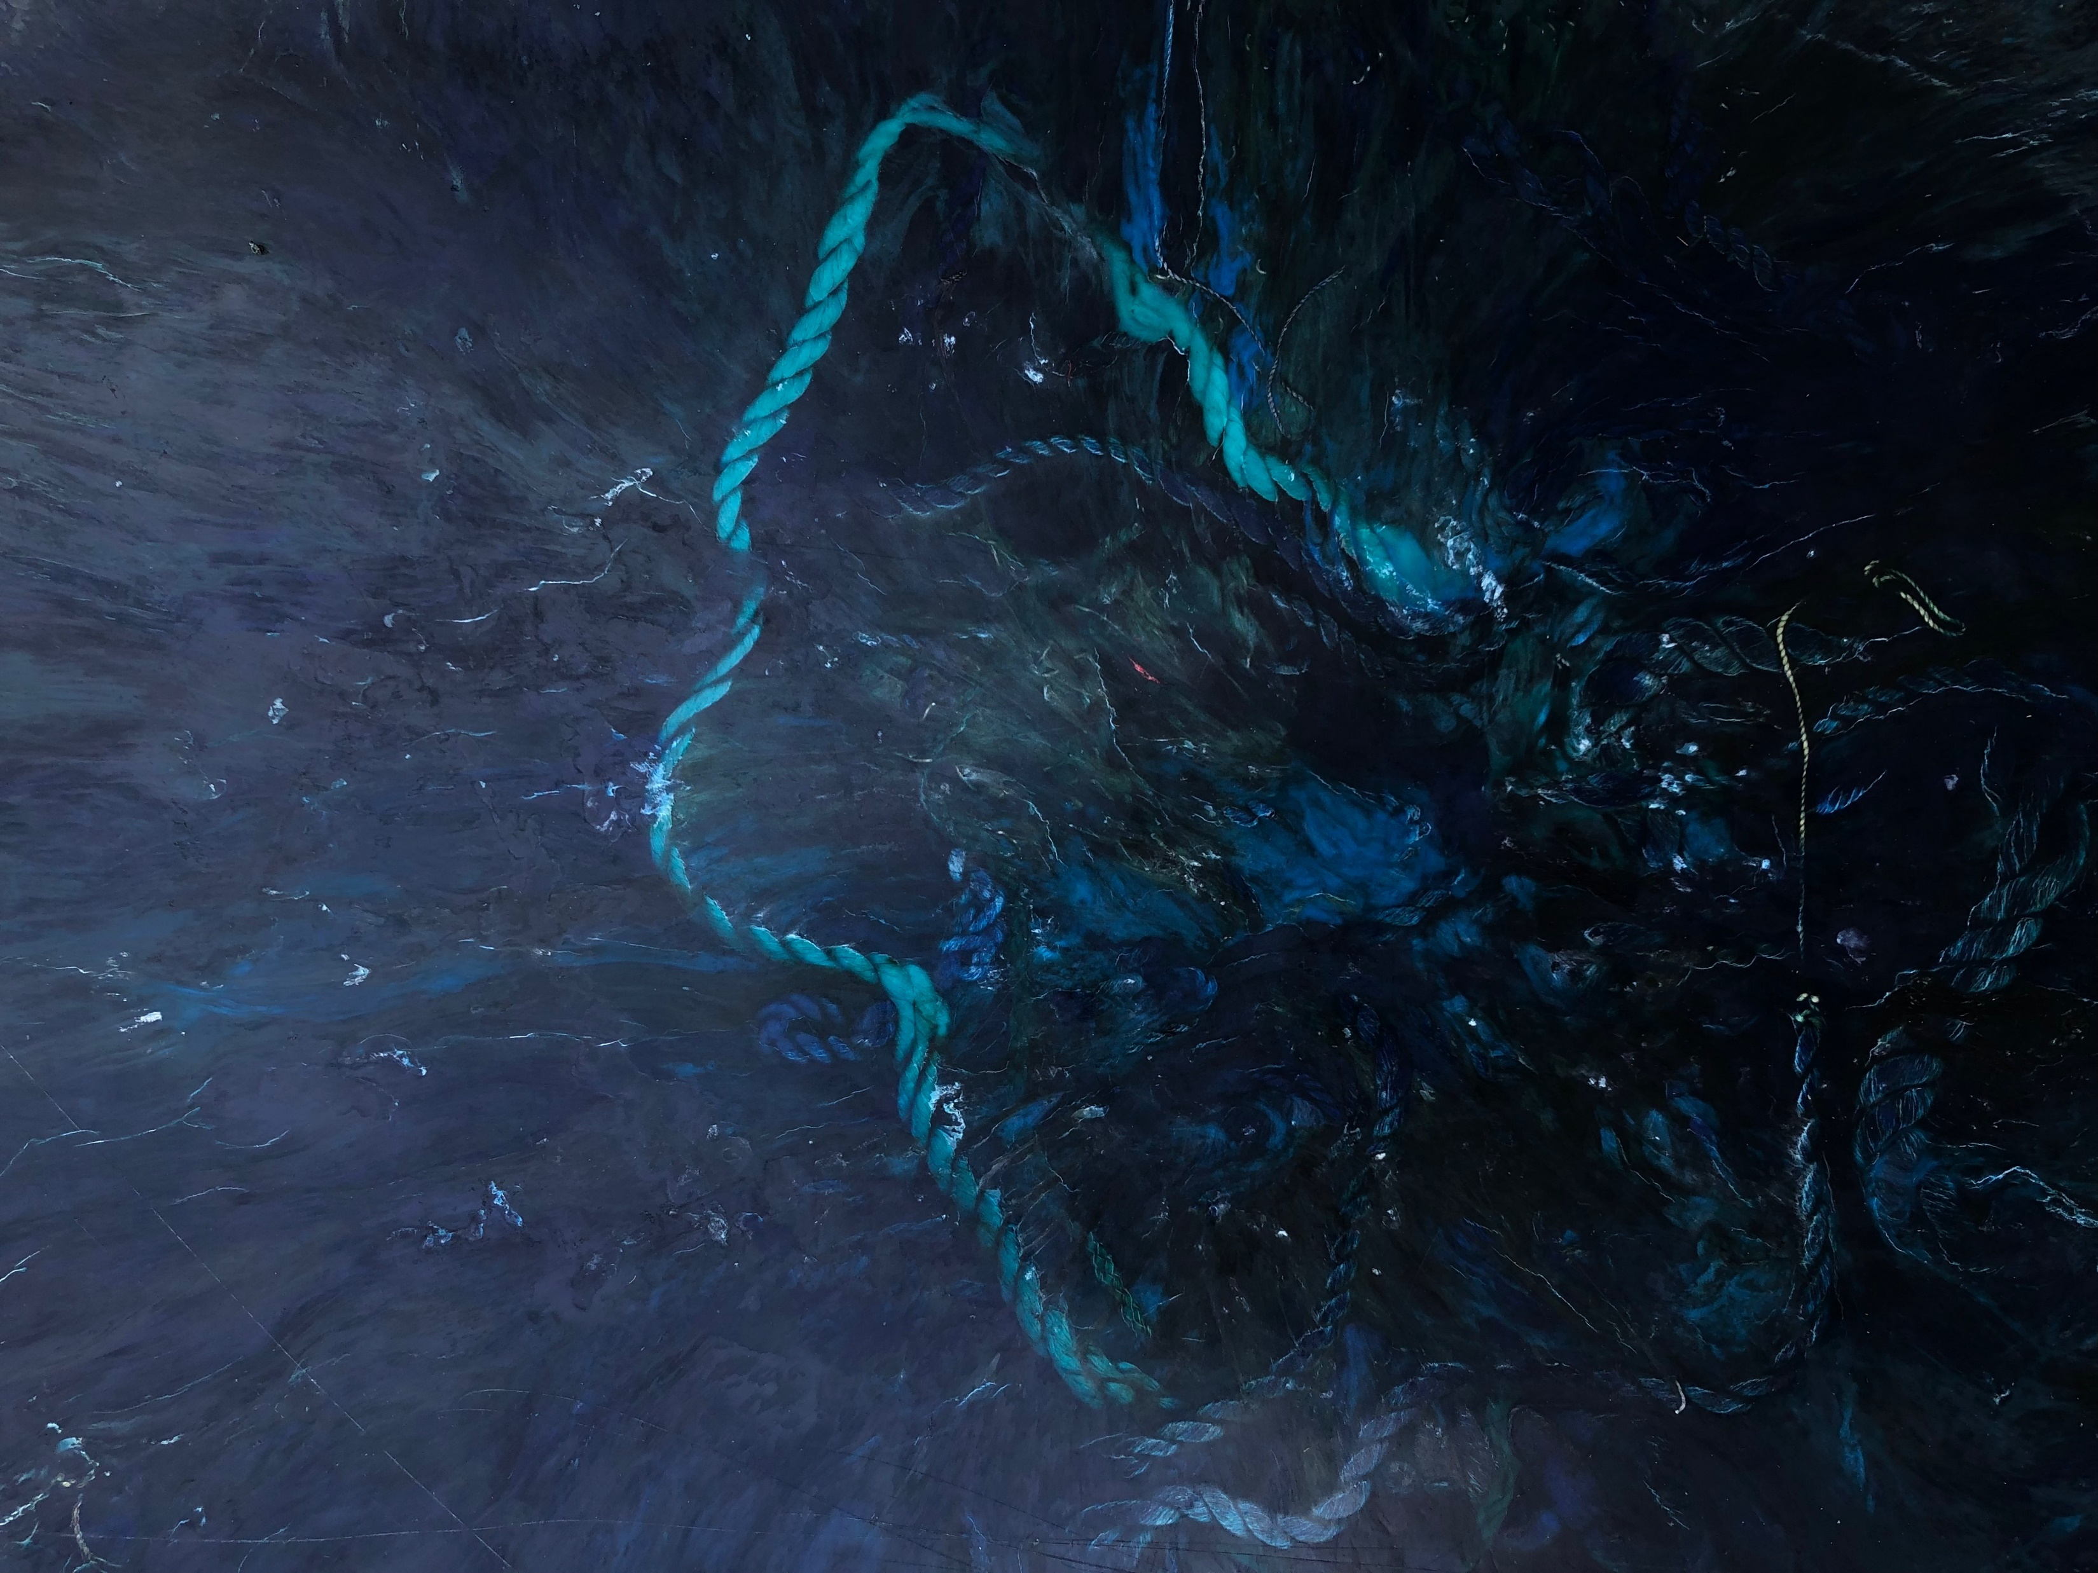
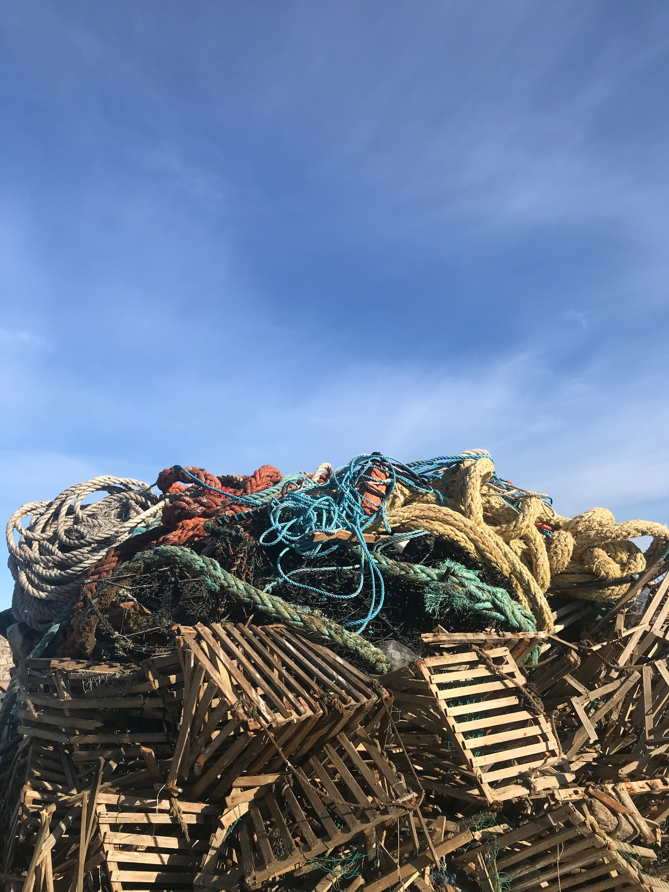
PROBLEM OPPORTUNITY
CIRCNETS
SeaClear2.0
Producentansvar med SFPO
SeaMe
Lightfishing
Notes:
Ett företags avfall blir ett annat företags resurs
Utvecklingsprojekt

Slide 15


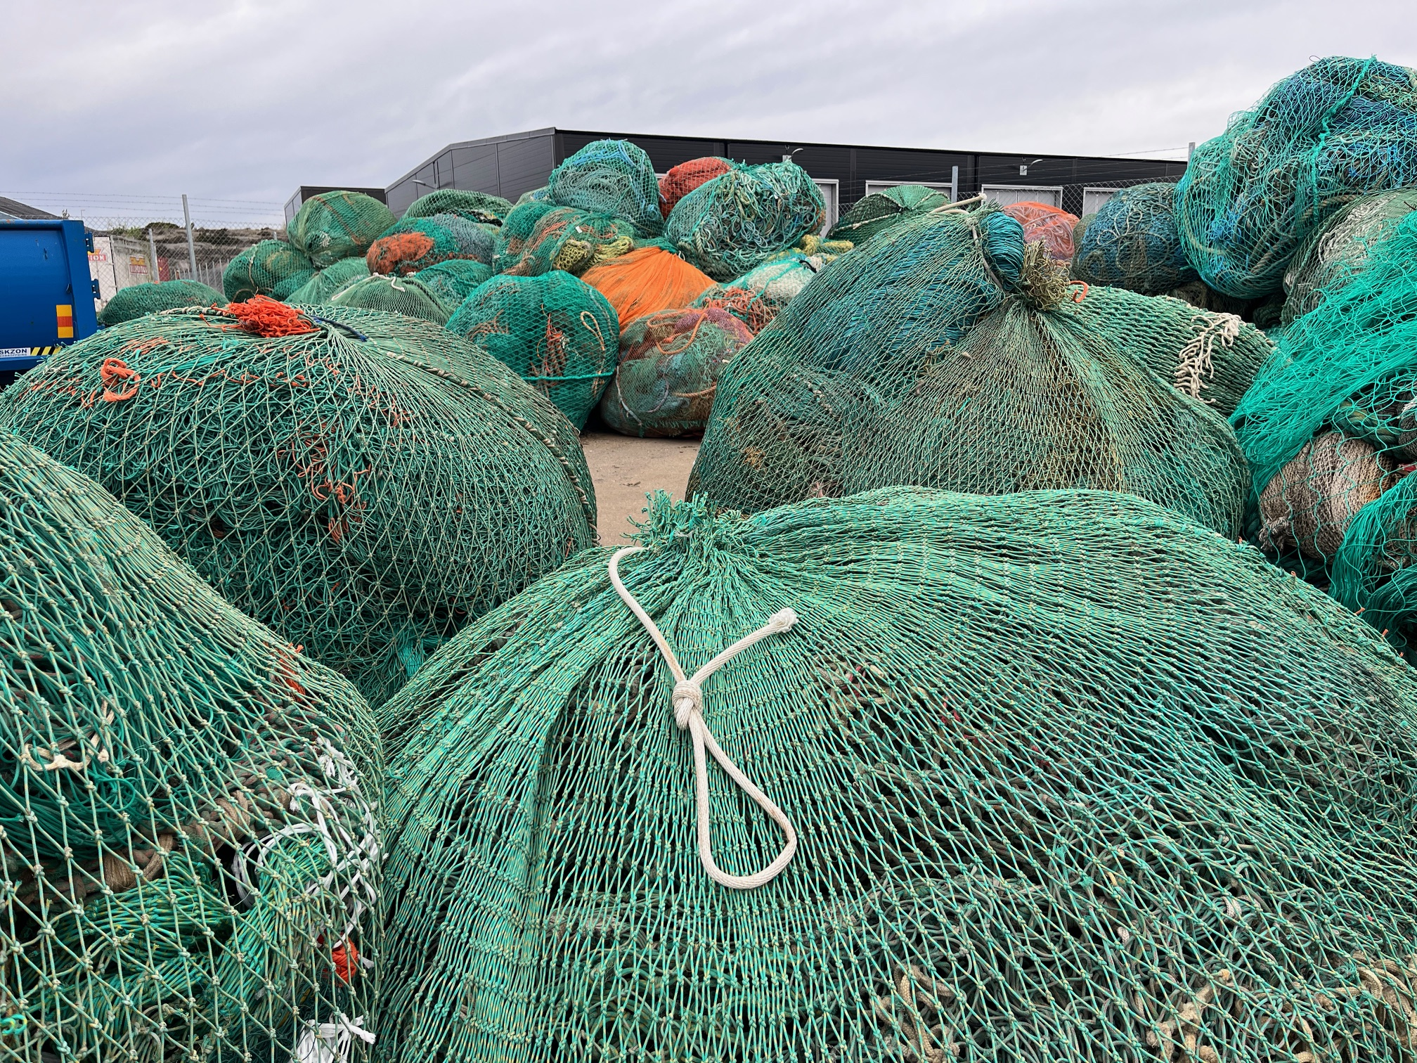
EU PROJECT
CIRCNETS
Supporting collection, treatment and recycling of fishing gear

Slide 16

CHALLENGES
Historical waste – hidden volumes and unclear division of responsibility, leading to economic consequences
Virgin plastic is too cheap – the market for recycled materials remains reluctant and immature
Time-consuming sorting and separation – due to mixed materials,tangled gear and biofouling.
Inconsistent material quality – caused by saltwater exposure and contamination
Small volumes – making large-scale recycling economically challenging
Foto: Andreas Bardell / Aftonbladet
Notes:
Separera, sortera.
PE, PP, Nylon. Metallfraktioner.
Återbruk, Upcykling, Återvinning.
50/50 metall plast
CHALLENGES
Historical waste – hidden volumes and unclear division of responsibility, leading to economic consequences
Virgin plastic is too cheap – the market for recycled materials remains reluctant and immature
Time-consuming sorting and separation – due to mixed materials
Inconsistent material quality – caused by saltwater exposure and contamination
Small volumes – making large-scale recycling economically challenging

Slide 17
In the GAP between systems

Slide 18
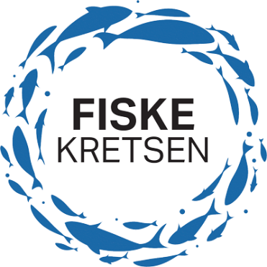
About Fiskekretsen AB
Founded by Svensk Sportfiskehandel which is an association of 15 wholesalers for sportfishing gear.
Enable legal sales of fishing gear
Member fee SEK 6000:- + SEK 10/kg
130 members
Expected revenue and cost 4m SEK
Cost will adjust according to true expenses
Financed by prepayments from members
Non profit
Managed by Joakim Stenberg chairman Per Henrik Bengtsson

Slide 19
Financial conditions decided by government
We are not allowed to make profit
We are not allowed to go bankrupt
We must use 290 recycling stations in each municipality and pay their cost which is decided by Naturvårdsverket
We do not know the volume collected
We do not know the exact volume sold by each producer as Naturvårdsverket is not allowed to share their information with us.

Slide 20
Getting acceptance from producers to become member
The reason for starting extended producer responsibility is said to be that 27% of all litter on beaches are fishing gear. However very few sportfisherman leave their rod & reel and go home.
  We do have 130 members most of the from sportfishing sector. But some are still being chased.
  Very few members and revenues from the commercial side and hobby fisherman using passive gear.
It is not mandatory for commercial fishermen to be member – but their suppliers of gear must be member. So far very few are.
Naturvårdsverket do not have staff to follow up and raise fines.
Naturvårdsverket do not have legal power to chase foreign suppliers. The commercial users buy gear from Denmark, but the Danish suppliers did not yet become members.
Direct import by sportfishing consumers from Temu are not contributing to the revenues.

Slide 21
Old gear
Government has decided it is Fiskekretsens responsibility to collect and take care of old gear.
But is impossible for us to go after old buyers and ask them to pay more.
  Therefore the burden will be on those buying new gear. This is against the environmental law and Naturvårdsverket have asked the Swedish Government to change this.
  We are waiting for their reaction.

Slide 22
Crazy expensive to collect
The main cost for Fiskekretsen is compensation to 290 municipalities.
The volume collected this way is very small. We are at the first year and based on the spring numbers it looks like the cost will be SEK 2000/kg.
There will be about 600 extra transportations due to the producer responsibility.

Slide 23
Different types of products hard to collect and recycle together
There are passive gear like nets, trawls and cages which are to some extent similar and can be treated and recycled. Fishing rods, reels, baits are totally different. They can be repaired by local shops, parts can be replaced but not recycled into new gear as there are no factories nearby.
Local shops are not allowed to be used for the EPR to collect, and some fisherman are already used to repair and replace.
The EPR does not make any sense at all to recycle and remake new fishing gear for the sportfishing sector.

Slide 24
Collection goal
Government set goal of 20% collection. But fishing rod and reels last much longer time than 5 years. Anglers keep their lures in their tackle box. They will not return them unless they are worn out or broken.

Slide 25
Suggestions for improvement of the EPR
Collect fees from customs through higher import duty. Then all will pay and less free riders. Commercial users should be part of bringing revenue
Financial support from Government to compensate for old gear.
Stop using 290 municipalities recycling stations for separate collection of sportfishing gear.
Use local tackle shops to collect and repair old gear sportfishing gear.
Use Fiskereturen setup for commercial and passive gear and Sotenäs MÅVC.
Use the money from sportfishing sector to clean beaches and dive. This can be 100:-/kg compared to existing collection at SEK 2000:-/kg from peoples garages.

