Slide 1
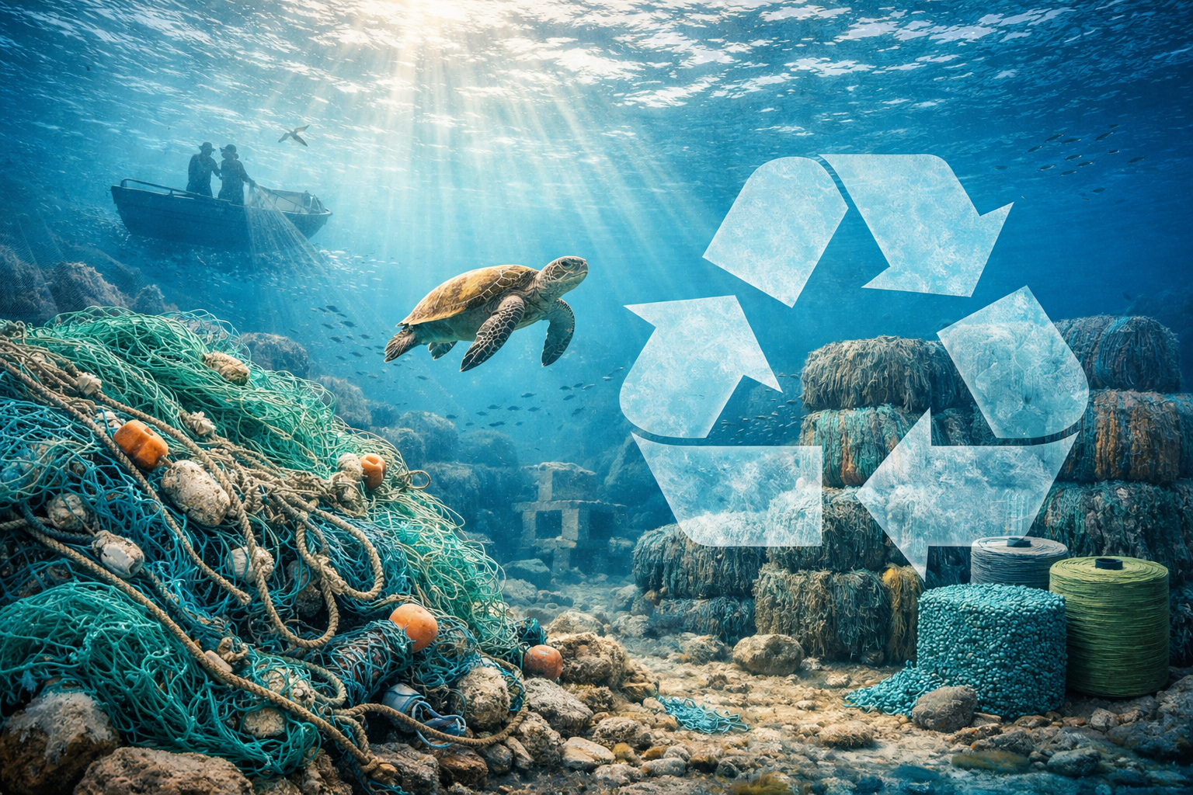

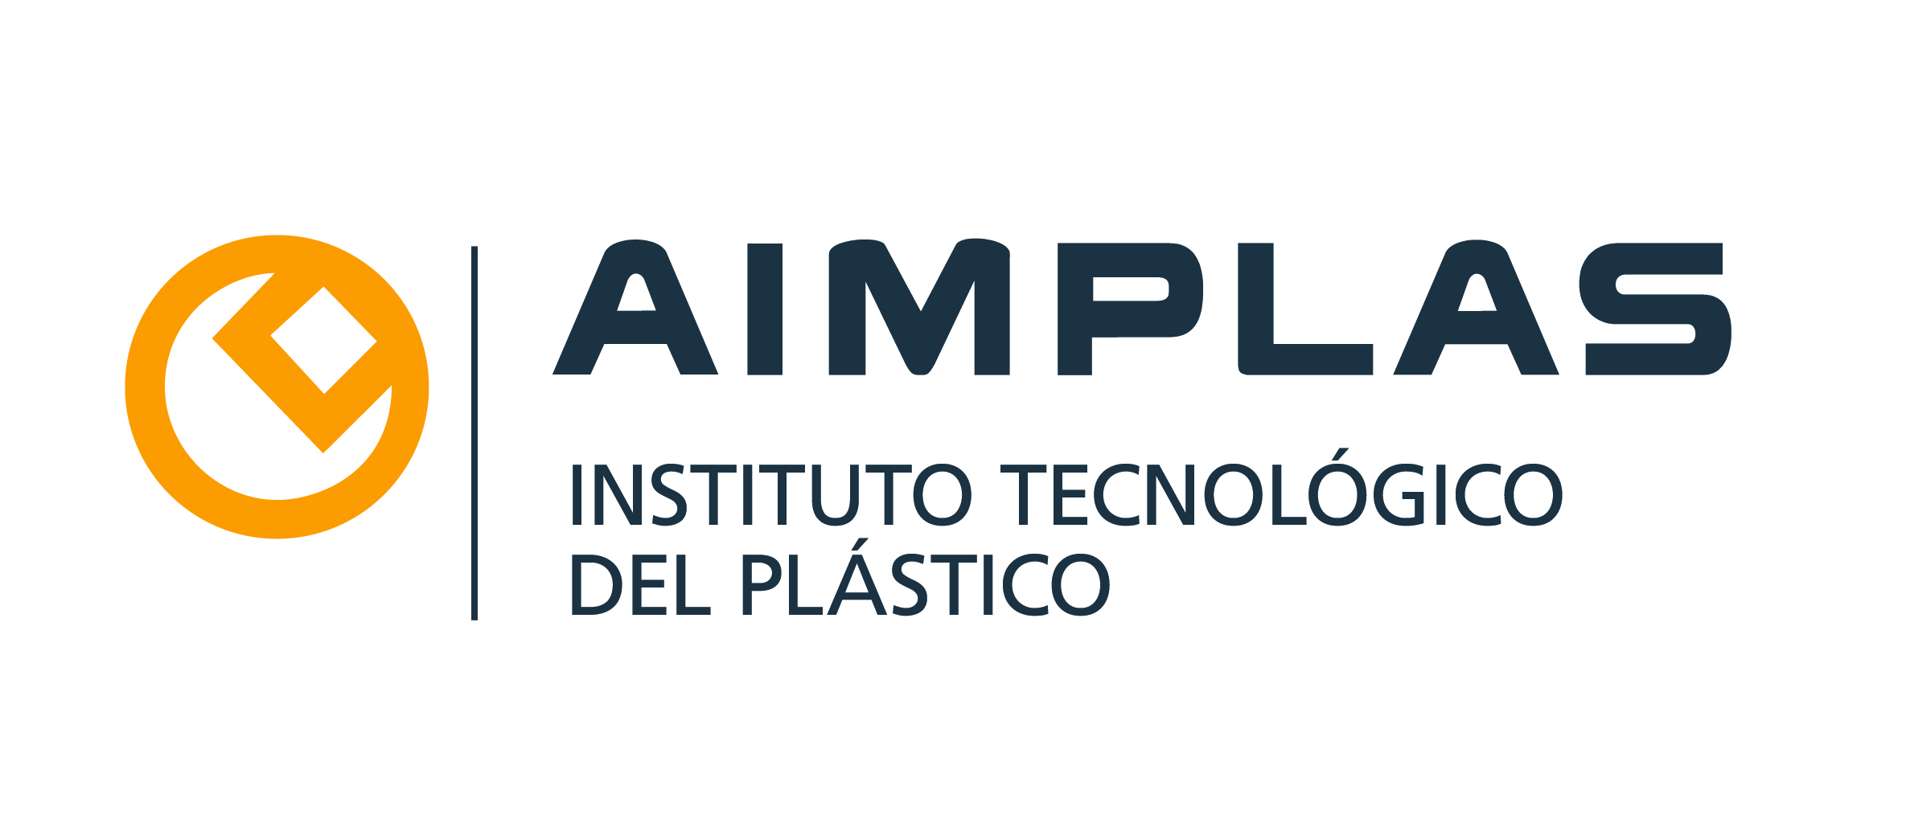
Main challenges to implement Waste Incidentally Fished management
The vision of the waste manager
Sonia Albein Urios, Head of Circular Economy and Environment at AIMPLAS
salbein@aimplas.es

Slide 2
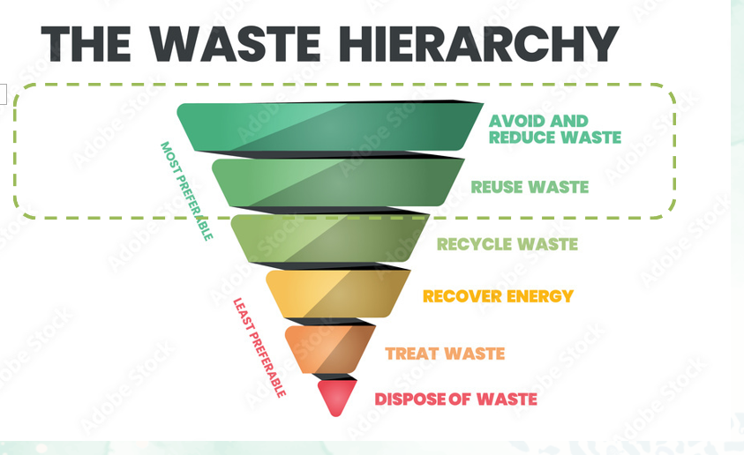
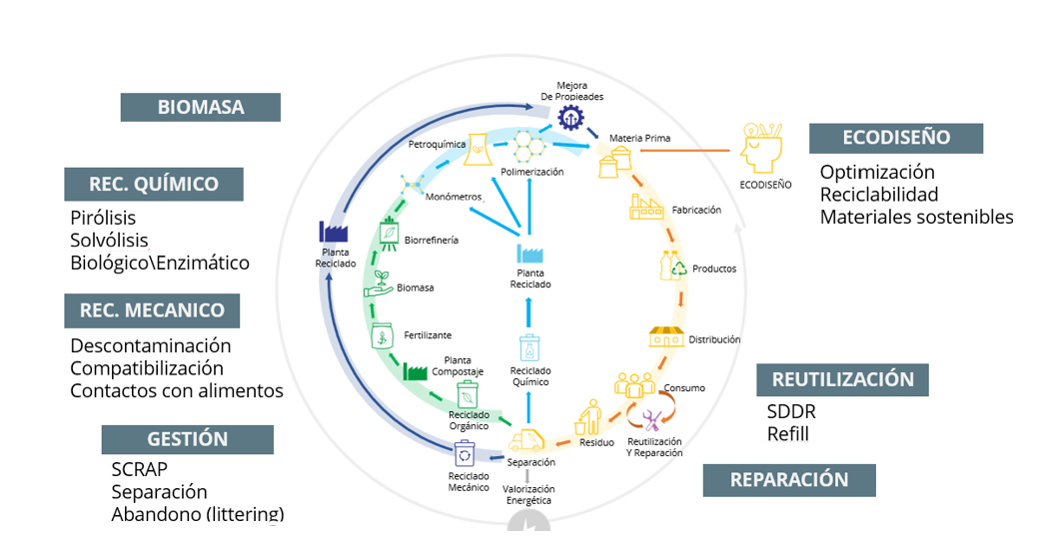
HARMONIZATION OF PROTOCOLS, PROCESSES, MEASUREMENTS…
REGULATORY FRAMEWORK
INNOVATION IN DIGITAL TOOLS
CERTIFICATIONS
- Text Calibri 16

Slide 3
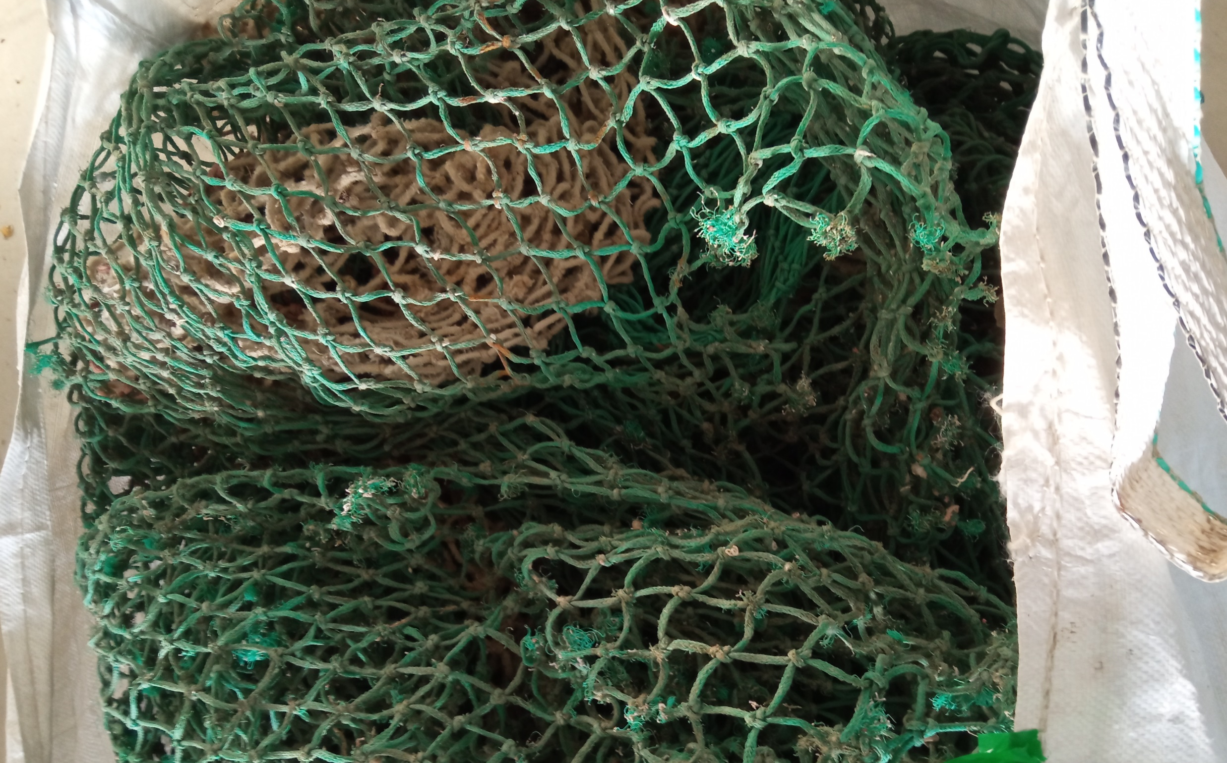
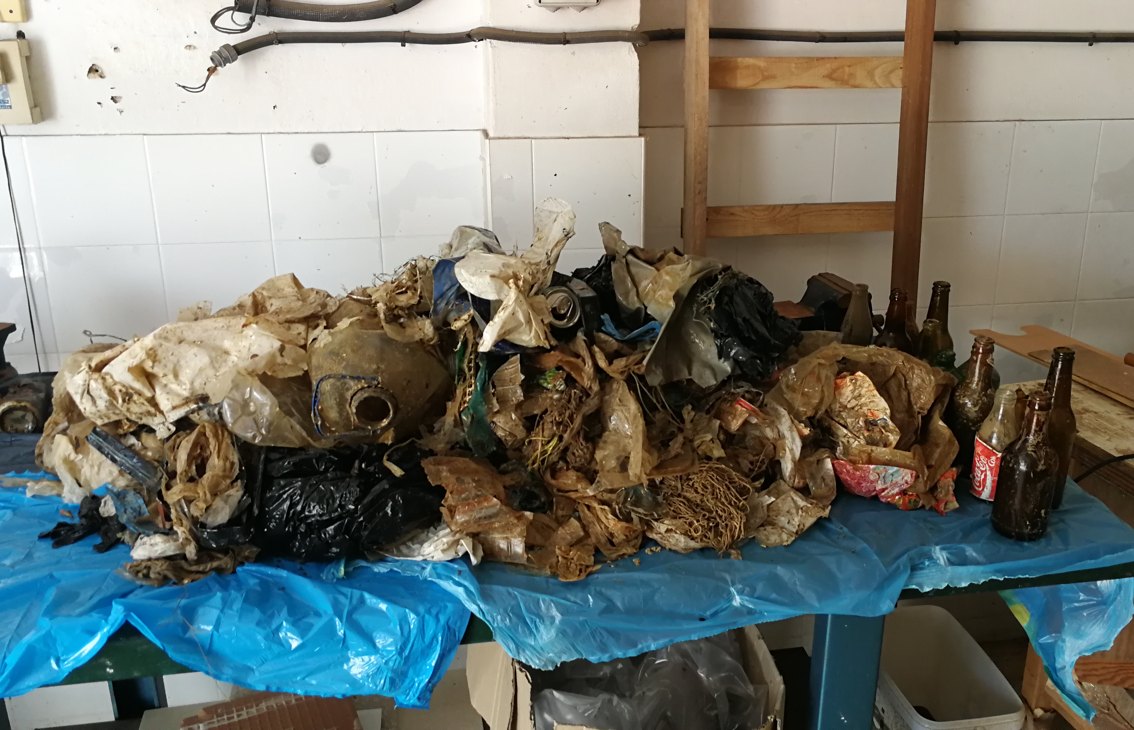
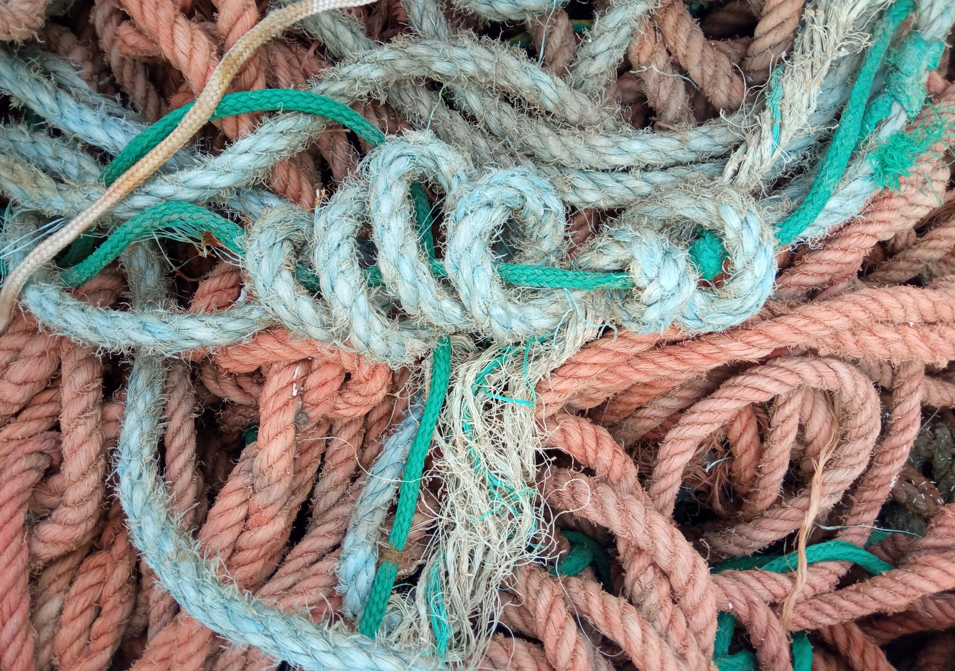
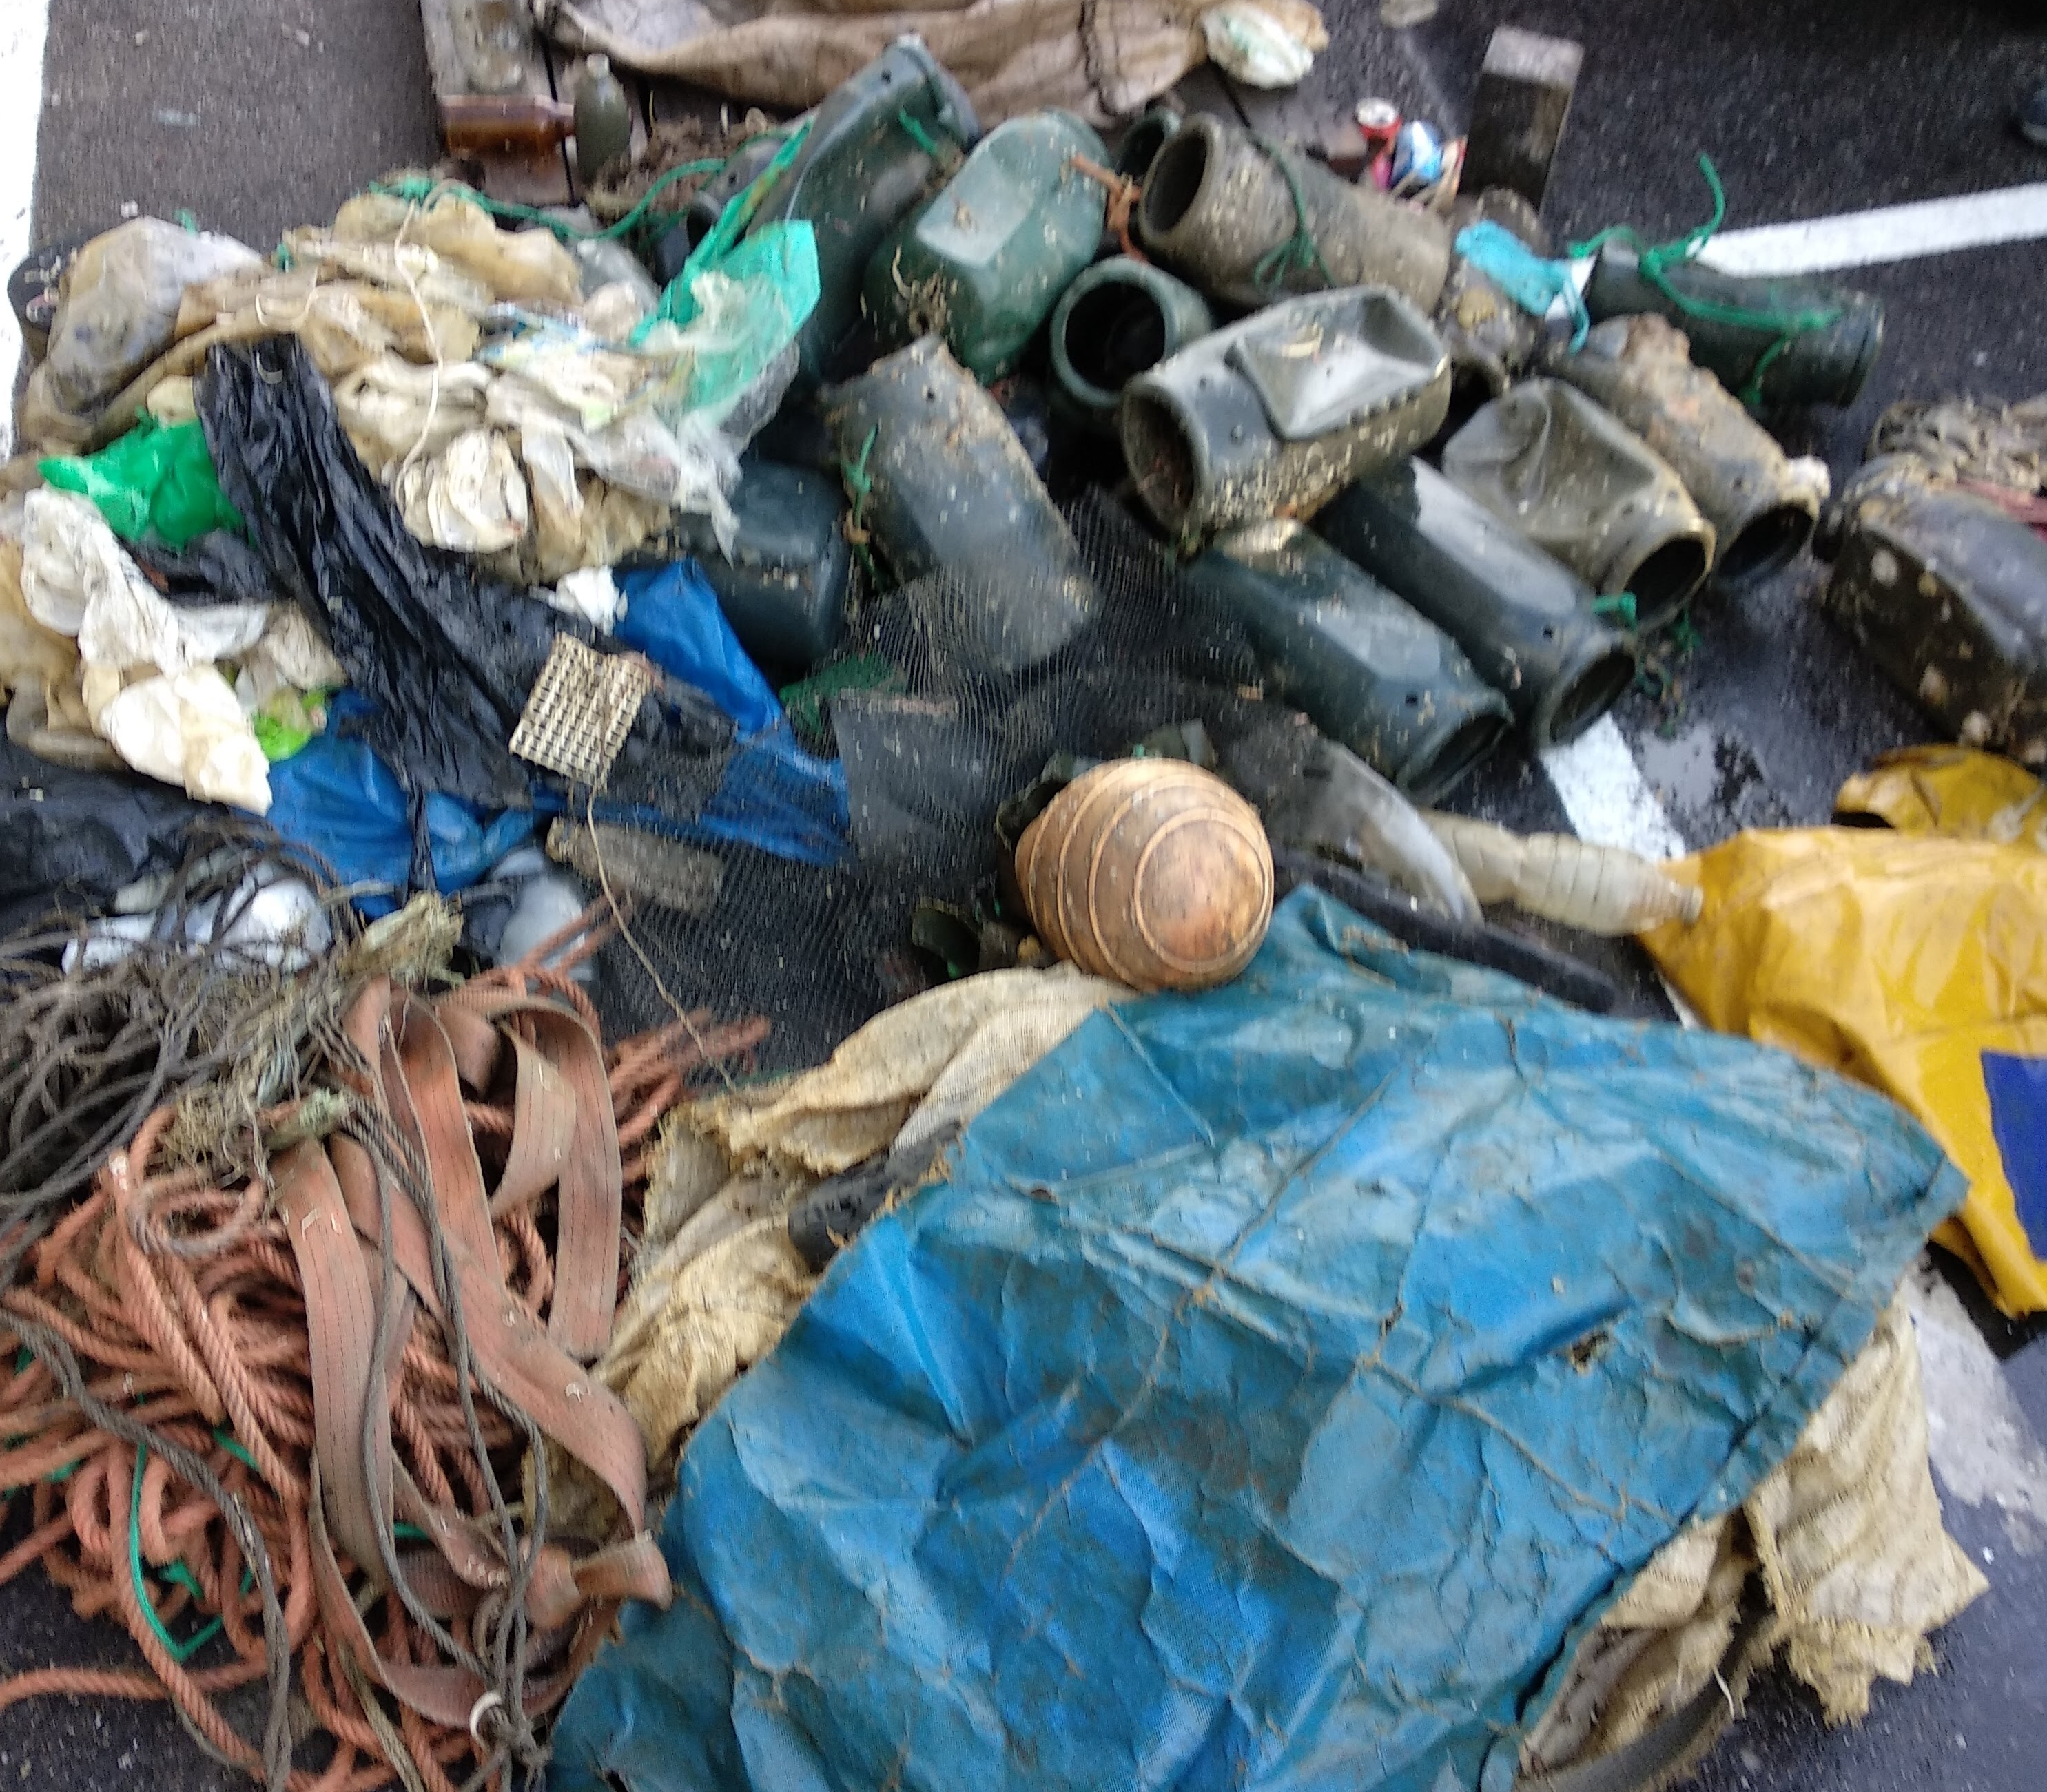
Challenge 1: Lack of waste characterisation and quality
Key issues:
Complex mixtures (plastics, organic matter, metals, sand, water)
Contamination due to:
  salinity
  biofouling
  oils and hydrocarbons
High variability between batches
Practical impact:
Increased pre-treatment costs
Limited recycling and recovery options
Mechanical recycling often becomes technically unfeasible

Slide 4
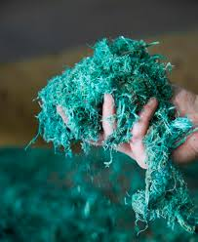
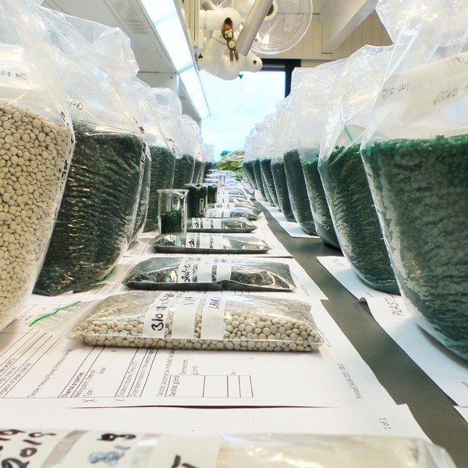
Challenge 2: High costs with limited economic return
Main problems:
High costs associated with:
  collection
  transport
  cleaning
  manual sorting
Low or null market value of recovered materials
Lack of stable economic incentives
Management is often economically unviable
Strong dependence on:
  subsidies
  pilot projects
  Extended Producer Responsibility schemes (where applicable)

Slide 5
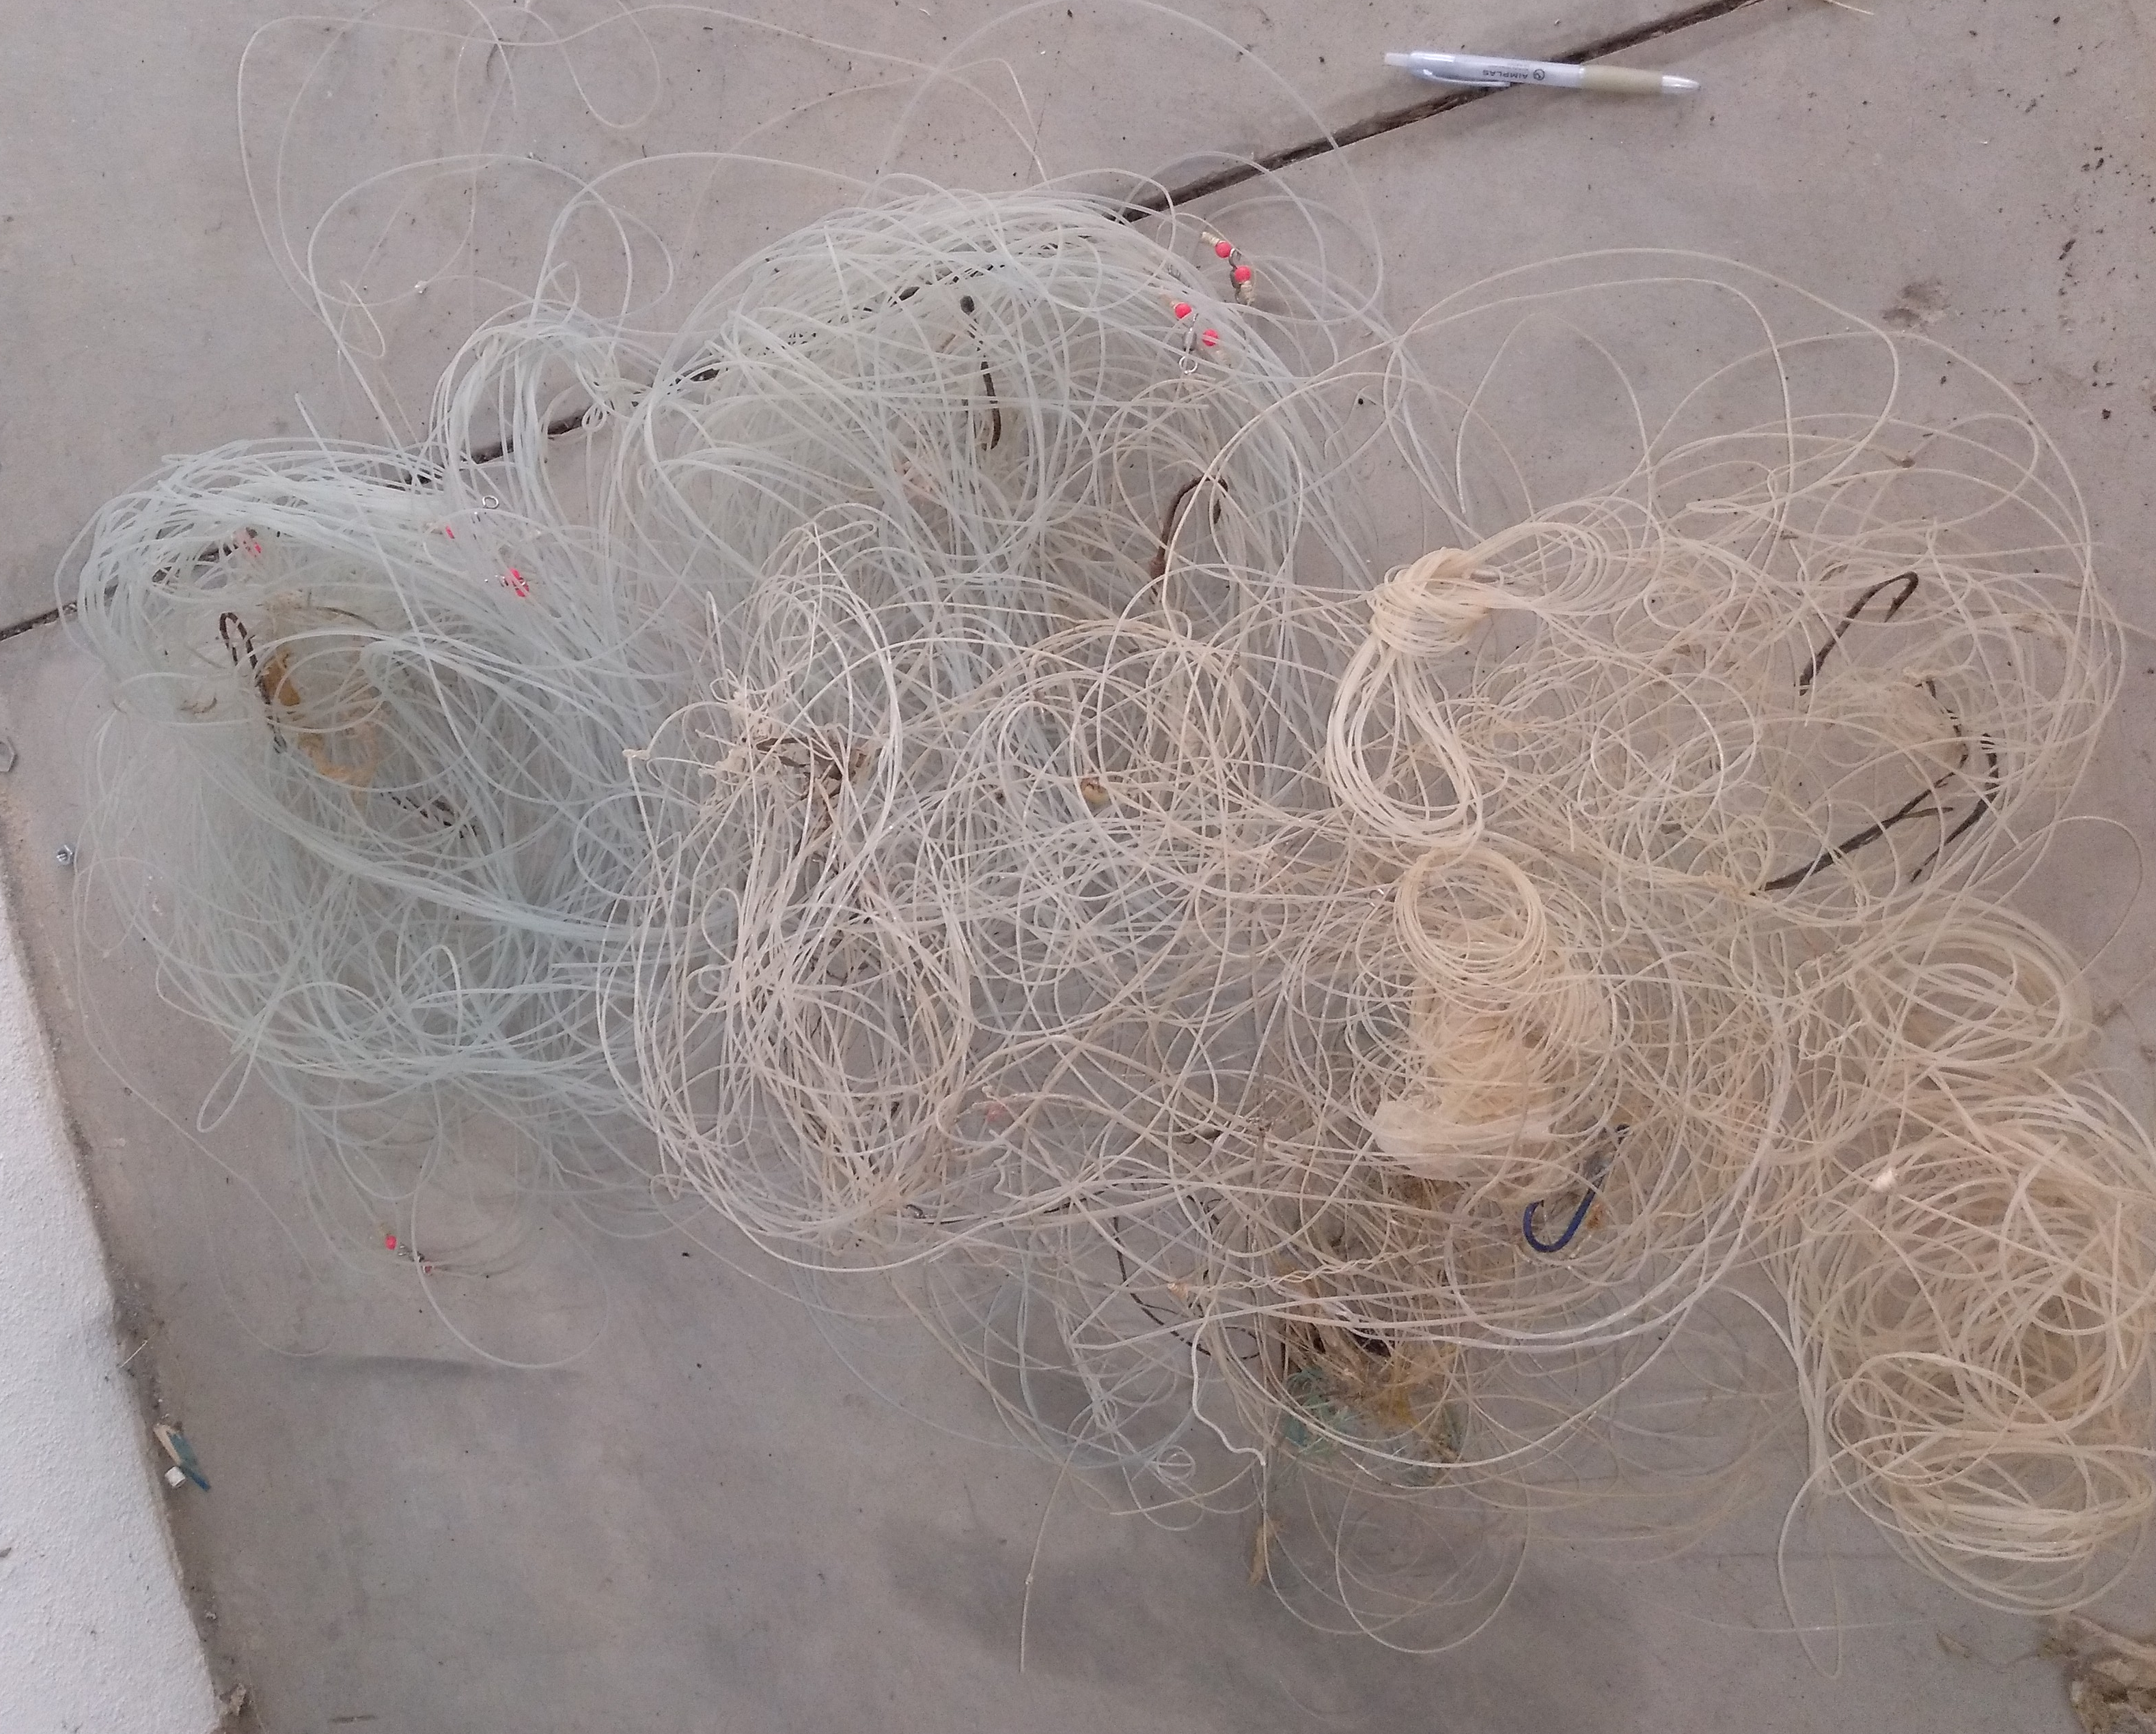
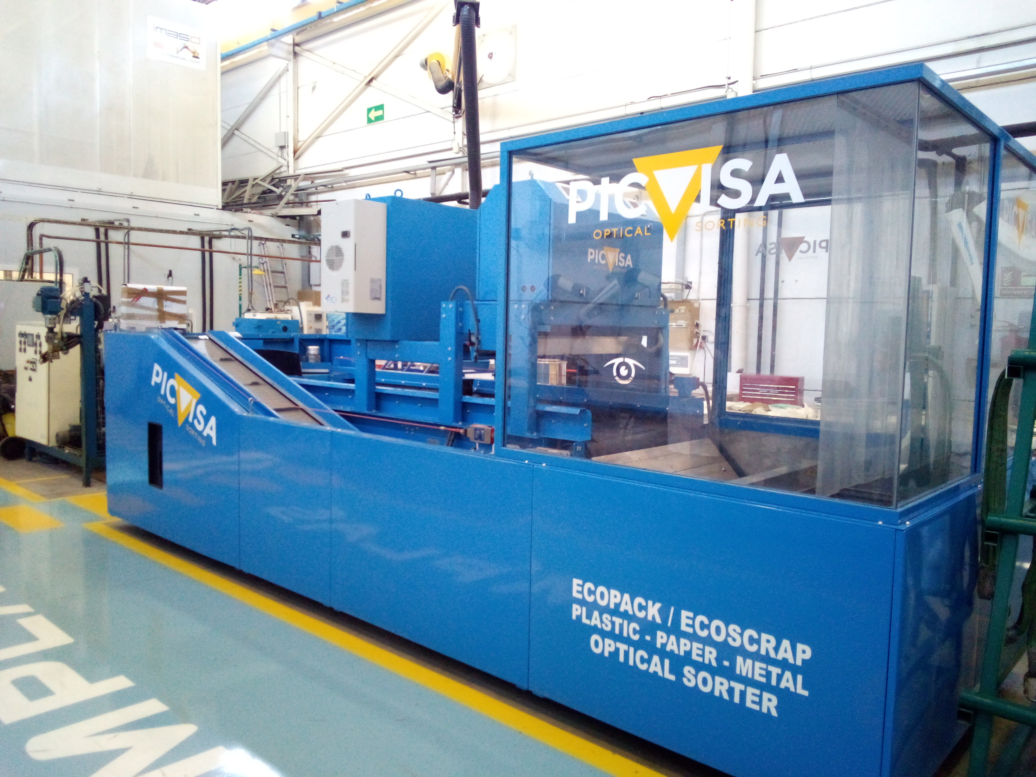
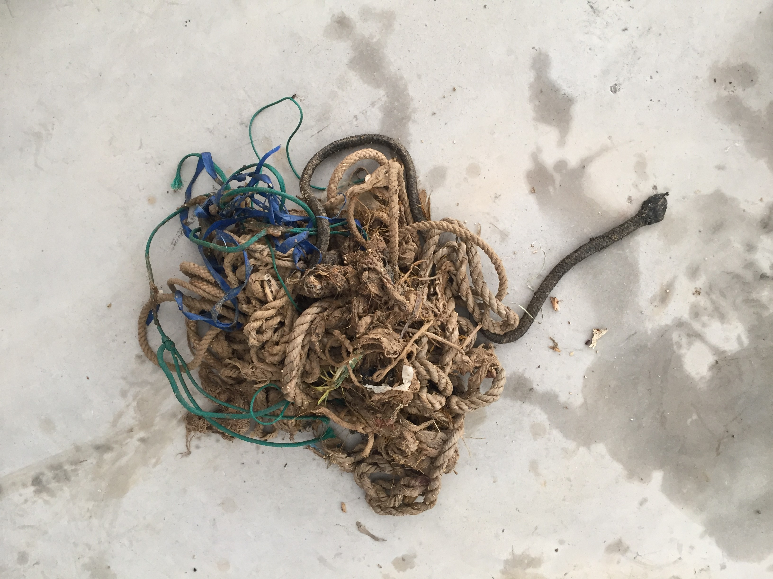
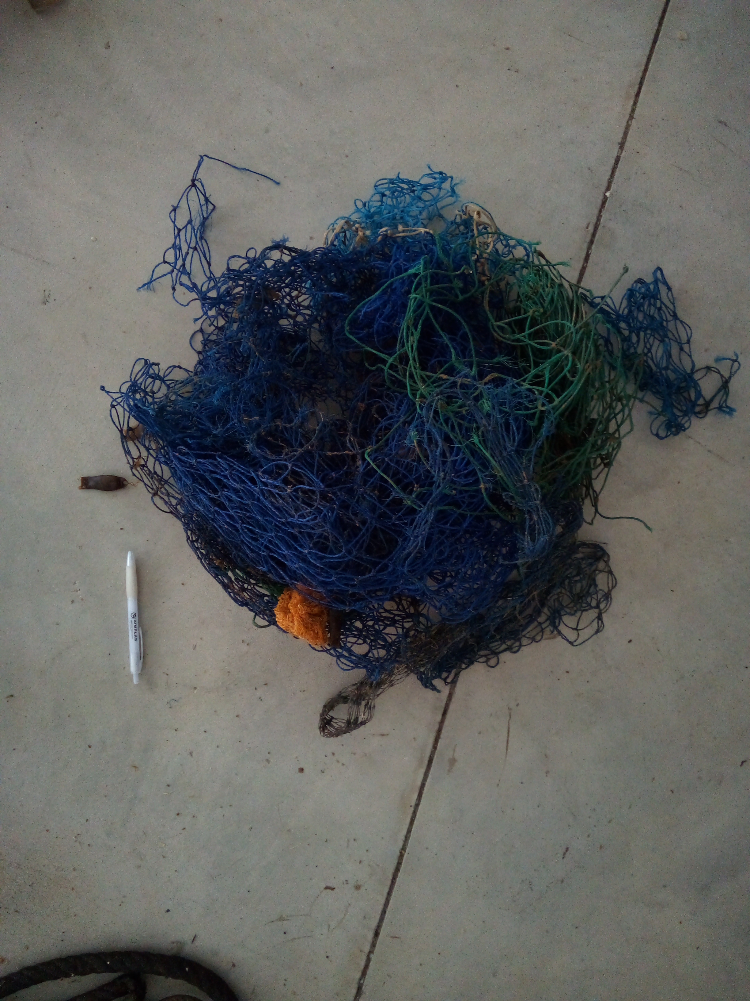
advanced pre-treatment solutions
material compatibilisation strategies
chemical recycling or hybrid recovery routes
Challenge 3: Technical and technological barriers
Common limitations:
Existing technologies not adapted to highly degraded or contaminated waste
Lack of industrial-scale, cost-effective solutions
Difficulty in meeting recycled material quality requirements
1- Separation by NIR (with more than 80% of the material treated, separated correctly).
2- Modification of equipment parameters (purity, detection area)

Slide 6
Challenge 4: Regulatory framework and responsibility
Challenge 5: Lack of coordination among stakeholders
Key stakeholders involved:
public authorities
waste management companies
manufacturing and converting industries
primary sector (fishing, ports, cleaning services)
research and technology centres
Unclear definition of:
  waste ownership
  financial responsibility for management
Regulations designed for conventional waste streams
Barriers to recognising these materials as secondary raw materials
Typical problems:
Fragmented initiatives
Limited continuity after pilot projects
Weak value chain integration

Slide 7
Closing: from challenge to opportunity
From the waste manager’s perspective, progress requires:
  Solutions designed around real waste, not idealised streams
  Applied technological innovation
  Economically viable business models
  Regulatory support and incentives
  A full value-chain approach
Without effective collaboration, circular economy solutions will not succeed.

Slide 8
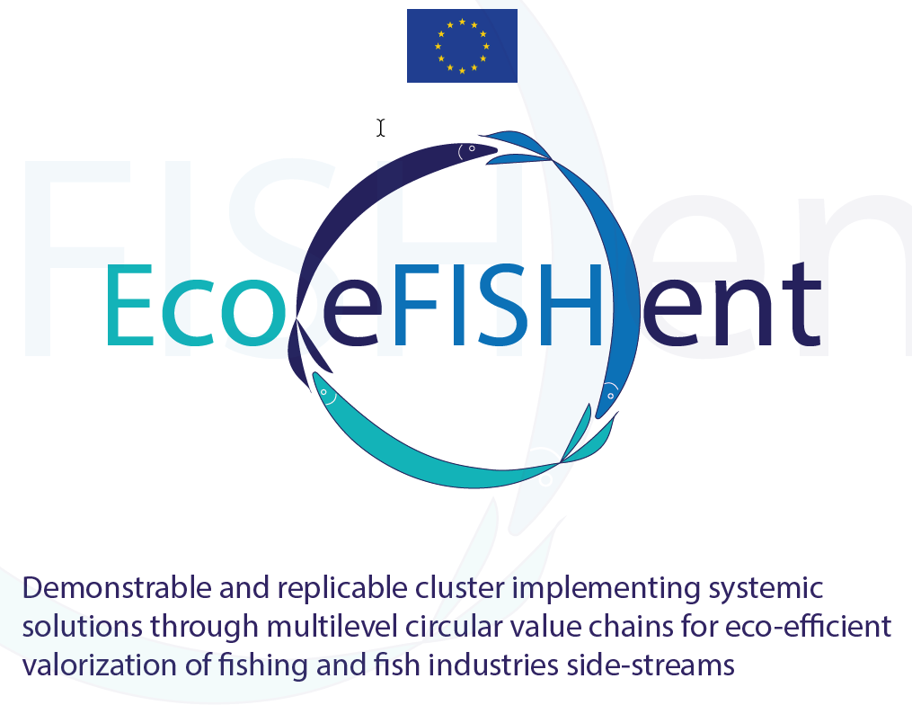
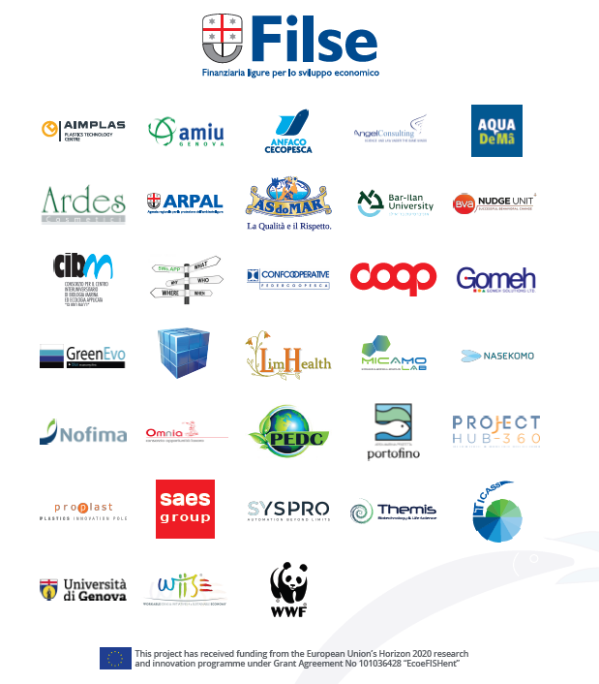
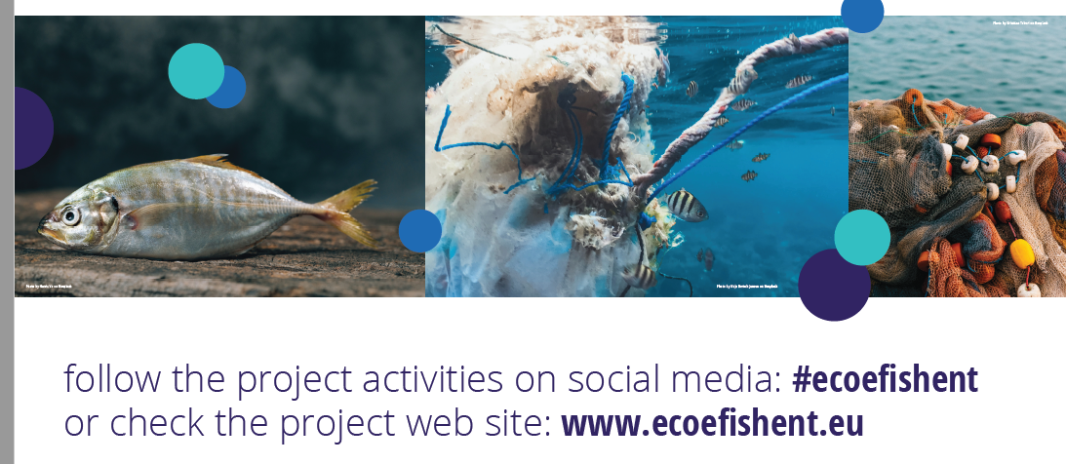
AIMPLAS encompasses different roles at Ecoefishent, such as the development of gelatin-based coatings for packaging and the recycling of fishing nets to produce packaging for cosmetics.

Slide 9

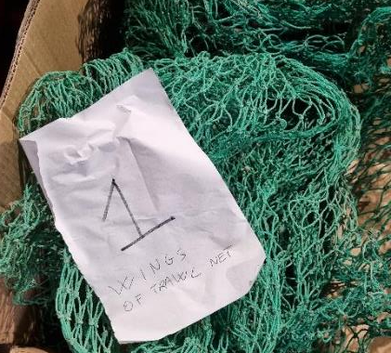
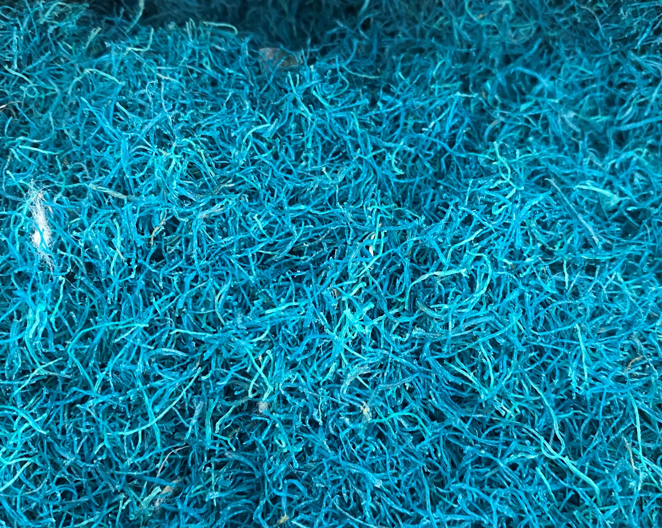
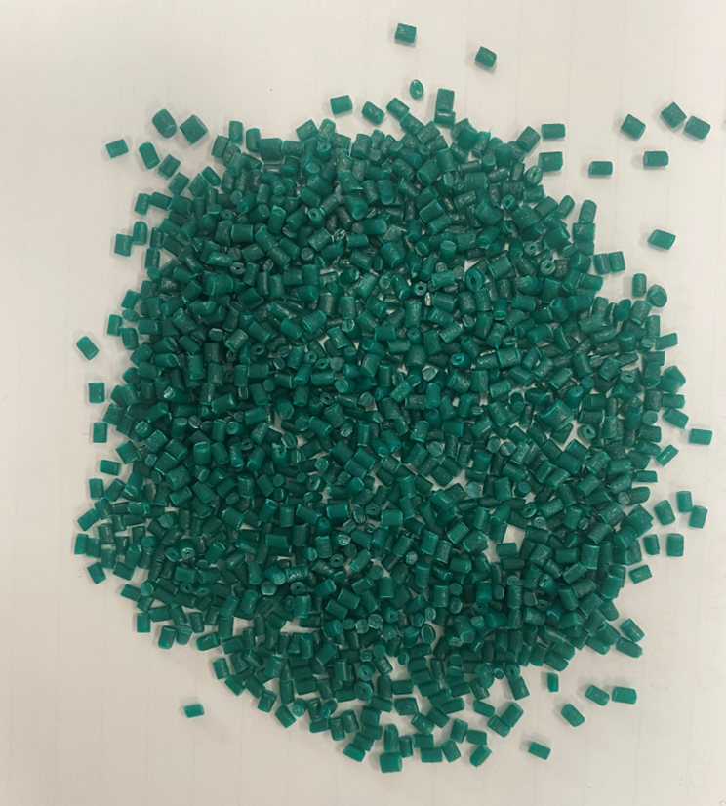
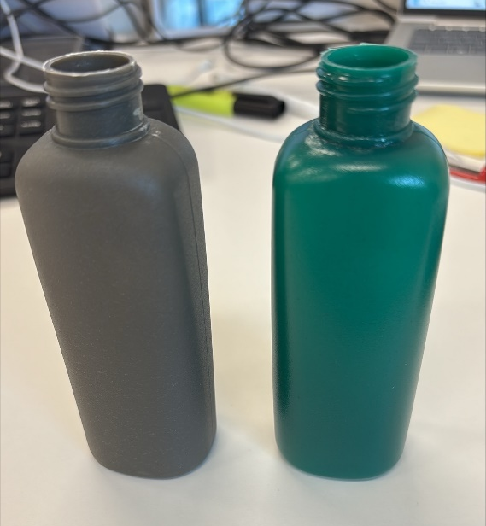
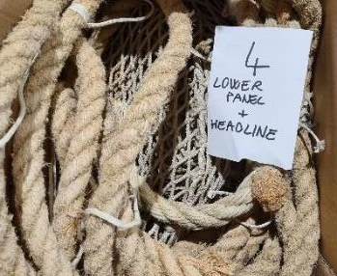
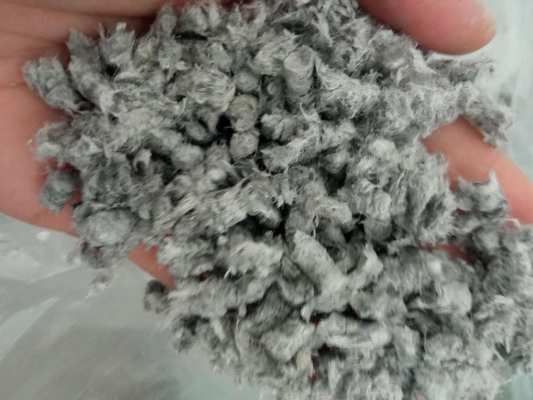
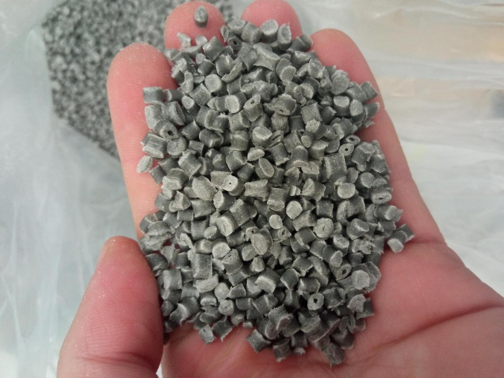

25% Redes de pesca

Slide 10
THANK YOU!!
Sonia Albein Urios – salbein@aimplas.es

