Slide 1

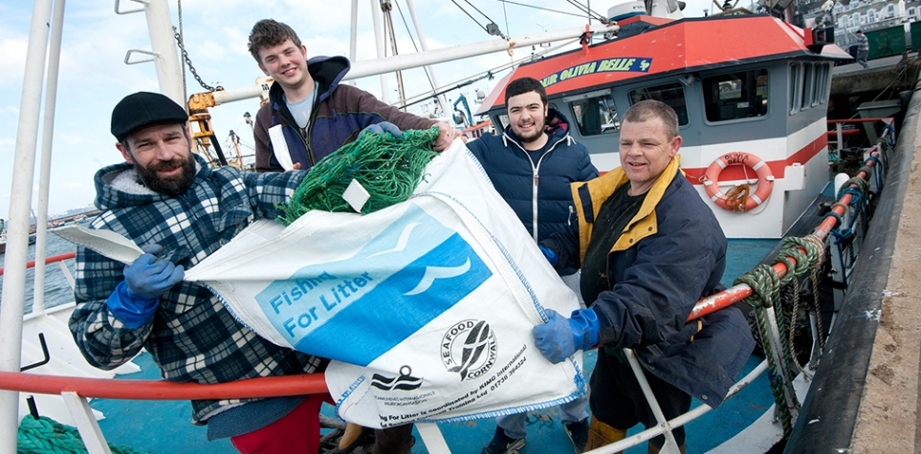
Overview of OSPAR actions on Fishing For Litter – state of implementation
OSPAR ICG ML 2026 |Marijke Boonstra, Ministry of Infrastructure Watermanagement, The Netherlands/ co-chair OSPAR Marine Litter Expert Group / action lead Fishing For Litter
FreeLitterAd- Fishing for Litter in the frame of PRF directive: Experiences and Challenges in the Atlantic Area
6 february 2026
#OSPARprotects

Slide 2
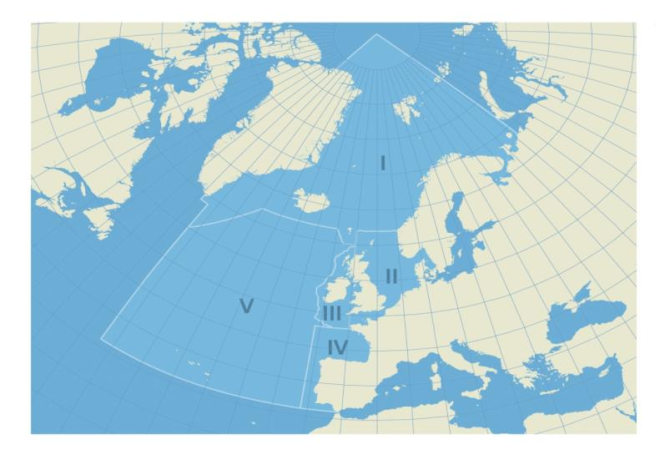


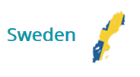
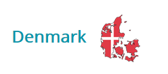












OSPAR Contracting Parties
OSPAR Maritime Area and Regions:
Region I: Arctic Waters
Region II: Greater North Sea
Region III: Celtic Seas
Region IV: Bay of Biscay / Iberian Coast
Region V: Wider Atlantic
#OSPARprotects
#OSPARprotects

Slide 3
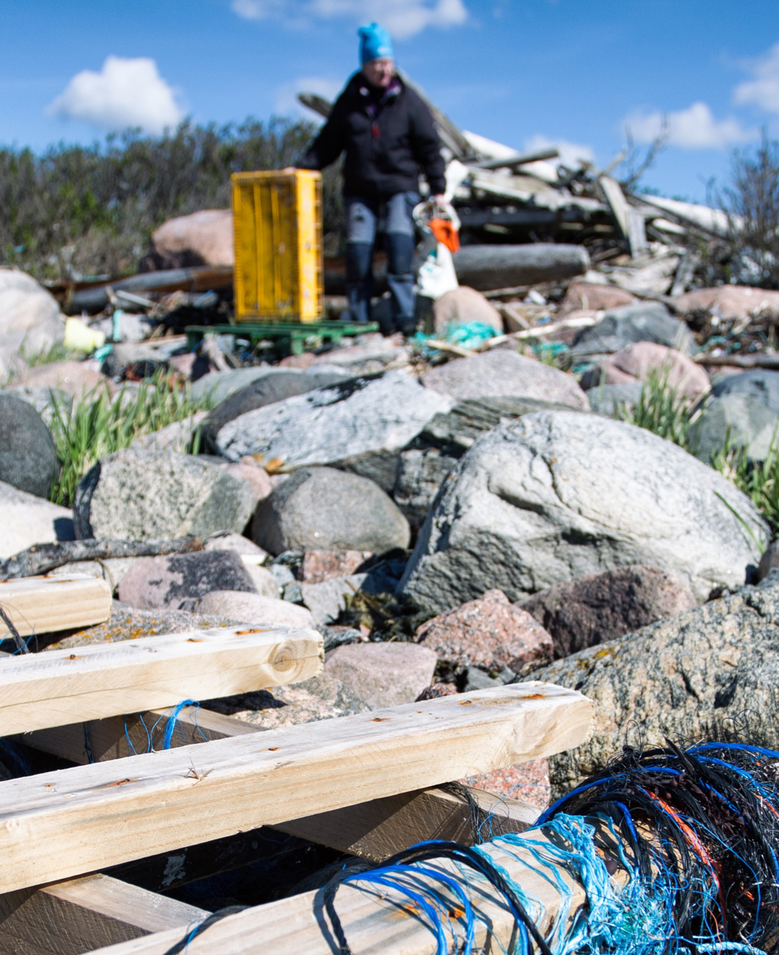
Obligations under the OSPAR Convention
Articles 3 and 5 and Annexes I and III require Contracting Parties to take, individually and jointly, all possible steps to prevent and eliminate pollution from land-based and offshore sources in accordance with the provisions of the Convention;
Annex V on the protection and conservation of the ecosystems and biological diversity of the maritime area makes it a duty of the OSPAR Commission to draw up programmes and measures for the control of the human activities identified by the application of the criteria in Appendix 3;
#OSPARprotects
Photo: Eleanor Partridge (Marine Photobank)
Photo: Jan Fredrik Frantzen
© Florina Lachmann

Slide 4
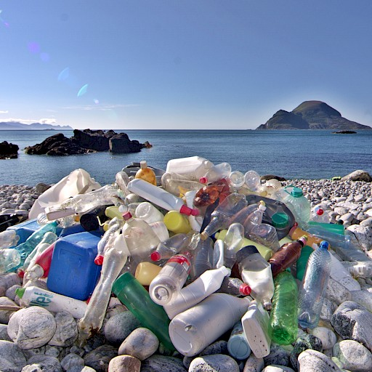
North-East Atlantic Strategy 2030
Strategic Objective 4 (out of 12)
“Prevent inputs of and significantly reduce marine litter, including microplastics, in the marine environment to reach levels that do not cause adverse impacts to the marine and coastal environment with the ultimate aim of eliminating inputs of litter”
#MarineLitter
#OSPARprotects
© Bo Eide

Slide 5
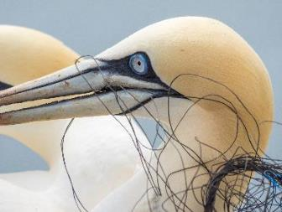
8 Operational objectives including targets for reducing marine litter
to reduce commonly found single-use plastic items and maritime-related plastic items on beaches by at least 50% by 2025 and by at least 75% by 2030, compared to a 2016 baseline; and
a 70% reduction in the prevalence of all marine litter on beaches by 2030;
© Wolf Wiechmann
#MarineLitter
to develop and implement measures to substantially reduce marine litter from fishing and aquaculture gear by 2025 and determine the need for and where appropriate adopt, targets or other actions for the separate collection of end-of-life fishing and aquaculture gear by 2027.
#OSPARprotects
© Kathrin Helmreich

Slide 6
Notes:
What is Fishing For Litter?

Slide 7
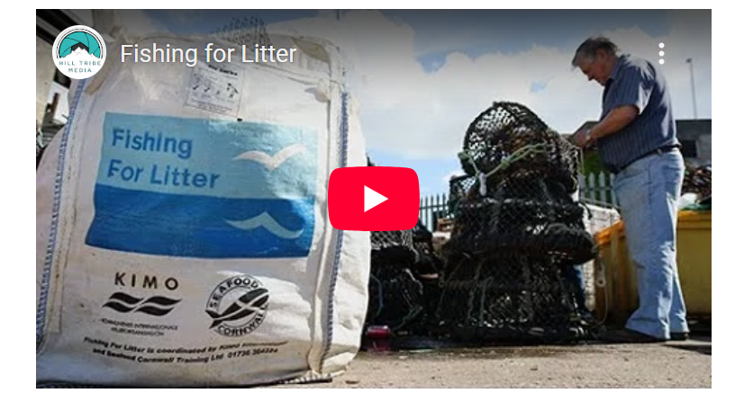
So what is it?
https://youtu.be/N3A-N_yofv4

Slide 8
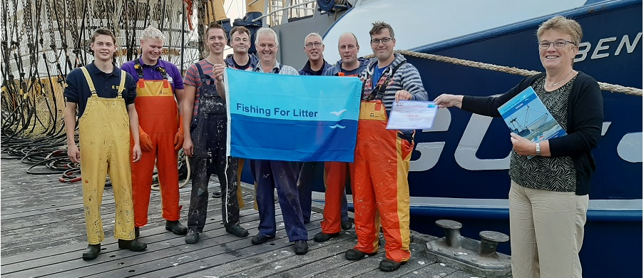
Early Development
Successful pilot project in the Netherlands (2001)
Gradual expansion across Europe
Growing engagement from:
  Fishing industry
  Port authorities
  Local governments
#OSPARprotects

Slide 9
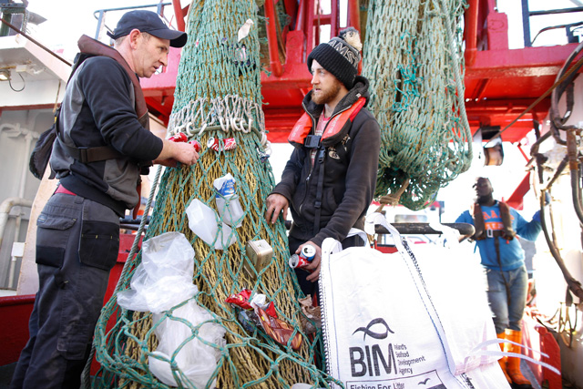
Impact of Fishing For Litter schemes
Encourages behavioural and cultural change in the fishing sector
Provides a practical mechanism to remove marine litter
Raises awareness among:
  Fishers
  Other industries
  The general public
Helps prevent new litter through stakeholder collaboration
#OSPARprotects

Slide 10
OSPAR Policy Milestones 2010-2026
2010 OSPAR Ministerial Meeting (Bergen): Adoption of Recommendation 2010/19
First assessment of implementation of recommendation (2014)
OSPAR adopted KIMO’s Fishing for Litter project guidelines (2017)
Established as the model for implementation across the OSPAR maritime area
Target set with 2017 baseline: “Increase the total number of vessels participating in FFL schemes by 100% by 2021”.
Integrated into:
  OSPAR’s first and second Regional Action Plan on Marine Litter
  North East Atlantic Environment Strategy 2020–2030
#OSPARprotects

Slide 11
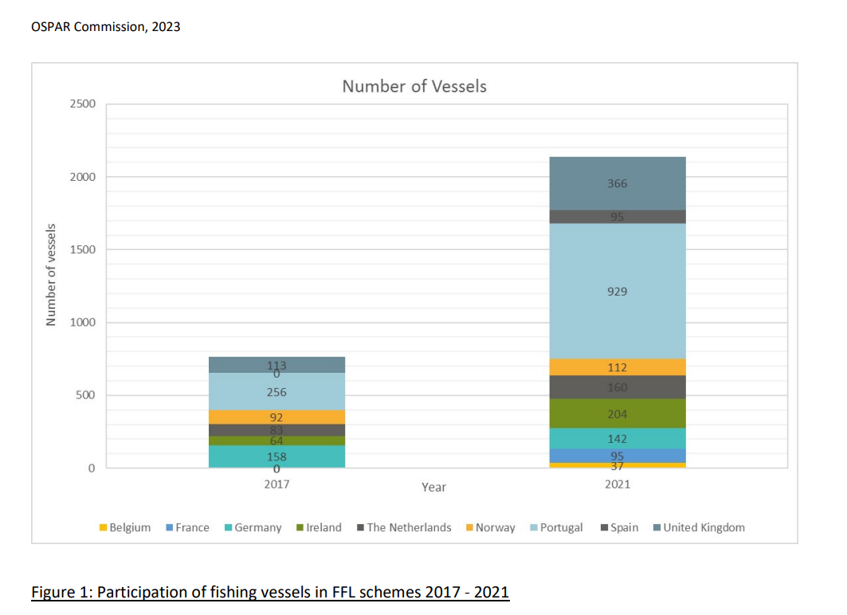
Progress of implementation (status in 2022)
9 Contracting Parties have implemented FFL schemes: Belgium, France, Germany, Ireland, The Netherlands, Norway, Portugal, Spain and UK
Number of participating vessels has increased => 179%
Shows growing commitment across the OSPAR region
Supports long‑term marine litter reduction
#OSPARprotects

Slide 12
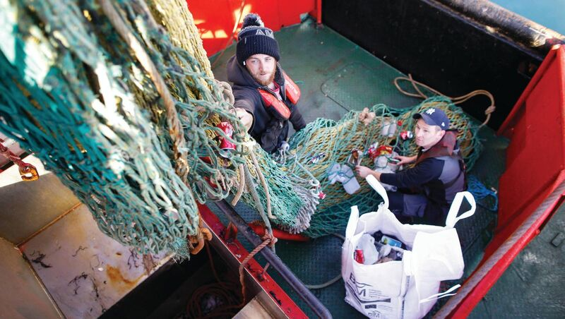
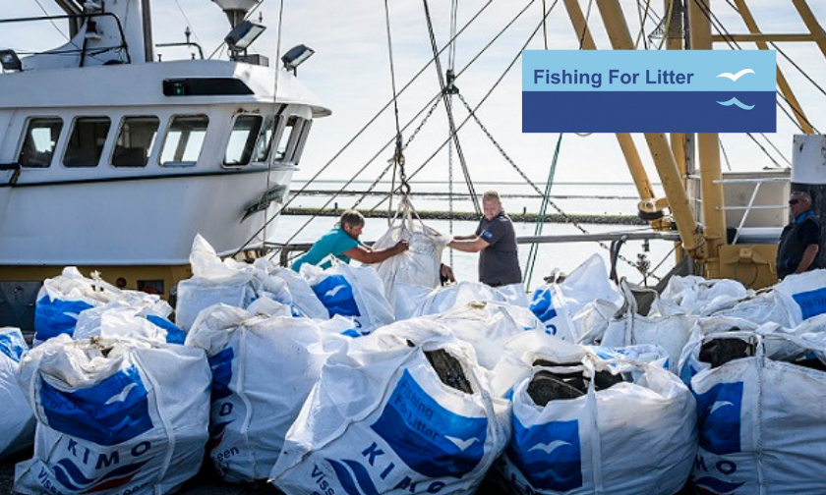
Challenges and opportunities
Funding remains a key barrier
EMFAF provides a framework for long‑term sustainability
EU PRF & SUP directives influence national FFL schemes
Need to strengthen links with ALDFG retrieval initiatives
#OSPARprotects

Slide 13
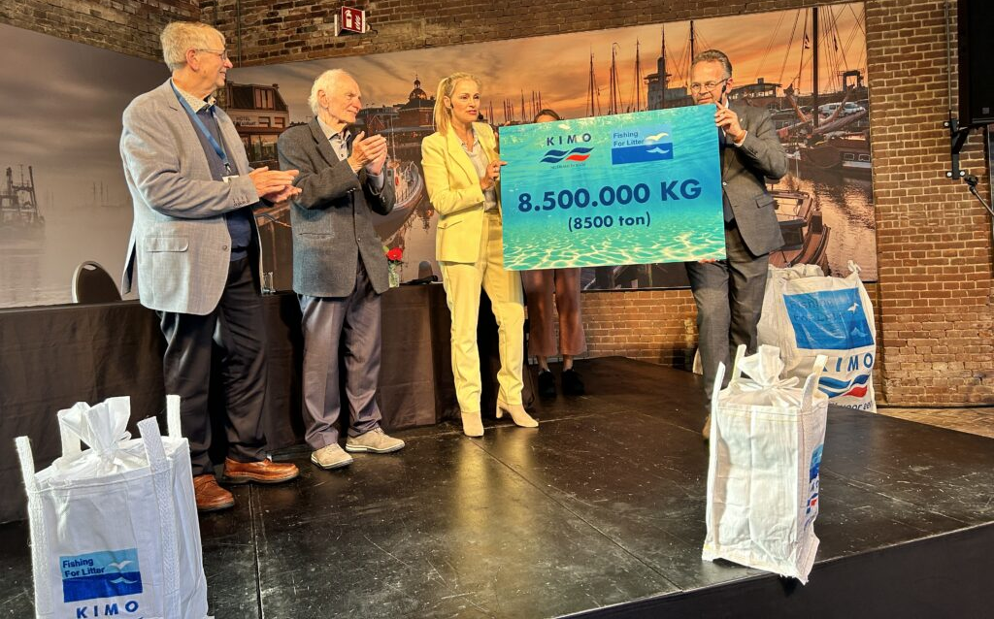
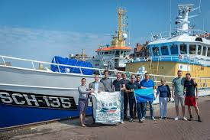
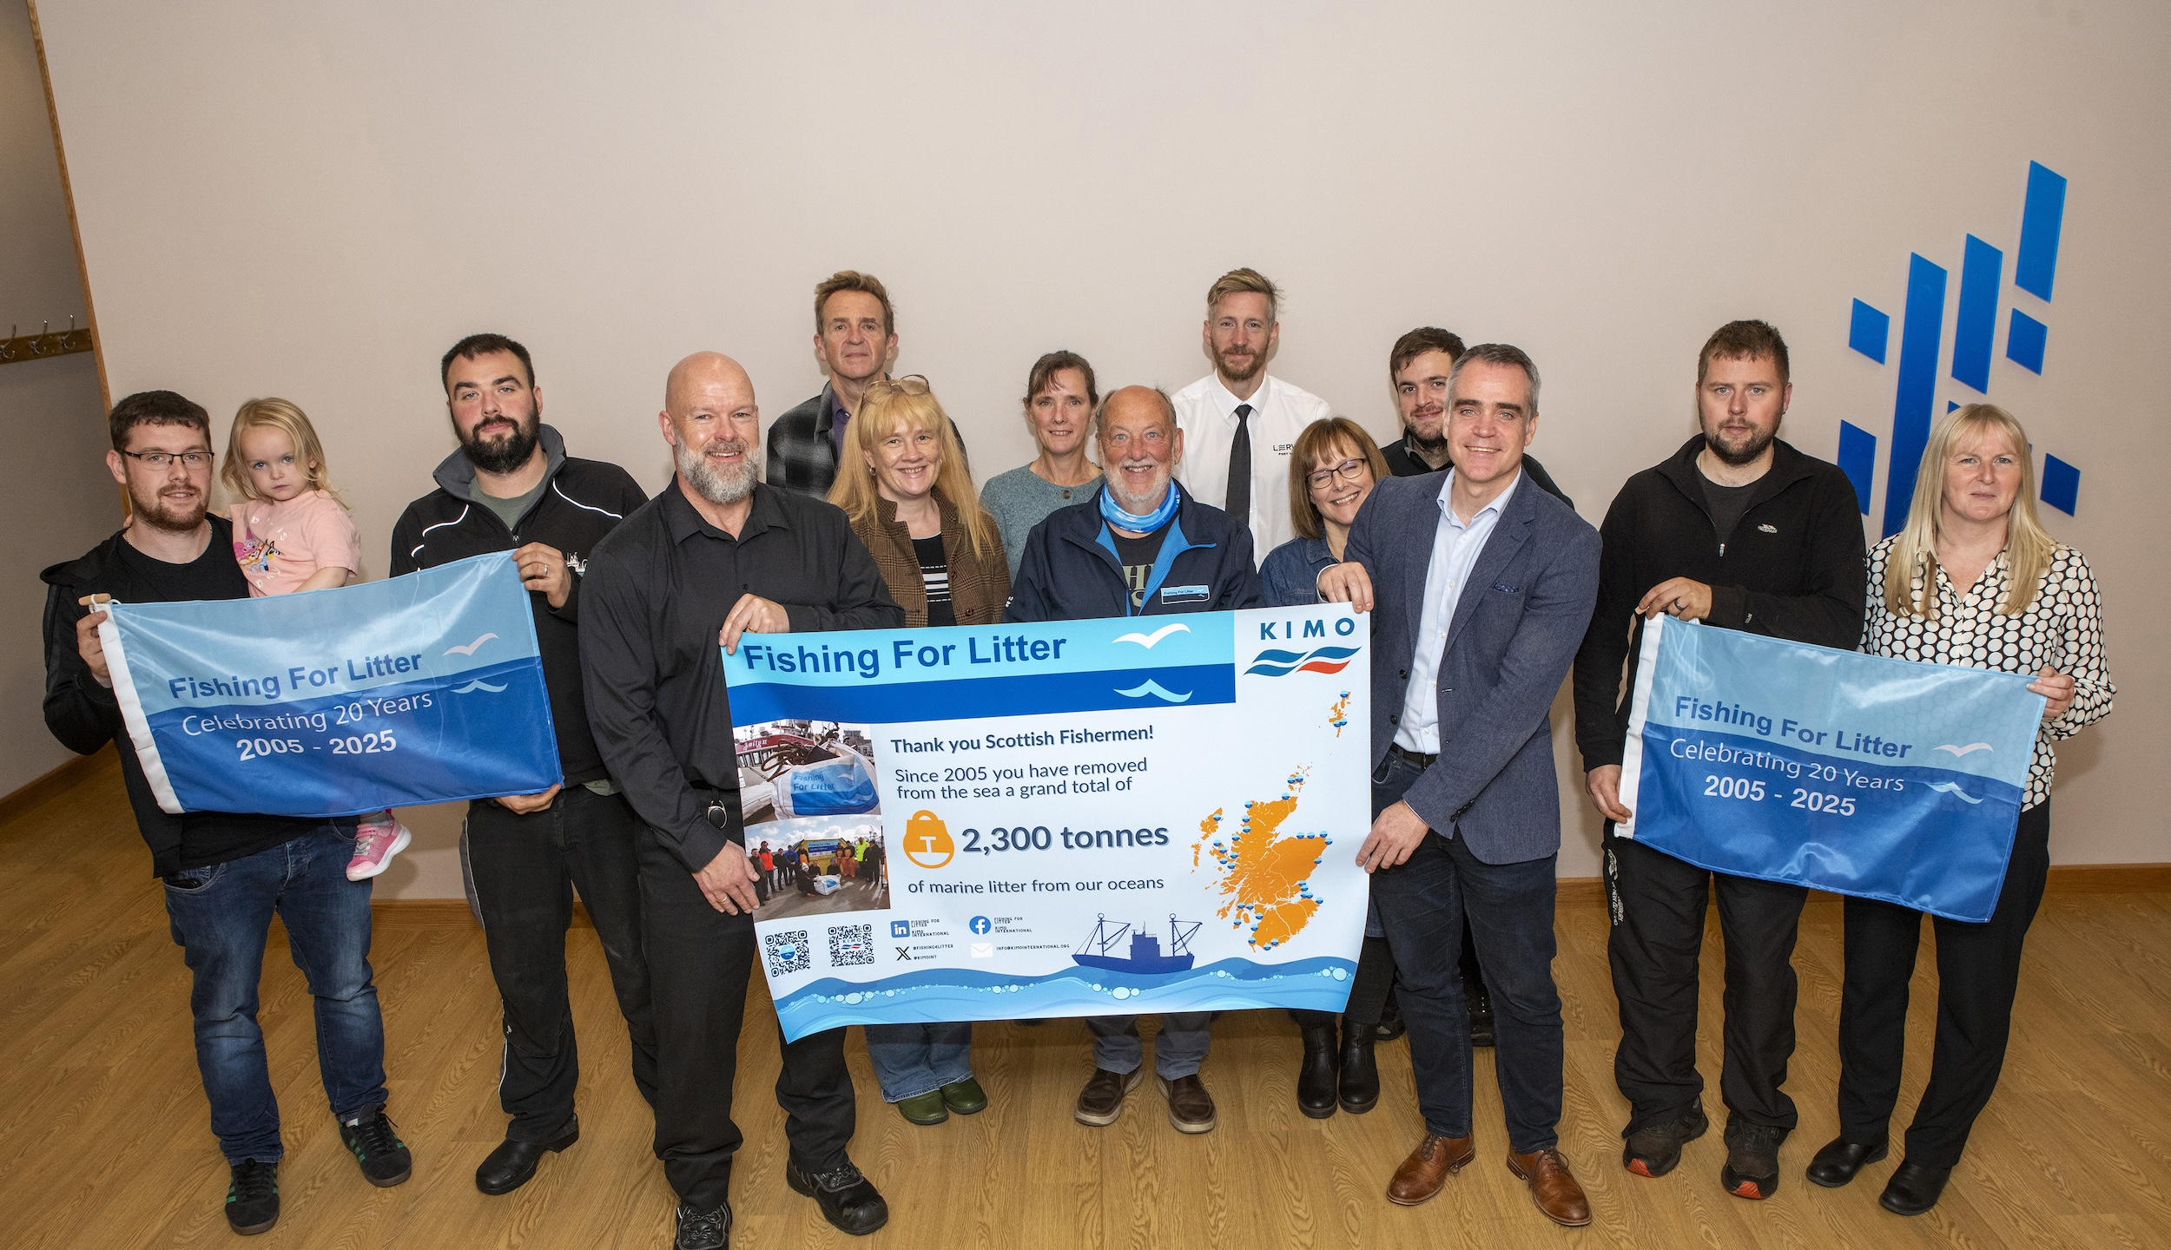
In conclusion
Fishing for Litter is a proven, scalable approach
Strong alignment between KIMO, OSPAR, and the fishing sector
OSPAR cooperation is crucial for successful FFL implementation. Benefits include:
  Information exchange
  Collective action
  Opportunities to link FFL with education, awareness, and recycling initiatives
Continued expansion strengthens marine litter reduction efforts across the North‑East Atlantic
#OSPARprotects

Slide 14

Thanks for your attention!
Any questions?
Follow OSPAR on Twitter @osparcomm and LinkedIn
#MarineLitter | #MLRAP2 | #OSPARprotects
www.ospar.org
#OSPARprotects
Notes:
Thank you

