Slide 1

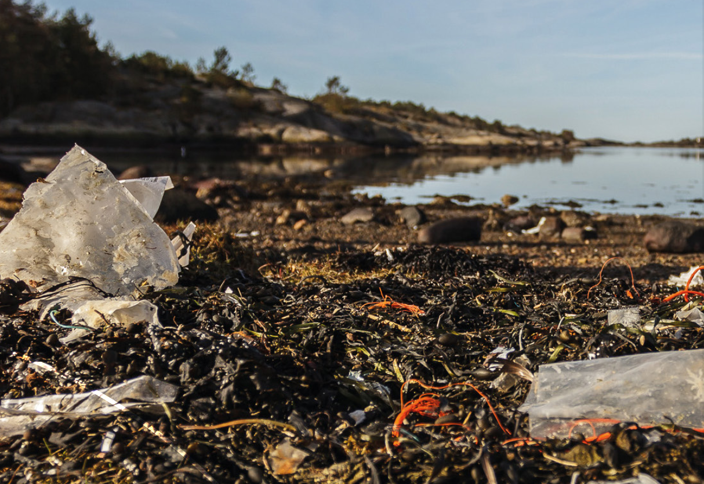
OSPAR’s second Regional Action Plan on Marine Litter (2022-2030)
Addressing Fishing gear as a source of marine litter in the North-East Atlantic
OSPAR 2025 | Marijke Boonstra|
ICG-ML Co-Convenor
#OSPARprotects
Notes:
Good morning. I’m here to talk to you about OSPAR’s second Regional Action Plan to reduce Marine Litter in the North East Atlantic – or the RAP ML for short, and specifically how it will address fishing gear as a source of marine litter.
I’ll start by giving you some background on OSPAR’s mandate to take action on marine litter
I’ll then talk briefly about the marine litter results of OSPAR’s most recent quality status report
And I’ll fisnih by giving you a brief overview of the second RAP ML and the actions that relate to litter from fishing activities

Slide 2
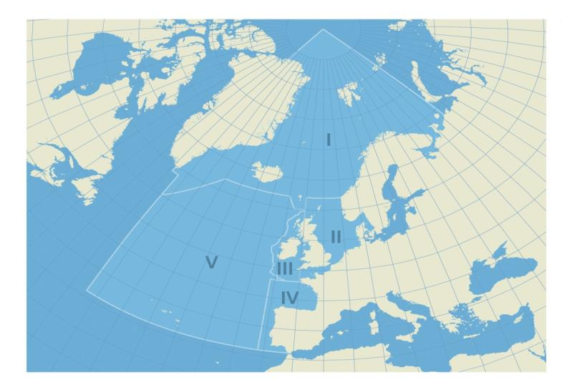
















OSPAR Contracting Parties
OSPAR Maritime Area and Regions:
Region I: Arctic Waters
Region II: Greater North Sea
Region III: Celtic Seas
Region IV: Bay of Biscay / Iberian Coast
Region V: Wider Atlantic
#MarineLitter
Notes:
So, OSPAR is a regional sea convention, and is the mechanism by which 15 Governments & the EU cooperate to protect the marine environment of the North-East Atlantic.
OSPAR began in 1972 as the Oslo Convention against dumping, and was broadened to include land-based sources and offshore industry in 1974 by the Paris Convention , thus becoming the OS-PAR Convention.
The fifteen governments who are Contracting Parties to OSPAR are shown on screen, and include both EU MS and non EU MS.
The OSPAR Maritime Area extends over the North East Atlantic and includes Arctic Waters, the Greater North Sea, Celtic Seas, Bay of Biscay & Iberian Peninsula, and the Wider Atlantic.

Slide 3
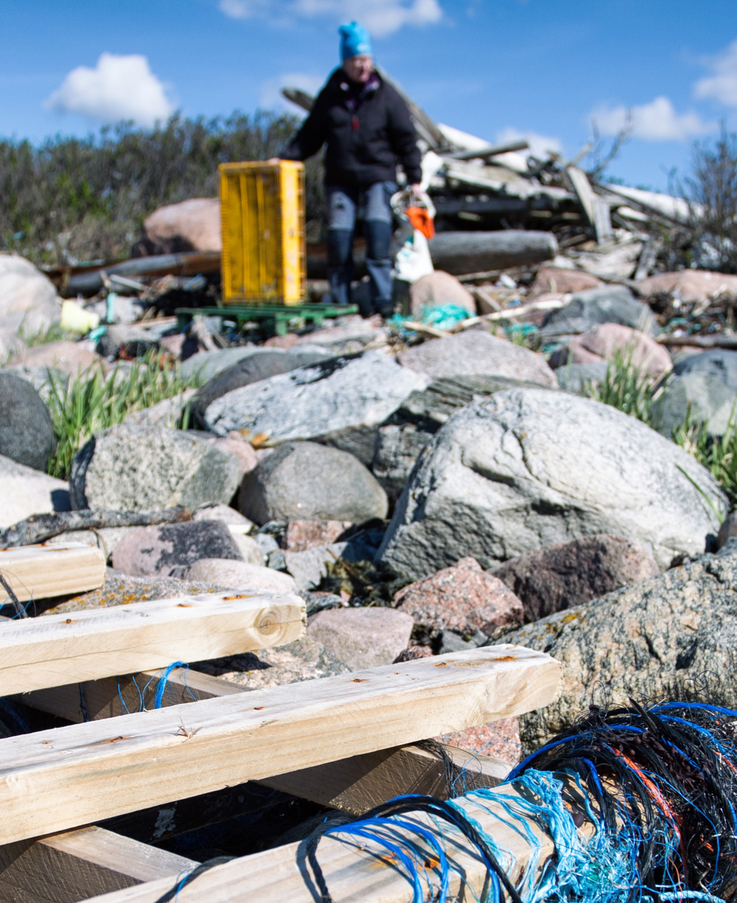
Obligations under the OSPAR Convention
Articles 3 and 5 and Annexes I and III require Contracting Parties to take, individually and jointly, all possible steps to prevent and eliminate pollution from land-based and from offshore sources in accordance with the provisions of the Convention;
Annex V on the protection and conservation of the ecosystems and biological diversity of the maritime area makes it a duty of the OSPAR Commission to draw up programmes and measures for the control of the human activities identified by the application of the criteria in Appendix 3;
#MarineLitter
Photo: Eleanor Partridge (Marine Photobank)
Photo: Jan Fredrik Frantzen
© Florina Lachmann
Notes:
The requirement for OSPAR Contracting Parties to take action on marine litter are provided for within the text of the Convention itself and within its annexes.
OSPAR can adopt measures either in the form of an OSPAR Decision that is legally binding under international law or an OSPAR Recommendations which is adopted by the Commission with a commitment from countries to implement the measure through national actions.
OSPAR also agrees on programmes of actions (like the RAP ML) or guidance aiming for coordinated approaches (such as joint monitoring and assessments) – these are mostly referred to as OSPAR Agreements.

Slide 4
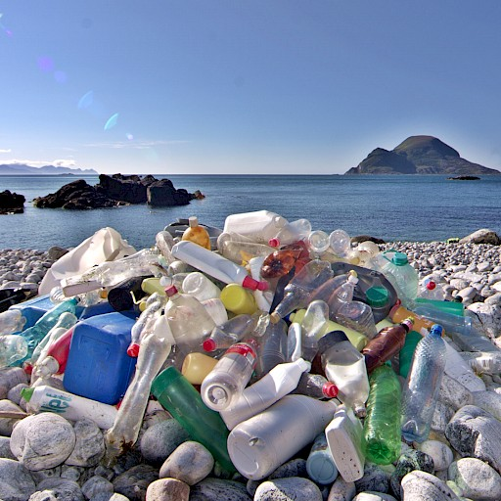
NEAES 2030
Strategic Objective 4
Prevent inputs of and significantly reduce marine litter, including microplastics, in the marine environment to reach levels that do not cause adverse impacts to the marine and coastal environment with the ultimate aim of eliminating inputs of litter.
8 Operational Objectives
#MLRAP2
© Bo Eide
Notes:
One such agreement was the North East Atlantic Environment Strategy, which was adopted in 2021 and runs until 2030.
The NEAES re-iterated Minsiters’ commitments to prevent and eliminate pollution including marine litter in the North East Atlantic.
Strategic Objective 4 relates specifically to marine litter, and is supported by a further 8 operational objectives on marine litter.
The main vehicle to deliver on these objectives is OSPAR’s Regional Action Plan on Marine Litter – which I’ll come to later on in this presentation.

Slide 5
NEAES 2030
Strategic Objective 4
OSPAR has agreed two targets for reducing marine litter:
to reduce commonly found single-use plastic items and maritime-related plastic items on beaches by 50% by 2025 and by 75% by 2030, compared to a 2016 baseline; and
a 70% reduction in the prevalence of all marine litter on beaches by 2030.
#MLRAP2
© Bo Eide
Notes:
One such agreement was the North East Atlantic Environment Strategy, which was adopted in 2021 and runs until 2030.
The NEAES re-iterated Minsiters’ commitments to prevent and eliminate pollution including marine litter in the North East Atlantic.
Strategic Objective 4 relates specifically to marine litter, and is supported by a further 8 operational objectives on marine litter.
The main vehicle to deliver on these objectives is OSPAR’s Regional Action Plan on Marine Litter – which I’ll come to later on in this presentation.

Slide 6
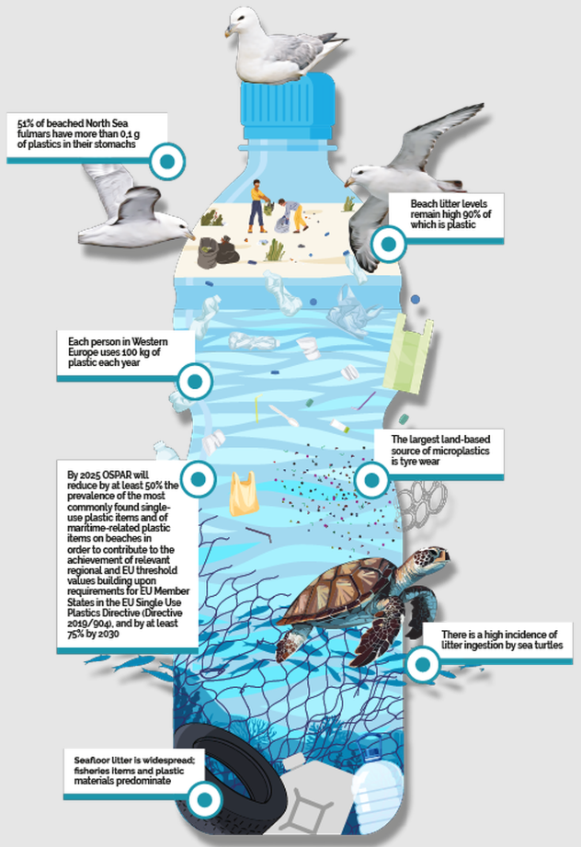
OSPAR’s Quality Status Report 2023
Marine Litter Thematic Assessment, builds on results of:
OSPAR Beach Litter Assessment
OSPAR Seafloor Litter Assessment
OSPAR Floating Litter Assessment (Litter Ingested by Fulmars)
Provisional results from other OSPAR assessments (turtle entanglement and development of microplastics in sediment)
#MLRAP2
Notes:
In addition to taking steps to prevent and eliminate pollution from land-based and offshore sources, the OSPAR Convention also requires Contracting Parties to undertake periodic assessments of the state of the marine environment through quality status reports - which are aligned with MSFD reporting cycles to avoid duplication of effort for OSPAR CP who are also EU MS.
The most recent QSR was published in 2023, and all of the assessments and conclusions can be found on the OSPAR website, but I’ll try to summarise some of the main marine litter results.
The marine litter thematic assessment pulled together the various litter indicator assessments (as you see onscreen), and concluded that:
Overall, in the North East Atlantic, Marine litter levels remain high despite signs of improvement over the last 10 years.
When we look at composition of litter items recorded in the various assessments, litter from fishing activities is one of the main sources of litter in the North-East Atlantic.
And…when we're talking about fishing related litter items, this includes trawl nets, gill nets, traps, cages and pots, ropes and other fishing gear such as dolly rope.
Furthermore, there is forecasted to be a significant increase in aquaculture activities in the OSPAR Maritime Area over the next 10 years.

Slide 7
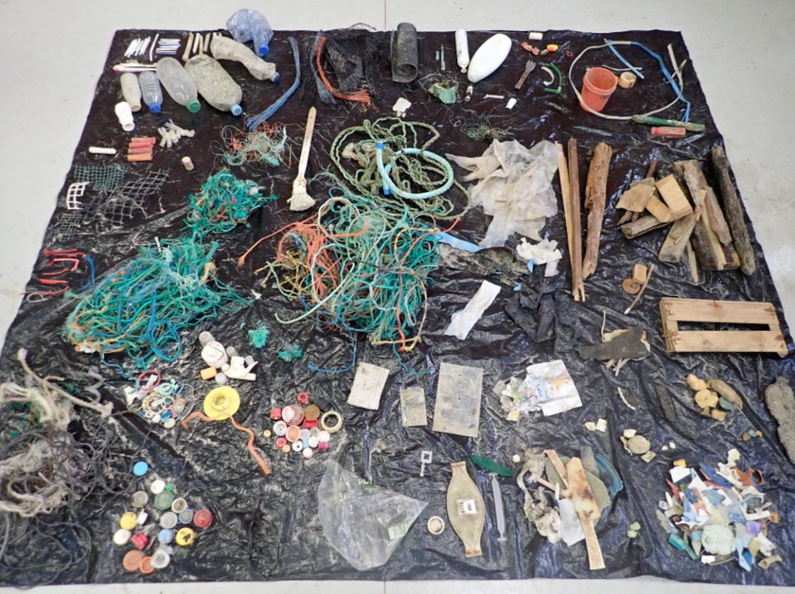
OSPAR’s Beach Litter Assessment
Plastic is predominant in all OSPAR Regions
Of the top 15 beach litter items recorded, 4 belong to the maritime related group
Significant decreasing trends for total counts of litter and plastics were observed in all regions
#MLRAP2
Examples of litter collected during an OSPAR beach litter survey (bottom) (Litter collected on beach FR002, “Le Stang”, France, Bay of Biscay region, on 09/01/2020, photo by Cedre)
Notes:
The Beach Litter assessment concluded that:
Beach litter is abundant in the OSPAR Maritime Area and plastic appears to be predominant in all OSPAR Regions.
Of the fifteen top beach litter types recorded, four belong to the ‘maritime-related group’, which includes fishing and aquaculture-related litter as well as strings and cords (which can come from different sources but are often mainly related to fishing).
And Single use plastics were also frequently recorded on beaches.
Significant decreasing trends for total counts of litter and plastics were observed in all regions - except in the Arctic Waters where they could not be assessed). However, levels of marine litter remain high and if we are going to reach the threshold value of 20 litter items per 100 m which has been adopted at the EU level - continued action is needed.

Slide 8
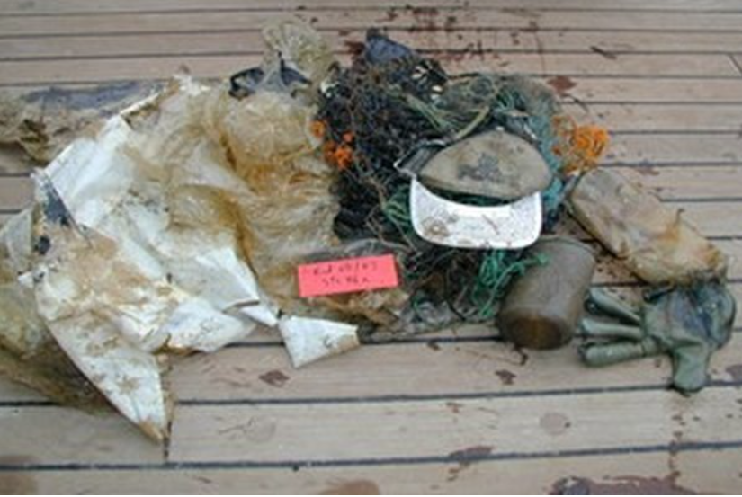
OSPAR’s Seafloor Litter Assessment
Litter is widespread on the seafloor
The Bay of Biscay has the highest probability that a haul will contain a litter item
Most common items made of plastic and relate to fishing activities
#MLRAP2
Marine litter by-catch on board the RV Endeavour. © J. Thain
Notes:
The Seafloor litter assessment concluded that:
Litter is widespread on the seafloor in the Greater North Sea, Celtic Seas, and Bay of Biscay and Iberian Coast, with plastic the predominant material encountered.
Seafloor litter is measured by making use of fish stock assessments, and assessing the probability that a haul will contain litter. Therefore, there are limitations in this assessment, but overall:
the Bay of Biscay has the highest probability that a haul will contain a litter item (87%),
with Greater North Sea next (69%)
and Celtic Seas lowest (45%).
The items most commonly found in each Region over time were mainly made of plastic (including bags, caps, bottles, bands, sheets) AND relating to fishing activities (including synthetic rope, other rope, monofilament fishing line, tangled fishline, fishing net).
Other items included clothing, processed wood, and drinks cans.
The top ten lists were similar for each of the OSPAR Regions.

Slide 9
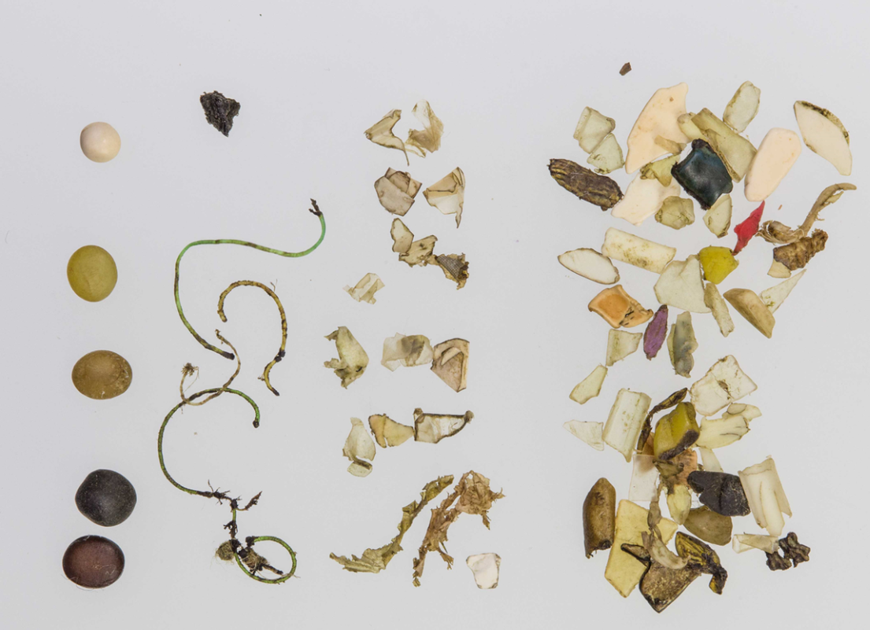
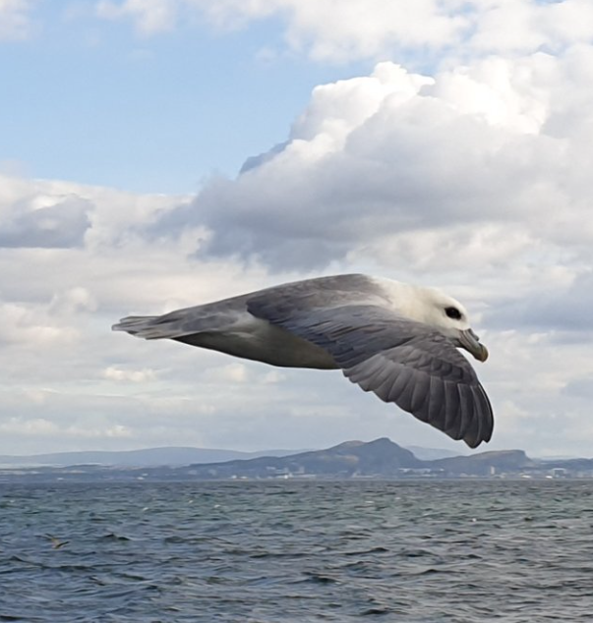
OSPAR’s Litter Ingested by Fulmar Assessment
51% of beached North Sea fulmars have more than 0.1g of plastics in their stomachs
#MLRAP2
Marine litter by-catch on board the RV Endeavour. © J. Thain
Fulmar in flight, Scotland. Source: Lucy Ritchie
Notes:
The litter ingested by Fulmar assessment concluded that:
Currently 51% of beached North Sea fulmars have more than 0.1g of plastics in their stomachs, which exceeds the OSPAR Fulmar Threshold Value of 10%.
This reflects the abundance of floating litter in the North sea and provides an indication of harm.
However, it should be noted that the amounts of ingested plastics have decreased significantly in the period between 2009 and 2018.

Slide 10
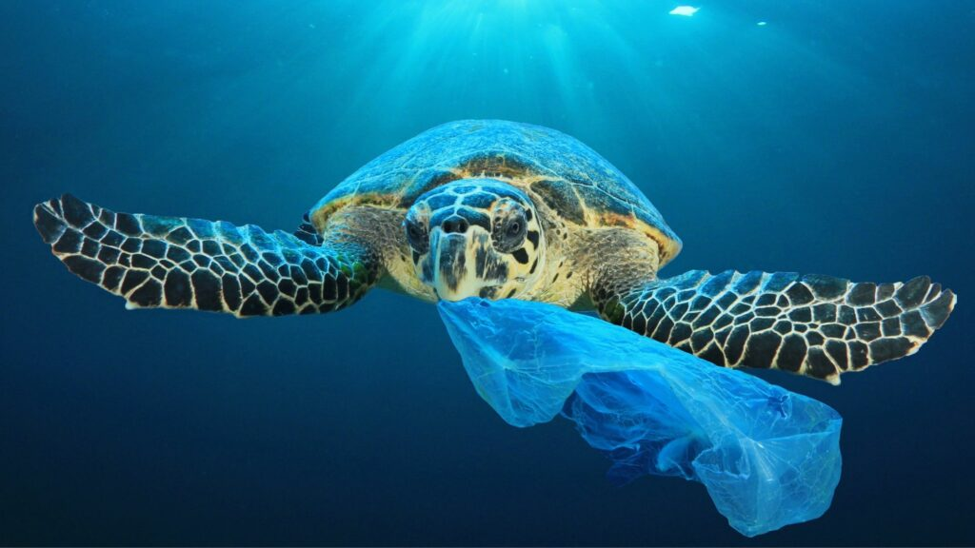
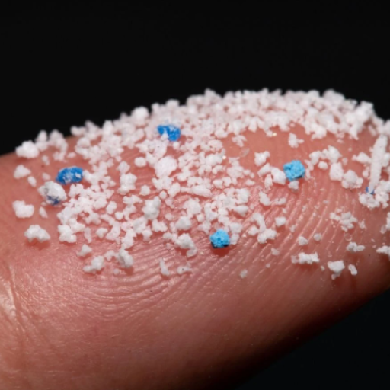
Other OSPAR assessments in development
Image Credit: Rich Carey/ Shutterstock.com
#MLRAP2
Notes:
OSPAR also has a newer indicator on litter ingested by sea turtles which indicates a high incidence of litter ingestion by sea turtles in OSPAR Regions 4 and 5 and Macaronesia but there are regional differences observed. This is really a first baseline for further monitoring and evaluation of trends.
OSPAR is also at a fairly advanced stage of developing a common indicator on microplastics in sediment.
And, OSPAR is in the early stages of developing a common approach to monitoring riverine litter, in line with the OSPAR NEAES operational objective to ‘develop, by 2025, approaches to prevent and reduce riverine marine litter inputs in cooperation with the relevant international river or river basin commissions, and other appropriate authorities and organisations.”

Slide 11
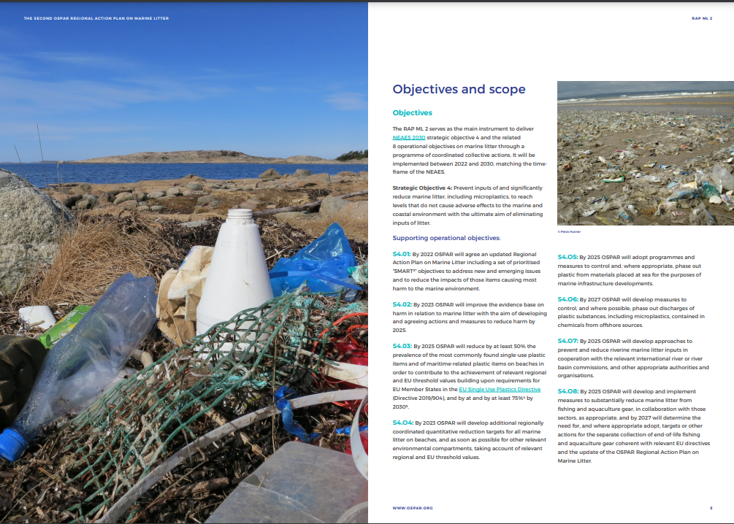
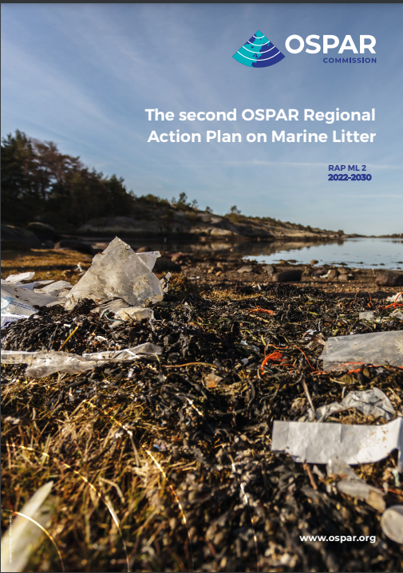
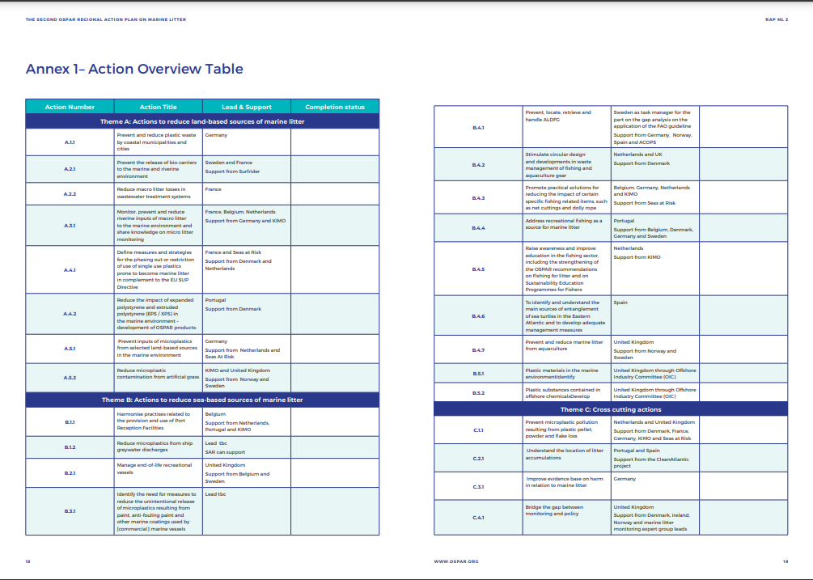
OSPAR’s Second Regional Action Plan to Reduce Marine Litter
#MLRAP2
Notes:
So we have seen that the situation is marginally improving but that we need to continue to take action.
And so to deliver on the commitment to ‘Prevent inputs of and significantly reduce marine litter in the marine environment’, OSPAR adopted its Second Regional Action Plan on Marine Litter in 2022. This second RAP will run until 2030, in line with OSPAR’s NEAES.

Slide 12
OSPAR’s Second Regional Action Plan to Reduce Marine Litter
Land based
Seabased
Cross cutting
Input from rivers (developing harmonized monitoring)
Microplastics
Inputs from coastal municipalities and cities
Contamination from artificial grass
Biocarriers and litter from wastewater treatment
Single use plastics
Polystyrene
Provision and use of Port Reception Facilities
Microplastics from grewater discharges and anti-fouling paint
End of life recreational vessels
ALDFG
Recreational fishing
Circular design and waste management in fishing and aqauculture gear
Reducing impact of net cuttings and dolly rope
Awareness and education in the fishing sector
Litter from aquaculture
Entanglement of sea turtles
Offshore industry
Microplastic pollution from pellets, flakes and powder loss
Understanding how floating litter accumulates
Bridging monitoring and policy action
Harm from marine litter
#OSPARprotects
3 key areas of action
25 Actions with detailed plans
23 with confirmed leads
Notes:
As with the first OSPAR RAP ML (2014-2021) the implementation of actions is through a lead country approach. However, the second RAP focusses on collective actions only (i.e. no national actions); and the plan is flexible, in order to respond to emerging issues and to adapt actions to reflect evolving policy landscapes.
There are 25 actions adopted, 23 of which have confirmed leads. They are presented in three themes, theme A on land-based sources, theme B on seabased sources, and theme C on cross cutting actions.
The selection of actions for the RAP ML 2 was based on the extent to which they:
· a) Targeted top litter items, harmful items or items prone to be litter within the OSPAR Maritime Area;
• b) the extent to which they filled evidence, policy or implementation gaps; and
· c) the extent to which they add value to other existing processes or efforts (for example those in the EU or other regional or global bodies).

Slide 13
Fishing related actions in the OSPAR RAP ML 2
Harmonise practices related to the provision and use of Port Reception Facilities
Prevent, locate, retrieve and handle ALDFG
Stimulating circular design and developments in waste management of fishing and aquaculture gear
      Circularity and recyclability of fishing gear and aquaculture equipment.
Promote practical solutions for reducing the impact of certain specific fishing related items, such as net cuttings and dolly rope
Address recreational fishing as a source for marine litter
Raise awareness and improve education in the fishing sector, including the strengthening of the OSPAR recommendations on Fishing for litter and on Sustainability Education Programmes for Fishers
Prevent and reduce marine litter from aquaculture
#MLRAP2 - Action B.4.7
Notes:
There are 7 actions in the RAP ML 2 that seek to address marine litter coming from fishing and aquaculture. Each of them are here on screen and are at varying levels of implementation. All details are on the OSPAR website.

Slide 14
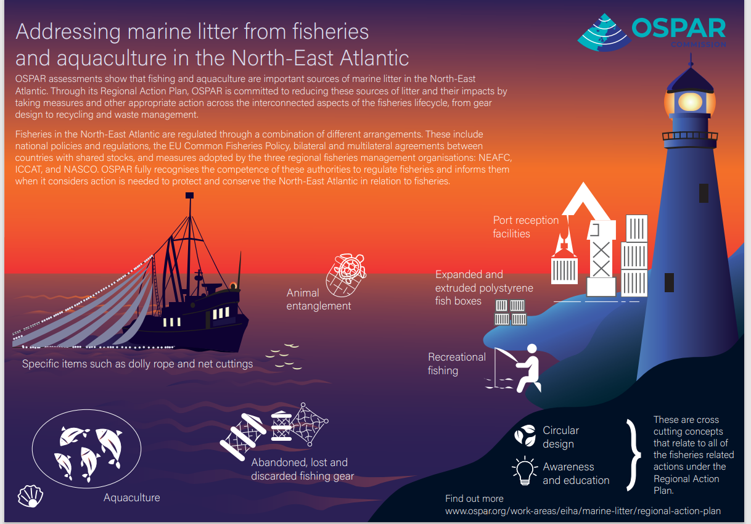
Notes:
We have several best practises = preventing net cutthings
Background documents, the most recent, is the background document on chafing gear

Slide 15
Fishing related actions in the OSPAR RAP ML 2 - outputs
Technical output: Gap analysis on the application of FAO’s voluntary guidelines for marking of fishing gear in the OSPAR maritime area.
Technical output: Entanglement of sea turtles in the Eastern Atlantic. State of play (2024).
Report of the EU-OSPAR JOINT WORKSHOP: Implementing measures to reduce marine litter from fishing gear, focusing on end-of-life and waste fishing gear policy, and promoting circularity. 20-21 March 2024, Brussels.
Background Document on the use of chafing gear with a focus on dolly ropes as a source of marine litter in the OSPAR Maritime Area
Agreement 2019-08: OSPAR Guidelines on the reduction of marine litter through the Implementation of Sustainability Education Programmes for Fishers. 2024 Update.
OSPAR Recommendation 2024/03 amending OSPAR Recommendation 2019/01 on the reduction of marine litter through the Implementation of Sustainability Education Programmes for Fishers.
OSPAR Recommendation 2024/04 on the management of expanded polystyrene (EPS) and extruded polystyrene (XPS) fish boxes in ports, to prevent release of EPS/XPS into the marine environment
And several more to come..
#MLRAP2 - Action B.4.7
Notes:
There are 7 actions in the RAP ML 2 that seek to address marine litter coming from fishing and aquaculture. Each of them are here on screen and are at varying levels of implementation. All details are on the OSPAR website.

Slide 16
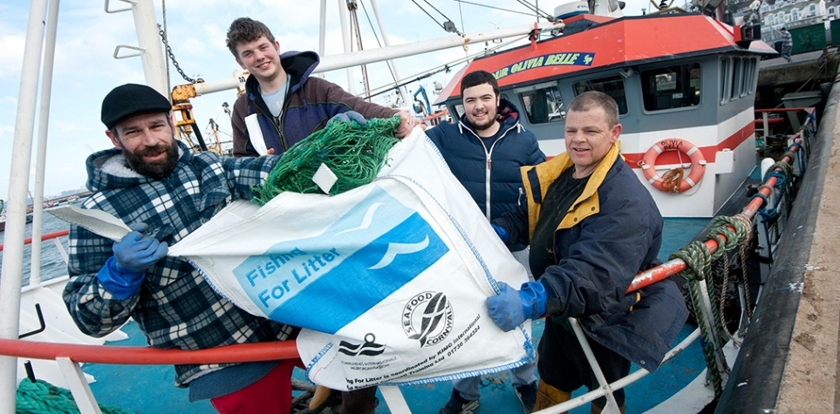
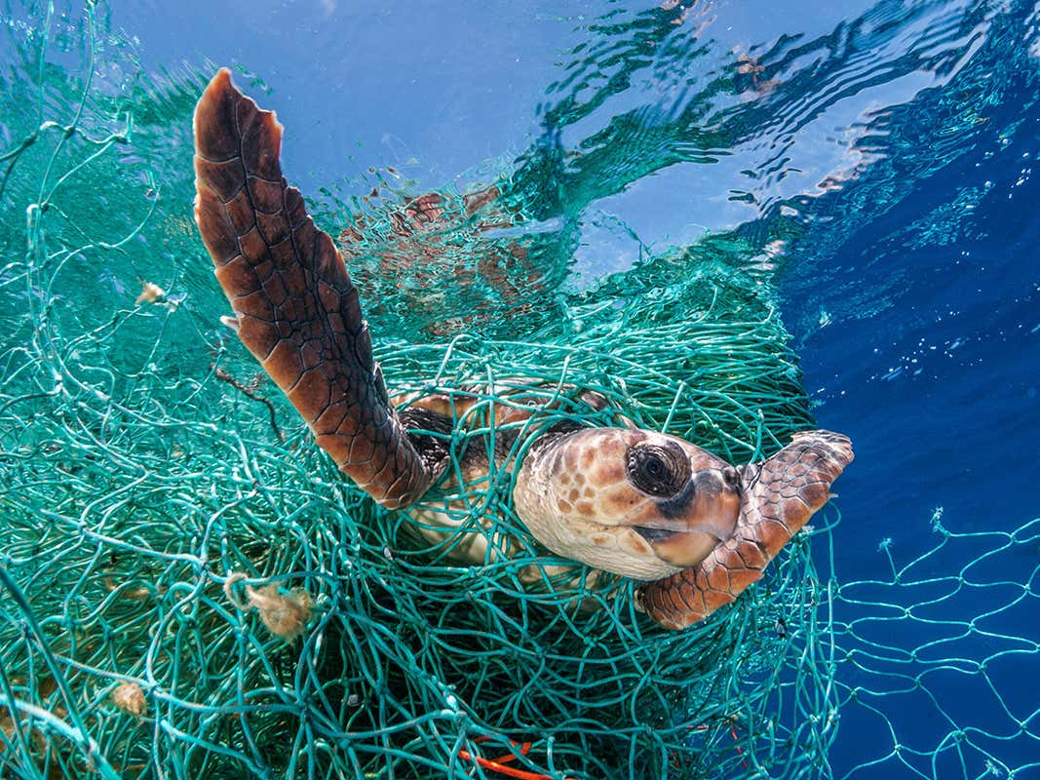
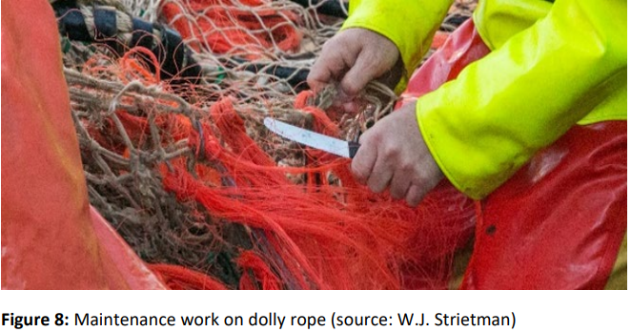
Lessons learned so far
There is no one solution to tackle fishing related litter;
There are various sources that need different strategies;
Important to look at the issue in a holistic way;
Communication and cooperation with the fishing sector is key.
#MLRAP2 - Action B.4.7

Slide 17
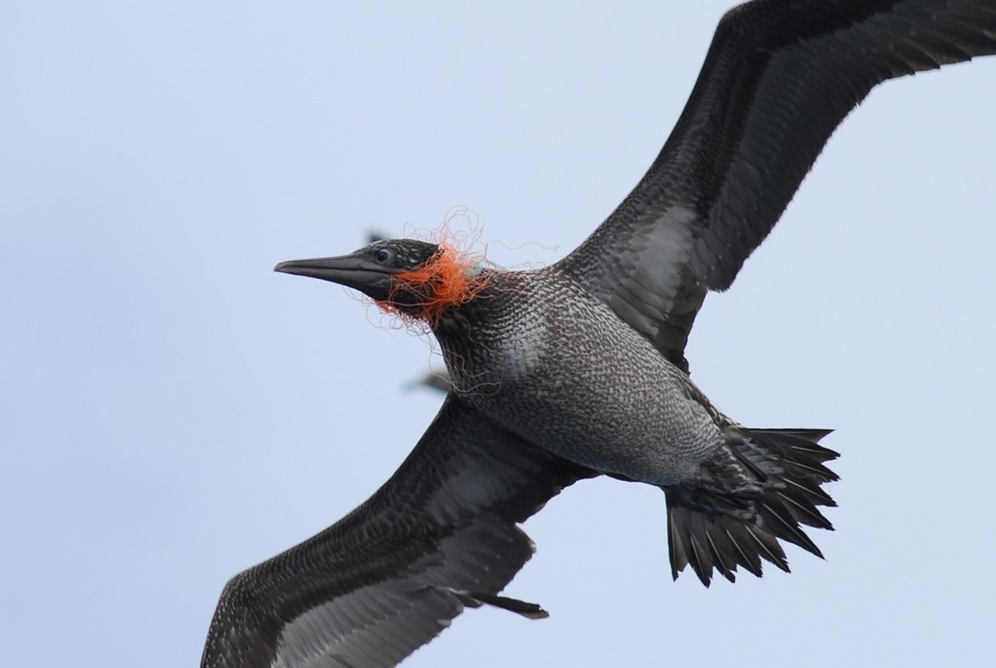
Thank you
Follow OSPAR on Twitter @osparcomm and LinkedIn
#MarineLitter | #MLRAP2 | #OSPARprotects
www.ospar.org
Seabird (Morus Bassanus) entangled in fishing net (NW Spanish coast). © Xulio Valeiras, Instituto Español de Oceanografía (IEO)
#OSPARprotects
Notes:
Thank you

