Slide 1

Fishing for Litter in the frame of PRF directive:
experiences and challenges in the Atlantic Area
Marisa Fernández
CETMAR
6 February 2025

Slide 2

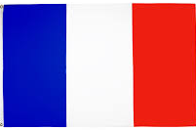






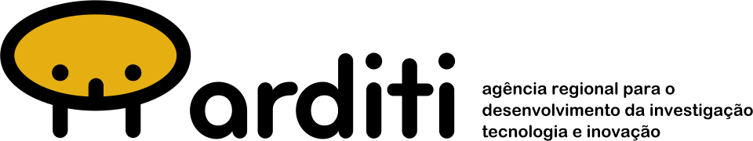



















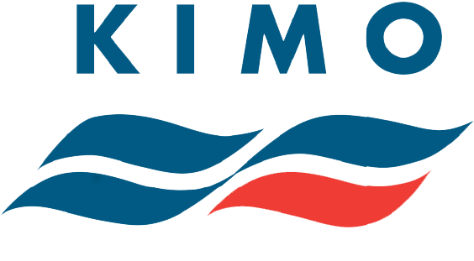



Free LitterAT project
Programme and duration INTERREG Atlantic Area (2021-2027); 1/11/2023 - 31/10/2026
General objective : To advance on achieving litter-free coastal communities by developing, testing and implementing innovative approaches for prevention, location and reduction of marine litter, with special emphasis on top litter items such as ALDFG and microplastics.
Total budget: 3,626,336.22 € (75% ERDF)
PARTNERS: 14 partners from 4 countries
ASSOCIATED PARTNERS: 9 (Advisory Board)
Notes:
Traducir

Slide 3





Objectives and Work Programme
Coordination and Management
Communication and Capitalisation
O1: Preventing marine litter by improving waste management and recycling and facilitating the implementation of SUP and PRF
O2: Understanding the origin, abundance and location of litter accumulation by identifying major sources, pathways and hotspots of marine litter (by monitoring and modelling)
O3: Reducing and removing marine litter and associated risks
WP1
WP2
WP3
WP4
Prevention by improving waste management and recycling
Assessing and Monitoring micro and macro litter
contamination
Modelling approaches from micro and macro litter: from modelling outputs to sources and hotspots
Reducing marine litter and associated risks
O4: Promotion of litter free local communities by developing pilot actions and awareness raising activities
(WP1, WP2, WP3, WP4)

Slide 4
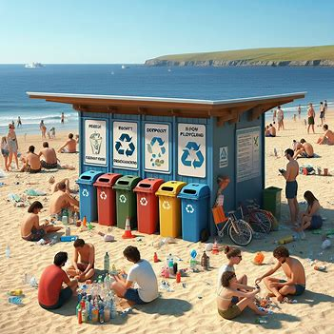
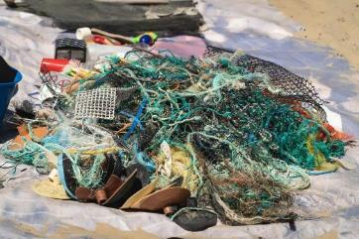
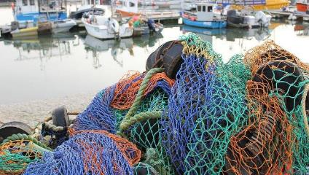
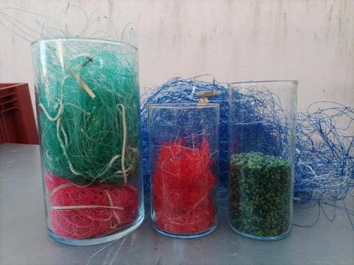
WP1: Preventing marine litter by improving waste management and recycling
Activity 1
Activity 2
Activity 3
Activity 4
Analysis of relevant aspects for SUP and PRF implementation and current practices for waste management in different ports
Management and Recycling of End-of-Life Fishing gears
Management of
Passively Fished Waste
Socio-economic analysis
Notes:
Señalar A1 y A3 y traducir

Slide 5
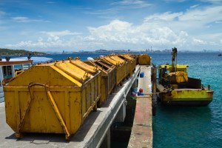

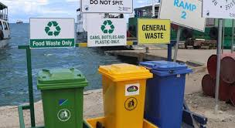
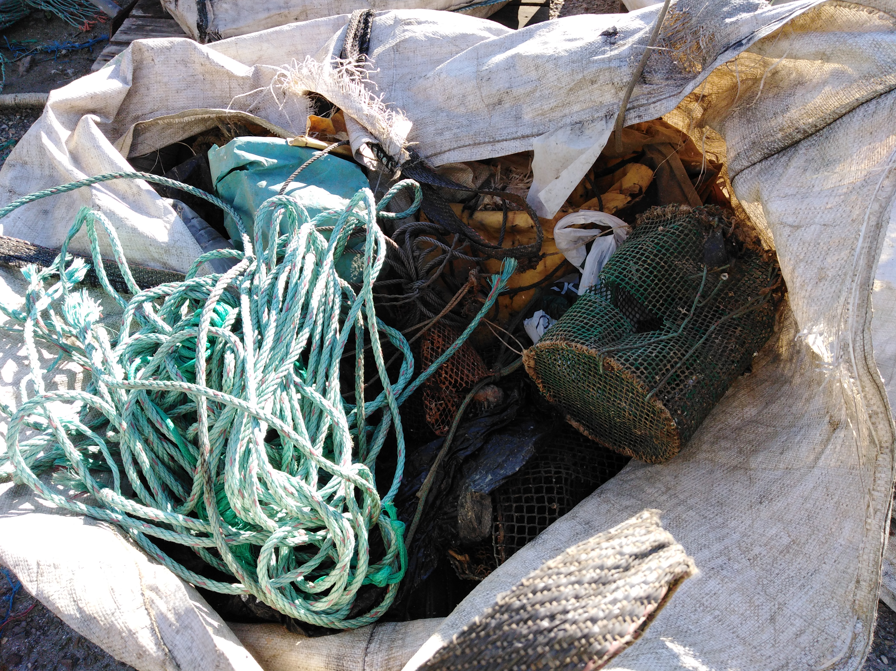
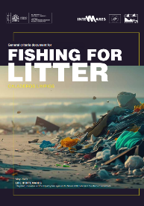
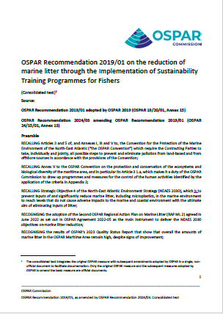
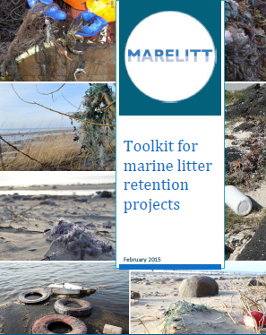
WP1: Methodology (Activities 1 and 3)
Compilation and analysis of information regarding PRF implementation in the partner countries
Consultation process on current practices for waste management: survey and meetings with ports
Compilation of information on Fishing for Litter experiences
Review of existent guidance and good practices

Slide 6



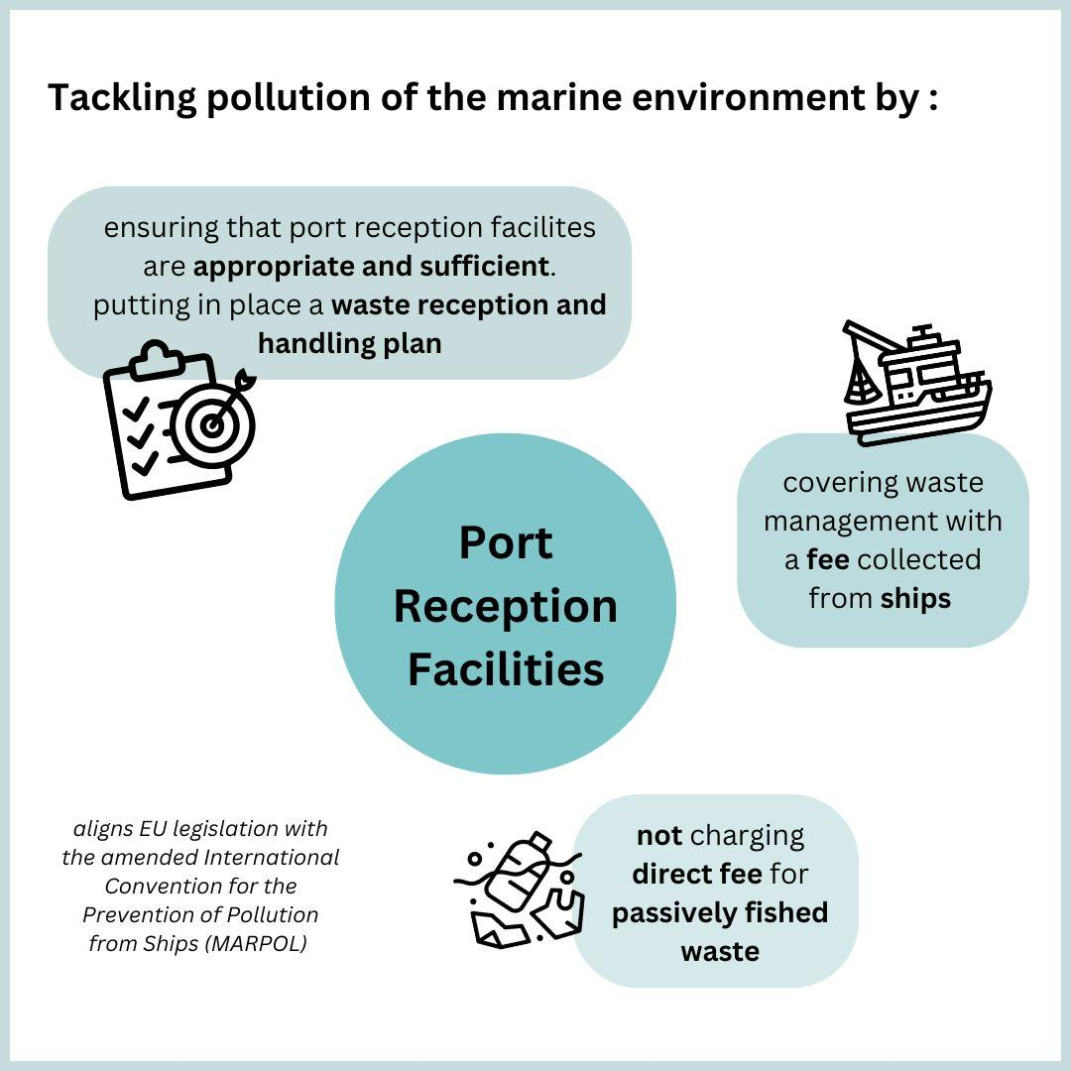

Analysis of implementation of PRF and PFW management
PRF Directive
How to make use of
lessons learnt from
Fishing for litter
Transposition to national legislation in the four countries:
Most ports have waste reception and handling plans in place
Many ports have already reception facilities, but systems are in the process of adaptation to new requirements
Challenges and room for improvement:
Cover and properly separate all relevant waste streams including:
End of Life Fishing gears
Passively Fished Waste
Adequate use of skips and containers by port users
Coordination and information flow among all the actors involved in the process
Availability of information and harmonized reporting
Difficulties to find alternative funding for PFW management
Management of
Passively Fished Waste
under PRF Directive

Slide 7
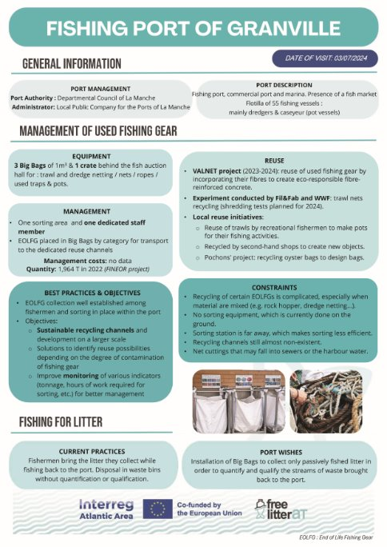
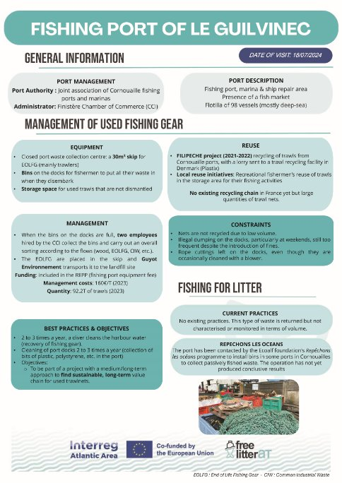
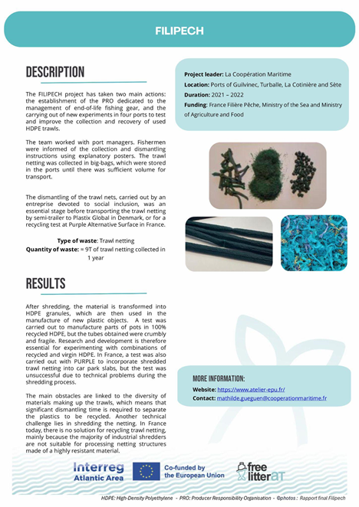
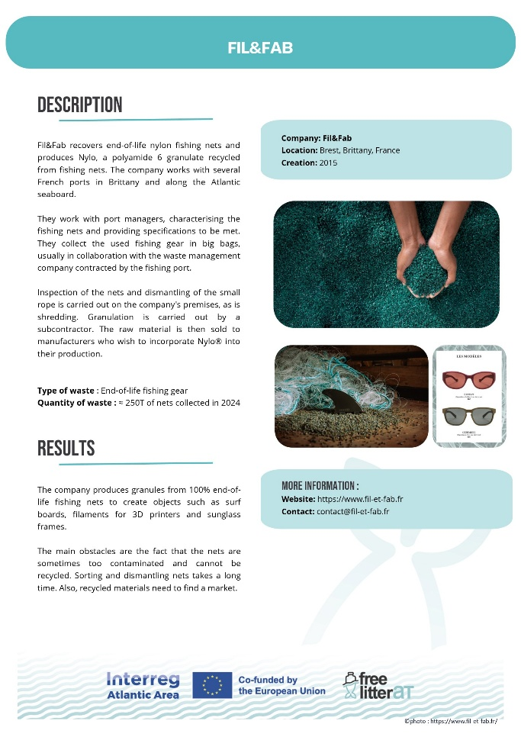
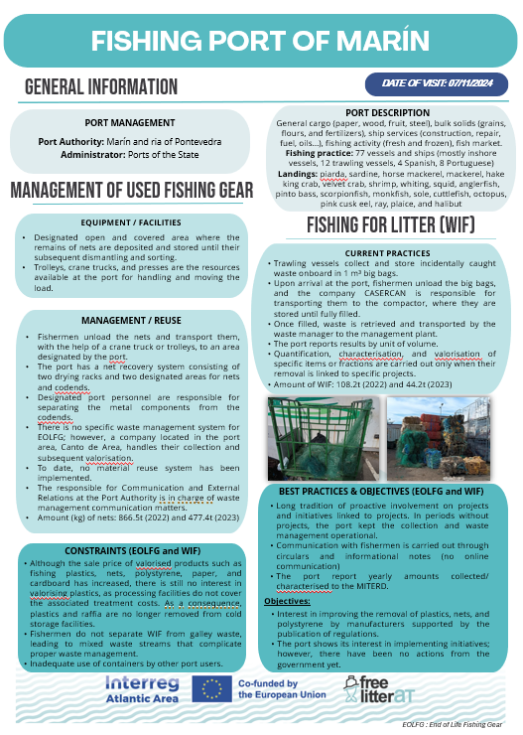
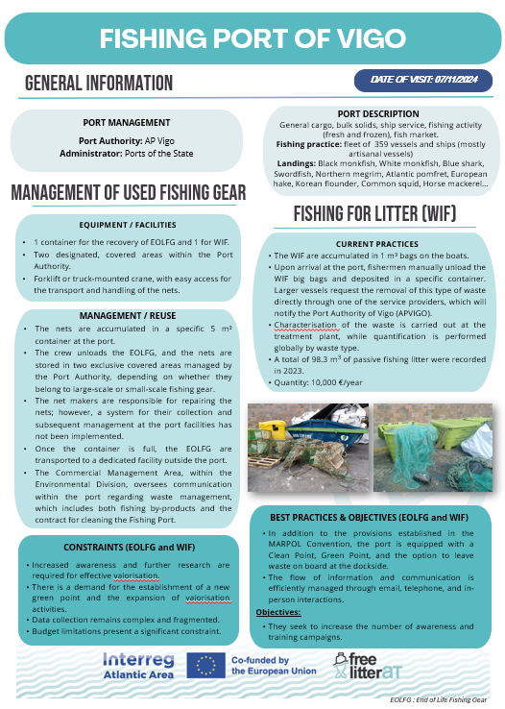
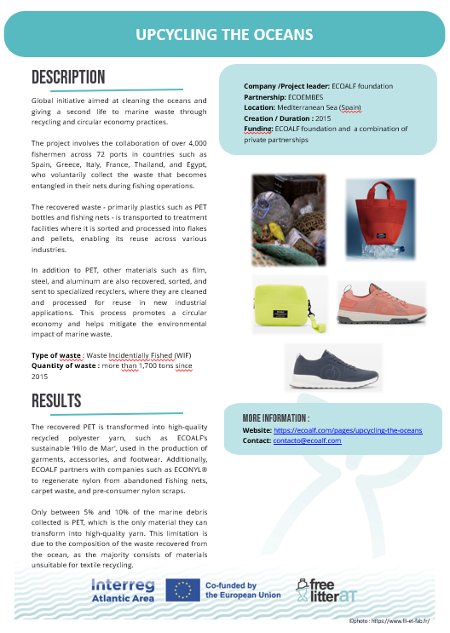
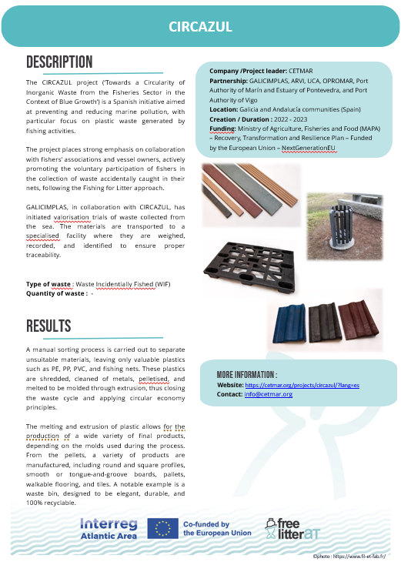
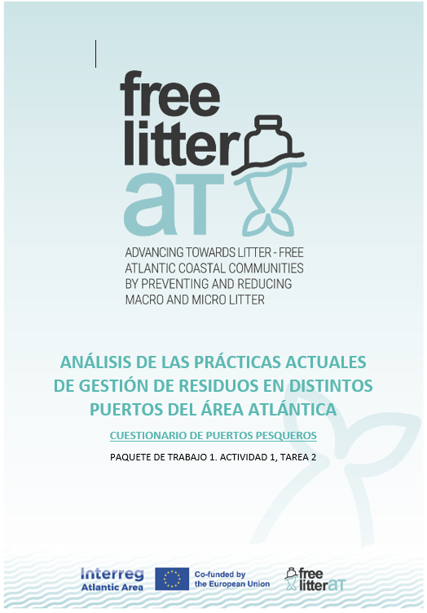
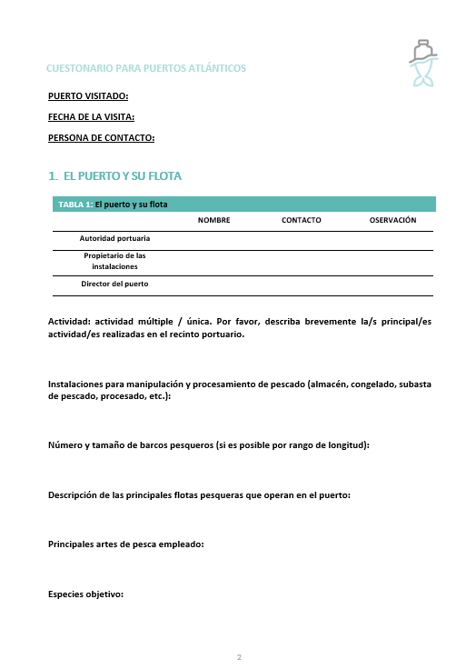
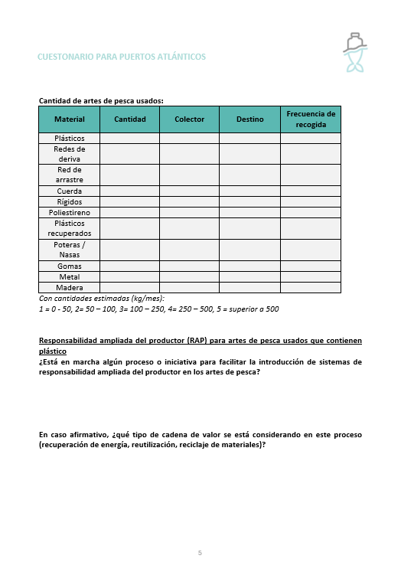
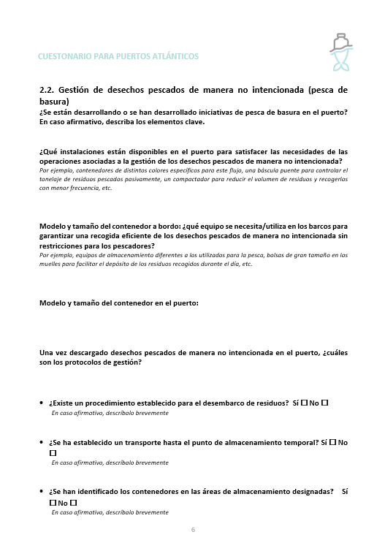
Analysis of current plastic waste management practices in ports
Consultation process with ports
1
2
Informative factsheets
from ports
3
Factsheets
Inspiring initiatives
Port surveys
(questionnaire)
Facilities and equipment
Management of EOLFG
Management of PFW
Drawbacks (APFVU y PFW)
Good practices
Planning for the future

Slide 8
Analysis of current plastic waste management practices in ports
Consultation process with ports
1
No common approach: great differences on waste management between ports and between regions. Differences in allocated resources and equipment
Some ports more advanced on dealing with PFW and others on EOLFG.
PFV tackled by “Fishing for litter” initiatives in many ports, mostly supported by projects.
Ports may facilitate container and/or space to place them and waste management. Difficulties to keep adequate use of skips and containers.
Need of training and awareness raising activities with fishermen and port users
Port surveys
(questionnaire)
2
Informative factsheets
from ports
3
Factsheets
Inspiring initiatives
Facilities and equipment
Management of EOLFG
Management of PFW
Drawbacks (APFVU y PFW)
Good practices
Planning for the future
Key findings PFW

Slide 9
Analysis of current plastic waste management practices in ports
Consultation process with ports
1
No common approach: great differences on waste management between ports and between regions. Differences in allocated resources and equipment
Some ports more advanced on dealing with PFW and others on EOLFG.
PFV tackled by “Fishing for litter” initiatives in many ports, mostly supported by projects.
Ports may facilitate container and/or space to place them and waste management. Difficulties to keep adequate use of skips and containers.
Need of training and awareness raising activities with fishermen and port users
Port surveys
(questionnaire)
2
Informative factsheets
from ports
3
Factsheets
Inspiring initiatives
Facilities and equipment
Management of EOLFG
Management of PFW
Drawbacks (APFVU y PFW)
Good practices
Planning for the future
Key findings PFW
Basic management of PFW on a routine basis complying PRF, that may be reinforced with characterization and valorization activities with support of FfL projects

Slide 10
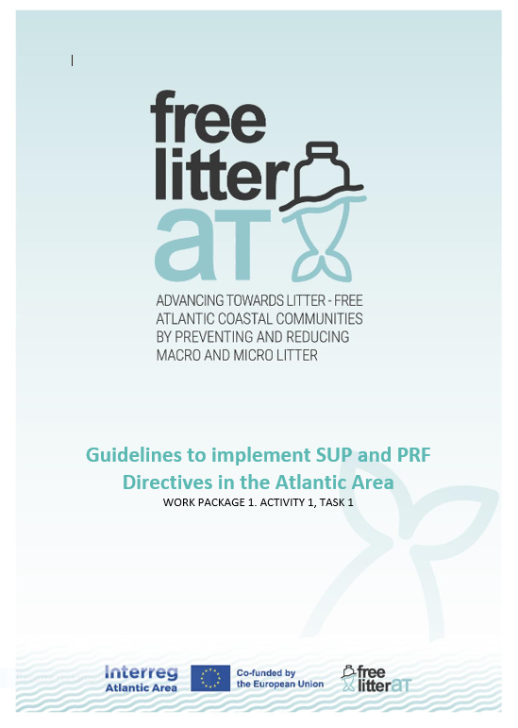
Analysis of current plastic waste management practices in ports
Consultation process with ports
1
2
Informative factsheets
from ports
3
Factsheets
Inspiring initiatives
Port surveys
(questionnaire)
Facilities and equipment
Management of EOLFG
Management of PFW
Drawbacks (APFVU y PFW)
Good practices
Planning for the future
https://goodpractices.freelitterat.eu/

Slide 11
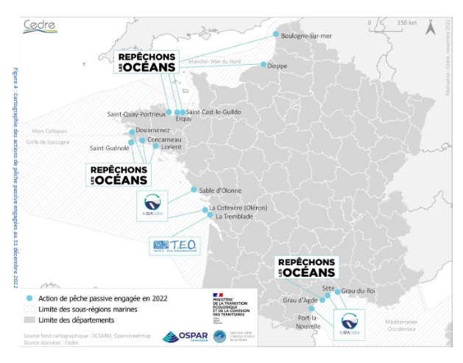
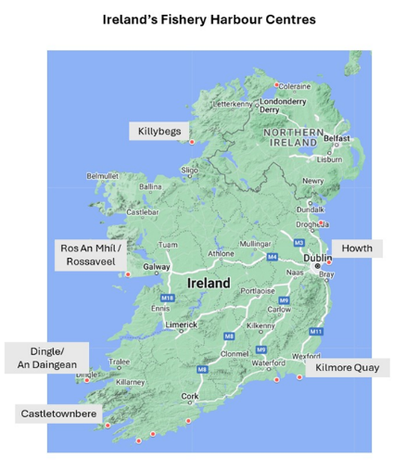
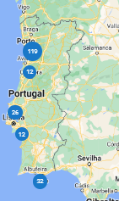
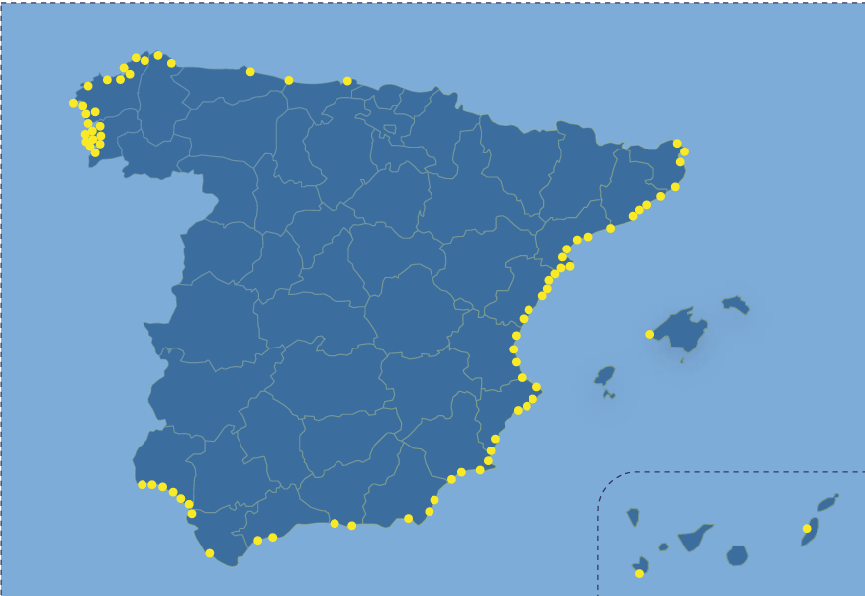
Analysis of the Fishing for Litter capacity
General criteria
for Fishing for Litter (MITERD)
Fishing for litter projects in all the countries with huge variation in the coverage and implementation of the scheme on the ground
Scheme linked to specific projects and only in few cases incorporated as routine operation within the waste stream management process of the ports
The schemes may cover all or some parts of the process: collection, quantification, characterization and valorization
Common challenges:
  Difficulties to keep this waste separated from other waste streams. PFW often mixed with galley waste. Misuse of containers
  Marine litter characterization and valorization have to be supported by project/coordinating organization
  Recycling or valorization very challenging (low amounts, heterogeneity, segregation costs, etc)
  Difficulties to keep the fishermen involvement and frustration when the FfL project reaches its end
Fishing for litter projects have been/will be crucial to paving the way for implementation of PRF requirements related to PFW

Slide 12

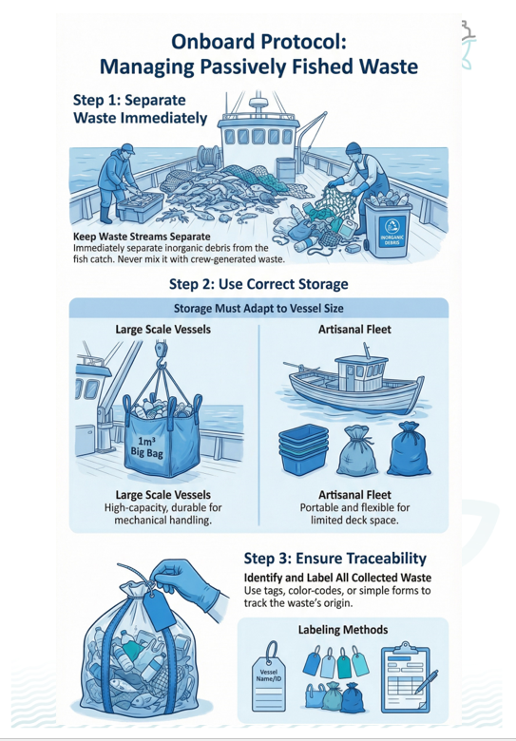
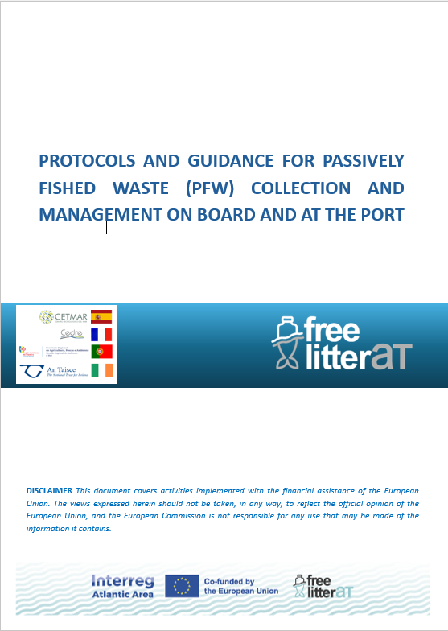
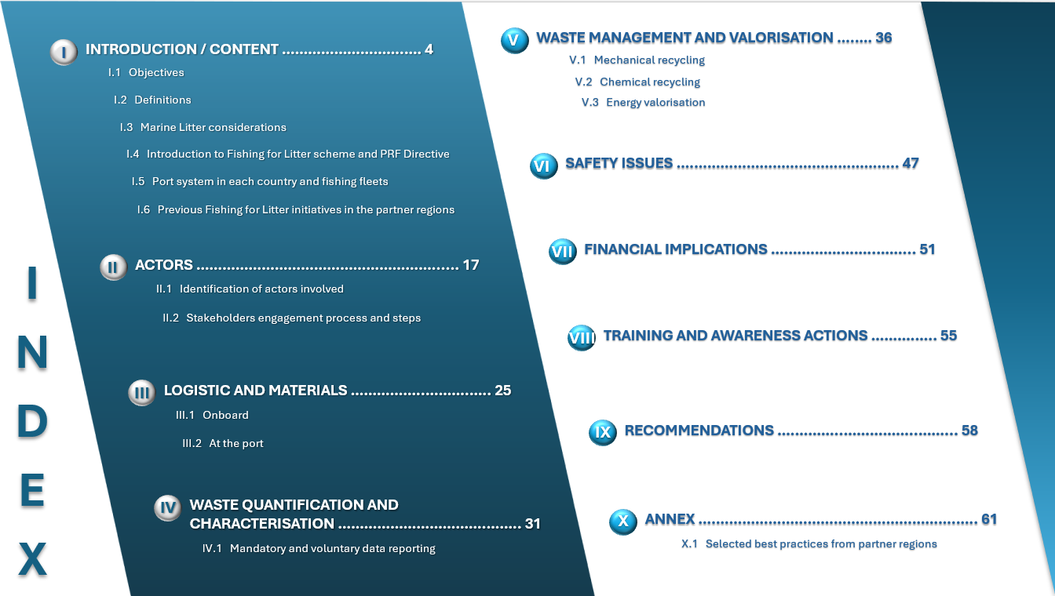
Development of guidance and recommendations
Partner information
Review of guidelines
Review of waste treatment options
  Port systems, fishing fleets and FfL initiatives
  Capture key lessons from experiences on partner regions
  Exchange with partners
  Port Questionnaires
  General criteria document for Fishing for Litter
  KIMO Guidelines for FfL and for PRF Implementation
  Marelitt project Toolkit: Marine litter retention
  Technical reports
  Availability of local facilities for waste treatment and recycling
  Mechanical and/or chemical recycling of plastic fraction
  Energy valorisation
  Recycling initiatives from projects (PET, PA, etc)
Building on:
Guidelines for PFW management in compliance with PRF
I)Detailed guidance on key information
II) Operational guidelines
III) Factsheets illustrating key steps
Training Package

Slide 13
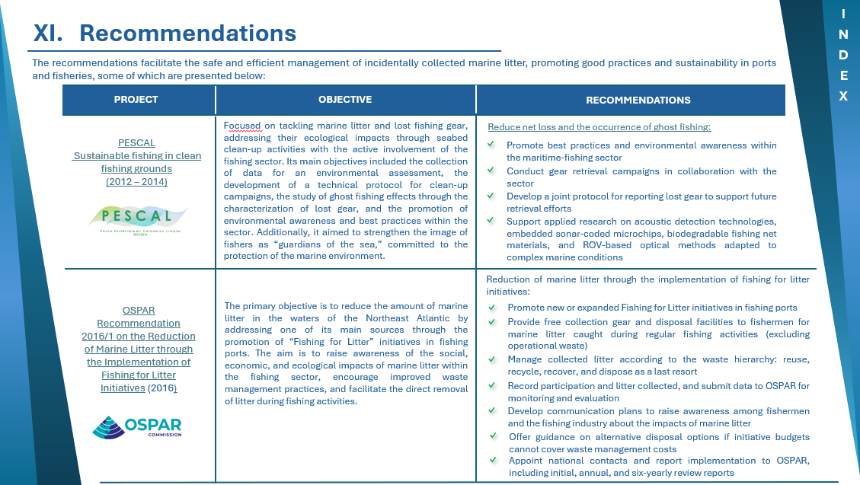
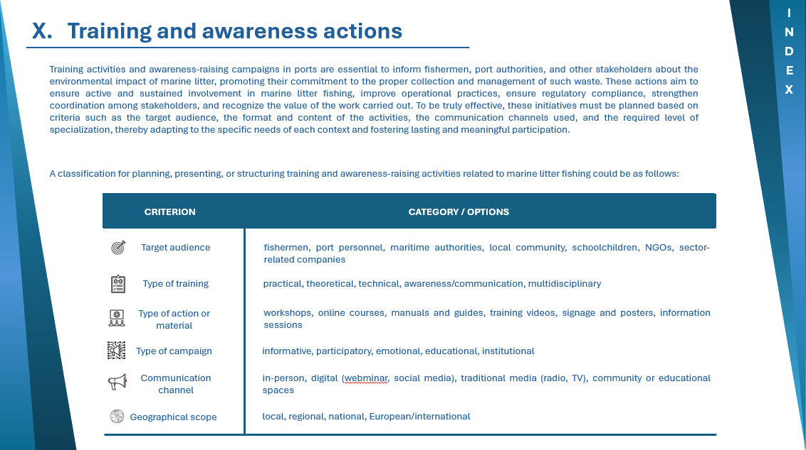
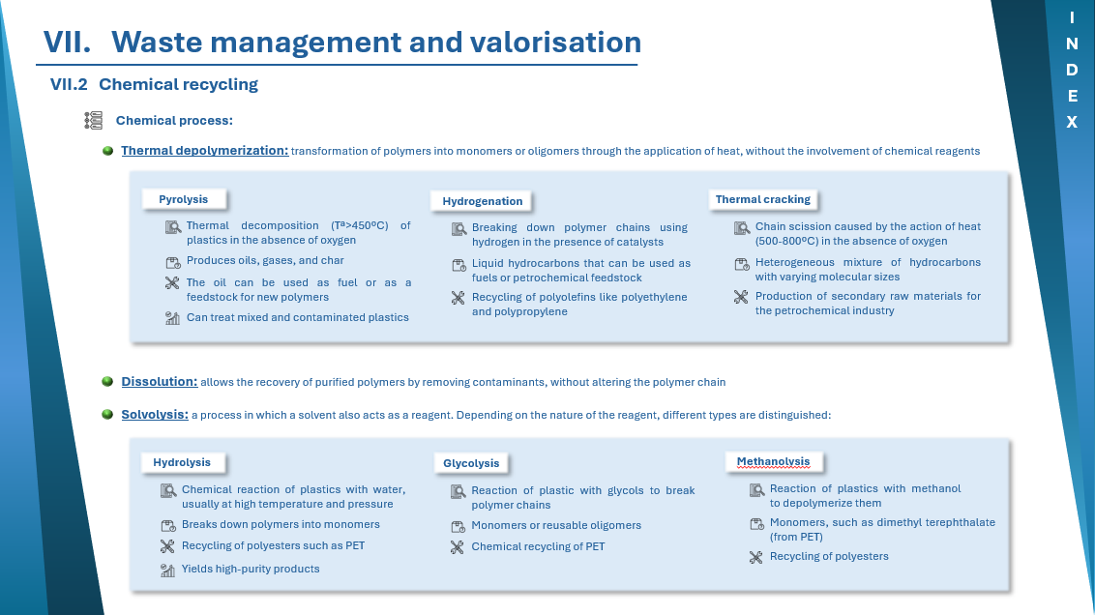
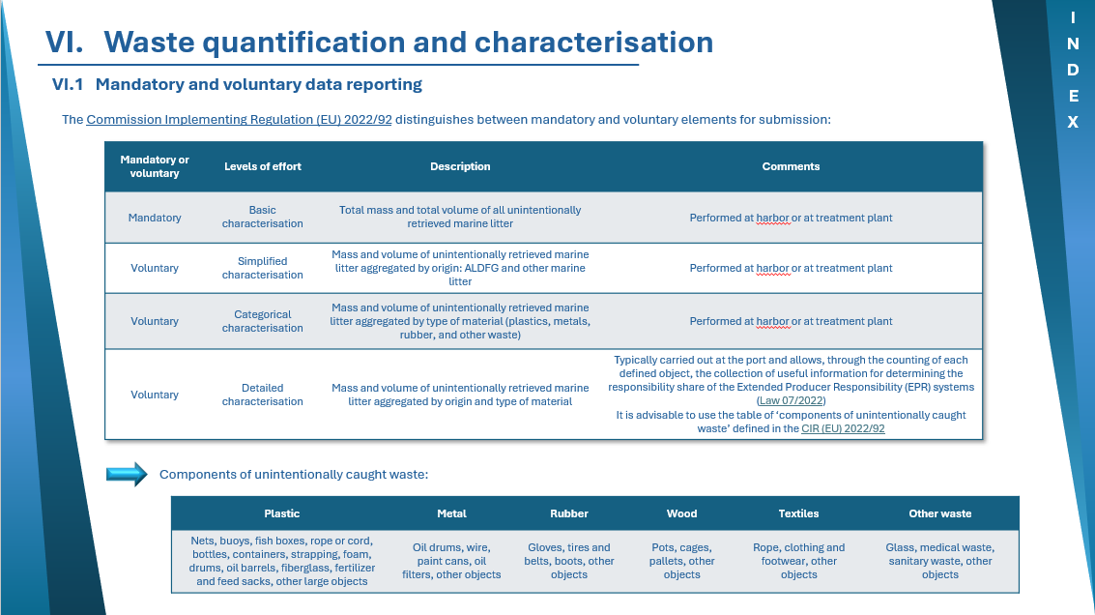
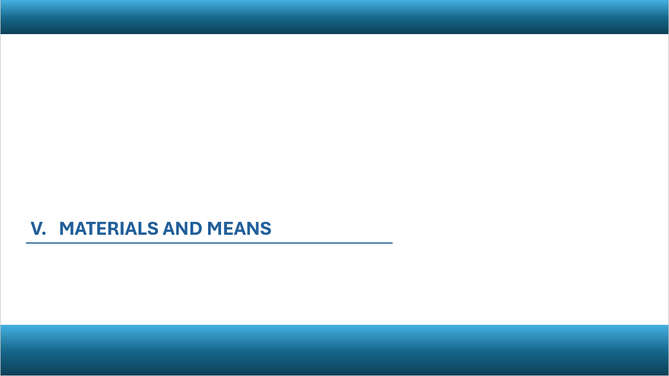
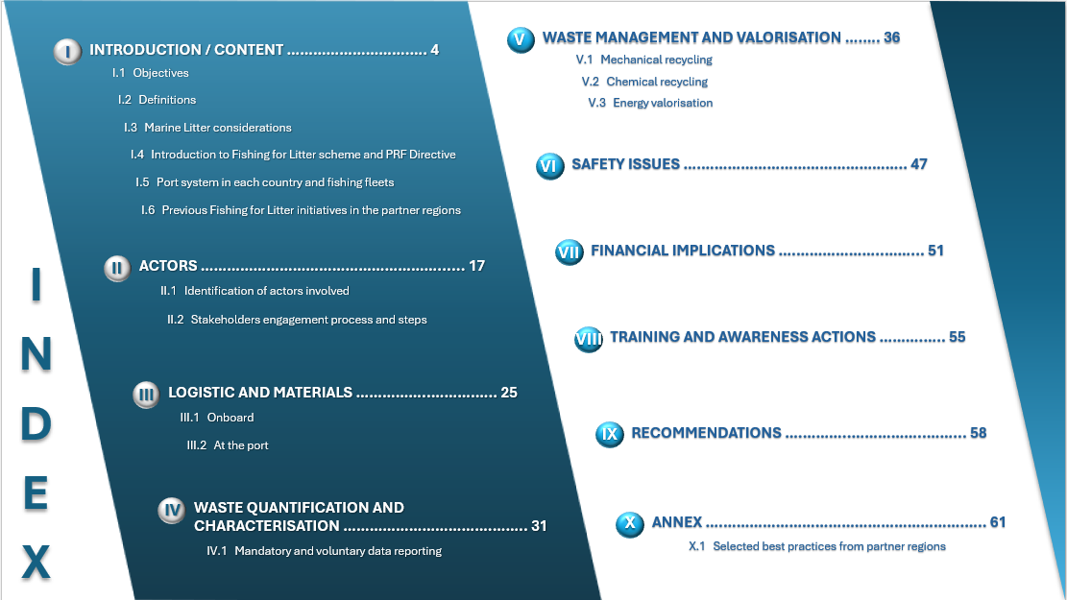
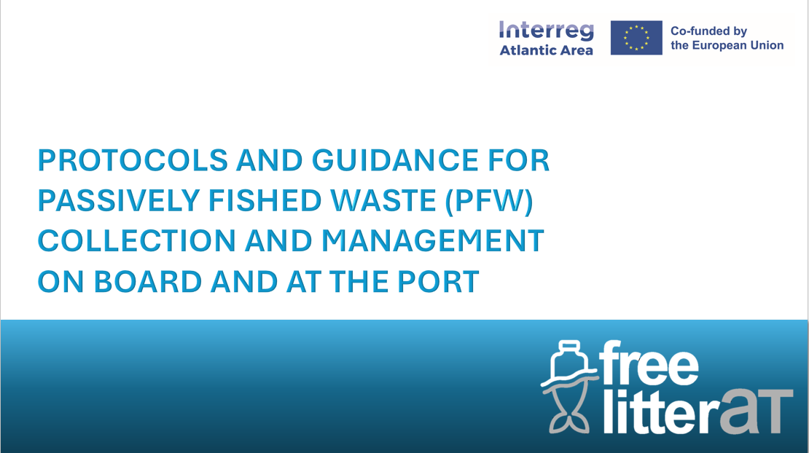

I) Development of detailed guidance for passively fished waste collection and management on board and at the port
Training package (I):
- Detailed e-guidance
Main characteristics:
✓
comprehensive but simple
By clicking on the specific section, the contents are accesible
✓
straightforward
✓
user-friendly
✓
user-oriented
✓
interactive

Slide 14
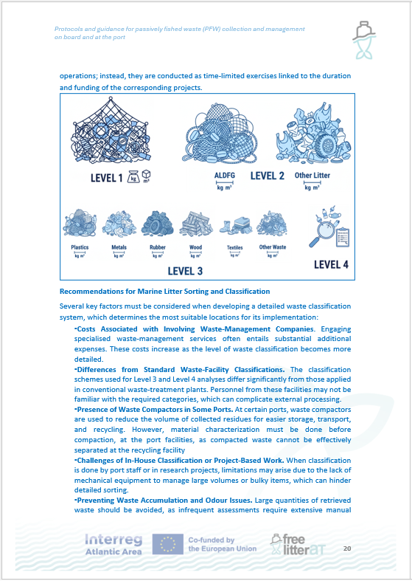
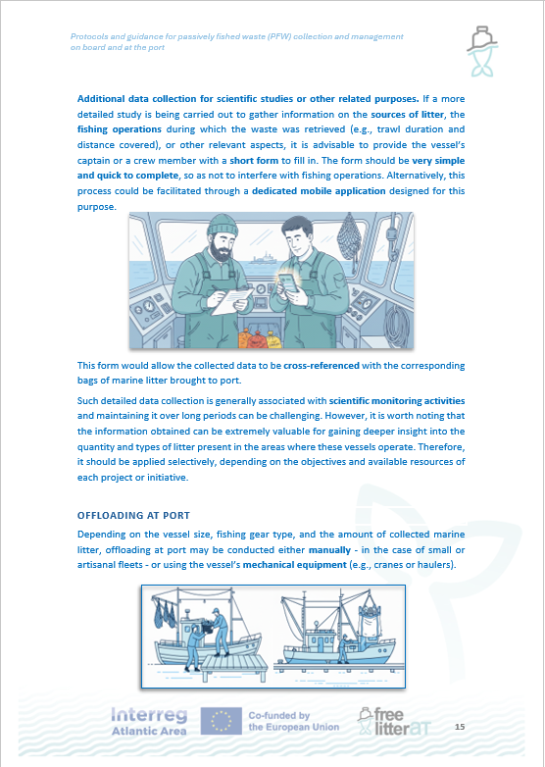
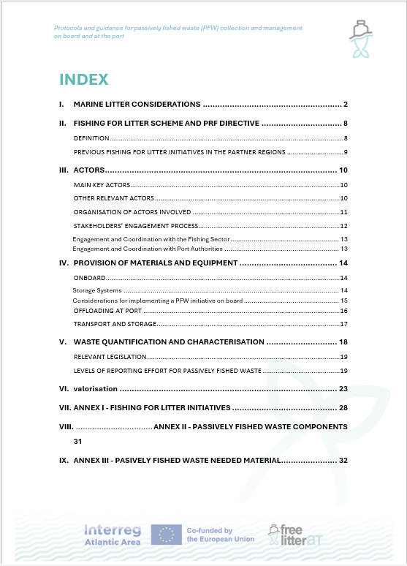
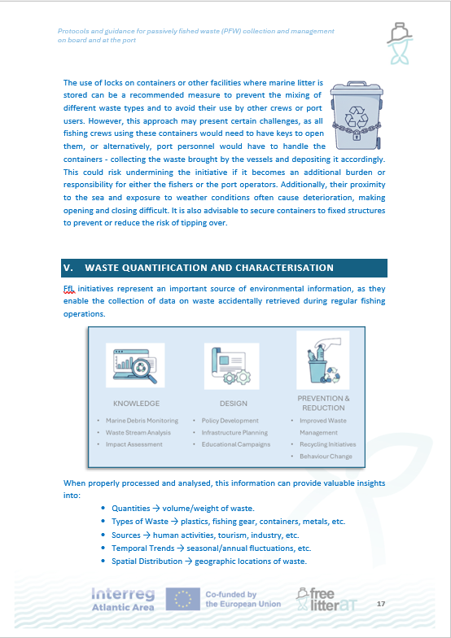
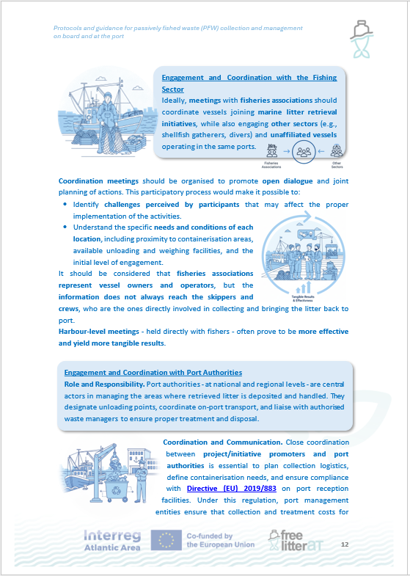
II Operational guidance for passively fished waste collection and management on board and at the port
Training package (II)
- Operational guide

Slide 15
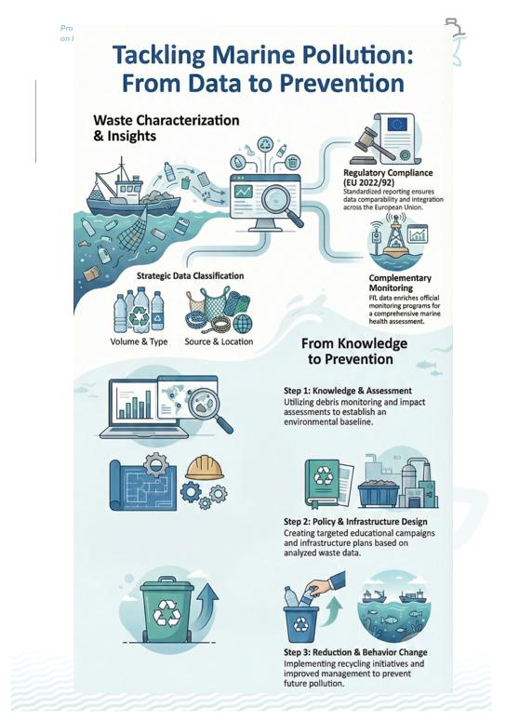
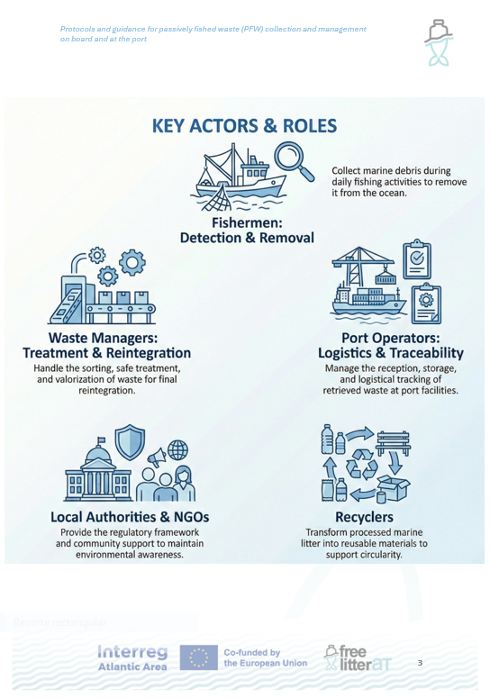
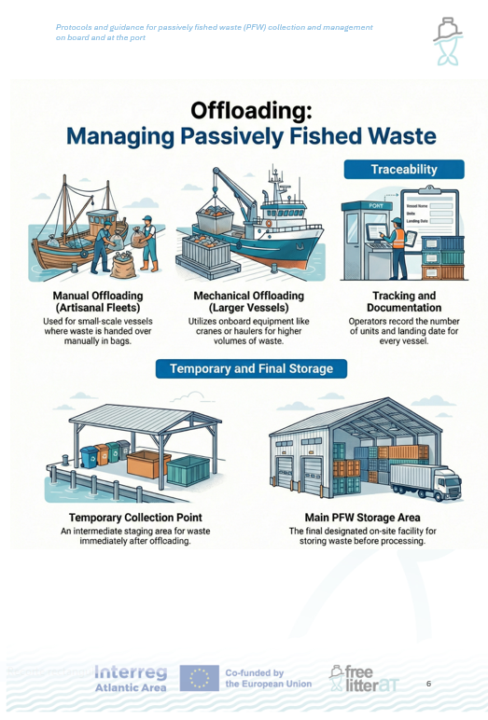
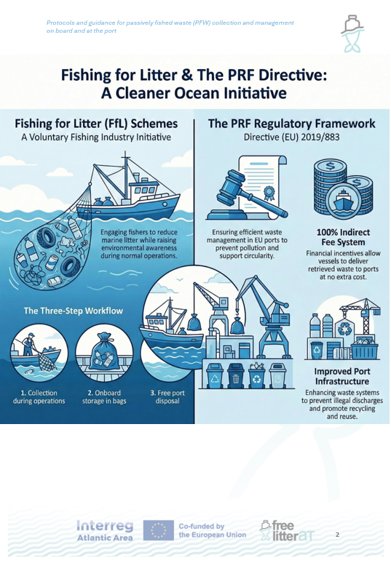
III) Factsheets illustrating key steps for passively fished waste collection and management on board and at the port
Training package (III) :
- Factsheets key steps

Slide 16







Deliverables / Pilot Actions / Workshops - WP1
Main deliverables
2 Webinars
SUP y RAP (13/10/25)
PRF y FfL (6/02/26)
Guidelines for the implementation of SUP and PRF requirements
Inventory of good practices for waste management
Guidelines for implementing the management of PFW in line with PRF (training package)
https://goodpractices.freelitterat.eu/
Life cycle assessment studies of fishing nets
Innovative recycling processes
Socio-economic study on promoting the reduction of marine litter
4 Workshops
Local Workshops (March - May 2026)
4 Pilot actions
Objective: Test and implement good practices of waste management
SUP y RAP
PRF y FfL
https://goodpractices.freelitterat.eu/

Slide 17





CONTACT:
FOLLOW US IN:
Project Coordination team
Centro Tecnológico del Mar - Fundación CETMAR
freelitterat@cetmar.org
www.freelitterat.eu
X: @FreeLitterAT
Instagram: @frelitterat
Web site: www.freelitterat.eu
THANKS FOR YOUR ATTENTION !

