Slide 1

Single-Use Plastics Directive (EU) 2019/904
Free litter AT webinar – 13 November 2025
Rodrigo Ataíde Dias
European Commission, DG MARE

Slide 2
Outline
Background of the SUP Directive
Main provisions of the SUP Directive and links to other relevant provisions
Implementation of the SUP Directive

Slide 3

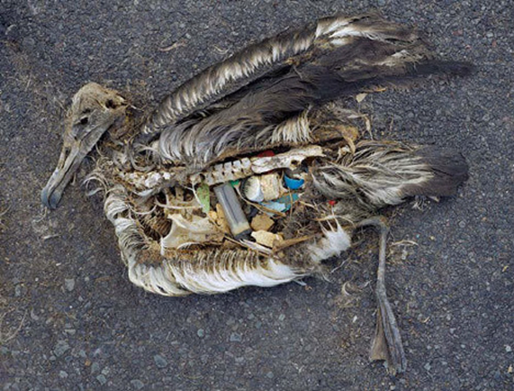
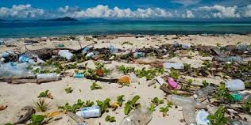
Marine Litter: The Challenge
Health concerns
Degradation of marine ecosystems
Impact on fisheries and aquaculture and ports/shipping
Tourism and coastal communities
a

Slide 4



SUPD: Context
The
European
Green
Deal
Improving the economics and quality of recycling & curbing plastic waste & littering
Maintaining the value of products, materials and resources in the economy for as long as possible, & minimising the generation of waste
A climate-neutral, resource-efficient and competitive economy

Slide 5
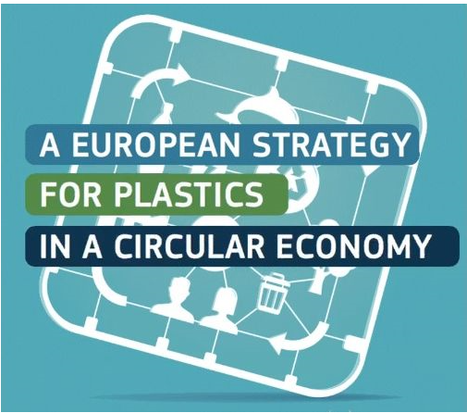
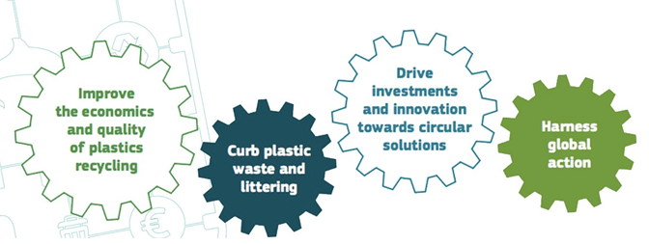
SUPD: Context
Foundation of SUPD in the European Plastics Strategy in 2018
COM proposal in May 2018, adopted by Council & Parliament in June 2019
Objectives:
      - prevent & reduce negative impact of certain plastic products on the (marine) environment and on human health
      - promote the transition to a circular economy
      - contribute to the efficient functioning of the internal market

Slide 6
SUPD: Approach
Most found marine litter items on European beaches (count)
SUPD covers 70% marine litter: top 10 SUP items (43%) + fishing gear (27%)

Slide 7
Top 10 SUP items
Ranking | Item
1 | Drinks bottles, caps and lids
2 | Cigarette butts
3 | Cotton buds sticks
4 | Crisp packets / sweet wrappers
5 | Sanitary applications
6 | Plastic bags
7 | Cutlery, straws and stirrers
8 | Drinks cups and cup lids
9 | Balloons and balloon sticks
10 | Food containers including fast food packaging

Slide 8
Outline
Background of the SUP Directive
Main provisions of the SUP Directive and links to other relevant provisions
Implementation of the SUP Directive

Slide 9







Different SUP products – different measures
items with available sustainable alternatives
promote less harmful alternatives:
market bans
prevention measures: design requirements, consumption reduction, consumer information
items with no clear alternatives
better waste management: separate collection, extended producer responsibility + clean-up

Slide 10
Measures
Art. 4: Consumption reduction
Art. 6: Product design requirements
Art. 7: Marking requirements
Art. 8: Extended producer responsibility
- including for fishing gear => costs of awareness raising, separate collection of waste FG, transport and treatment
- MS minimum collection rates of fishing gear containing plastic for recycling
- MS reporting obligations of FG placed on the market and waste FG collected
- harmonised standard for the circular design of fishing gear => encourage recyclability
Art. 9: Separate collection targets
Art. 10: Awareness raising
  - provide information to consumers including on fishing gear on availability of reusable alternatives, waste management options & impact of littering

Slide 11
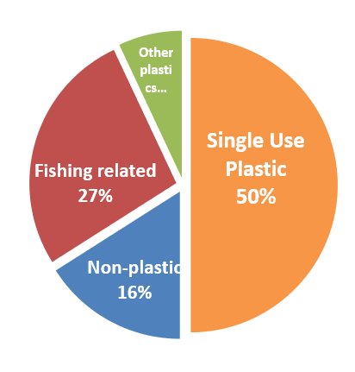
Directive on the reduction of the impact of certain plastic products on the environment (EU)2019/904
focuses on top 10 single-use plastic products and fishing (commercial and recreational) and aquaculture gear that are considered as significant contributors to marine debris
‘Fishing gear’: means any item or piece of equipment that is used in fishing or aquaculture to target, capture or rear marine biological resources or that is floating on the sea surface, and is deployed with the objective of attracting and capturing or of rearing such marine biological resources (commercial & recreational fishing gear and aquaculture gear and equipment)
                = 27% of marine litter in the EU, ~11,000 tons of fishing gear lost at sea every year in the EU (Eunomia, 2017)
                = Globally: estimates range from 640,000 tons (National Geographic, 2016) to 1.15 million tons of lost and discarded fishing gear per year (Montarsolo et al., 2018)
Measures on fishing gear under Directive (EU)2019/904:
Extended producer responsibility schemes for producers of fishing gear – to finance the collection, transport, treatment, awareness raising measures
Reporting requirements – amounts placed on the market and amounts collected as waste
MS to set national annual collection targets for fishing gear for recycling
CEN harmonised standard for a circular design of fishing gear
Alignment with the Port Reception Facilities Directive (EU)2019/883:
100 % indirect fee = bring all waste to port, including fishing gear, without any additional fees
Obligation to separately collect fishing gear in ports

Slide 12
Port Reception Facilities Directive (2019/883)
  Main provisions:
  to set up adequate port reception facilities
  delivery of waste from all ships before departure (incl. fishing vessels)
  cost Recovery system based on the 100% indirect fee
  specific focus on marine litter from ships, incl. waste from fishing vessels, waste fishing gear and passively fished waste > separate collection of waste
  EU implementing regulation laying down rules as regards monitoring data methodologies and the format for reporting passively fished waste (EU) 2022/92
  Annex 4 Categories of costs and net revenues related to the operation and administration of port reception facilities – incl. net financial benefits provided by EPR schemes, and other net revenues from waste management and recycling & complementary funding (EMFAF)

Slide 13
Revised fisheries control regulation 2023/2843
Mandatory gear marking
Improved recording of fishing gear and measures for reporting lost gear
Procedures for masters to notify their end-of-life fishing gear and return it to port reception facilities

Slide 14
  EMFAF & Fishing for litter schemes support
EMFF - 2014-2020
  At least 14 coastal MS committed in their OPs to the collection of marine litter
  108 operations planned in the OPs by 2023 worth €50 million, of which more than €30 million from the Fund
EMFAF - 2021-2027
  Art. 25 (2) a&b - financial support for passive collection by fishers of lost fishing gear and marine litter from the sea and for investments in ports to provide adequate reception facilities for lost fishing gear and marine litter
synergies with SUP and PRF Directives & close links with objectives (PRF investment, separate collection, PFW, marine litter and fishing gear collection

Slide 15
Outline
Background of the SUP Directive
Main provisions of the SUP Directive and links to other relevant provisions
Implementation of the SUP Directive

Slide 16
Secondary legislation & guidelines
  Guidelines
    on SUP products (Commission Notice 2021/C 216/01)
    on costs of cleaning up litter (EPR)
  Standardisation requests
    tethered caps and lids (Art. 6(1)) (EN 17665:2022+A1:2023)
    circularity of fishing gear (Art. 8(9)) (EN 17988, 2024)
  Implementing acts
    Implementing Regulation (EU) 2020/2151 on marking requirements
    Implementing Decision (EU) 2021/958 on fishing gear placed on the market and waste fishing gear collected
    Implementing Decision (EU) 2021/1752 on the separate collection of SUP beverage bottles
    Implementing Decision (EU) 2021/2267 on post consumption waste of tobacco products with filters
    Implementing Decision (EU) 2022/162 on consumption reduction for food containers & cups for beverages
    Implementing Decision (EU) 2023/2683 on recycled plastic content in SUP beverage bottles (amendment in progress)

Slide 17
Transposition by Member States
  MS had to transpose the SUP Directive into national laws and regulations by 3 July 2021
  COM is monitoring the transposition

Slide 18
Reporting by Member States to COM
Member States report to COM :
Cups for beverages & food containers placed on the market
Measures to reduce consumption of CfB & FC
Separate collection of beverage bottles
Fishing gear placed on the market & waste fishing gear collected
    - In 2024 MS reported the first figures (for reference year 2022) of fishing gear placed on the market and waste fishing gear separately collected => Commission report (2025) on the implementation of SUPD.
Recycled content in beverage bottles
Post-consumption waste of filters for tobacco products

Slide 19
Evaluation of the SUP Directive
COM will evaluate SUPD by 3 July 2027 and review
SUP products listed in the different parts of the Annex
feasibility to set quantitative consumption reduction targets for food containers and beverage cups and establish binding collection rates for fishing gear
assessment of the change in materials and consumption
assessment of progress for a standard on biodegradability of SUP in the marine environment
an assessment whether additional SUP products, should be covered under the SUPD to achieve its objectives more effectively.

Slide 20

Thank you
© European Union 2025
Unless otherwise noted the reuse of this presentation is authorised under the CC BY 4.0 license. For any use or reproduction of elements that are not owned by the EU, permission may need to be sought directly from the respective right holders.

