Slide 1

General criteria for Fishing for Litter in Spain
Free LitterAT Webinar
Fishing for Litter in the frame of PRF Directive:
Experiences and challenges in the Atlantic Area
6 February 2026

Slide 2

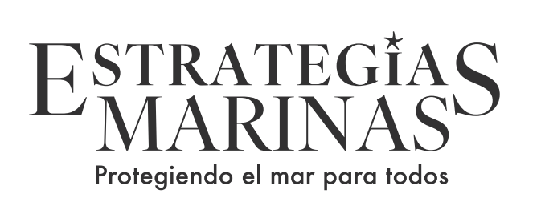

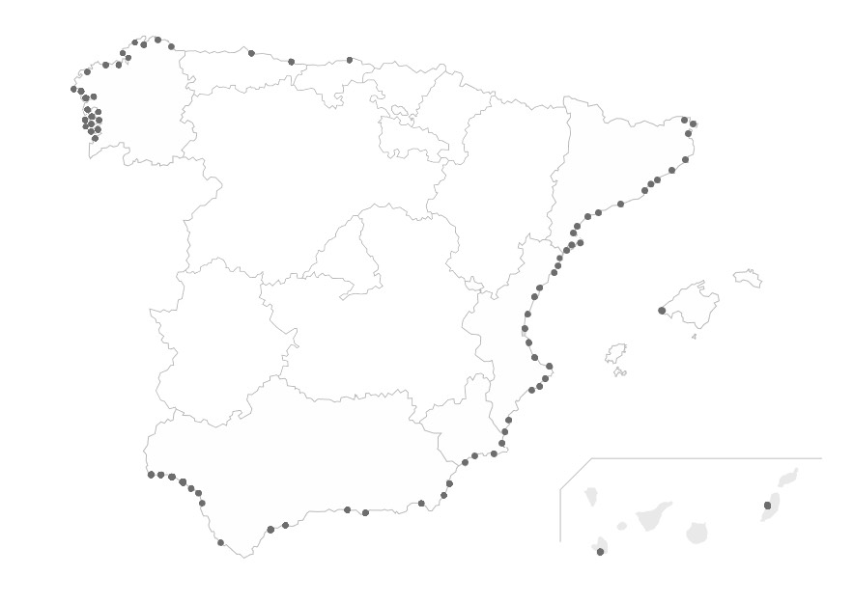
Fishing for Litter in Spain
  Fishing for Litter started in Spain in 2009 and has significantly increased since then. It is considered a Best Practice, involving fishers in marine protection.
  Independent actions, not harmonized: Usefulness of general technical criteria.
  The professional bottom trawling fishing fleet is the greatest ally. It is necessary to involve all stakeholders: Participation Strategy.
  The characterization of the collected waste provides valuable information, complementary to the D10 monitoring programme. Usefulness of a national data collection DB.
  Long-term sustainability: financing options
  Legislative framework: Directive (EU) 2019/883: PRF Directive

Slide 3
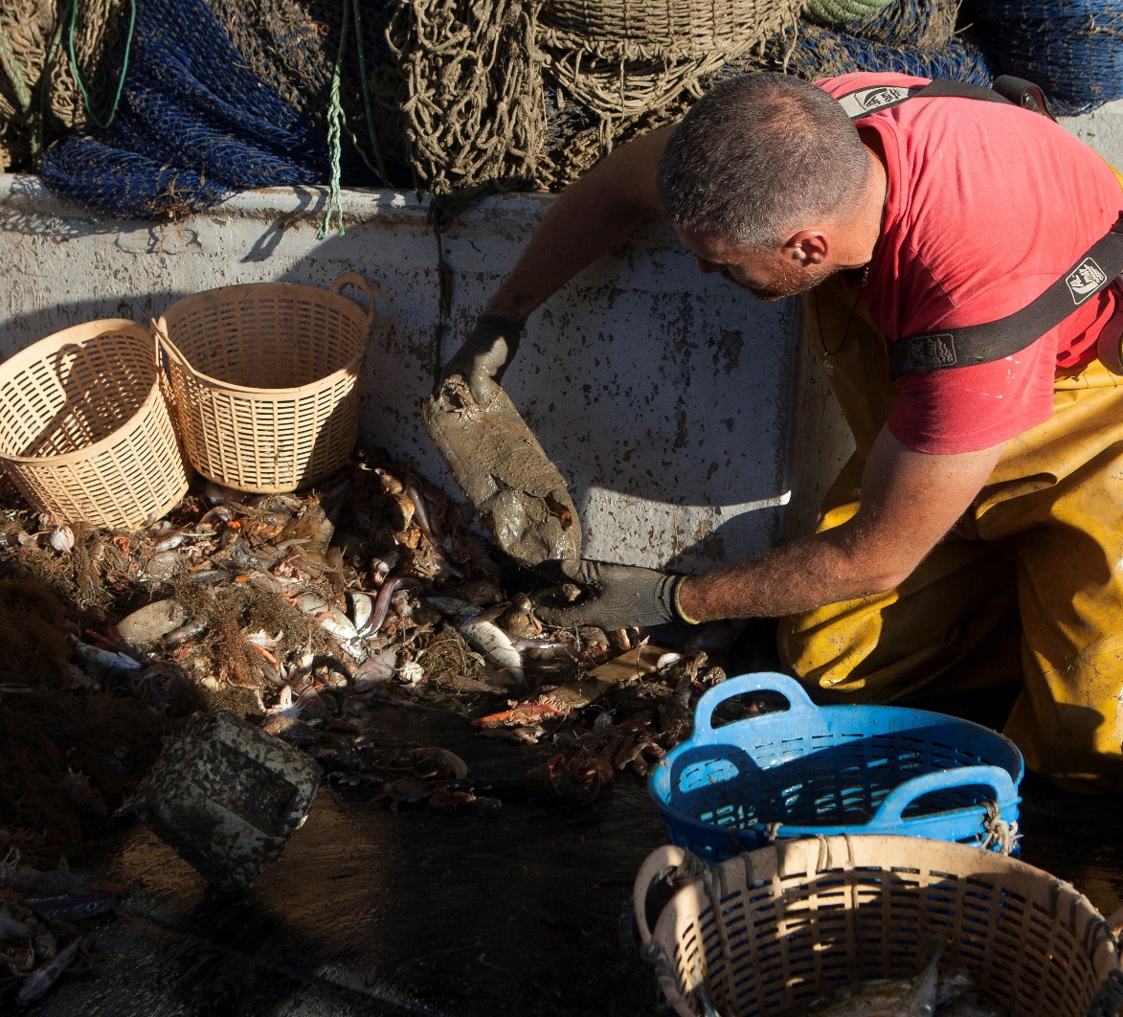

Factsheet “INTEMARES Caladeros limpios”
Duration: May 2021 – May 2023
Titile: Activities for the development of common guidelines for fishing for litter and implementation of a pilot project to test their effectiveness in the Natura 2000 marine network.
Objective: Harmonized scheme under common criteria while respecting the identity of ongoing projects
Contractor:
Budget: 255.126,08 €
Partner: National Federation of Fishermen's Guilds
Part of the Marine Strategies Programme of Measures (2022-2027)
Source: Mares Circulares project

Slide 4
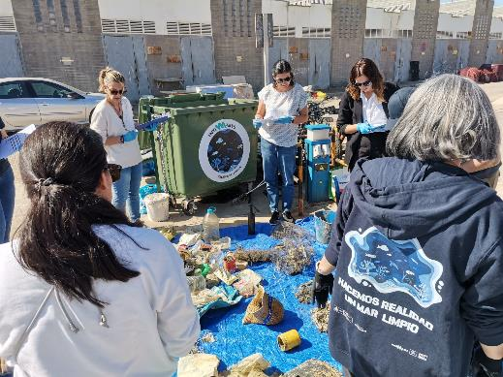
Project actions
General criteria document for fishing for litter: Folleto intemares IN2
National database for fishing for litter activities (to facilitate the national biannual report to the EC and the national report to OSPAR)
Development of 2 demonstration actions in Fuengirola and Camariñas (to test and adjust the general criteria document)
Communication and raise-awareness

Slide 5
1st Challenge: DEVELOPMENT OF A PARTICIPATION PROCESS
Preliminary discussion in sectoral groups (July and September 2021): 86 participants in 5 stakeholder meetings
First draft On-Line consultation (from 17 January to 15 February 2022)
Webinar on database and reporting: 25 participants, port representatives
Intercalibration workshop (on data template and data collection) (March 2023): 11 participants.
Final draft discussion - Multi-stakeholder workshop (Spring 2023): all stakeholders represented.
Key stakeholders
• Fishermen
• Technical experts
• Fisheries administrations
• Ports
• Waste managers
2021
2022
2023
Base de datos + Acciones demostrativas
Inicio
de los
trabajos
Reuniones sectoriales
Primeros borradores del documento de criterios
Consulta online a sectores
Webinar base de datos y
Taller caracterización
Taller multisectorial para la validación del borrador
Análisis de la información
Segundo borrador
Tercer borrador
Publicación
May.
Jul. a Sept.
Oct. – Dic.
Ene. Feb.
Feb.- Mar.
Abr.
Jun.

Slide 6
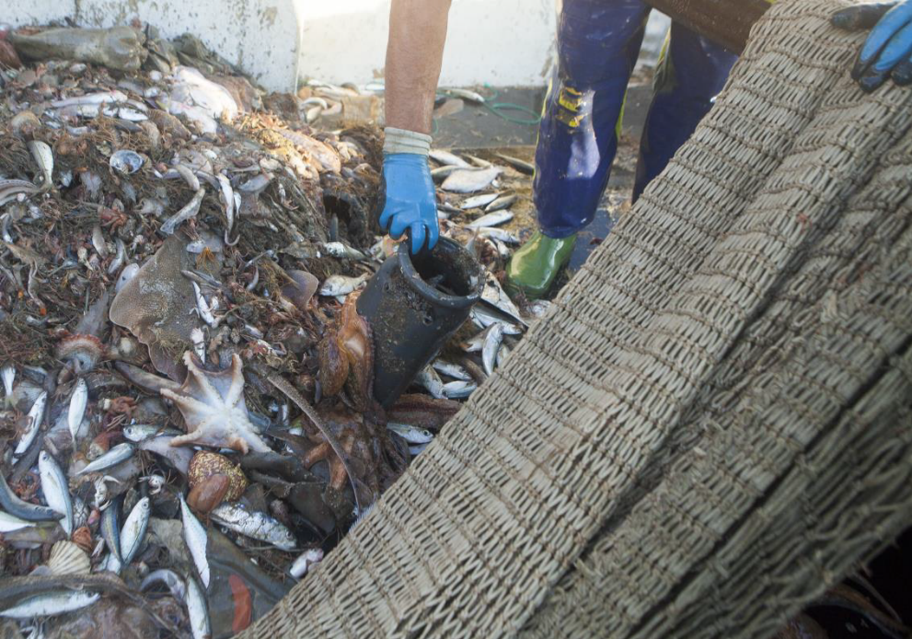
General criteria document for fishing for litter
  Objective: to design the foundations for the development of a common fishing for litter scheme in Spain.
  Scope:
            - The document refers solely to fishing for litter activities that are carried out voluntarily (passive FfL).
  *The above does not prevent the development of specific active fishing for litter activities aimed at removing particular marine debris (for example, lost gear) and/or in previously identified accumulation areas, but they are not considered in this document.
  - The fishing fleets that can be part of the scheme may be at industrial level (bottom trawling) or artisanal fleets (longline, seine net, etc.), although the use of gillnets, hook-based gear, or traps will also be encouraged to the same extent. It can also be adapted to other extractive activities such as shellfishing (on foot or from a boat), seaweed harvesting, and professional divers working in fisheries such as the harvesting of certain mollusks, etc.

Slide 7
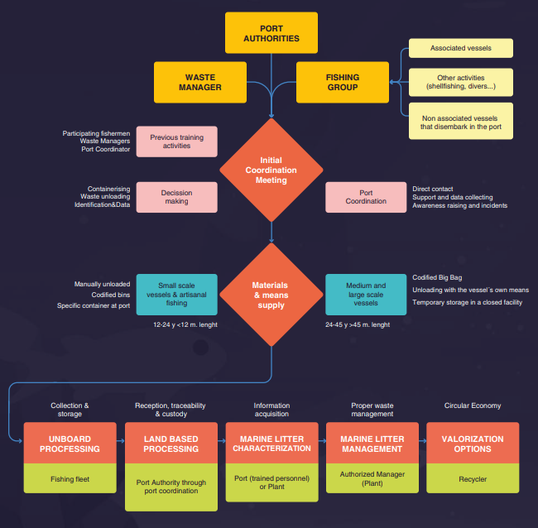

Slide 8
ROYAL DECREE 128/2022, of February 15, on port facilities receiving ship waste
Article 20. Monitoring of unintentionally fished waste.
1. The port management entities will collect monitoring data on the volume and quantity of unintentionally fished waste and report it to the Directorate General for the Coast and the Sea of the Ministry for the Ecological Transition and the Demographic Challenge on an annual basis.
The methodology applicable to the monitoring data and the format of its communication will be those established in Commission Implementing Regulation (EU) 2022/92 of 21 January 2022, which lays down provisions for the implementation of Directive (EU) 2019/883 of the European Parliament and of the Council regarding the methodologies applicable to monitoring data and the format for reporting unintentionally fished waste.
2. The Directorate General for the Coast and the Sea shall transmit such monitoring data to:
a) The European Commission; and
b) The bodies responsible for the Regional Seas Conventions.

Slide 9
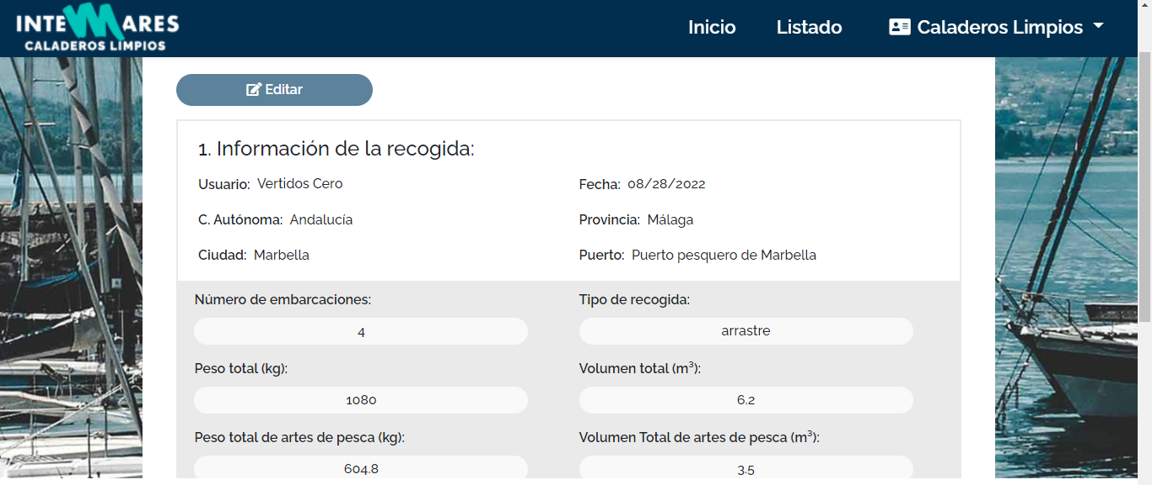
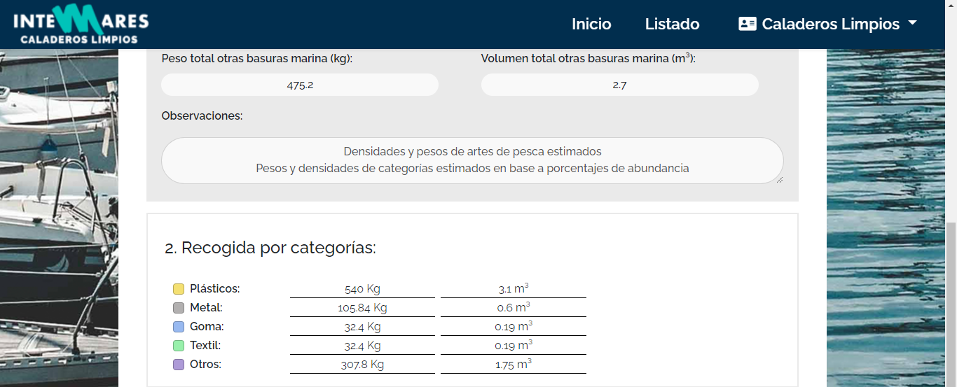
National Reporting System that is being used to gather data from ports and to report them into DONA.

Slide 10
CONCLUSIONS
  Waste management on land should be handled by the port management entity; however, these entities still do not have a specific hiring mechanism in place for the proper segregated collection of marine litter and its characterization.
  The locations of onshore collection points require an agreement between the fishing organizations involved and the port management entities. A location far from landing areas discourages their use.
  A continuous effort is needed to inform the fleet about the need of properly separating onboard generated waste from marine litter.
  Disaggregated data show that, to achieve circularity, the main workstream should be the search for options for the plastic fraction, with particular interest packaging, due to its quantity, and fishing gear, due to its weight.

Slide 11
CURRENT SITUATION
Method for collecting data: Data are obtained by a specific person with this role at the port. In ports with an ongoing Project (for example, Mares Circulares, Upcycling the Oceans, or others), this role is normally assumed by the project. In ports with no specific Project, this role is assumed by the Port Authority (as currently in Marín and Vigo ports).
Involvement of fishermen: Each initiative includes its own activities to involve local fishers. We estimate that around 1.200 fishers and 10% of the fishing fleet are already involved.
  Involvement of port authorities: They have the responsibility to report data to the Ministry. Training workshops in September and October 2024.
Mediterranean subregion: vessels are smaller, they fish closer to the coast and marine litter is higher in number of units but lower in weight = small objects related to land-based activities (single-use plastic objects derived from tourism and domestic consumption).
Atlantic subregion: vessels are larger, fishing at longer distances from the coast and for more days. Most of the litter is composed of large objects related to fishing activity.
 | European Commision (total Spain) | Spain Atlantic | Spain Mediterranean
2022 | 144,24 tn | 63,89 tn | 80,35 tn
2023 | 156,47 tn | 57,46 tn | 99,01 tn
2024 | 326,49 tn* | 75,74 tn | 250,75 tn

Slide 12
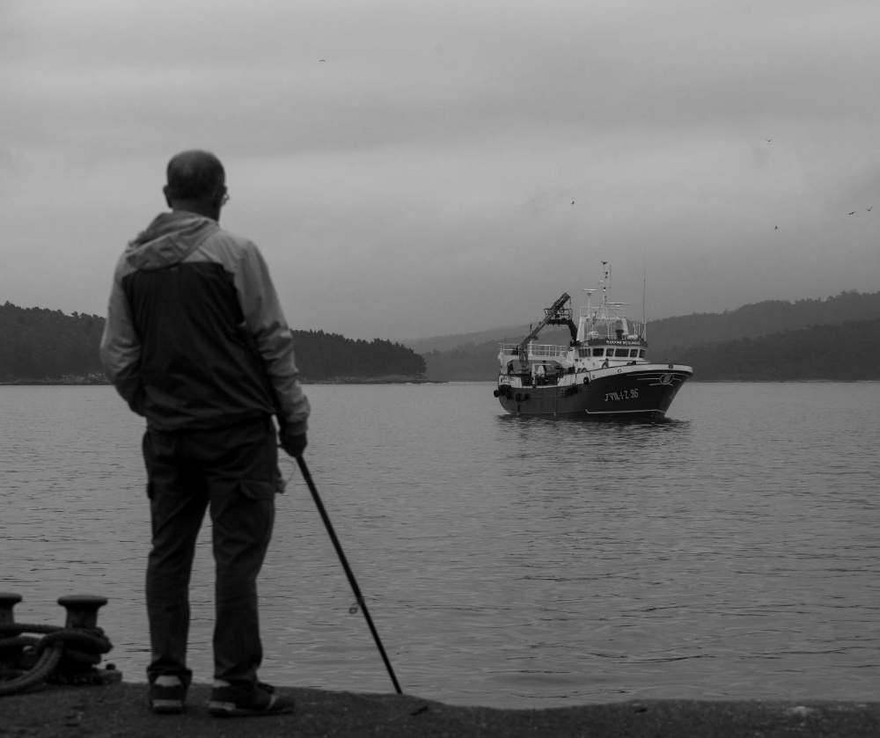
Thanks for your attention

