Slide 1
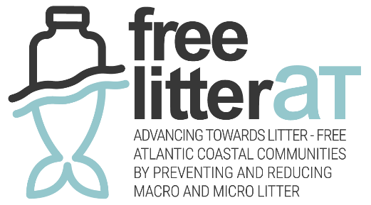
Webinar
13 November 2025
Tackling plastic pollution in the Atlantic Area: Moving forward in the implementation of the EPR for fishing gear

Slide 2
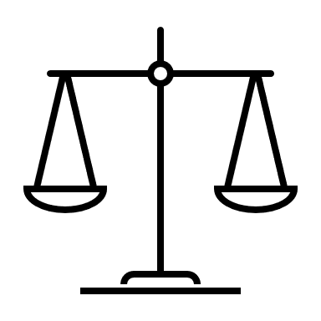

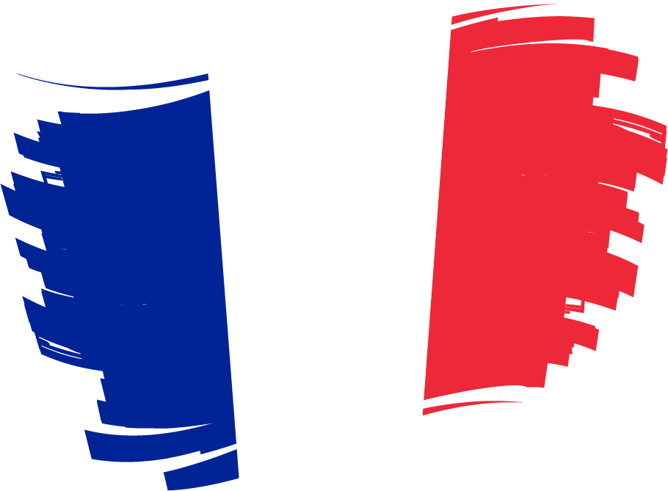
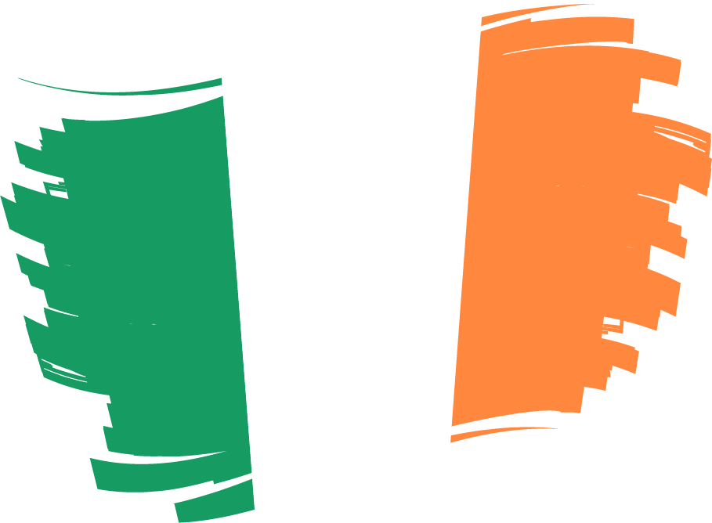
Free LitterAT : Analysis of relevant aspects for SUP and PRF implementation and current practices for waste management in different ports
Different stages of implementation of the regulations in the 4 countries involved in the project
France | The law of 10 February 2020 on the fight against waste and the circular economy (AGEC Act) introduces extended producer responsibility (EPR) for fishing gear containing plastic into article L. 541-10-1 of the Environment Code, with effect from 1 January 2025. Decree No. 2025-775 of 5 August 2025: amendments to the definitions of ‘placing on the market’ and "producers of single-use plastic products‘, as well as the definitions of ’fishing gear‘, ’fishing gear waste‘ and ’fishing gear producers", within the meaning of the SUP Directive. The French used fishing Gear EPR scheme is a voluntary scheme. There will be an agreement between the French Ministry for Ecological Transition and producer representatives. There is no collection rate established. 11 April 2025 : creation of the Aquapêche France association representing 5 main fishing gear producers. Organisation established to lead and bring together all initiatives to meet obligations to collect used fishing gear.
Ireland | To take legal effect in Ireland, the Directive was transposed into national legislation through SI No. 516 of 2021, as amended by SI No. 136 of 2022. Collection rate of 400 tonnes has been set for 2025. Jan – April 2025, DECC appointed Foster Environmental to manage scheme ‘Reel It Back’ (approx. 20 producers registered and collected data on fishing gear placed on the market during 2024) Interim PRO is currently being set up by producers called ‘Haul It Back’ to run scheme until the end of this year and a new application to operate a for Permanent PRO/EPR scheme is currently being considered. Work Plan includes, trials to determine best methods of dealing with end-of-life fishing gear and costs involved.

Slide 3
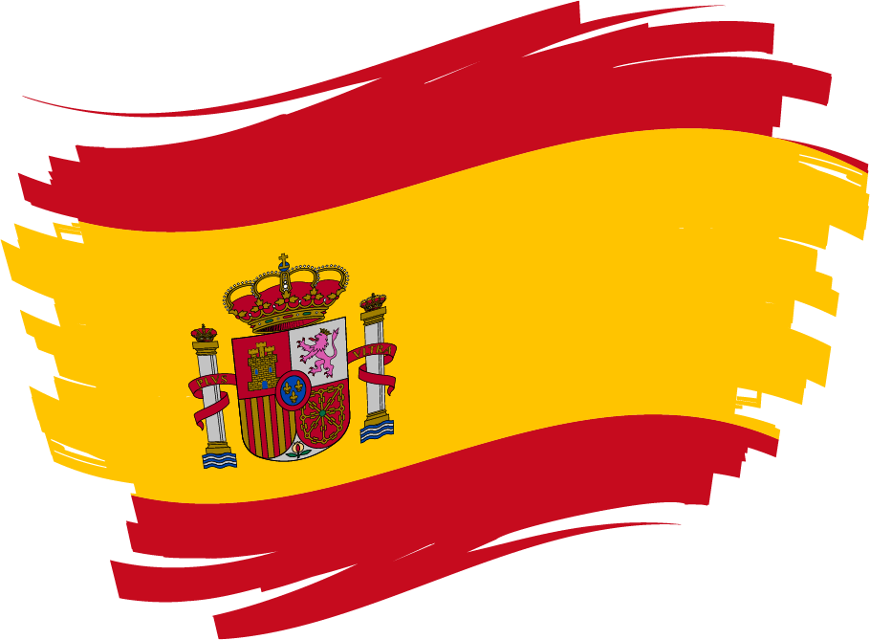

Spain | The Spanish Law 7/2022 of April 8th, on Waste and Contaminated Soils for a Circular Economy and the Royal Decree 128/2022, of 15th February on port reception facilities intend to fulfil with the new waste objectives set by EU Directives. The Government of Spain is working on the necessary instruments to implement an EPR scheme and ensure its compliance. A first draft of the regulation is currently being prepared, with the final publication estimated for mid to late 2026, and information is being gathered on cross-cutting aspects of EPR, the definition of “producer,” the management of waste from foreign or EU vessels, and fishing gear discarded in other countries. Additionally, relevant aspects such as the tracing of fishing gear, the collection and management of waste, and improvements in materials and design, promoting eco-design and sustainability, are being evaluated.
Portugal | Transposed by decree law n.º 78/2021 of 24 September - Transposes Directive (EU) 2019/904, on reducing the impact of certain plastic products on the environment. Law nº 83/2022 of 09 December - Transposition of Directive (EU) 2019/904, defining the extended producer responsibility regimes for certain single-use plastic products. Portugal is establishing EPR through a collective management system involving producers, fishers, and authorities
Guidelines to implement SUP and PRF directives in the Atlantic Area.

Slide 4
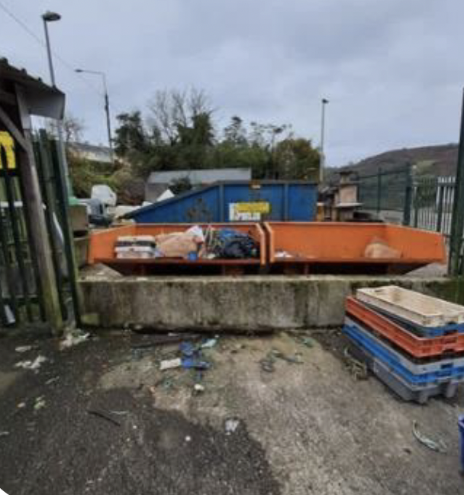
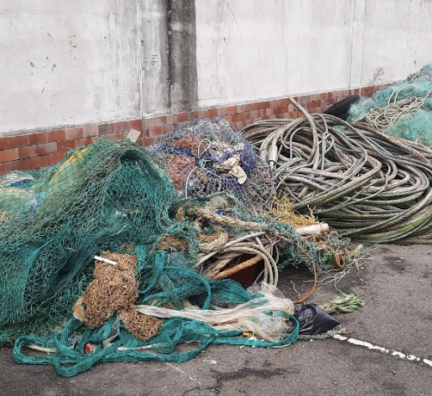
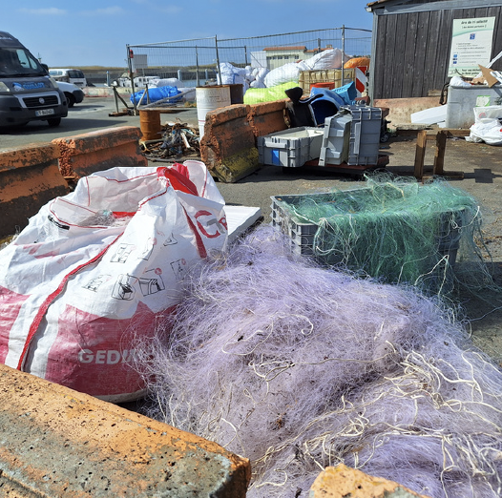
Free LitterAT : Analysis of relevant aspects for SUP and PRF implementation and current practices for waste management in different ports
The project partners established a questionnaire and made a series of visits to fishing ports.
20 fishing ports visited
PORTS VISITED | DATE OF VISIT
GRANVILLE | 03/07/2024
PORT-EN-BESSIN | 03/07/2024
ROSCOFF | 10/07/2024
LE GUILVINEC | 18/07/2024
LE CONQUET | 27/08/2024
CAMARET-SUR-MER | 28/08/2024
LA COTINIERE (OLERON) | 03/10/2024
AUDIERNE | 03/05/2025
Ports visited | DATE OF VISIT
MARÍN | 07/11/24
VIGO | 07/11/24
A CORUÑA | 18/12/24
BUEU | 04/12/24
RIBEIRA | 12/02/25
Ports of Galicia | On line interview
Ports of the State | On line interview
PORTS VISITED | DATE OF VISIT
HOWTH | 10/09/2024
KILMORE QUAY | 11/09/2024
DUNMORE EAST | 11/09/2024
UNION HALL | 29/10/2024
CASTLETOWNBERE | 30/10/2024
Union Hall
A Coruña
La Côtinière

Slide 5
Free LitterAT : Analysis of relevant aspects for SUP and PRF implementation and current practices for waste management in different ports
Local initiatives. Differences in how used fishing gear is handled from one port to another.
Approximately half of fishing ports are sorting used fishing gear. Practices depend very much on the involvement of port managers and the presence of dedicated staff.
Ports waste collection centres may be open or closed.
Existence of storage or dismantling areas in certain ports. Nets are often stored in 1 m³ big bags and transported by forklift trucks.
Some ports apply fines for illegal or unauthorised dumping.
There may or may not be specific staff to manage waste and prepare nets for recycling.
Some ports are involved in initiatives with recycling companies (fil&fab for PA)
The involvement of fishermen varies from port to port. Sorting is perceived as a constraint, but communication and proactive action by port managers can foster engagement.
A lot of used fishing gear goes to landfill or is stored until it can be recycled.

Slide 6
Free LitterAT : Analysis of relevant aspects for SUP and PRF implementation and current practices for waste management in different ports
Clear regulatory framework, but implementation varies depending on port size, and recycling channels are still limited.
Large ports are well equipped (supervised PRFs, handling equipment available). However, small ports, managed by local authorities, suffer from a lack of resources.
In large ports, fishermen deposit sorted waste at collection points. In small ports, self-disposal leads to sorting errors and inappropriate deposits.
To communicate, some ports use WhatsApp, signs or pictograms to inform fishermen, but there is no national standardisation.
End of Life (EOL) nets are either stored on site for spare parts or end up in general waste, as there is currently little or no value stream for materials such PE and PP.
Nylon is sent abroad for recycling.

Slide 7
Free LitterAT : Analysis of relevant aspects for SUP and PRF implementation and current practices for waste management in different ports
Solid experience in fishing waste management. Long tradition of fishing for litter. Recycling of used gear still dependent on projects.
Spain has long and solid experience in waste incidentally fished management from Fishing for Litter pilot projects. The challenge and current goal is to keep the scheme operational beyond the project lifetime.
The Ministry of Ecological Transition (MITERD) has delivered INTEMARES – Cleaning Fishing Grounds, a key document containing common criteria and guidelines for fishing for litter in Spain.
Waste reception plans are in place in most ports. In Galicia, a single plan for all regional ports has been drawn up and is awaiting approval.
End of Life (EoL) management and recycling initiatives are often dependent on one-off projects and need to be better integrated into a coherent national framework.
Infrastructure exists in some ports, but implementation remains fragmented across regions and data collection systems on EoL fishing gears vary greatly depending on the port.
Collection & processing of the majority of used fishing gear is centralised in a single company (Chicolino).

Slide 8
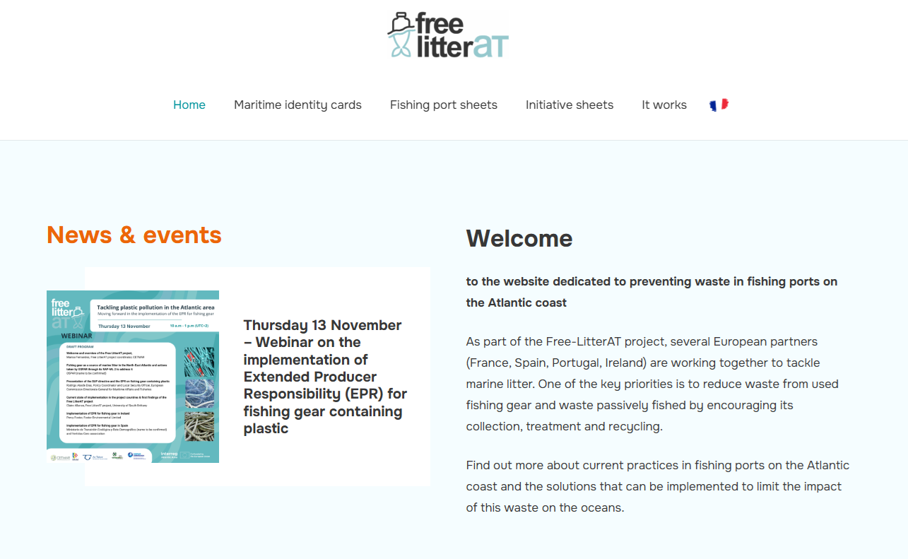

Free LitterAT : Analysis of relevant aspects for SUP and PRF implementation and current practices for waste management in different ports
dissemination of port visits and best practices
https://freelitterat.com/en

Slide 9
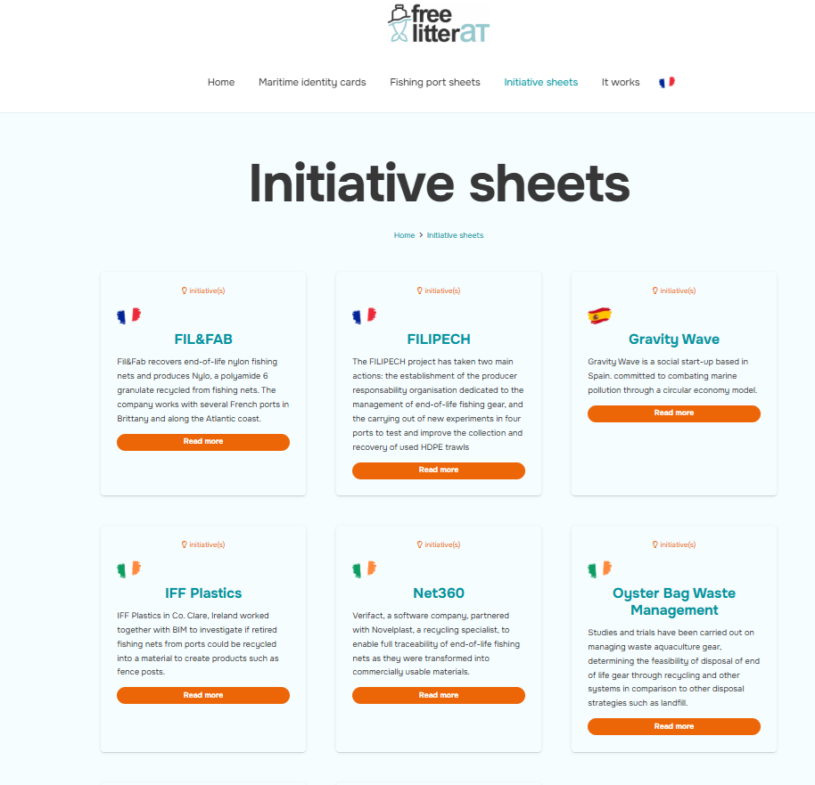
Free LitterAT : Analysis of relevant aspects for SUP and PRF implementation and current practices for waste management in different ports

Slide 10
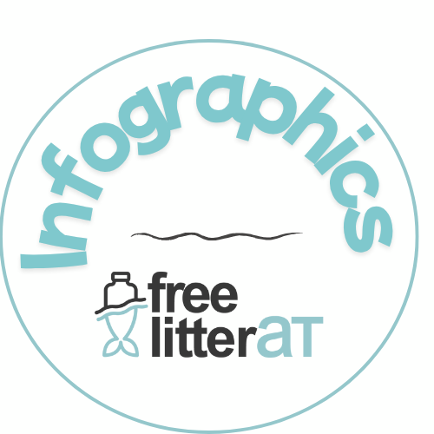
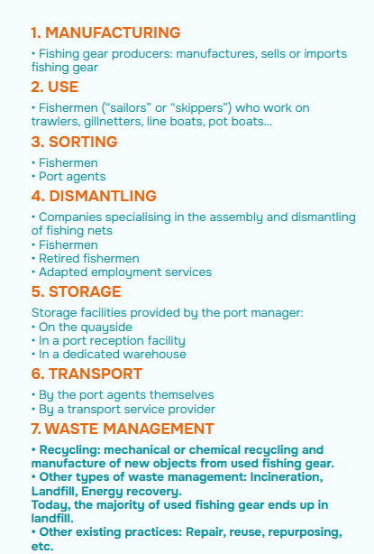
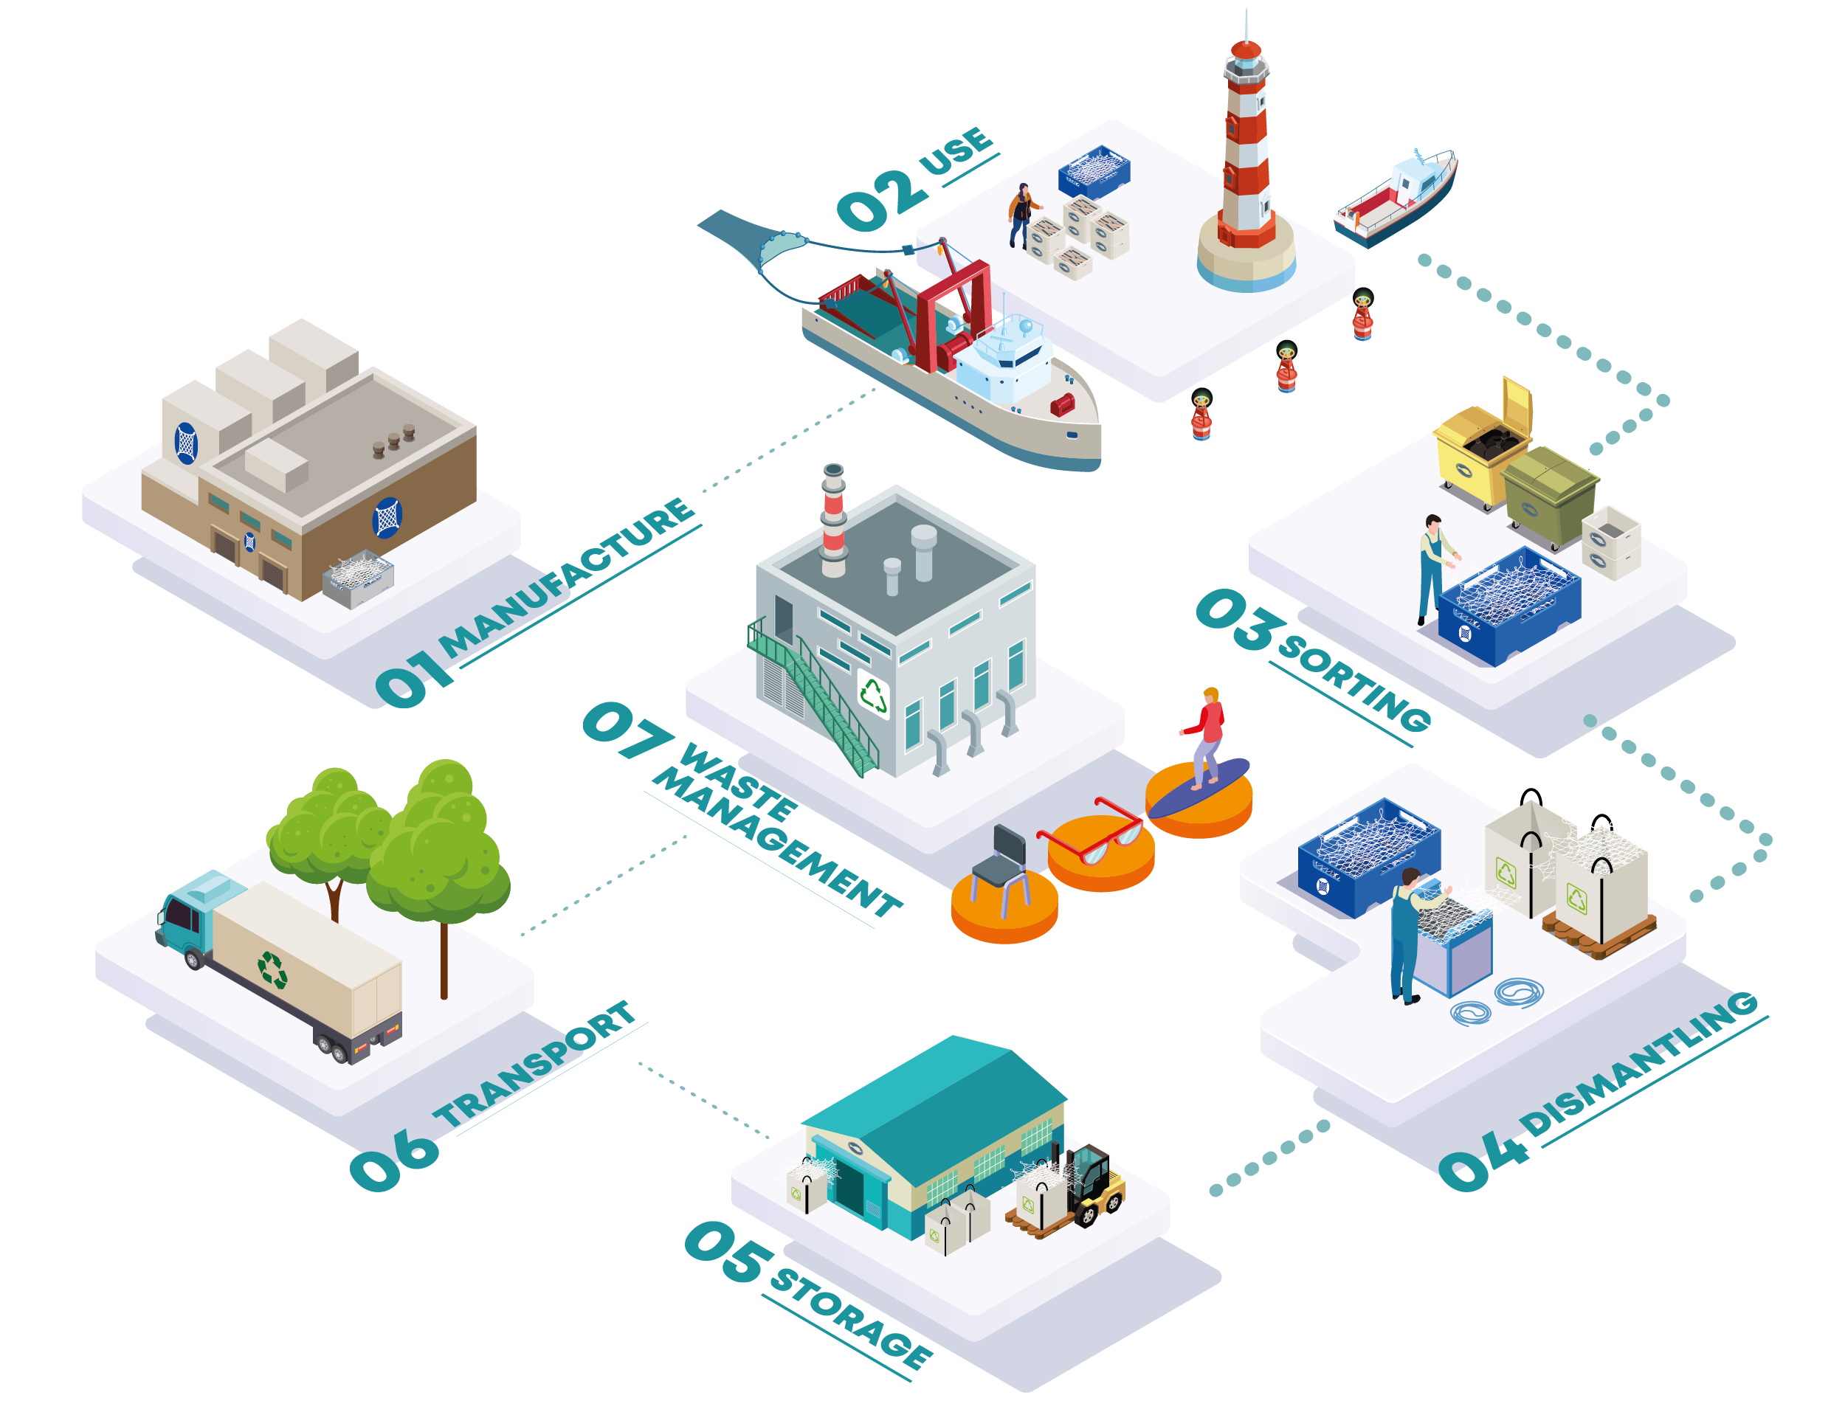
Free LitterAT : Analysis of relevant aspects for SUP and PRF implementation and current practices for waste management in different ports

Slide 11
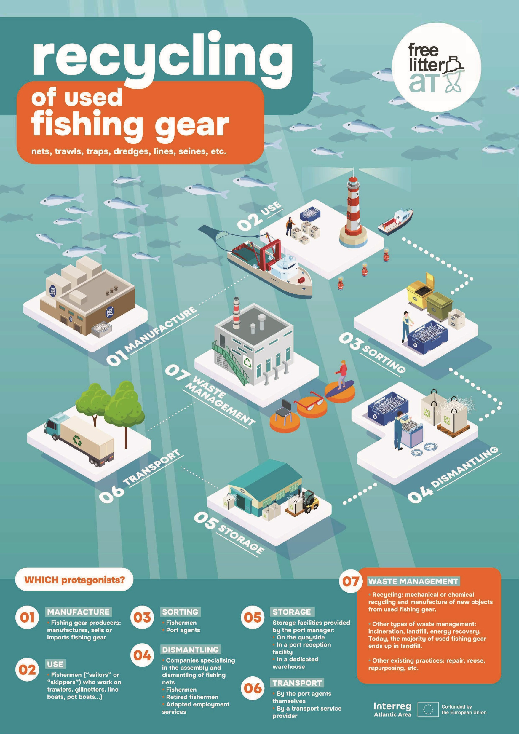
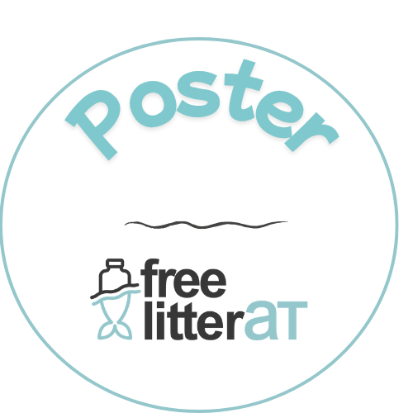
In French and English

Slide 12
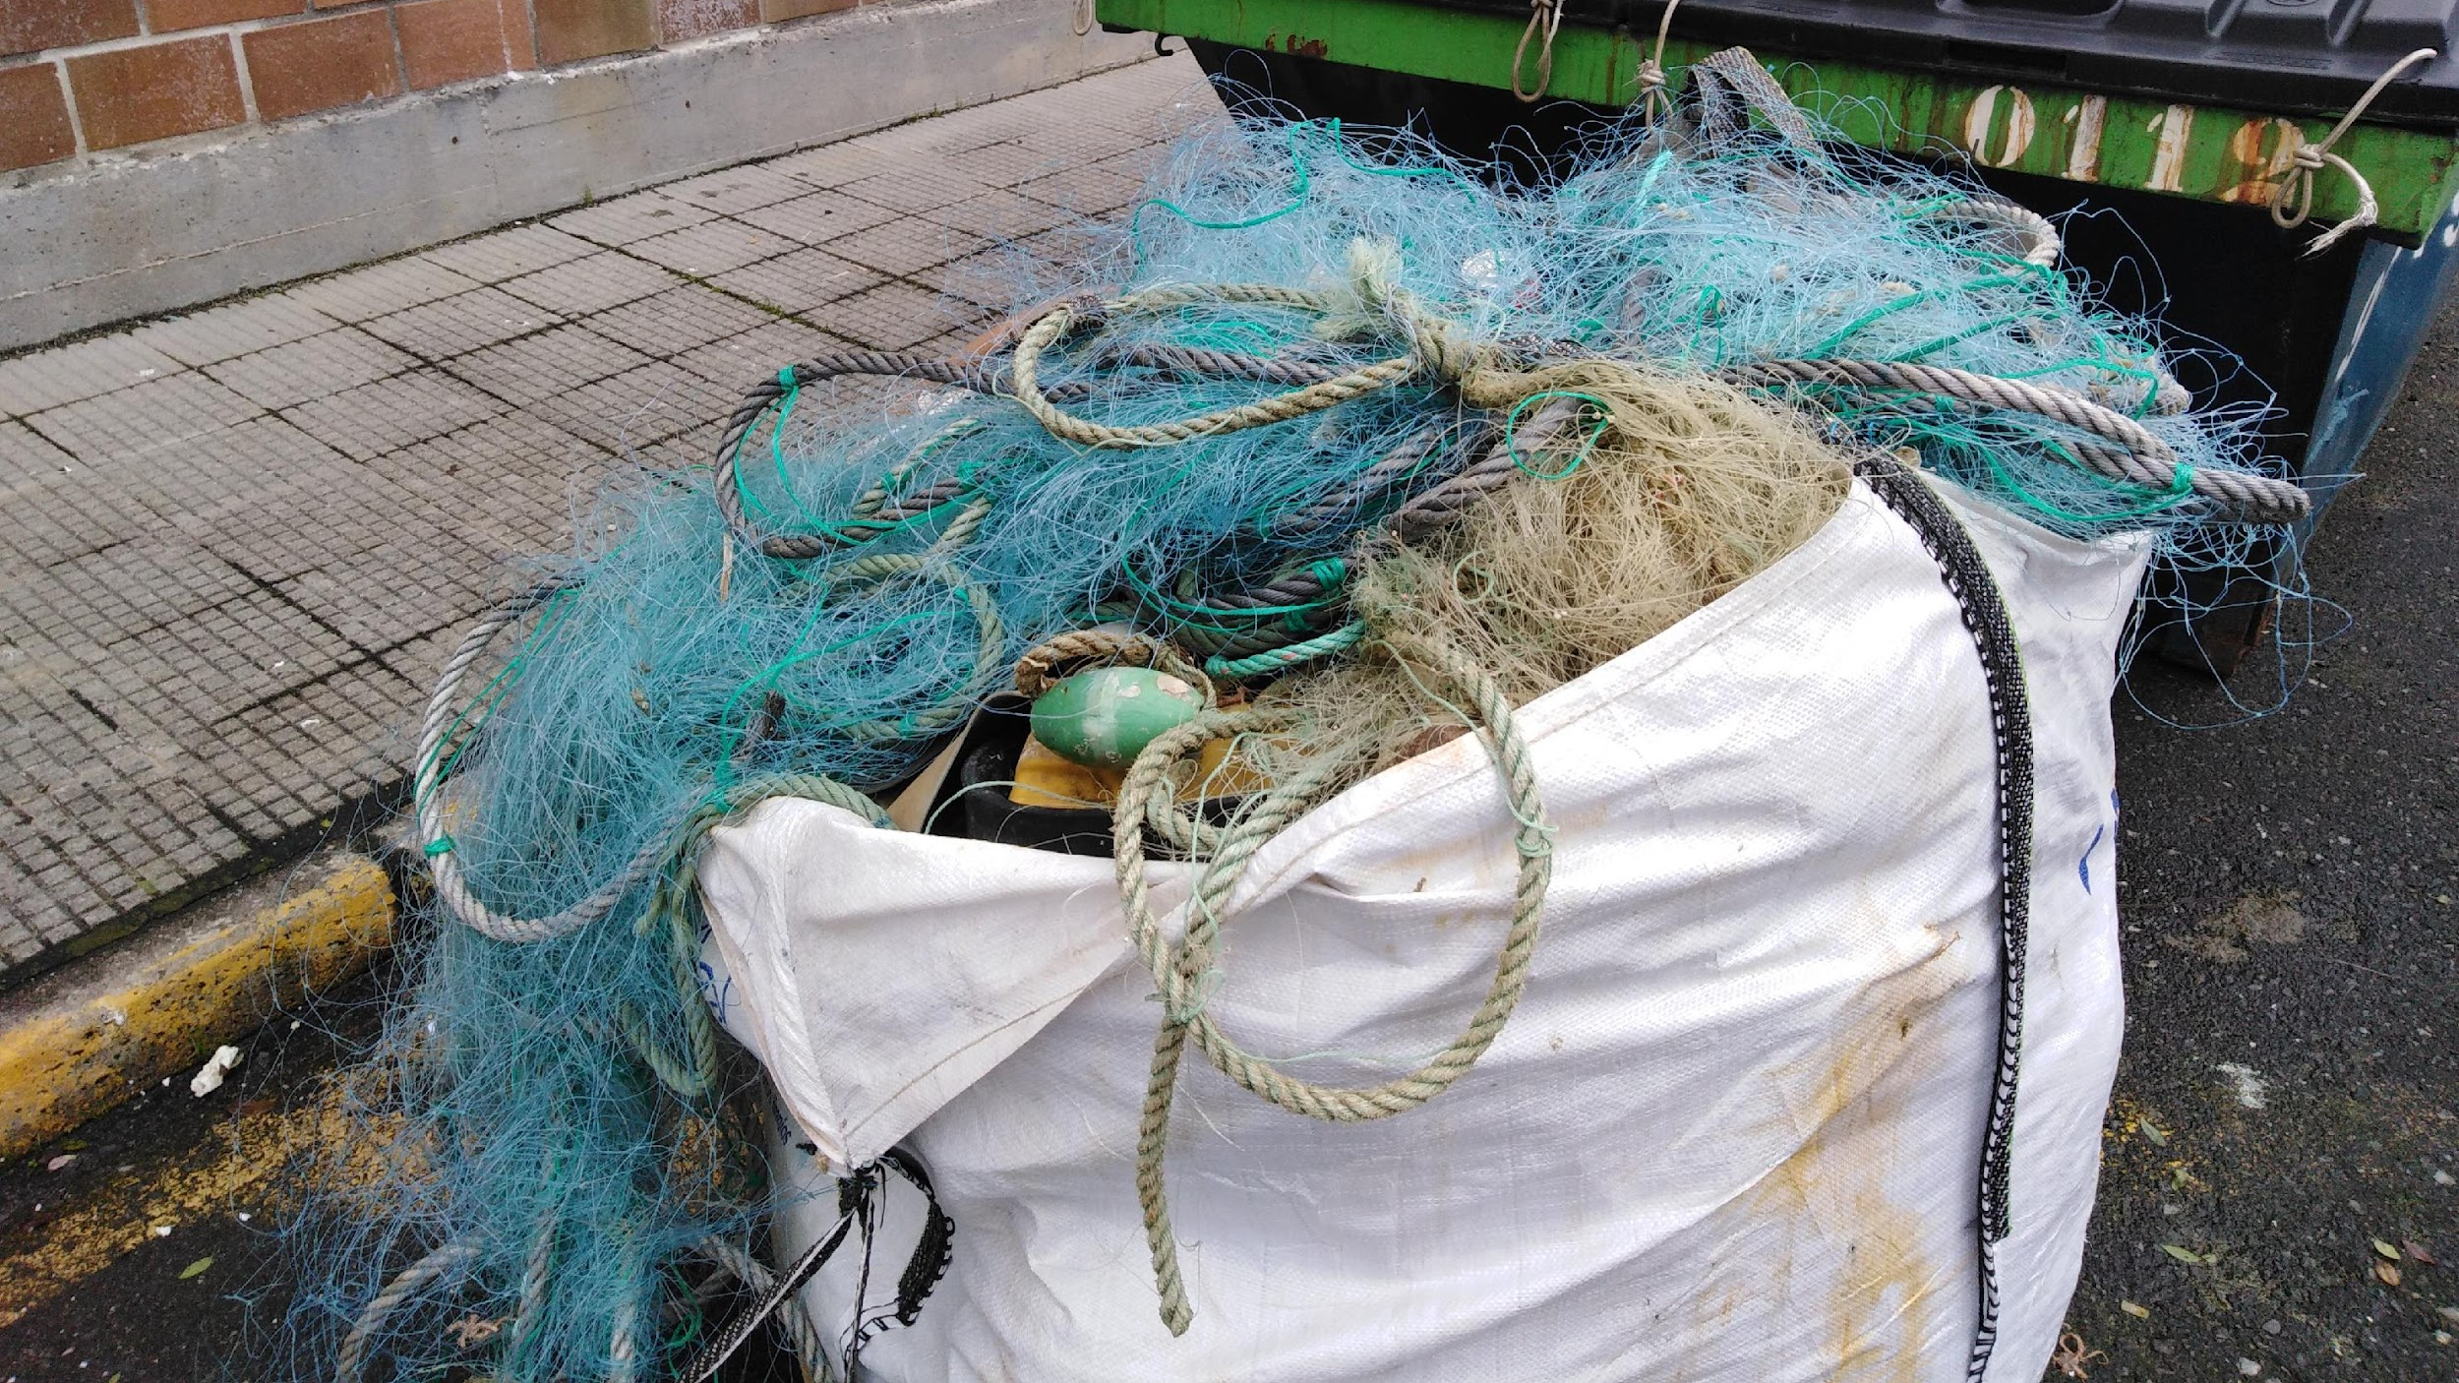
Free LitterAT : Management and recycling of end-of-life fishing gear
Fishing gear life cycle studies : Galicia, Brittany & Ireland
Main types of fishing gear and materials:
Type of gear | Materials | End-of-life (EOL) plastics
Purse seine | Polyamide (PA6, PA66), Polyester (PES), Nylon, Polyethylene (PE), Steel | PA6, PA66, PE
Gillnet | Polyamide (PA), Nylon, PE, Steel | PA6, PA66, PE
Longline | PA monofilament, Nylon, Plastic-rubber buoys, Stainless steel | PA6
Bottom trawl | PE, PA, PES, Polysteel, Steel-covered rope, PP, HMWPE, UHMWPE | HDPE
Buoys | PE, PUR, EPS | Same
Pots / Traps | HDPE ropes, PA6 net body | HDPE, PA6
available in early 2026
Life cycle observations:
Estimated nets used in Galicia: 441,253 nets /year
EOLFG discarded: 1643 t/year
  HDPE: 1602 t (97.5%)
  PA: 41 t (2.5%)
Port-level management: containers, cages, big-bags, direct floor disposal
Most recycling is mechanical, chemical recycling under development for PE/PP
Opportunities & Limitations:
Segregation and cleaning of materials enable recycling
Contaminated or mixed EOLFG complicates valorisation
Centralised data collection and port-based EOLFG programs could improve management and recycling efficiency

Slide 13
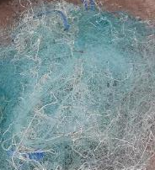
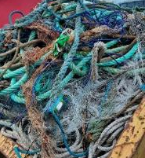
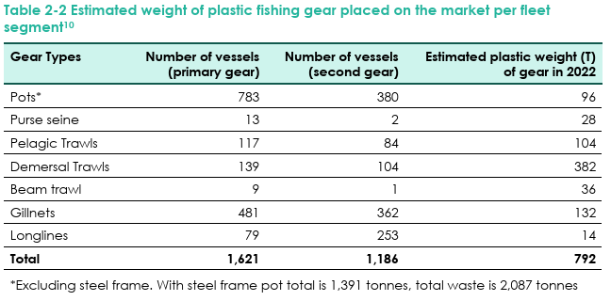
Free LitterAT : Management and recycling of end-of-life fishing gear
Fishing gear life cycle studies : Galicia, Brittany & Ireland
Study for Ireland investigating the current life cycle of fishing gears and materials completed by the Clean Technology Centre.
The main types of gear and the materials they are composed of, have been summarised. This has identified current opportunities for these materials to be recovered or not.
In addition, information regarding uses of gear, FG placed on/ off the market, ALDFG, FFL, practice on ports, local studies and recommendations are included also.

Slide 14

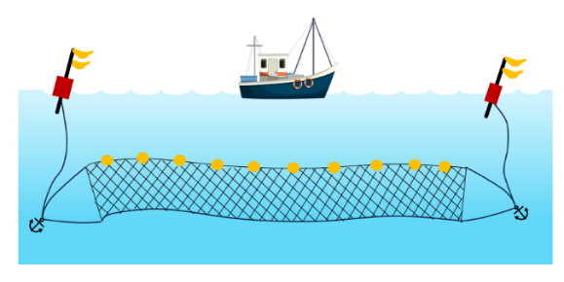
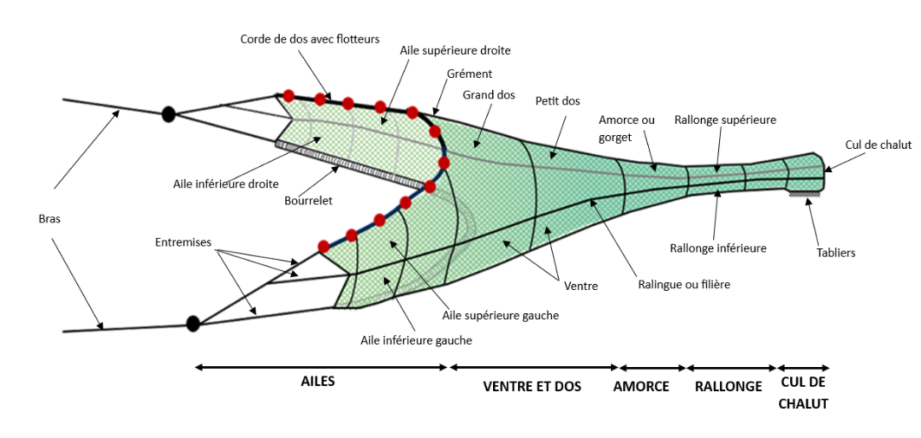
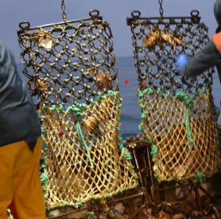
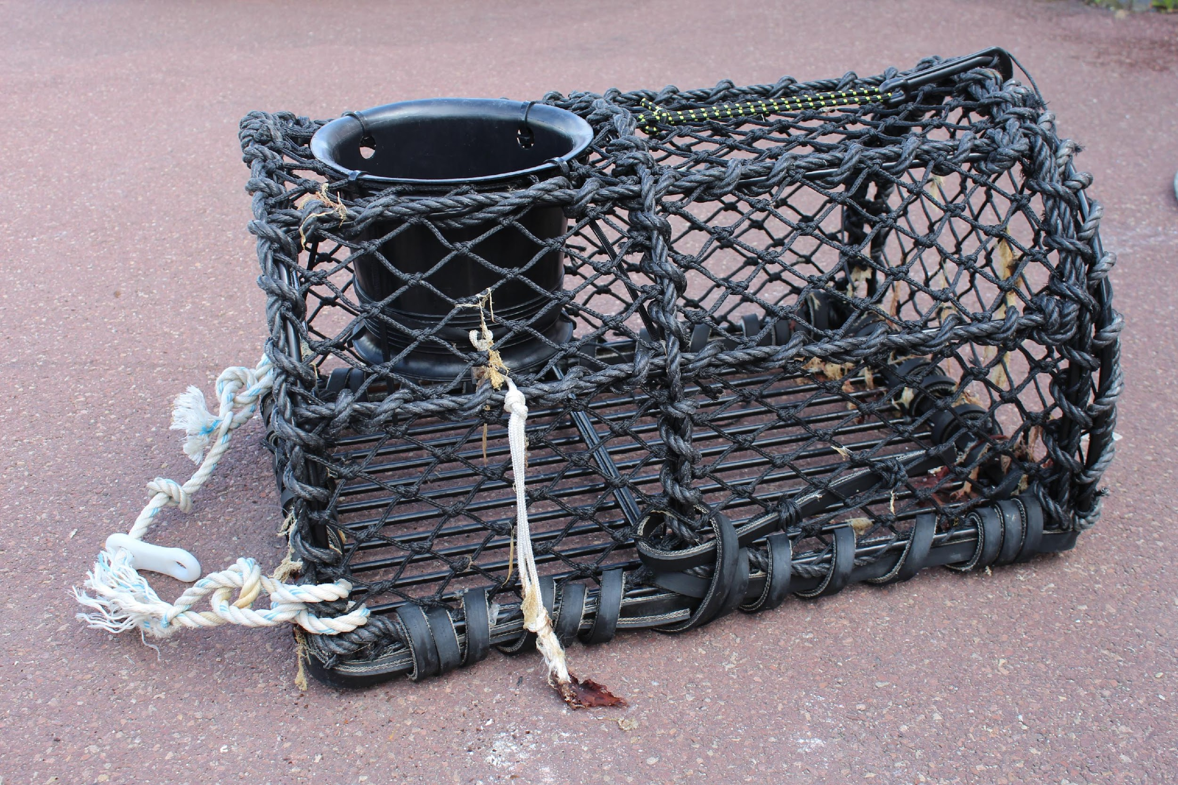
Free LitterAT : Management and recycling of end-of-life fishing gear
Fishing gear life cycle studies : Galicia, Brittany & Ireland
Types of plastics in main fishing gear used in Britanny and EOLFG recycling solutions
 |  | EOLFG : RECYCLING SOLUTIONS
FISHING GEAR (in Britanny) | MAIN PLASTIC COMPONENTS | in FRANCE | in EUROPE
GILLNETS | POLYAMIDE | YES | YES
TRAWLS | HDPE | NO | YES
 | POLYAMIDE , PP |  | Denmark (Plastix)
DREDGES | POLYAMIDE | NO | NO
 | HDPE
TRAPS | HDPE | NO | NO
 | POLYAMIDE
QUANTITIES ESTIMATE of MARKETED FISHING GEAR in FRANCE and BRITTANY
500 T / year in France (1 main producer ≈ 80% of the market)
Gillnets (PA)
250 T / year in Brittany
300 T / year in France (2 main producers ≈ 90% of the market)
Trawls (HDPE and PA nets)
100 T / year in Brittany
Dredges (« english » type with PA or HDPE nets) / breton dredge mainly metal
Fishing gear and aquaculture waste
The amount of marine plastic waste is estimated at 4,606 t/year - FranceAgrimer study (2020)
Traps : no data

Slide 15
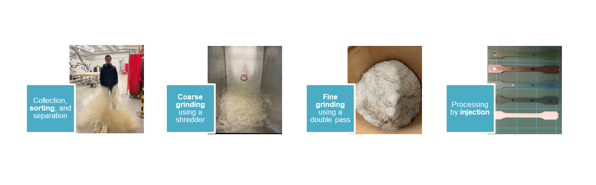
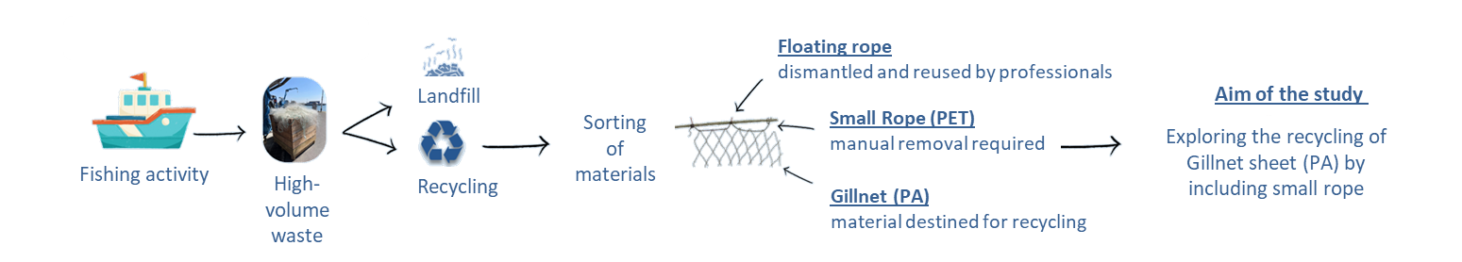
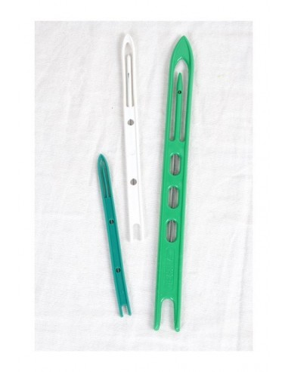
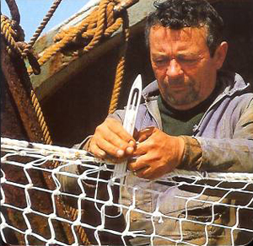
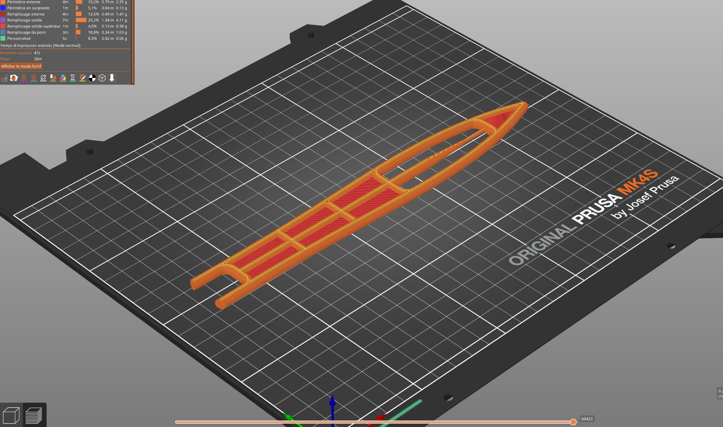
Free LitterAT : Management and recycling of end-of-life fishing gear
→ Different steps of recycling
→ Making prototypes from recycled fishing gear
Creating objects from used fishing net for fishermen = needle net

Slide 16
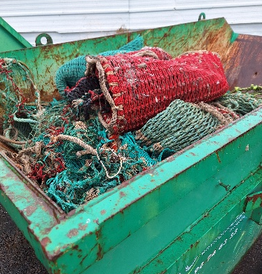

Free LitterAT : Next steps
Publication of deliverables on https://freelitterat.eu/ in 2026
Next webinar on fishing for litter in early 2026
Local workshops in Spain, France and Ireland during 2026
Implementation of pilot actions related to recycling and fishing for litter in the ports of the project countries
Content for the workshops
Sharing best practice in terms of collection, dismantling and recycling in Atlantic ports
Sharing best practice in terms of collection and management of FFL in Atlantic ports
Issues and potential solutions
Meeting the technical challenges of recycling
Finding opportunities for valorisation

Slide 17
Free LitterAT : Key remarks
The directive has been transposed in all four countries, but although the date for the implementation of EPR is 1 January 2025, the countries are still in the process of organising themselves to implement this regulation.
In each country, implementation varies and progress is at different stages (voluntary or mandatory EPR, collection rates, PROs already in place, etc.).
Much used fishing gear still ends up in landfill or is stored awaiting recycling.
There are initiatives in some countries, but they are often not sustainable. Overall, Member States lack solutions for dealing with their waste fishing gear.
Main challenges:
Improving and harmonising waste sorting and management practices.
Recycling contaminated or mixed materials.
Improving infrastructure in ports.
Improve engagement with fishermen.
Encouraging all stakeholders to work collectively: fishermen, port managers, recyclers, etc.
Finding markets for this waste and ensuring that it is reintegrated into new products
https://goodpractices.freelitterat.eu/

