Slide 1
Extended Producer Responsibility (EPR) for Fishing Gear in Portugal
13/11/2025
Mafalda Mota
DFEMR

Slide 2
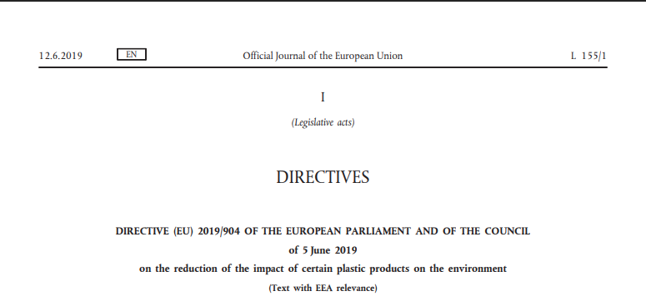
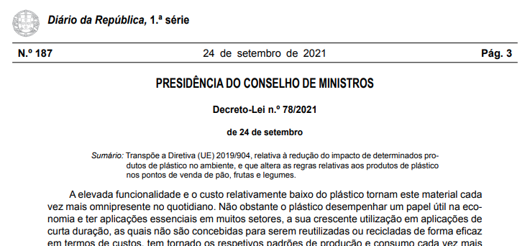
Context and Legislative Framework
Marine litter from fishing gear is a key environmental issue.
The EU Single-Use Plastics Directive (EU) 2019/904 establishes EPR for fishing gear containing plastic.
Transposed into Portuguese law by Decree-Law No. 78/2021.
Objective: ensure collection, treatment, and recycling of fishing gear waste.

Slide 3
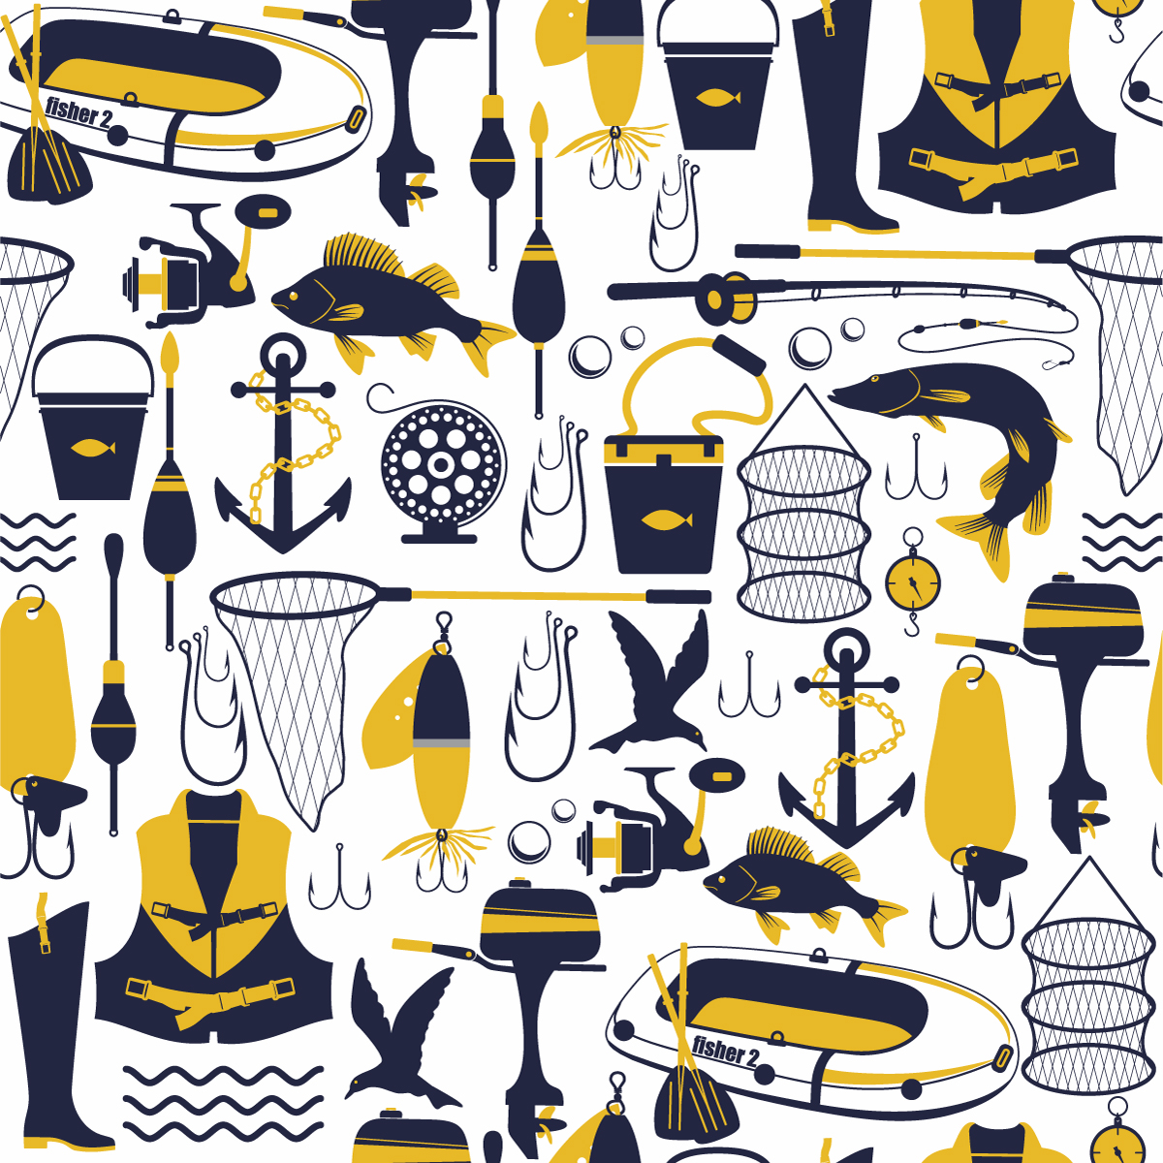
Key definitions
Fishing gear containing plastic: any product used for catching or farming fish that contains synthetic polymers.
Placing on the market: first making a product available on the market of a Member State.
Making available on the market: any supply for distribution, consumption or use in commercial activity.
⚠️ Loophole: fishermen manufacturing or importing gear for their own use are not considered to place it on the market.

Slide 4
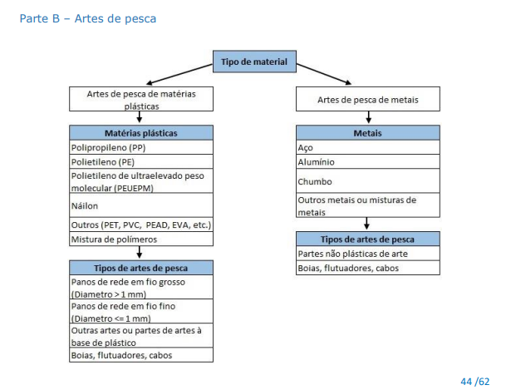
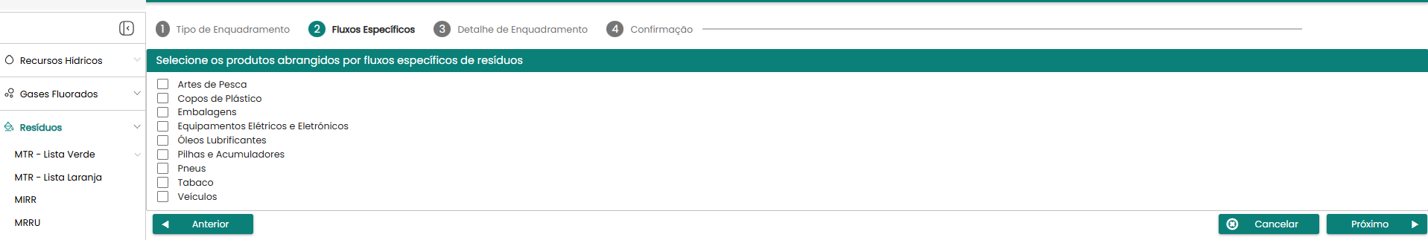
EPR Obligations in Portugal
Producers (manufacturers, importers, or distributors) must:
  Register in the national producer register (APA – SIRER platform).
  Finance collection, transport, and treatment of end-of-life fishing gear.
  Report annually on quantities placed on the market.
  Ensure awareness among users and cooperate with port authorities.

Slide 5
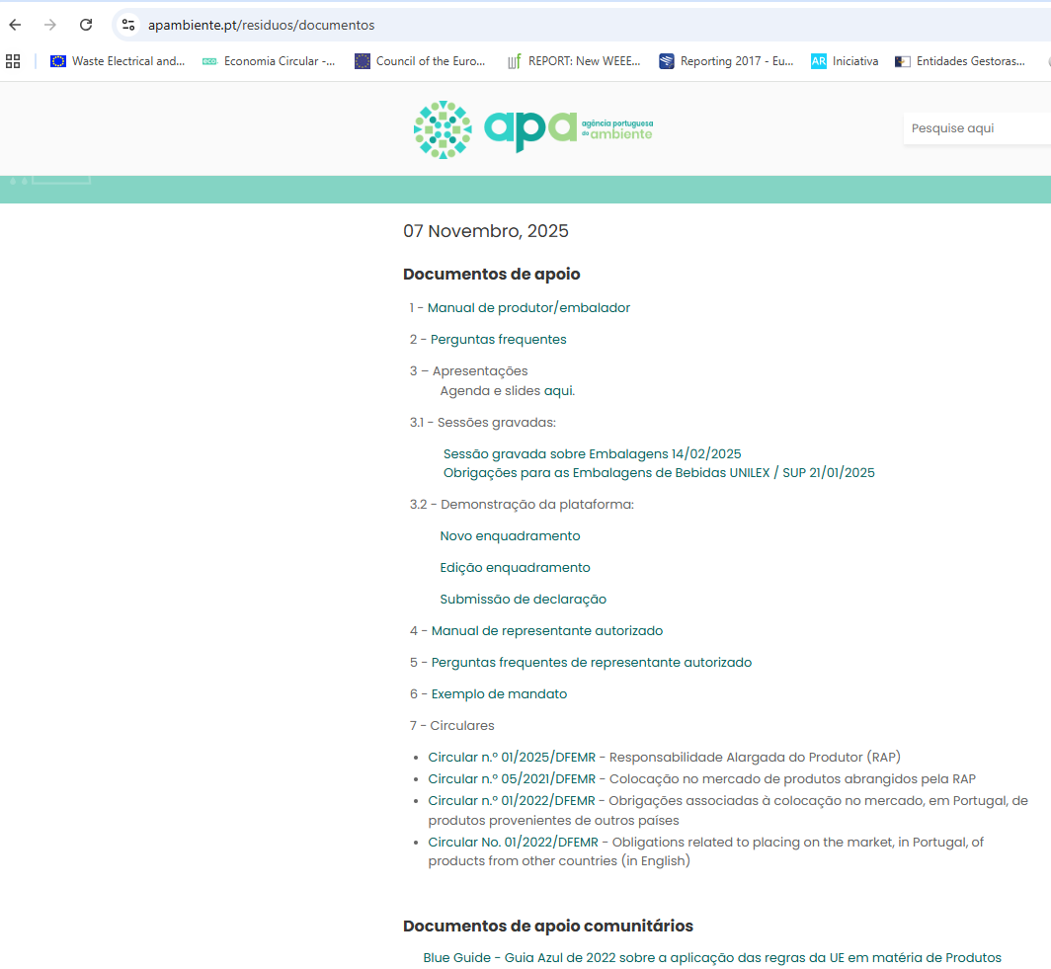
EPR Obligations in Portugal
Regarding producer registration, we have several supporting documents published on our portal.

Slide 6
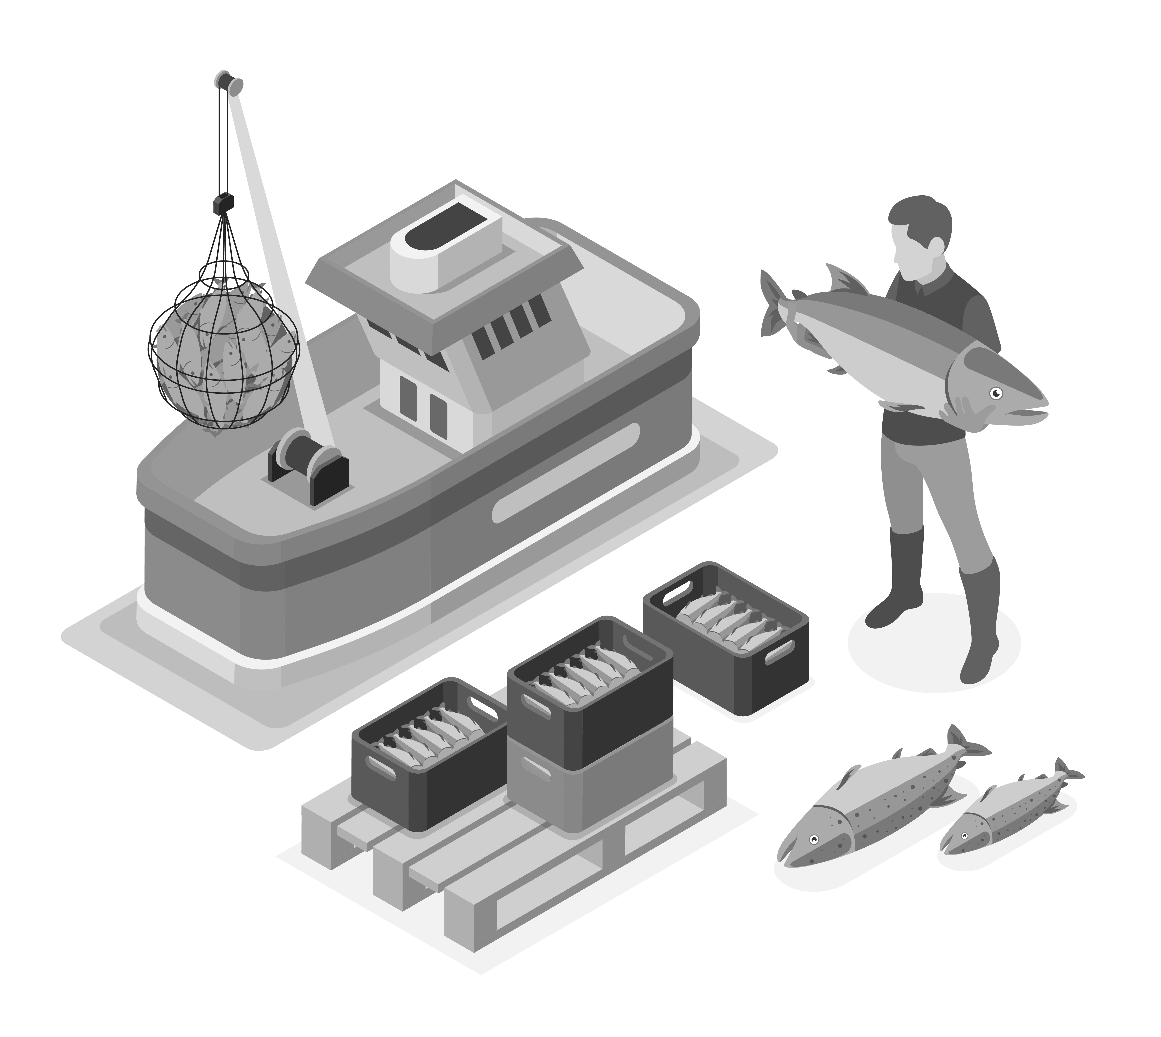
System Implementation
EPR to be implemented through collective management systems (PROs) must be approved by APA, DGAE e DGRM.
Collaboration between:
APA
DGAE
DGRM
• Port authorities and waste operators – collection
and logistics.

Slide 7

System Implementation
Article 24
Study to support extended producer responsibility schemes
The Directorate-General for Natural Resources, Safety and Maritime Services (DGRM) is responsible for carrying out a study to support the definition of a minimum annual national rate for the collection of fishing gear waste containing plastic for recycling, with a view to its inclusion in an extended producer responsibility scheme for fishing gear containing plastic to be approved, with the study preferably financed by European funds, and the DGRM requesting the collaboration of the APA, I. P., whenever necessary.
This study is ongoing.

Slide 8
Institutional Framework in Portugal
APA – Portuguese Environment Agency
National authority for environment and waste management
Main responsibilities:
  Implementing national waste and circular economy policy.
  Managing the national producer register (SIRER platform).
  Licensing and supervising Producer Responsibility Organisations (PROs).
  Monitoring collection and recycling targets.
  Coordinating the national implementation of the Single-Use Plastics Directive (EU) 2019/904.
➡️ In the context of EPR for fishing gear:
APA acts as the regulatory and environmental authority, responsible for the legal framework, producer registration, and oversight of the EPR system.

Slide 9
Institutional Framework in Portugal
⚓ DGRM – Directorate-General for Natural Resources, Safety and Maritime Services
National fisheries and maritime authority
Main responsibilities:
  Licensing fishing and aquaculture activities.
  Managing fishing ports, auctions, and maritime logistics.
  Overseeing collection, storage, and return operations for end-of-life fishing gear.
  Coordinating with APA and DGAE on the implementation of EPR for fishing gear containing plastic.
➡️ In the EPR system:
DGRM ensures operational coordination with the fisheries sector, linking ports, fishers, and waste operators in the collection and management of waste gear.

Slide 10
Institutional Framework in Portugal
⚙️ DGAE – Directorate-General for Economic Activities
Public body under the Ministry of Economy.
Focuses on industrial, commercial, and business policy.
Main responsibilities:
  Regulating and monitoring economic and industrial activities.
  Supporting the registration and compliance of producers under EPR schemes.
  Promoting cooperation with industry and producer associations.
➡️ In the context of EPR for fishing gear:
DGAE contributes to inter-ministerial coordination, ensuring consistency with market rules, trade practices, and competitiveness for producers and importers of fishing gear.

Slide 11
Current Status and Challenges
Legal framework established, but EPR system not yet fully operational.
There are expressions of interest in submitting specifications to obtain a license for the integrated system.
- Challenges:
Lack of traceability of gear placed on the market.
Difficulty distinguishing 'for own use' cases.
Limited recycling infrastructure for fishing gear materials.
Need for coordination between fisheries and waste sectors.

Slide 12
Opportunities and Next Steps
Development of gear marking and tracking systems.
Integration with EU data reporting requirements.
Innovation in recyclable and biodegradable materials.
Strengthening collection points in fishing ports.
Cross-sector collaboration under Circular Blue Economy initiatives.

Slide 13
Conclusions
EPR for fishing gear is a key tool to reduce marine litter and promote circularity in fisheries.
Portugal is establishing a comprehensive system involving producers, fishers, and authorities.
Success depends on:
• Clear implementation rules.
• Effective data collection and monitoring.
• Strong stakeholder engagement.

Slide 14
THANK YOU

