Slide 1
Fishing Gear Containing Plastic EPR Scheme for Ireland
Percy Foster, General Manager

Slide 2
Overview
Background to HIB
Temporary Approval
Pilot Legacy Fishing Gear Programme
Our Vision for Permanent PRO

Slide 3
Haul It Back
Haul It Back Company Limited by Guarantee (non profit) set up April 2025
Directors (2) producers & (2) independent
Foster Environmental is providing management services
www.haulitback.ie

Slide 4
April to August 2025
Prepared Application to Department of Climate, Energy & Environment for approval as interim body until 30 December 2025
Engaged with DCEE, Environmental Protection Agency & BIM (Seafood Development Agency)
Assisted EPA in preparing data for EU reporting requirements for SUP
Factfinding: visited some stakeholders – producers, coastal groups, Local Authorities, recyclers, harbour masters and waste sector

Slide 5
Interim Approval
From 1st September to 31 December 2025
Provide a membership service for fishing gear producers
Collect data on the volume of fishing gear placed on the market each year to meet mandatory reporting obligations under the Single-Use Plastics Directive.
Consult with members on the design of a five-year plan to operate as the permanent PRO
Submit 5 year plan to Department of Environment for approval

Slide 6
Key Functions of HIB
Provide a membership service for fishing gear producers to ensure compliance with S.I. No. 612 of 2022.
Collect data on the volume of fishing gear placed on the market each year to meet mandatory reporting obligations under the Single-Use Plastics Directive.
Consult with members on the design of a five-year plan to operate as the designated EPR scheme for fishing gear containing plastic from 1 January 2026.

Slide 7
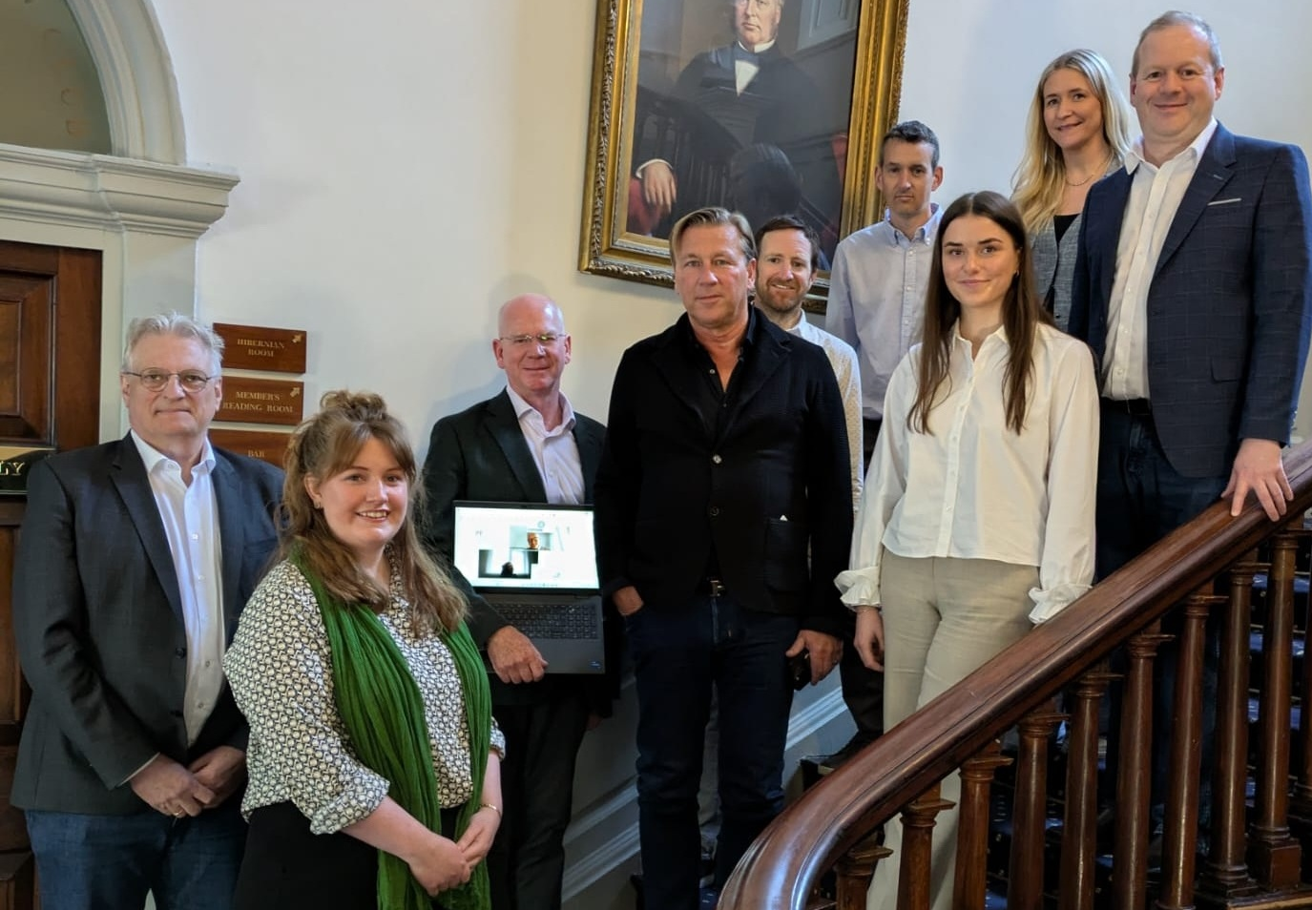
Collaboration Agreed with European PROs
Met in Dublin in May
Formed a discussion group and meet up every 6 months (next January 2026)
Welcome any other new PRO to join us
Ireland- Haul It Back
Denmark-RETUR
Finland- Finnish SUP Producers Association
Iceland-Fisheries Iceland
Norway-Profo
Sweden-Fiskekretsen AB
Spain-CEPESCA

Slide 8
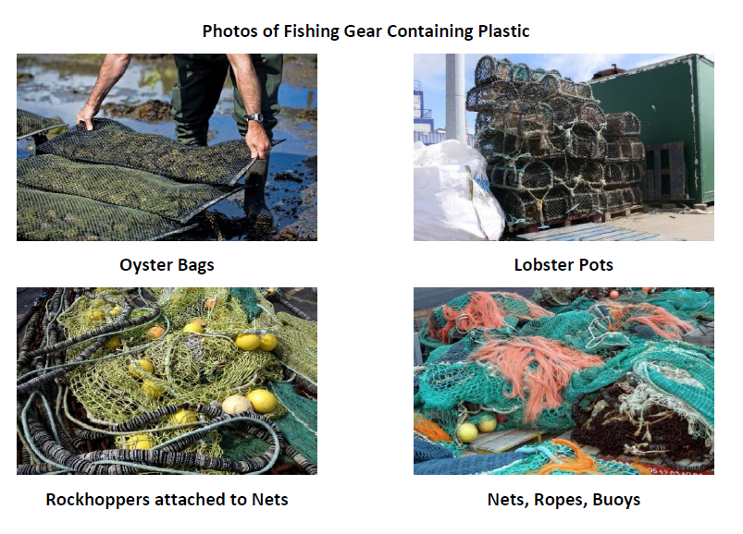

Pilot Fishing Gear Legacy- 2025
Haul It Back is managing a Pilot Fishing Gear Legacy Programme grant aided by the Department of Climate, Energy and the Environment.

Slide 9
Pilot Fishing Gear Legacy Programme
Oyster bags from farms (send them 1 tonne bags & then do ‘milkround’ with truck- (recycled/ fuel for cement kiln)
Lobster pots-Milkround collection with truck with a grab- (metal recycled/ fuel for cement kiln)
Collection of fishing gear with large truck to landfill
Rockhoppers on foot rope collected on a pallet (Reuse with Fishermen & recycled into sport pitches)
Fishermen dismantling 2 types of nets – least amount effort/reward
Stimulate markets- clothes sector
‘Track & Verify’ reuse of fishing gear

Slide 10
Permanent PRO ?
In December 2025, HIB will submit a 5 year plan for consideration by Department of Environment
Hopefully, the plan will be approved
5 year licence for HIB to operate
However, there is a big issue that has to solved ………..

Slide 11
Issue to Success- SUP Directive Loophole
The loophole in the Directive means fishermen/ fisherwomen (regardless of company size) who are manufacturing or importing fishing gear containing plastic for their own use, are not considered to be ‘placing it on the market.,
Therefore are not subject to the SUPD legislation
‘placing on the market’ means the first making available of a product on the market of a Member State;
‘making available on the market’ means any supply of a product for distribution, consumption or use on the market of a Member State in the course of a commercial activity, whether in return for payment or free of charge;

Slide 12
Impact of this Issue
People or organisations who import fishing gear may identify as fishermen and could therefore claim they are exempt from the Directive.
Risk distortion of the market by incentivising the direct purchase by from abroad. This could distort the market for compliant registered producers, leaving them at a commercial disadvantage.
The exempted fishermen fishing gear is being used without paying any fees to the PRO, leaving the PRO responsible for covering the cost of its waste management in the future.

Slide 13




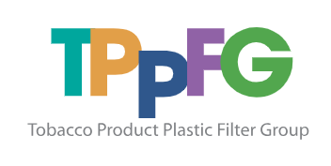


Thank You To Those Working with Us
Thanks to Organisations for Input
Producers
Harbour Masters
International PROs
Recyclers
Waste Companies
Local Authorities – e.g. Donegal County Council

Slide 14
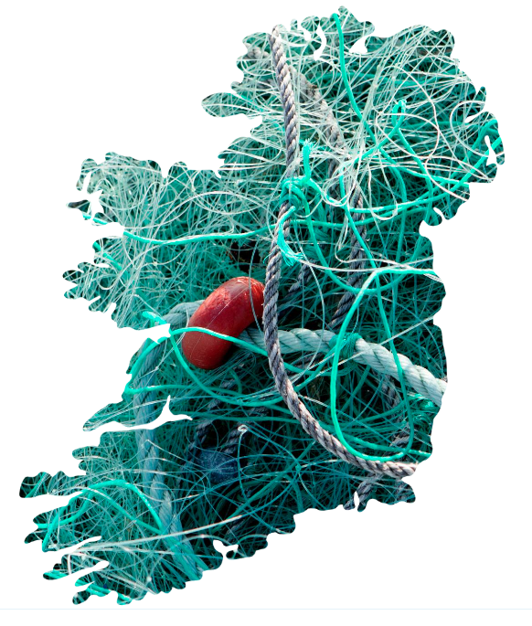
Contact Us
For more information check the website www.haulitback.ie
Percy Foster, General Manager
E: percy@haulitback.ie
T: 086-8129260

