Slide 1


Slide 2
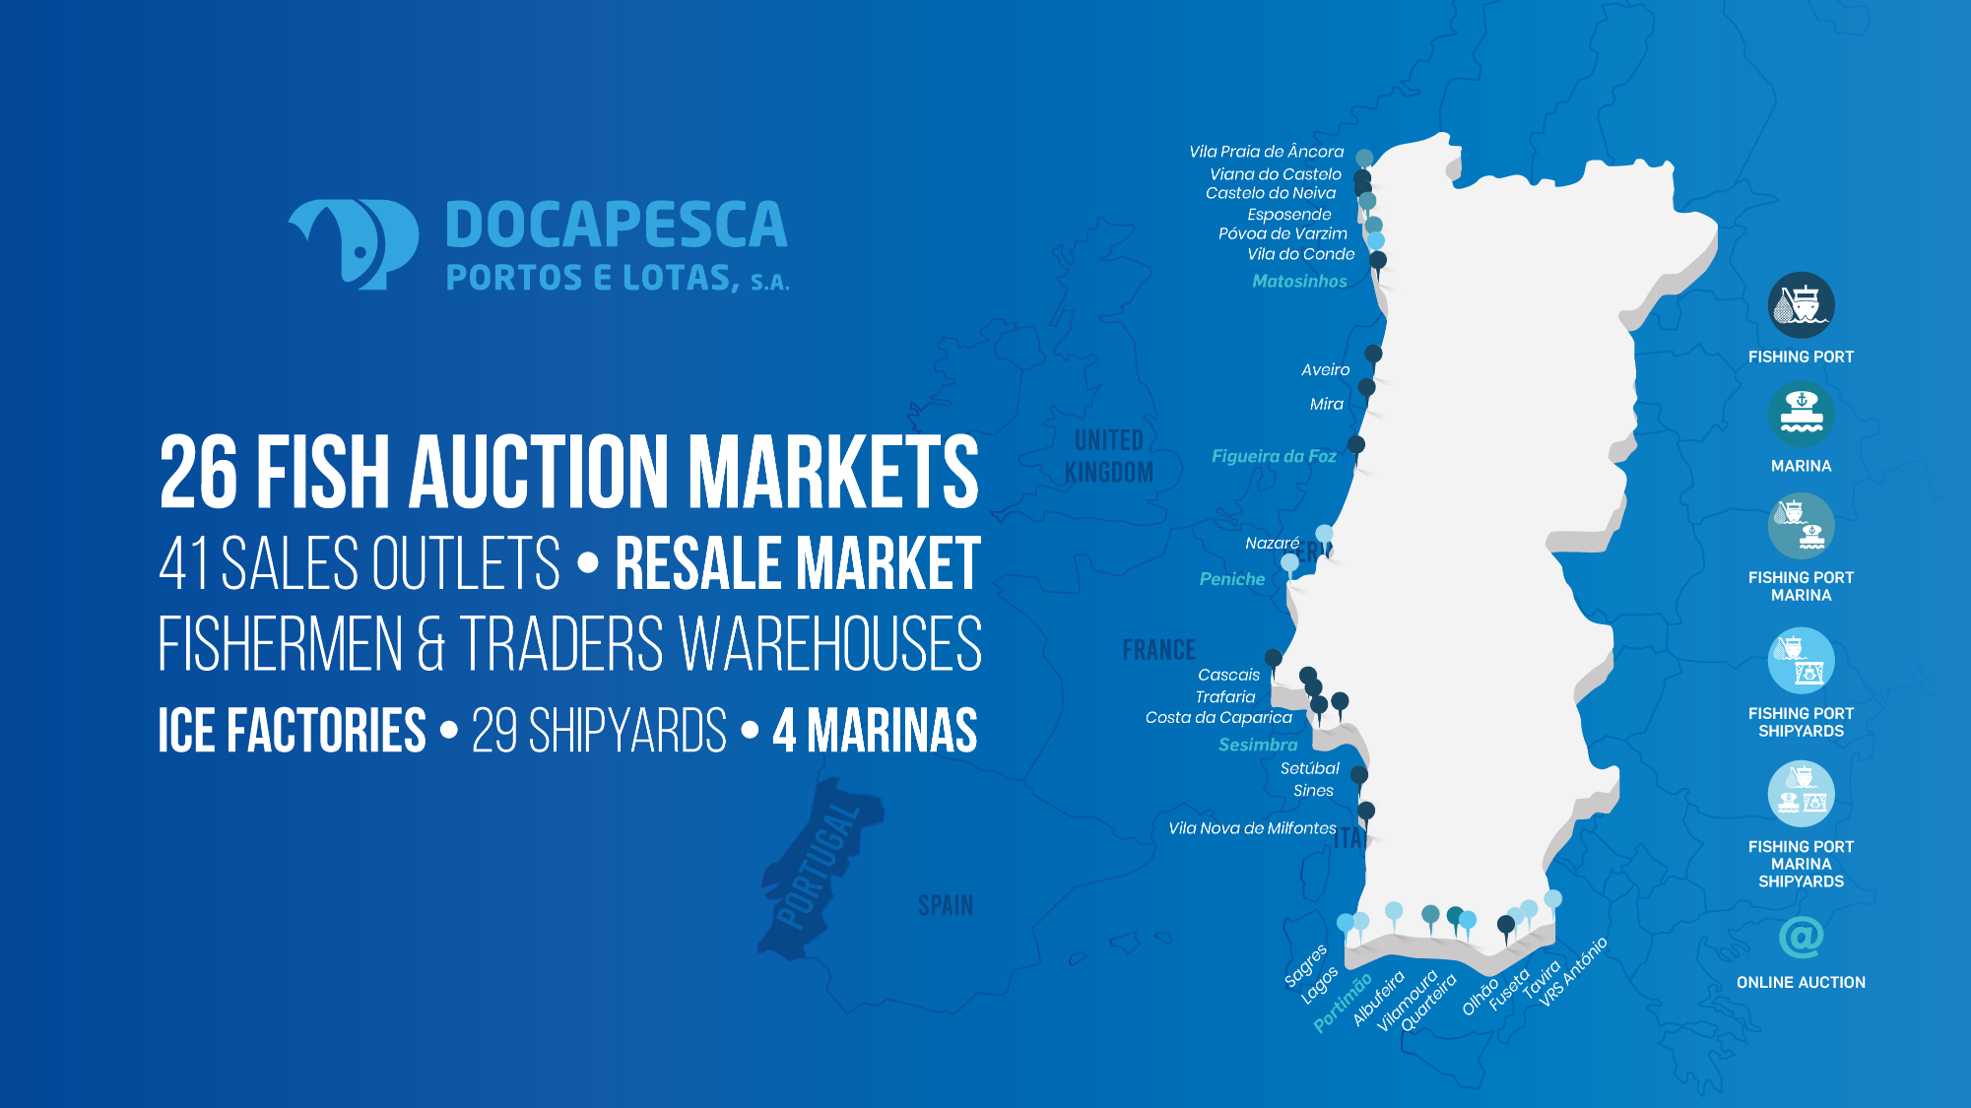

Slide 3

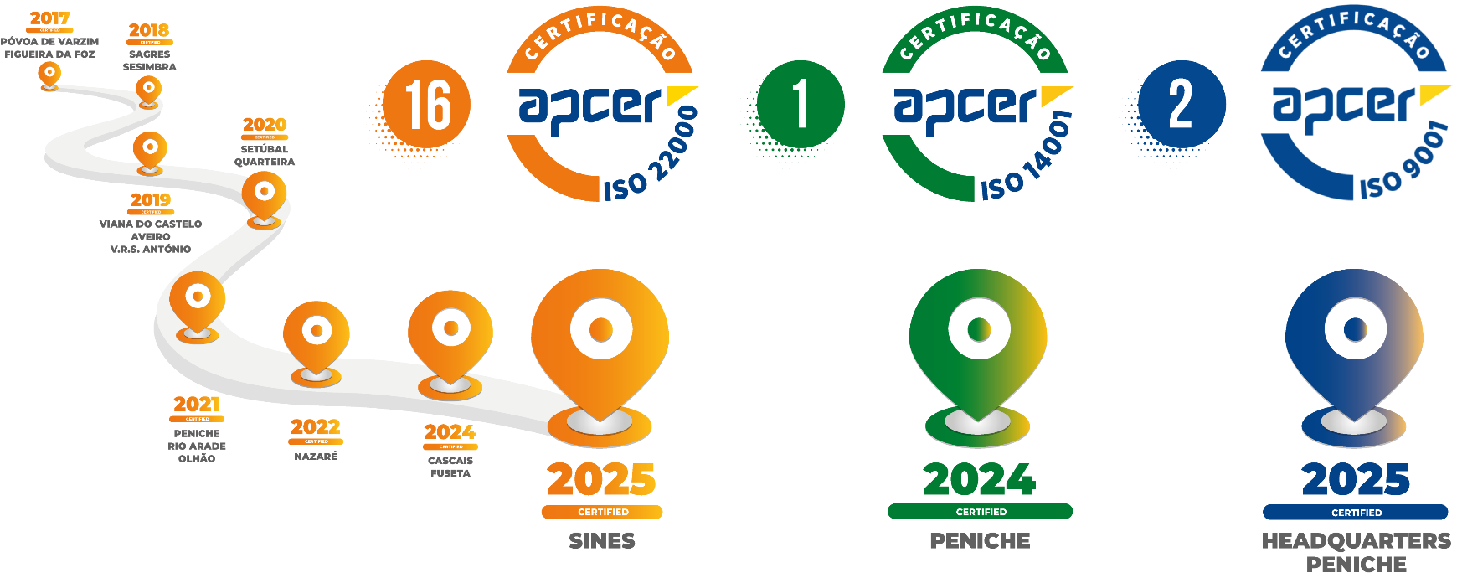
Certifications

Slide 4

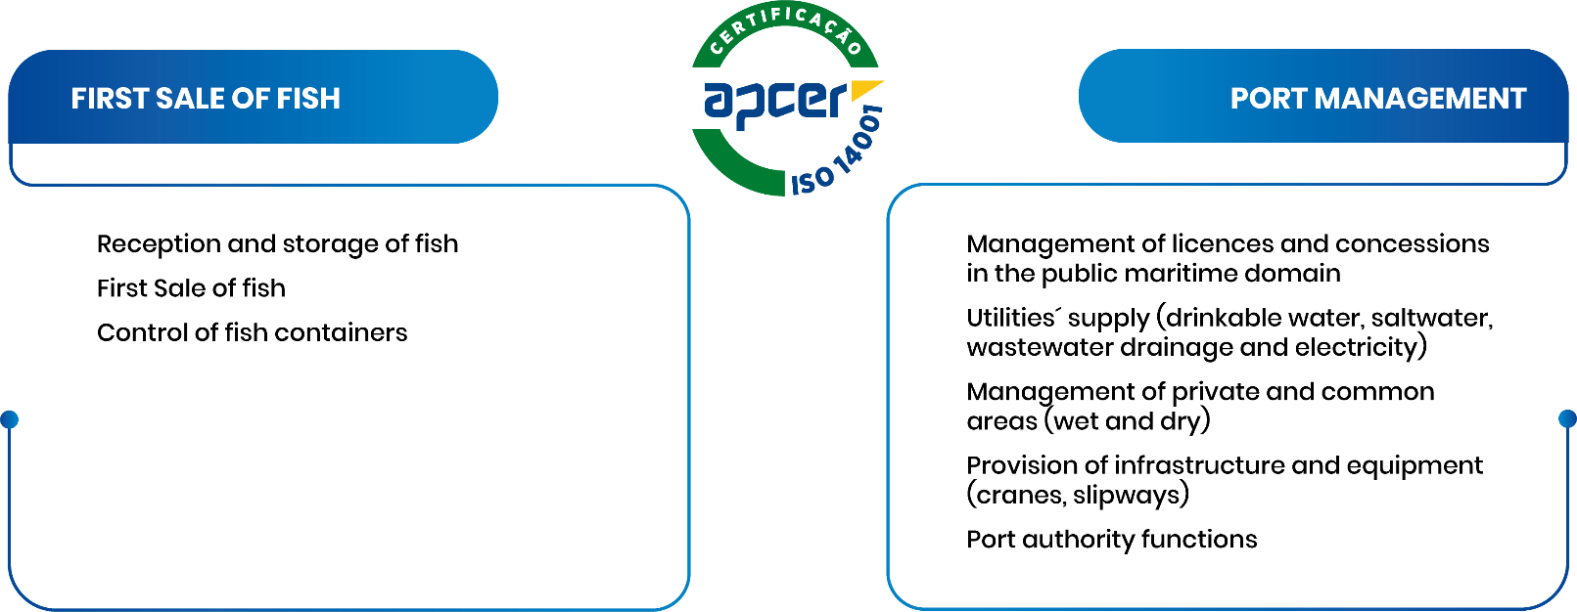

Environmental
Management System
The EMS, based on the EN ISO14001, was implemented at Docapesca in 2024 (certification audit, December 2024)
Scope: First Sale of Fish and Port Management at the Port of Peniche

Slide 5

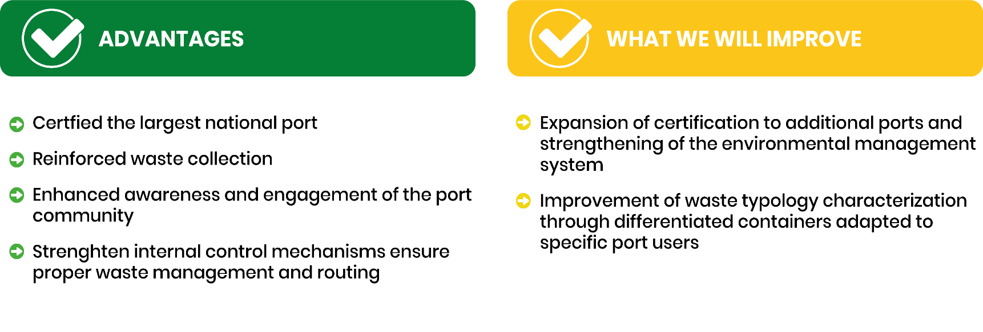
Environmental
Management System

Slide 6
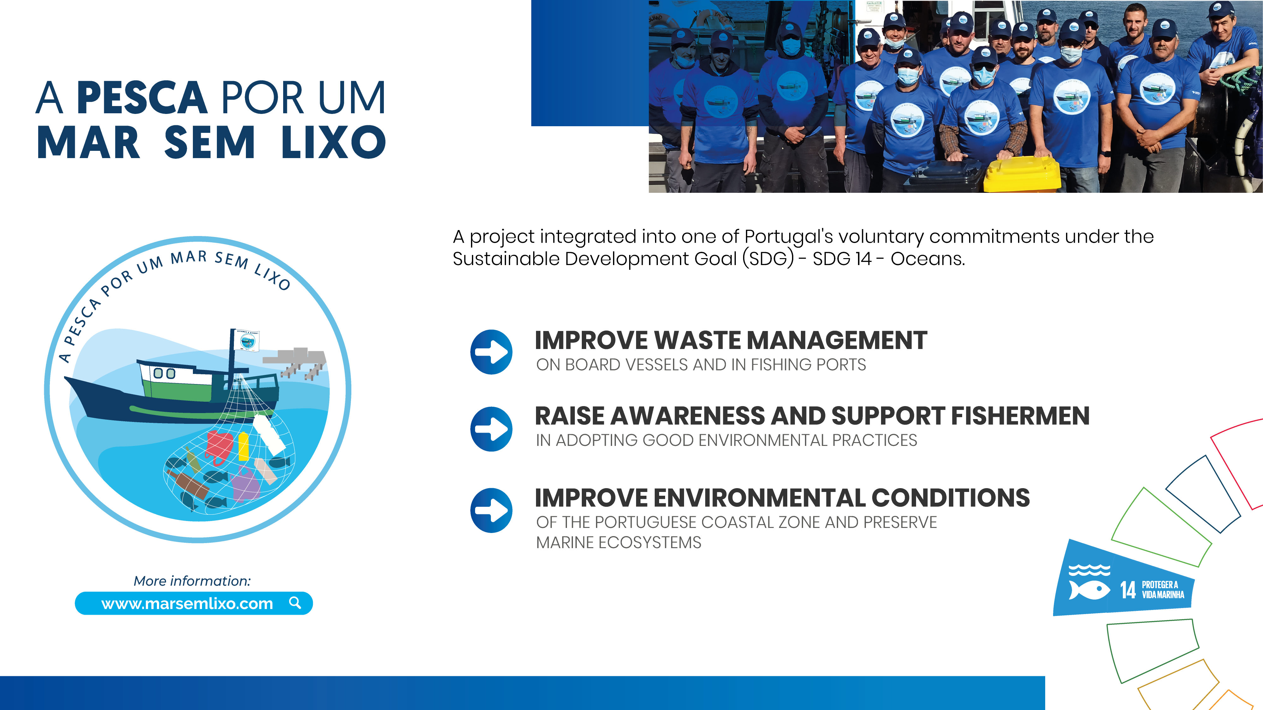


Slide 7
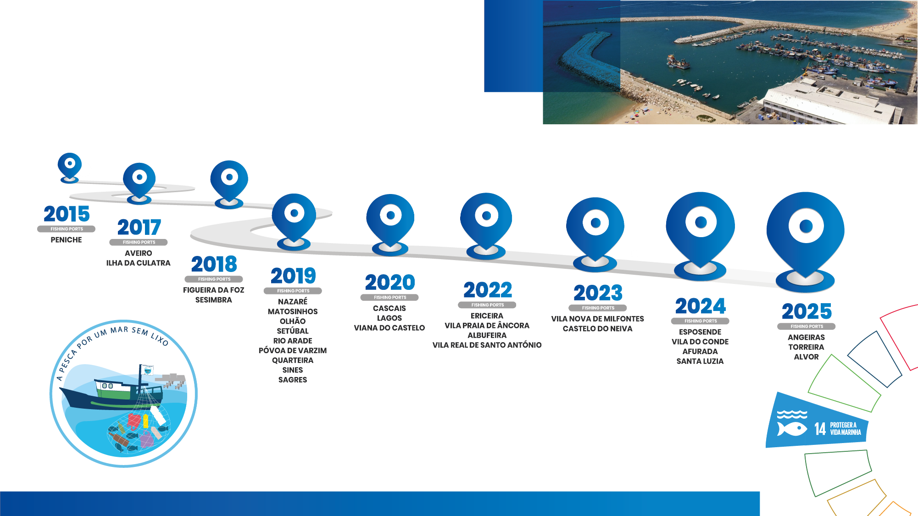
Participating Ports
Pesca por Um Mar Sem Lixo

Slide 8
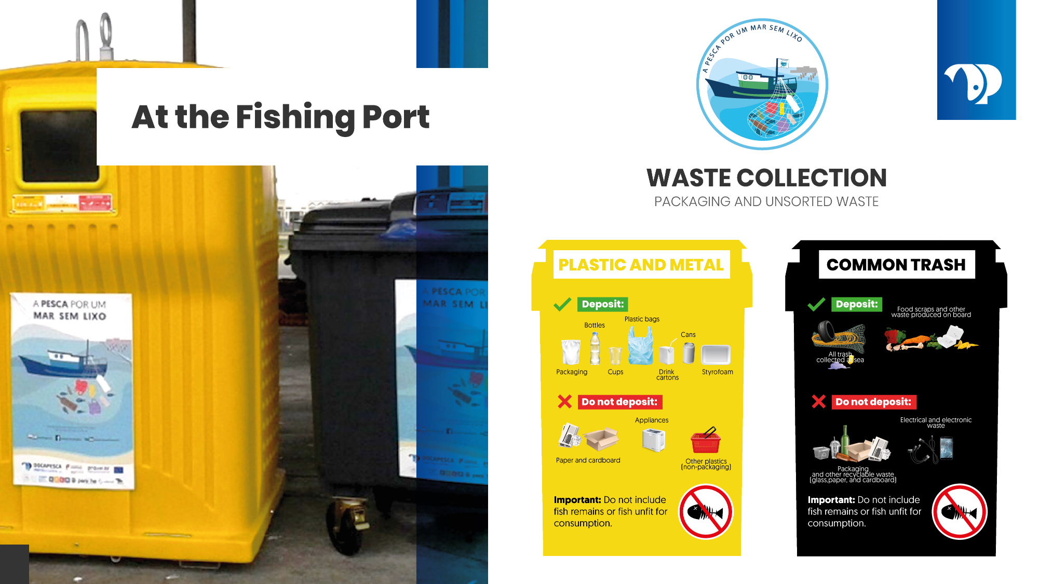

Slide 9
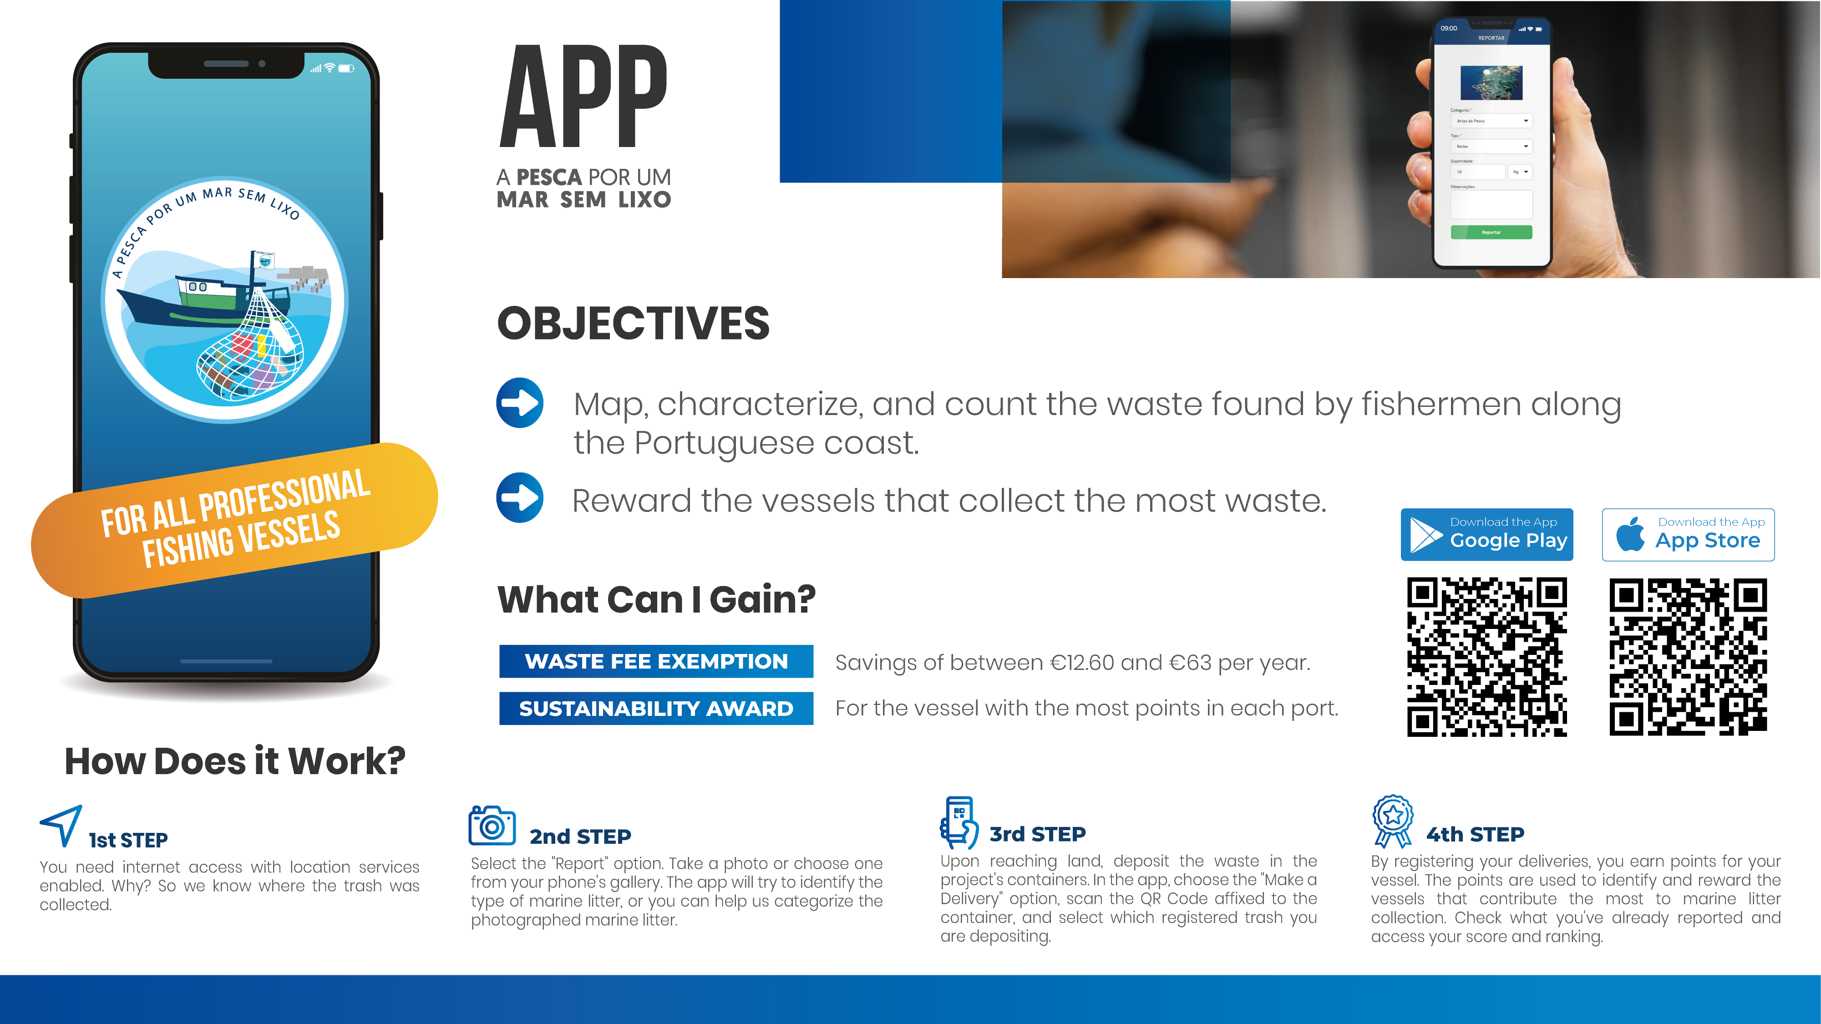

Slide 10

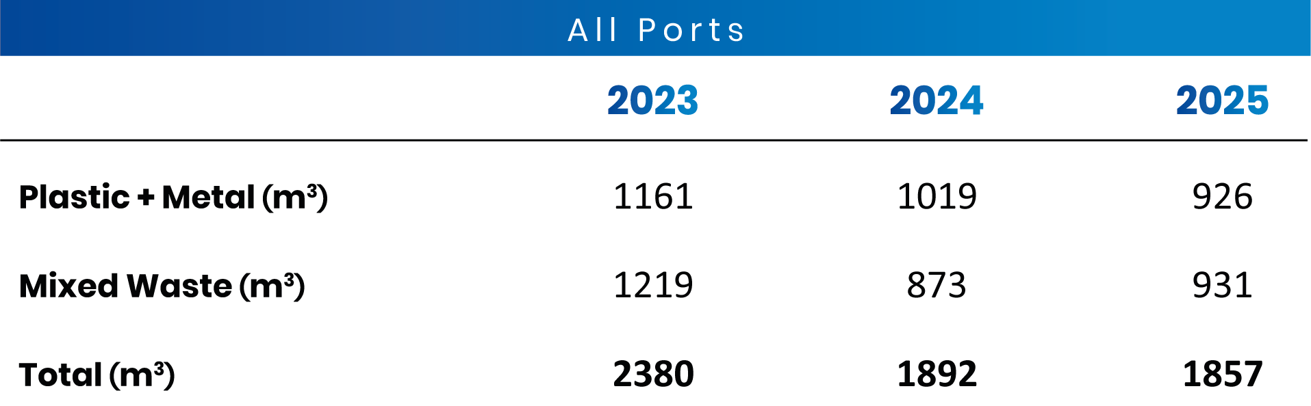
Collected amount
Total All Ports

Slide 11
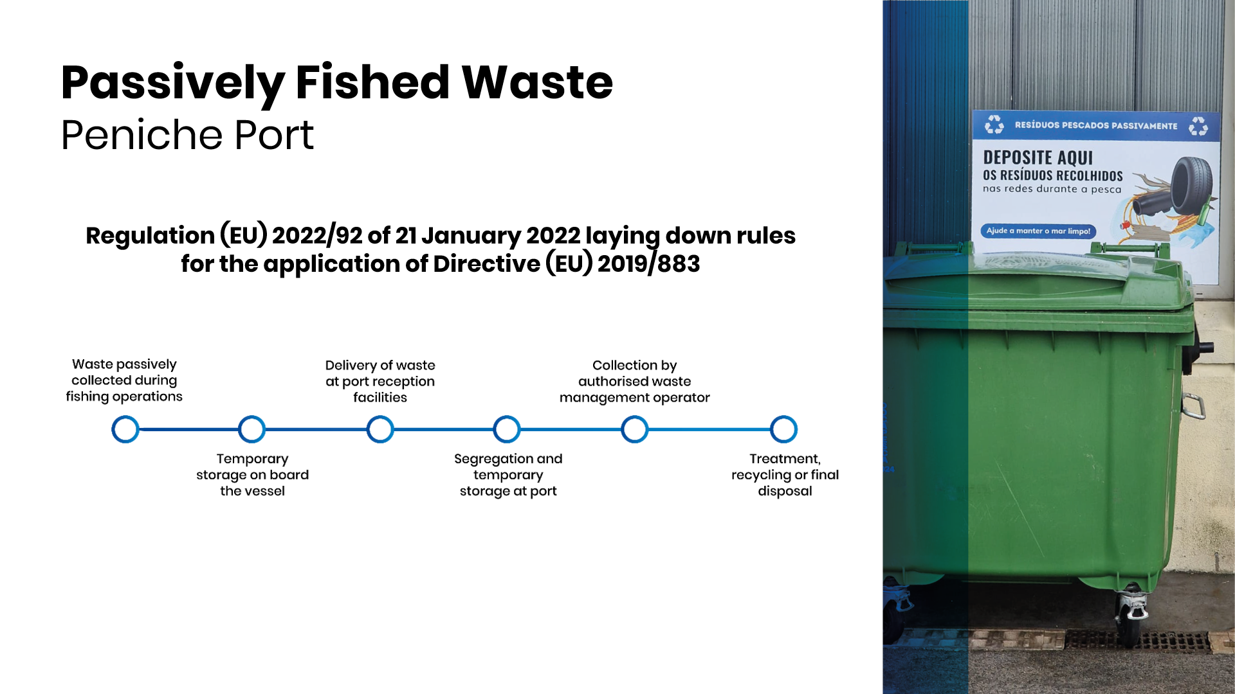

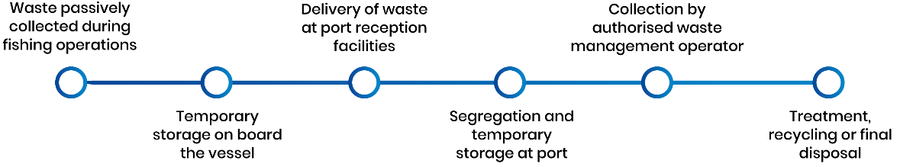
Passively Fished Waste
Peniche Port
Regulation (EU) 2022/92 of 21 January 2022 laying down rules for the application of Directive (EU) 2019/883​

Slide 12

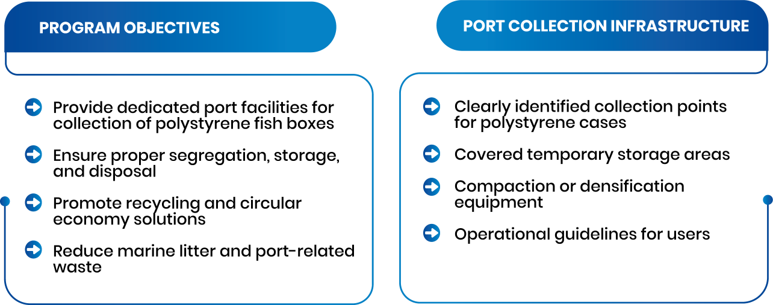
Polystyrene Collection
Port Facilities

Slide 13
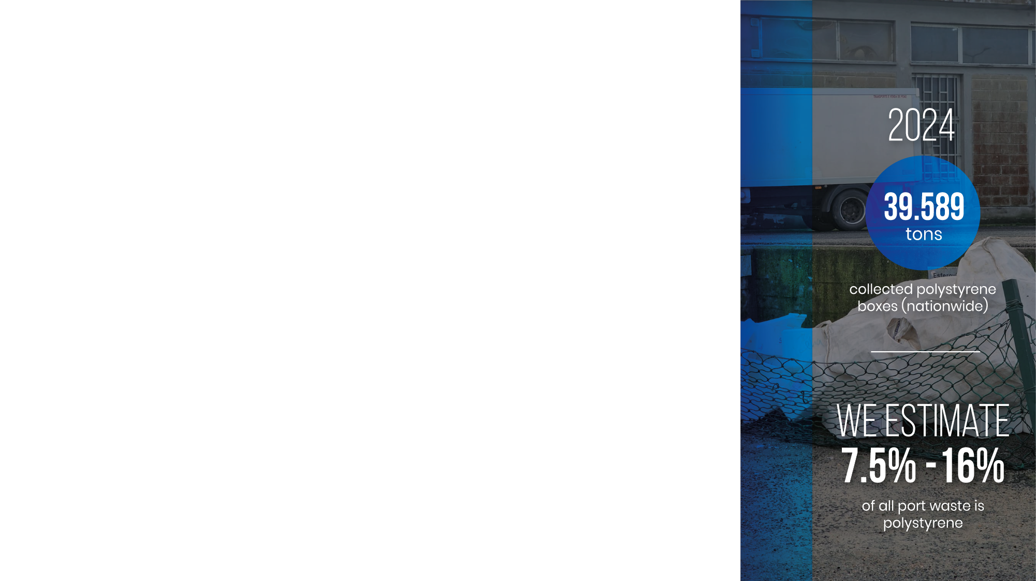
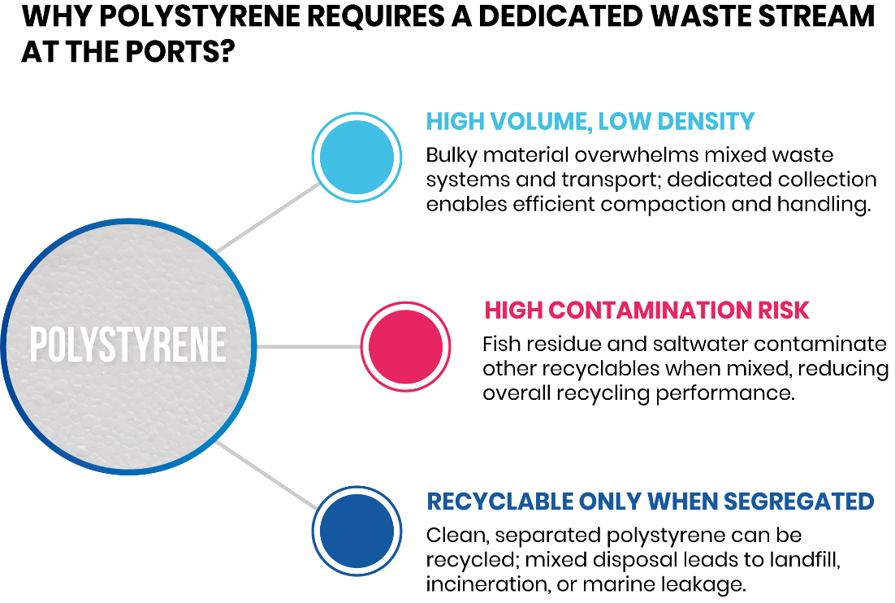
Polystyrene Collection
Data

Slide 14

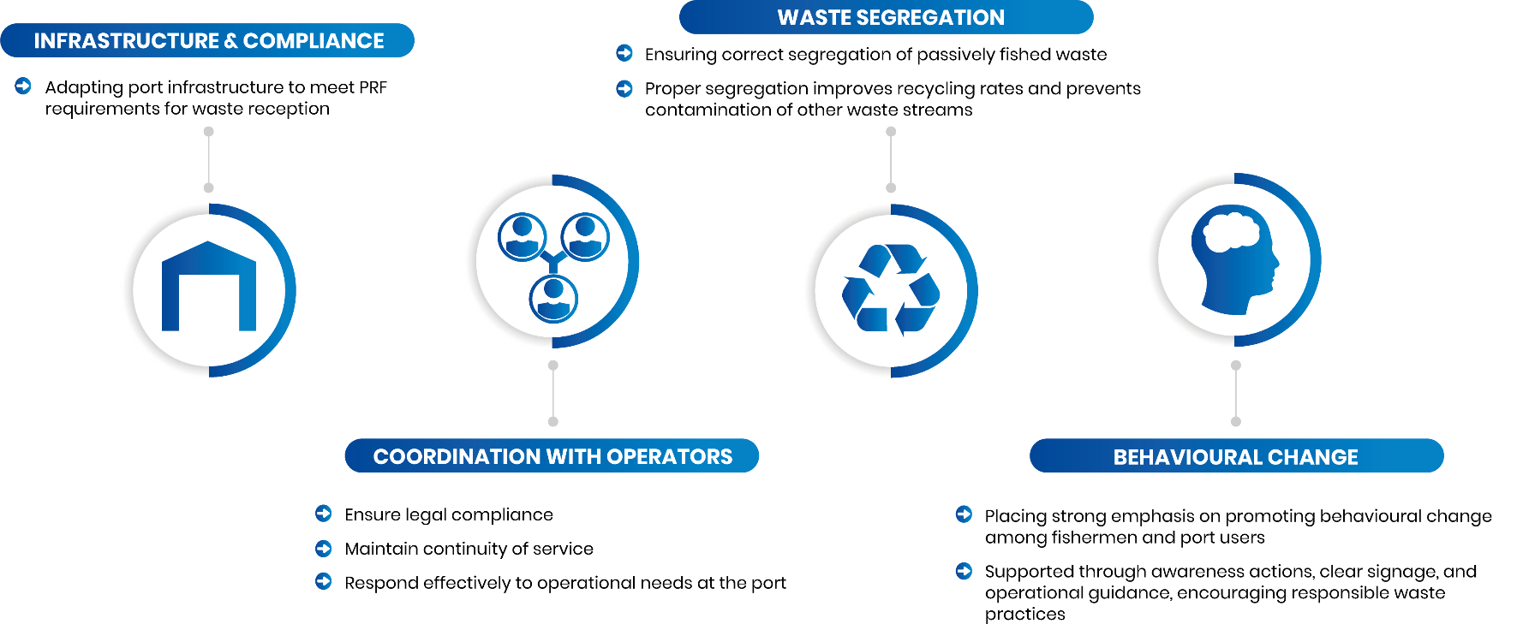
Port Management
Next steps

Slide 15



