Slide 1

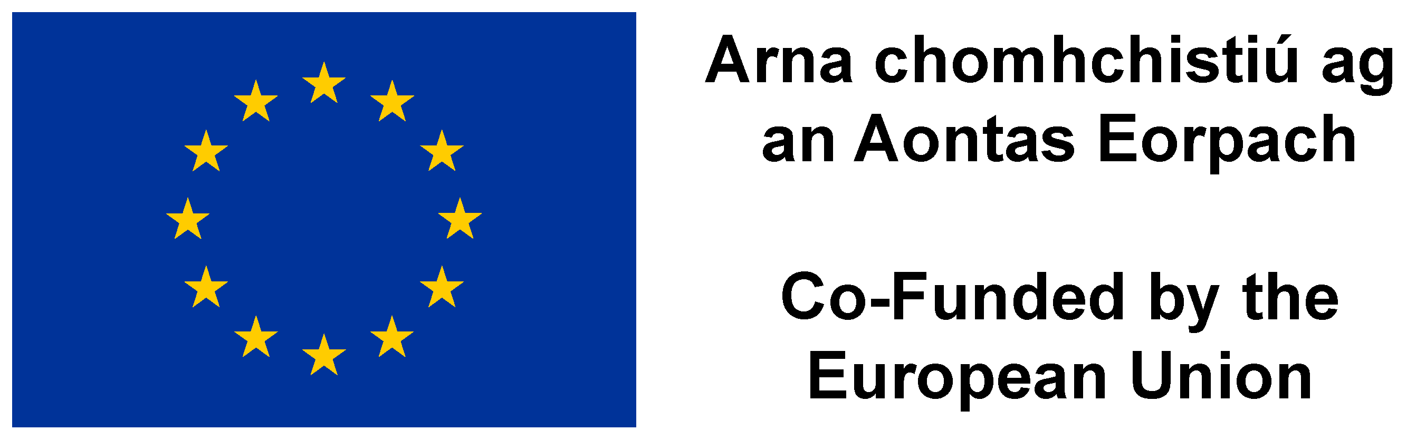

Slide 2
Background
Fishing for Litter has been running in Ireland since 2015
In 2019, BIM launched the Clean Oceans Initiative.
Incorporates FFL, CLAMS beach and pier cleans and other industry supports
Notes:
Fishing for litter is only 1 small piece in a puzzle for BIM’s Clean Oceans Initiative but it’s the catalyst for unlocking partnership, discussions and solutions that all support the Clean Oceans Initiative .
A driver for the Clean Ocean Initiative are the new Directives : Single Use Plastic Directive and the Port Reception Facilities Directive drive a number of “reference” and research activities to prepare the industry but also to work collaboratively to identify potential solutions and programmes that will enable a joint approach to succeed.

Slide 3

Why Clean Oceans?
Two key Directives
  Reducing of plastics in the Marine Env (SUP)
  Port Reception Facilities (PRF)
Overarching EU policies
    New plastics economy
    Circular Economy
    Green Deal
Support the implementation of these new directives
Leverage expertise in the sector
Manage the economic cost of the business change
Explore the opportunities associated with these changes
Earn the public social trust for stakeholders
Notes:
A

Slide 4
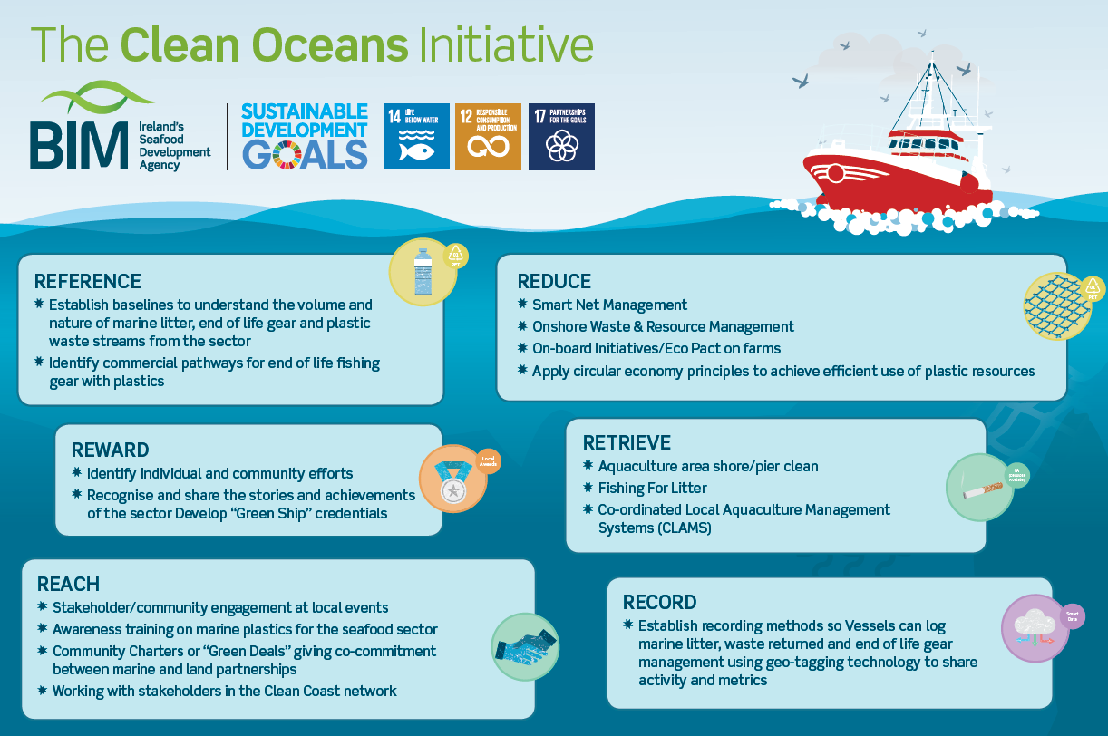

Notes:
4

Slide 5
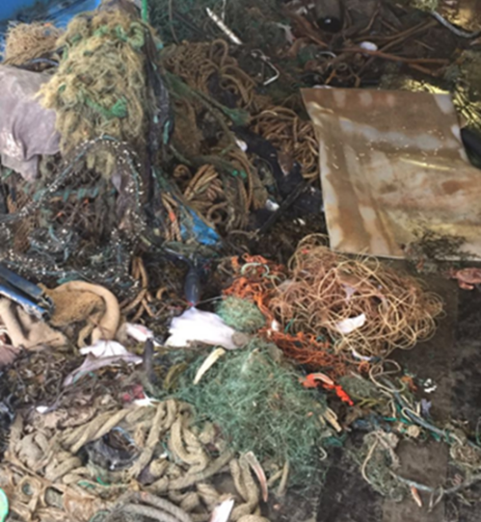
FFL in Ireland
Voluntary initiative supported by BIM
Delivered in partnership with fishers and harbour authorities to remove marine litter brought ashore during normal fishing activity.
How it works:
BIM supplies Fishing for Litter bags to participating vessels
Waste collected at sea is brought back to port
Bags are left on the pier and placed into dedicated FFL skips
Harbour authorities arrange disposal through waste contractors

Slide 6
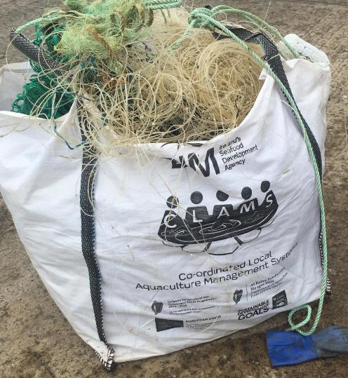
The Stats
Fishing for Litter
  244 vessels registered to take part
  1169 crew
  12 ports
  CLAMS Cleans
  11 groups
  Collaborate with local communities and NGOs
  29 events took place in 2023
  1000 tonnes+ waste collected
Notes:
2025 snapshot:
Active in 12 fishing harbours nationwide
Strong participation from the fishing industry
Ongoing support provided through the Clean Oceans Initiative

Slide 7
Fishing For Litter
Discarded
Lost/abandoned
Retired

Slide 8
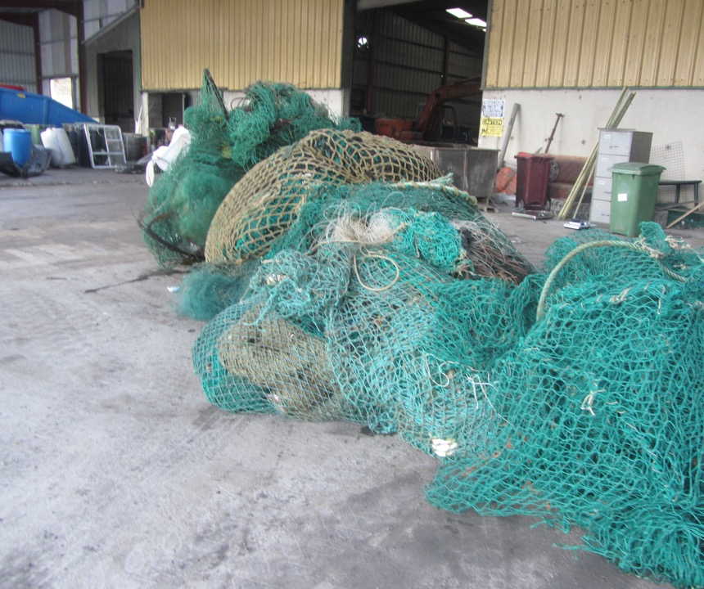
FFL Sort of 2.3 tonnes

Slide 9
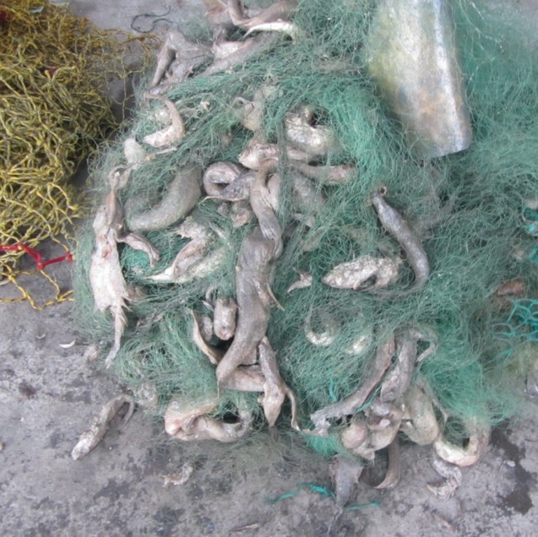
Discarded

Slide 10
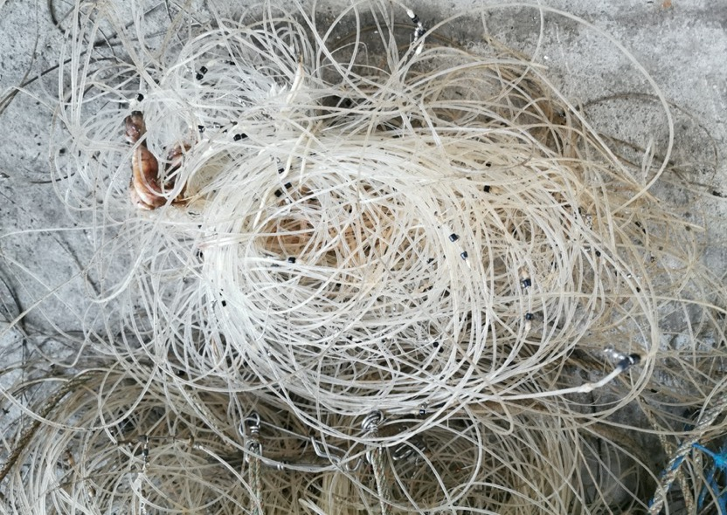
Lost/
Abandoned

Slide 11
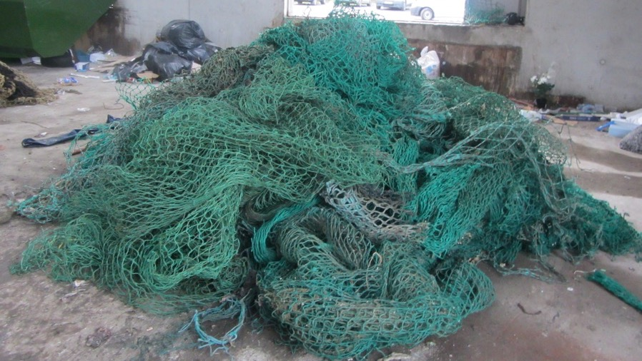
Retired?

Slide 12
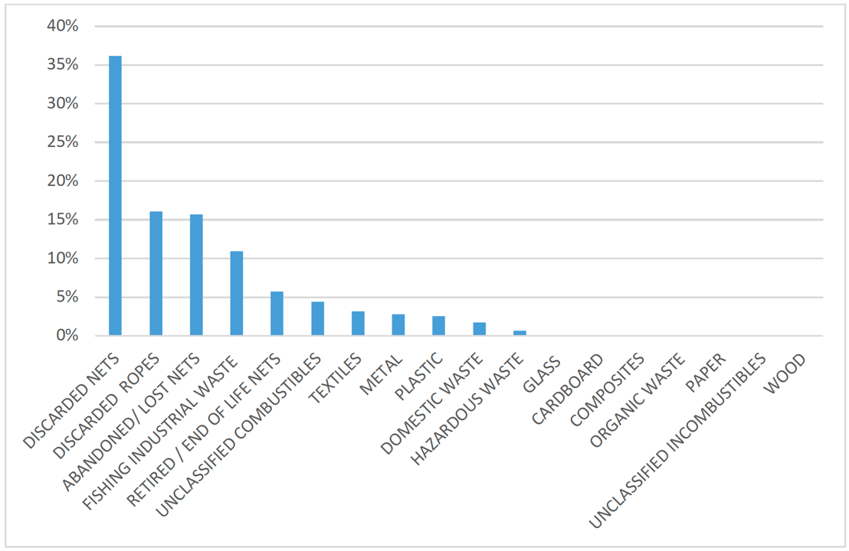

Slide 13

Why FFL needs a refresh?
Based on engagement through the Clean Oceans Initiative, BIM has identified opportunities to strengthen and modernise Fishing for Litter.
Key challenges identified:
Disposal routes focused mainly on landfill
Inconsistent data capture on waste collected
Limited number of participating harbours
Lack of standardised signage and guidance
Our aim:
To build on what’s already working and create a more consistent, visible, and environmentally robust Fishing for Litter programme
This isn’t about reinventing Fishing for Litter — it’s about making it stronger, clearer, and more future-proof.

Slide 14
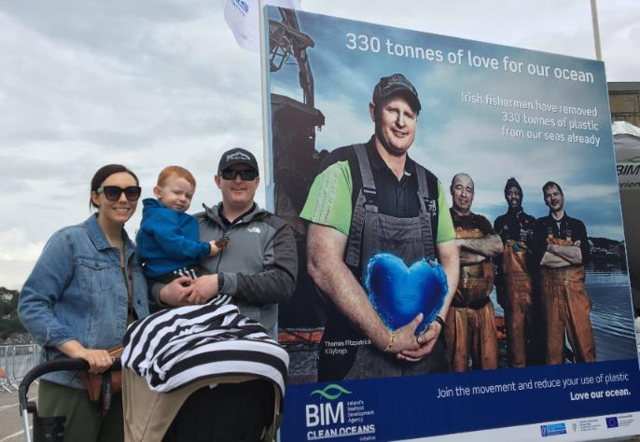
Looking Ahead: Fishing for Litter in 2026
Expanding participation
  Increase the number of harbours involved
  Improve consistency across locations
Improved visibility and awareness
  Clearer signage at ports
Better waste outcomes
  Explore options to divert FFL materials from landfill
Stronger data and oversight
  Improved tracking of waste volumes
  Better evidence to support funding and future investment

Slide 15

Thank You!
For further information or to discuss Fishing for Litter and Clean Oceans initiatives, please contact:
BIM
  Sandra Hennessy: sandra.hennessy@bim.ie
  Catherine Morrison: catherine.morrison@bim.ie
MTU – Clean Technology Centre
  Colum Gibson: colum.gibson@mtu.ie

