Slide 1
Extended Producer Responsibility for fishing gear in Spain

Slide 2
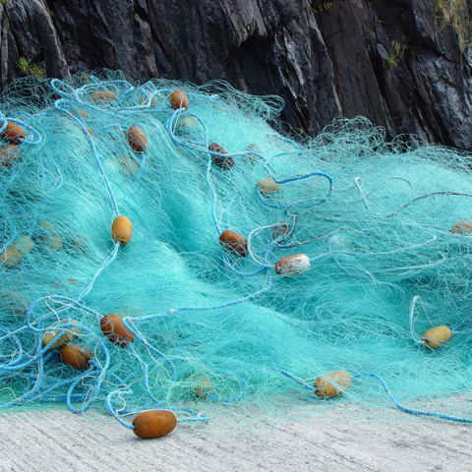
Summary
1
Current situation of the Spanish fishing fleet
2
Implementation status of EPR for fishing gear in Spain
3
Issues identified in data collection and reporting
4
Passively fished waste
5
Marine Litter Seminar

Slide 3
CURRENT SITUATION OF THE SPANISH FISHING FLEET
1

Slide 4
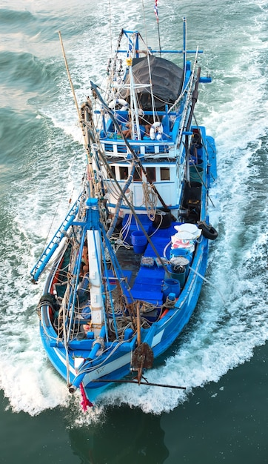
Current situation of the Spanish fishing fleet
8.549 fishing vessels
249 ports that can be managed by:
Up to 9 different types of fishing gear:
Trawling
Purse seine
Longline
Gillnets
Small-scale gear (various small gillnets, longlines, or traps)
National and international fishing grounds
High variability in dimensions
State Ports Authorities
Regional authorities

Slide 5
IMPLEMENTATION STATUS OF THE EPR FOR FISHING GEAR IN SPAIN
2

Slide 6
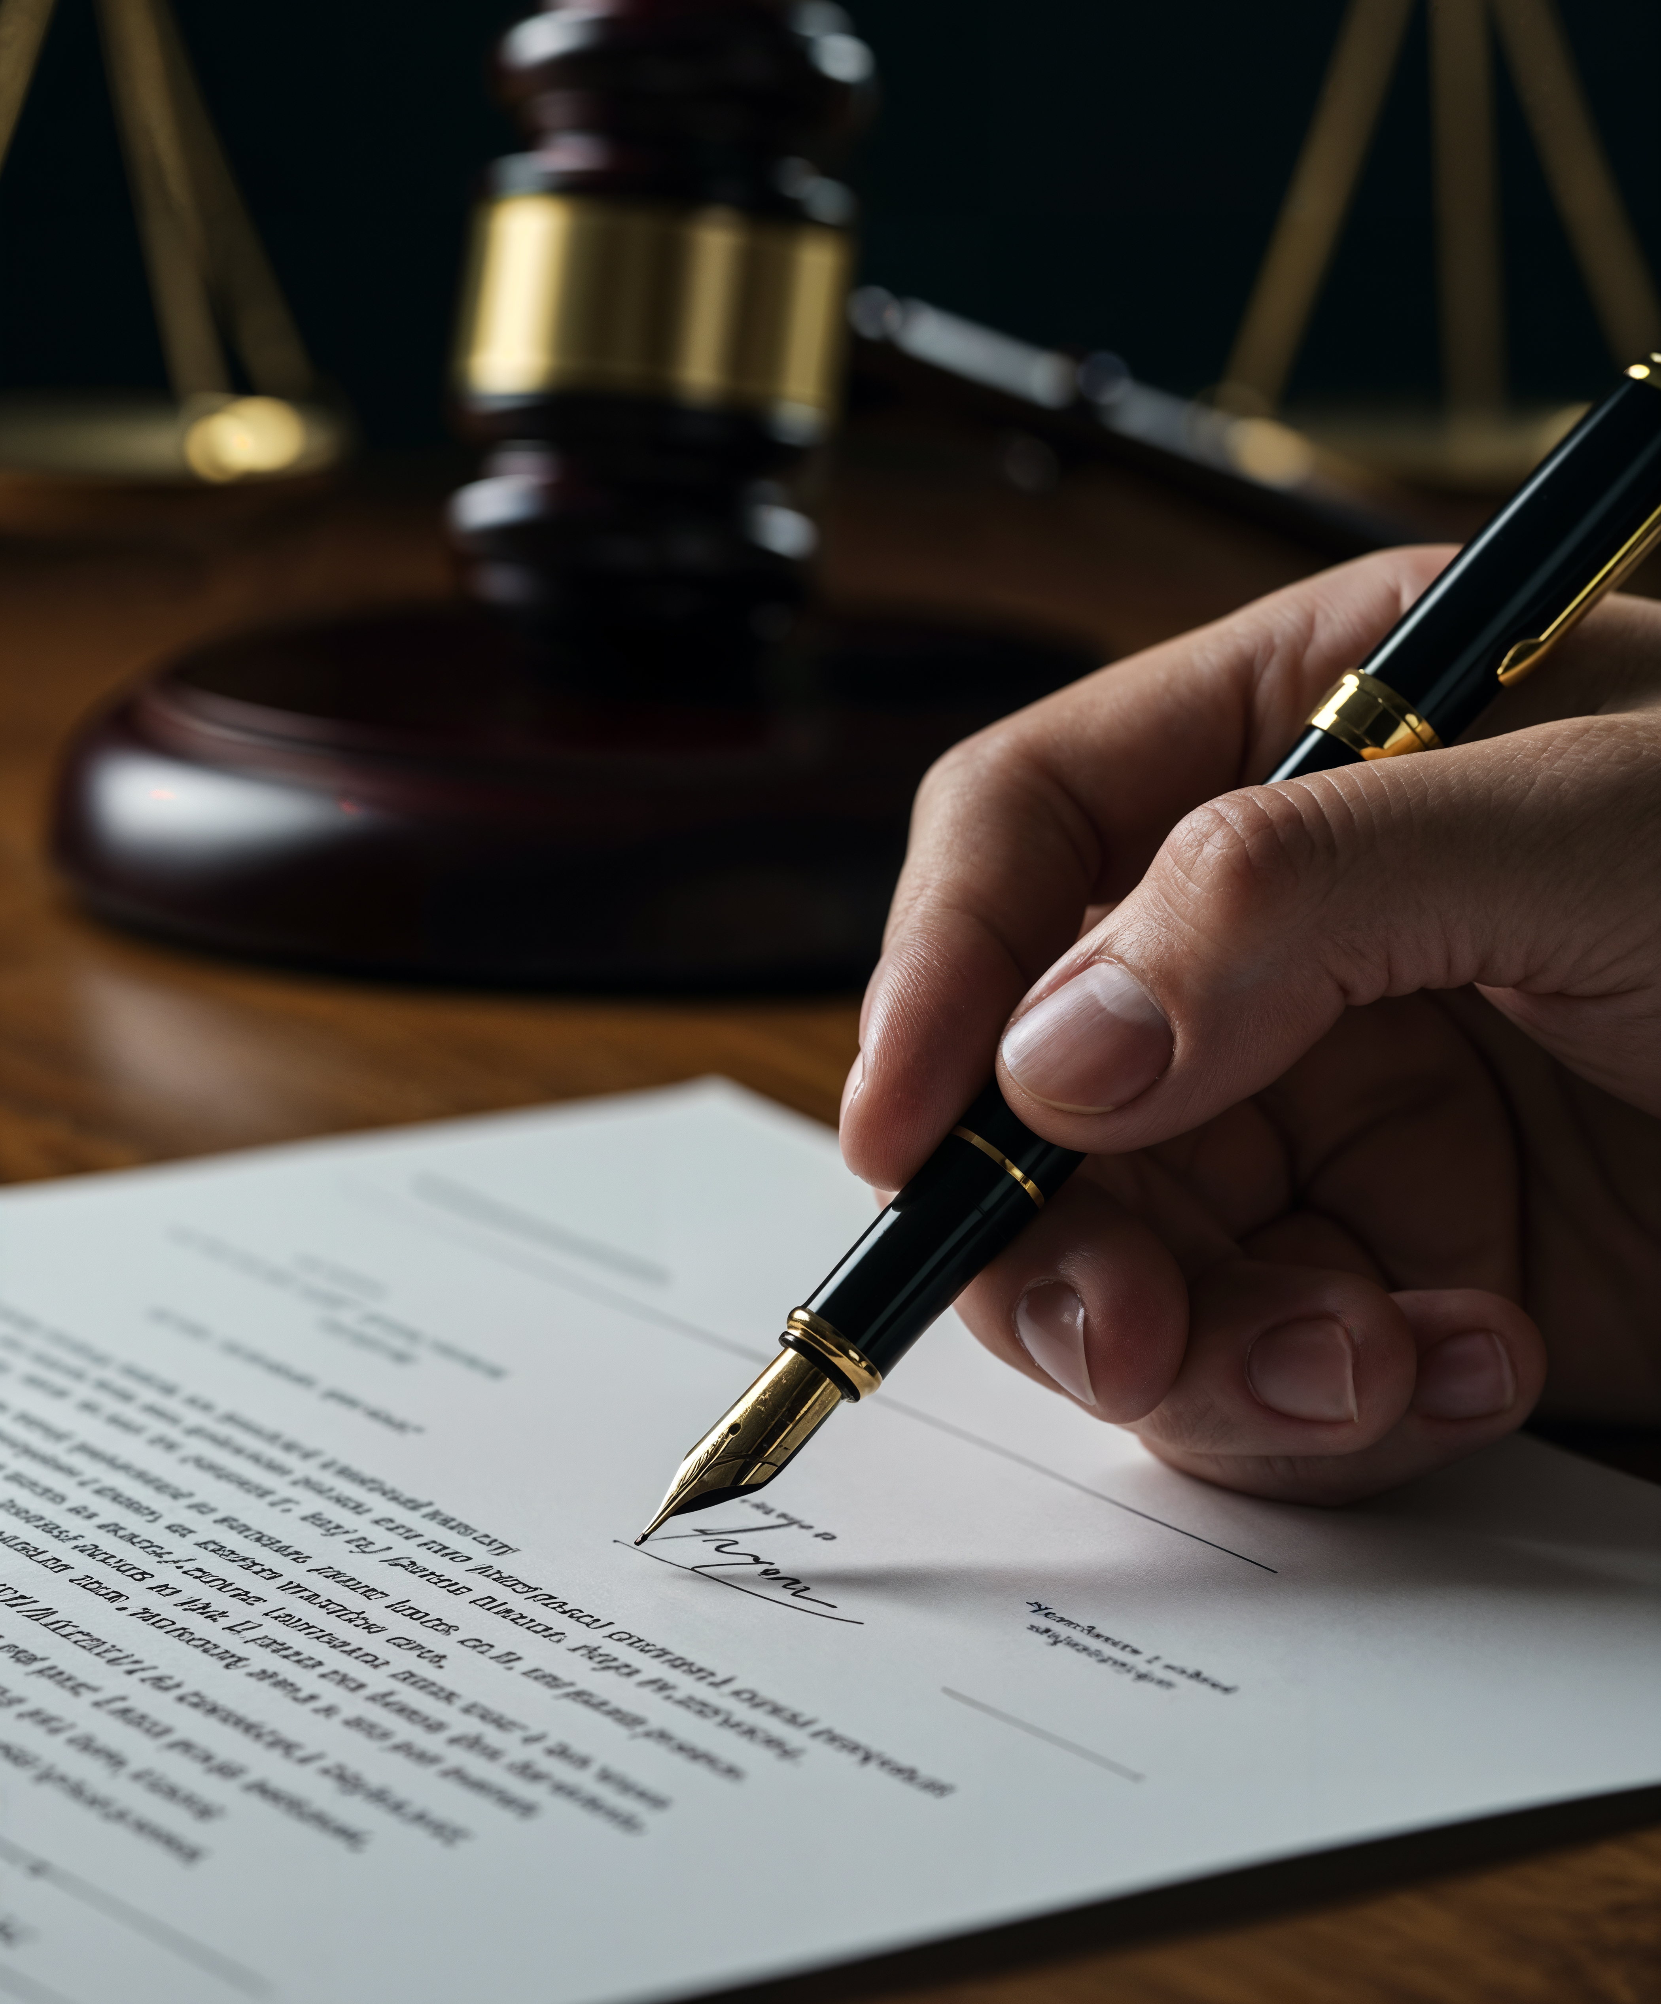
Implementation status
Current status of the law
Draft in development
Next steps
Public information

Slide 7
ISSUES IDENTIFIED IN DATA COLLECTION AND REPORTING
3

Slide 8
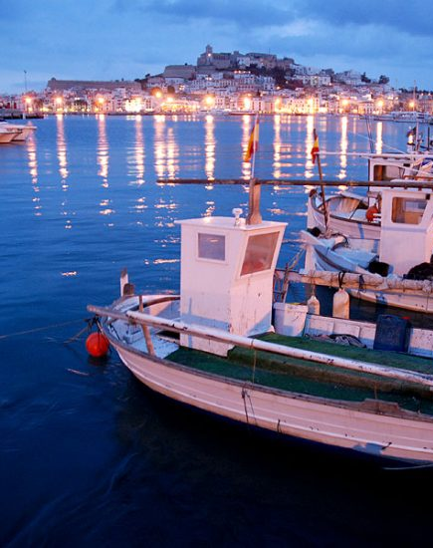
Issues identified in data collection and report
Fishing gear placed on the market:
Identifying which entities participate in the sale of fishing
Lack of organization or formal association among fishing gear producers
Producers have not been highly cooperative
Fishing gear collected in ports:
Ports managed by different authorities
No common waste management system
No regulation requiring all ports to report information in a standardized manner
Some ports do not provide separate data on fishing gear waste

Slide 9
Data reported
Fishing gear COLLECTED in ports
Fishing gear PLACED on the marked
Data collected by surveys and meetings
Data source: ports, proyects, waste management and acuiculture companies
Data collected by surveys
Data source: fishing gear producers
85%
Year | 2022 | 2023
Total sold (ton) | 7.106,75 | 6.732,25
Year | 2022 | 2023
Total collected (ton) | 635,28 | 921,24

Slide 10


PASSIVELY FISHED WASTE
4

Slide 11
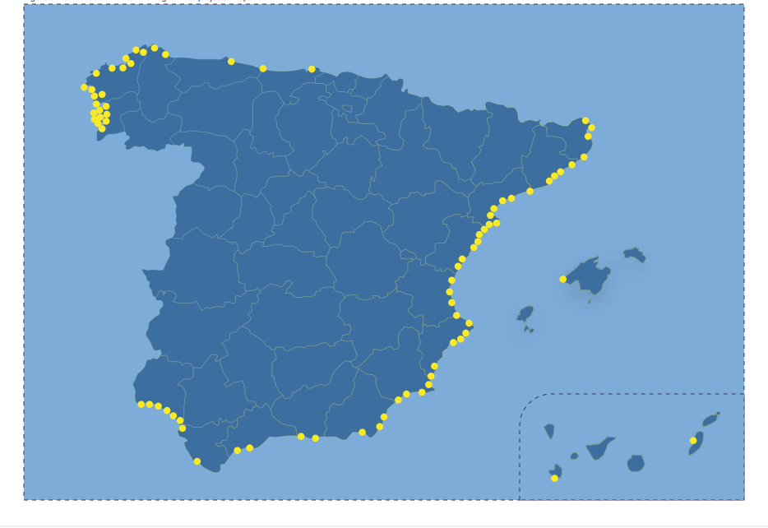

Fishing for litter started in 2009 and has significantly increased since then. Considered a Good Practice committing fishers in marine protection.
  In 2023 we formalised a National Fishing for Litter Scheme, supported by National Guidelines (Folleto intemares IN2), demonstrative actions and a National Reporting System that is being used to gather data from ports and to report into DONA.
Mediterranean subregión: vessels are smaller, they fish closer to the coast and marine litter is higher in number of units but lower in weight = small objects related to land-based activities (single-use plastic objects derived from tourism and domestic consumption).
Atlantic subregión: vessels are larger, fishing at longer distances from the coast and for more days. Most of the litter is composed of large objects related to fishing activity.

Slide 12
method for collecting data
  Data are obtained by a specific person with this role at the port.
  In ports with an ongoing Project (for example, Mares Circulares, Upcycling the Oceans, or others), this role is normally assumed by the project. In ports with no specific Project, this role is assumed by the Port Authority (as currently in Marín and Vigo ports).
Involvement of fishers
  Each initiative includes its own activities to involve local fishers. We estimate that around 1.200 fishers and 10% of the fishing fleet are already involved.
  Involvement of port authorities
  They have the responsibility to report data to the Ministry. Training workshops in September and October 2024.
Year | 2022 | 2023
Total collected (ton) | 144,24 | 152,87

Slide 13
MARINE LITTER SEMINAR.
FISHING GEAR. EXTENDED PRODUCER RESPONSIBILITY
5

Slide 14
Marine Litter Seminar
08-09 October, 2025 (Valsaín, Segovia)
Goals
Atendees
Main results
Discussed topics
The main goal was to lay the foundations for a more coherent, effective, and sustainable management system that ensures compliance with producers' obligations and contributes to a real circular economy in the fishing sector.
Waste management companies
Port Authorities
Fishing gear producers
Environmental Associations
Public Administration
Sharing of identified needs and analysis of how to move forward with the implementation of the RAP for fishing gear.
Transversal aspects: fishing gear producer definition, recreational fishing
Traceability in fishing gear
Waste managements models in ports: collection, cleaning and transport, improvement of materials and designing

