Slide 1
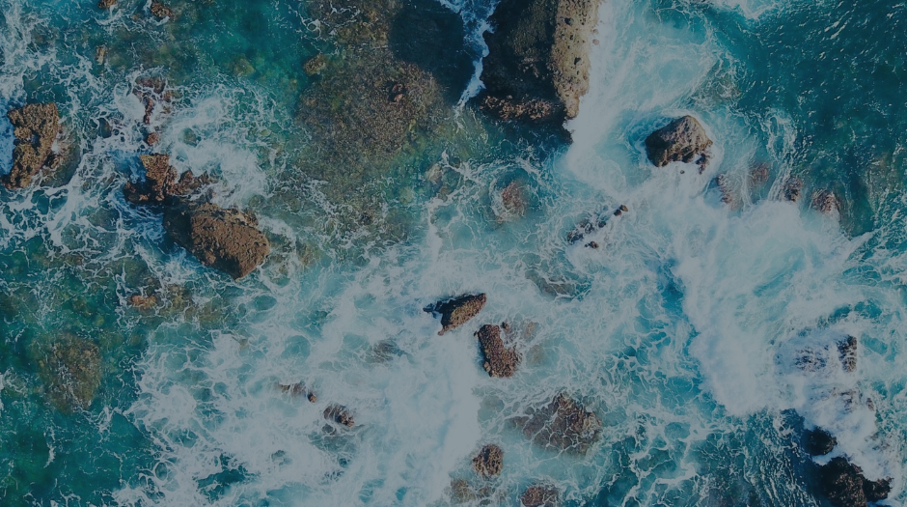

Local Authorities International Environmental Organisation

Slide 2
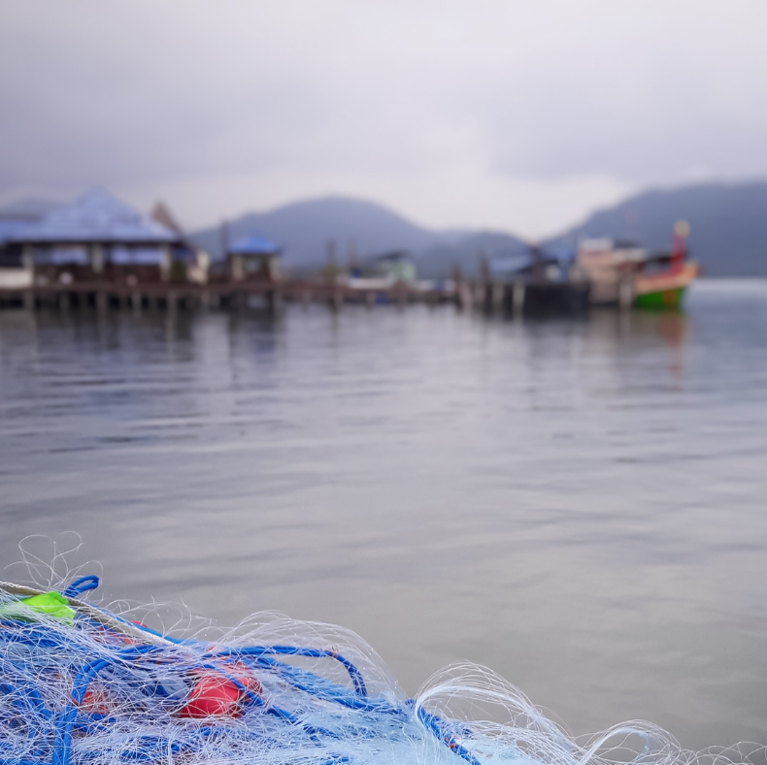
Municipalities for sustainable seas
Since 1990 KIMO has united local governments in preventing pollution and protecting, preserving and enhancing the seas and coastal waters of the North-East Atlantic, Baltic, Irish and North Sea
Notes:
KIMO was established in 1990 by four municipalities from the UK, Denmark and Norway out of concern for the marine environment and a shared recognition that issues related to pollution require cross-boarder collaboration.
This ambition is reflected in KIMO’s mission which is to unite local governments in preventing pollution and protecting, preserving and enhancing the seas and coastal waters of the North-East Atlantic, Baltic, Irish and North Sea

Slide 3
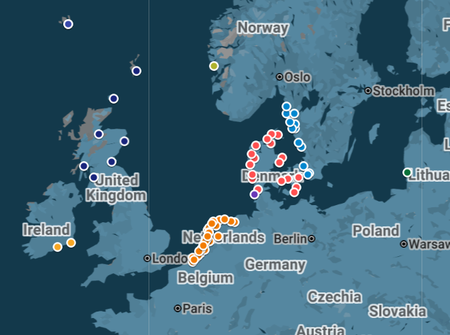
Members
Notes:
KIMO’s network currently unites 78 municipalities from eight countries.
As can be seen from the map, KIMO has most members in Denmark, Sweden, the Netherlands and the UK.

Slide 4
A clear path forward with three priorities (2026-2030)
Marine litter
Chemical pollution
Maritime safety and pollution
Notes:
In October 2025 KIMO’s members approved a new strategy for the next five years. The strategy sets a clear path forward, focusing on three thematic areas which are present a key concern for KIMO’s members.

Slide 5
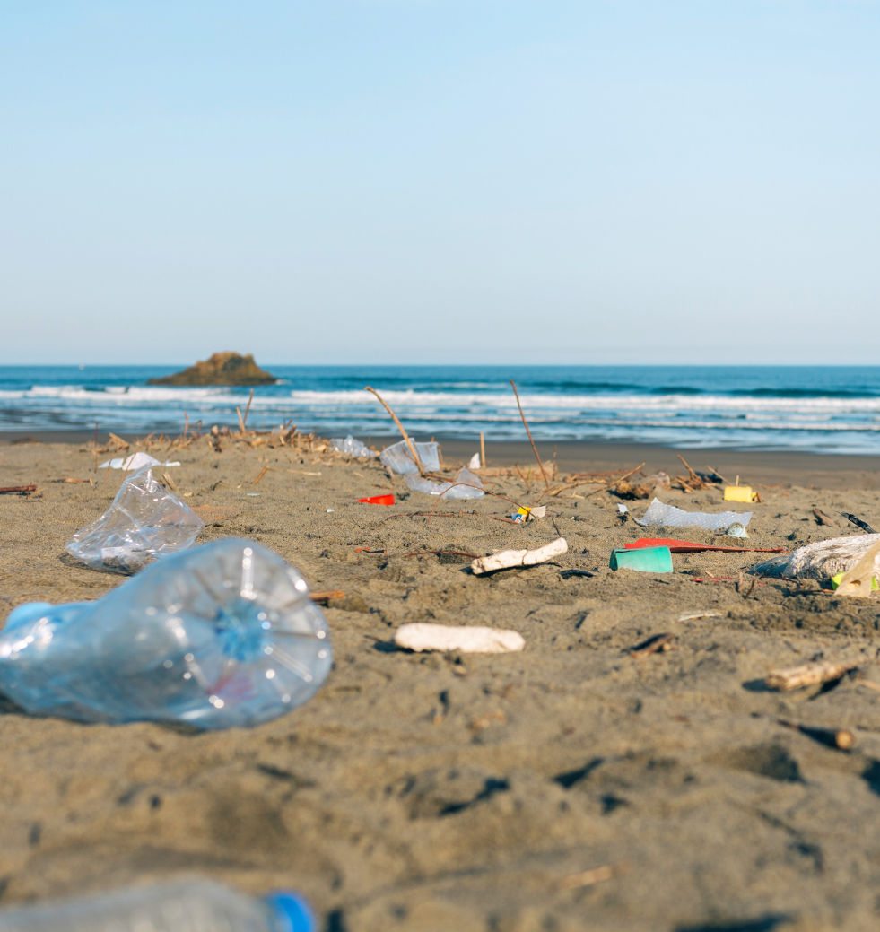
Priority 1:
Marine Litter
Mission
Reduce and prevent marine litter by raising awareness about its negative impacts, lobbying for legislative change and implementing projects and activities to ensure that coastal communities have access to solutions that mitigate the threats posed by marine litter.
Action areas
Riverine litter
Maritime waste
Microplastics
Notes:
Marine litter continues to be one of KIMO’s key focus areas and Fishing for Litter a flagship project.

Slide 6
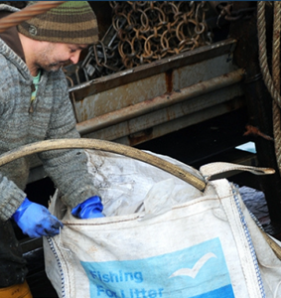
Fishing for Litter
Initiated by KIMO as a project in the Netherlands in 2004
Since expanded to 11 countries across Europe and is recognized as a best practice by the European Commission, HELCOM and OSPAR which encourages Contracting Parties to adopt similar schemes.
KIMO coordinates FFL projects in KIMO UK and KIMO Netherlands & Belgium
KIMO continues to gather information across the FFL network through Fishing for Litter – Working with fishermen to clean our seas
Notes:
Marine litter continues to be one of KIMO’s key focus areas and Fishing for Litter a flagship project.

Slide 7

KIMO UK
Fishing for Litter
Evolution Over Time Celebrating 2005 to 2025

Slide 8
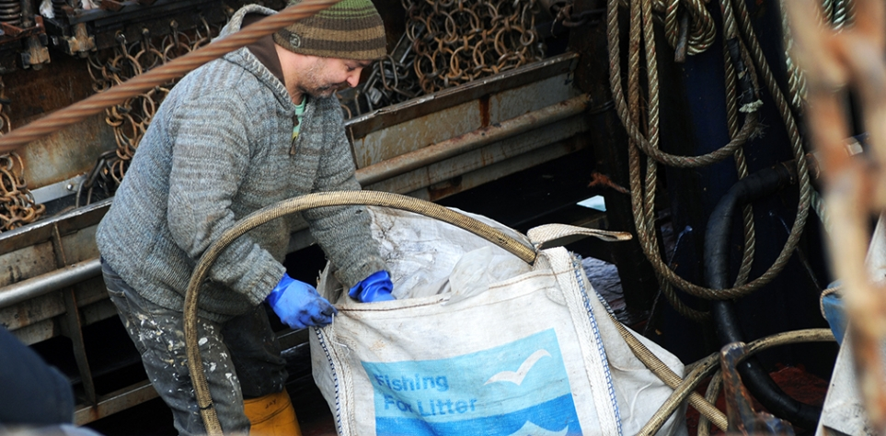

What is Fishing for Litter?
A simple, effective initiative that aims to reduce marine litter through involvement of the fishing industry, ports and harbours

Slide 9
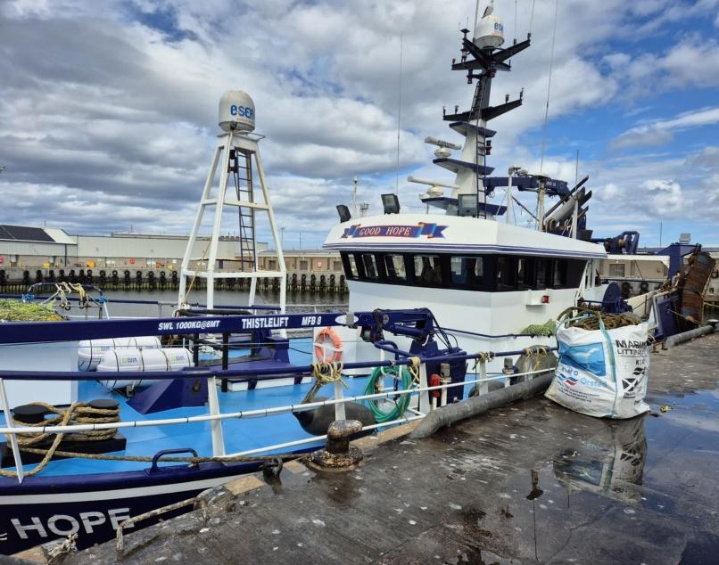
\
KIMO’s Fishing for Litter has established itself as the leading scheme for fishers to remove marine litter from the sea - and takes place across Europe
Photo – Good Hope landing at Peterhead

Slide 10
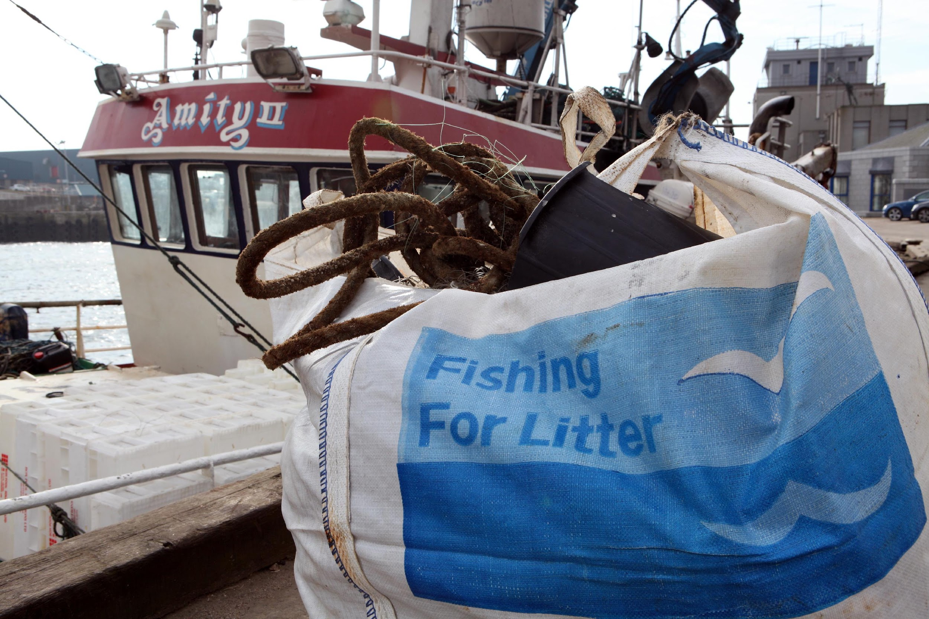
Who takes part in the UK?
70 harbours across the UK – including 38 across Scotland
Fraserburgh, Lerwick and Peterhead in Scotland were original 3 participants in FfL Pilot – joining at the launch in 2005.
Over 700 vessels registered in UK , 480 of which in Scotland.
Over 3,250 tonnes of litter collected in since start of project in 2005. Of which…2,650 tonnes collected in Scotland!
This equates to approximately 35,000 large bags

Slide 11
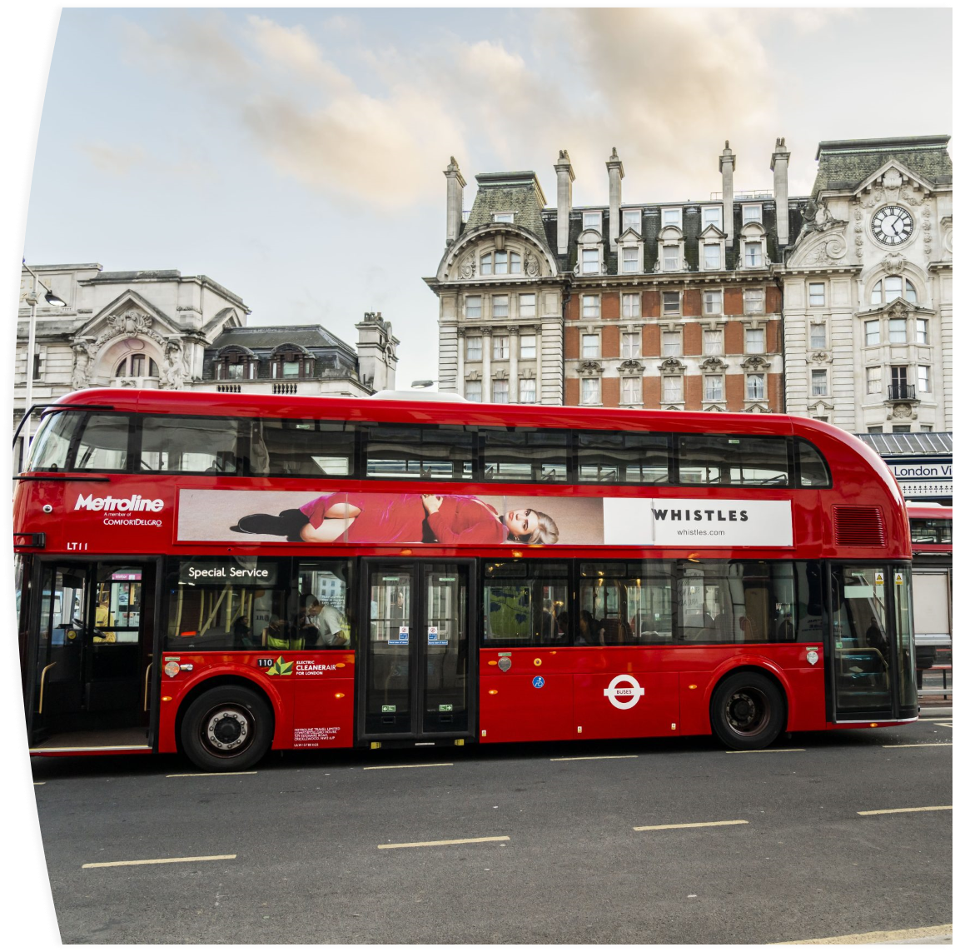
Interesting Fact!
1,000 TONNES OF LITTER = Approx 80 new Routemaster buses!

Slide 12
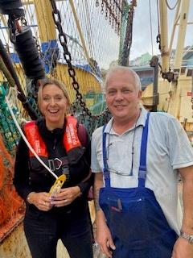
Why do we do it?
Reduces the amount of marine litter in the oceans
Increases awareness amongst fishers and the fishing industry of…
Monitoring marine litter coming ashore
Investigating the possibility of recycling marine litter

Slide 13
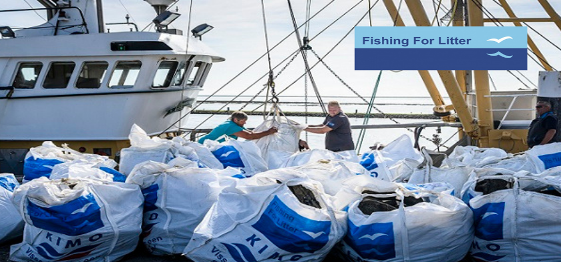
How does it work?
Participation is voluntary
Boats are issued with hard-wearing bags
Fishers collect marine litter caught in nets and gear during normal fishing activity
Waste is removed and disposed of by a waste management company or local authority
Both support and Funding received from Scottish Government.
No cost to the fishermen

Slide 14
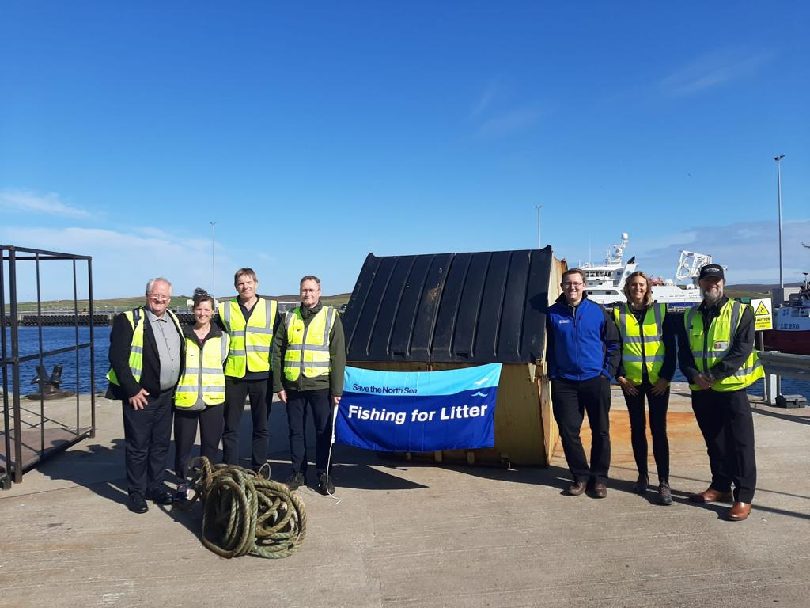
Positive Outcomes
Organisation is simple, passive, voluntary & effective - easy to participate
Raises awareness amongst fishers
Raises awareness with public when attending events
Engagement with schools to deliver education resources
Creates long term behaviour change in the fishing sector
Reduces the amount of litter in the marine environment
Produces a ‘feel good’ factor for participants
Better quality catch.

Slide 15
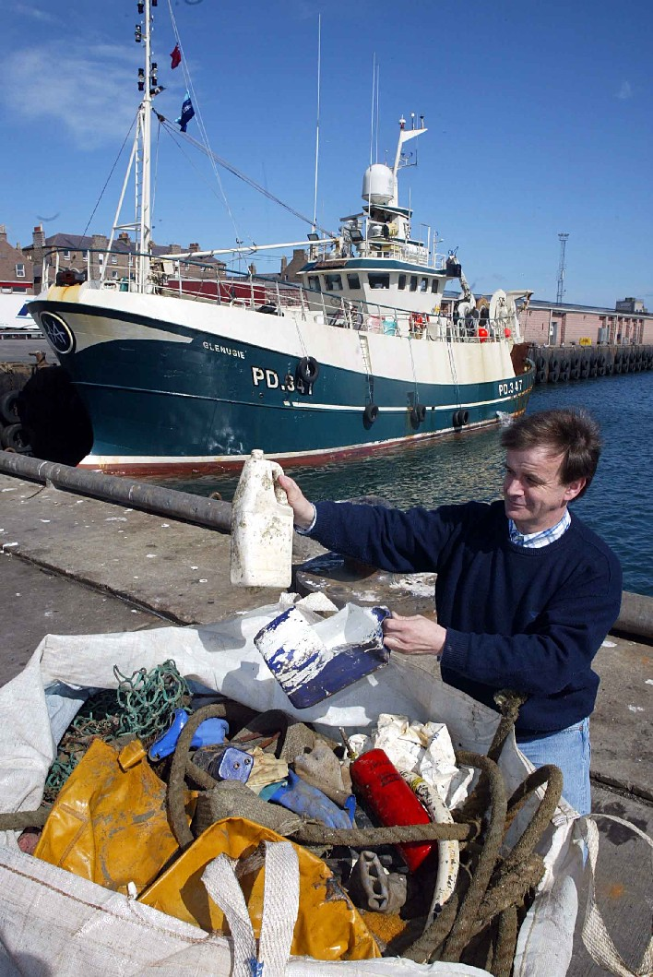
Challenges
Boat size, fishing practises, lack of FFL facilities in harbours
Collection & sorting
Misuse of skips and bins
Costs and logistics
Recycling/repurposing
Obtaining funding

Slide 16
So what else do we do …..?

Slide 17
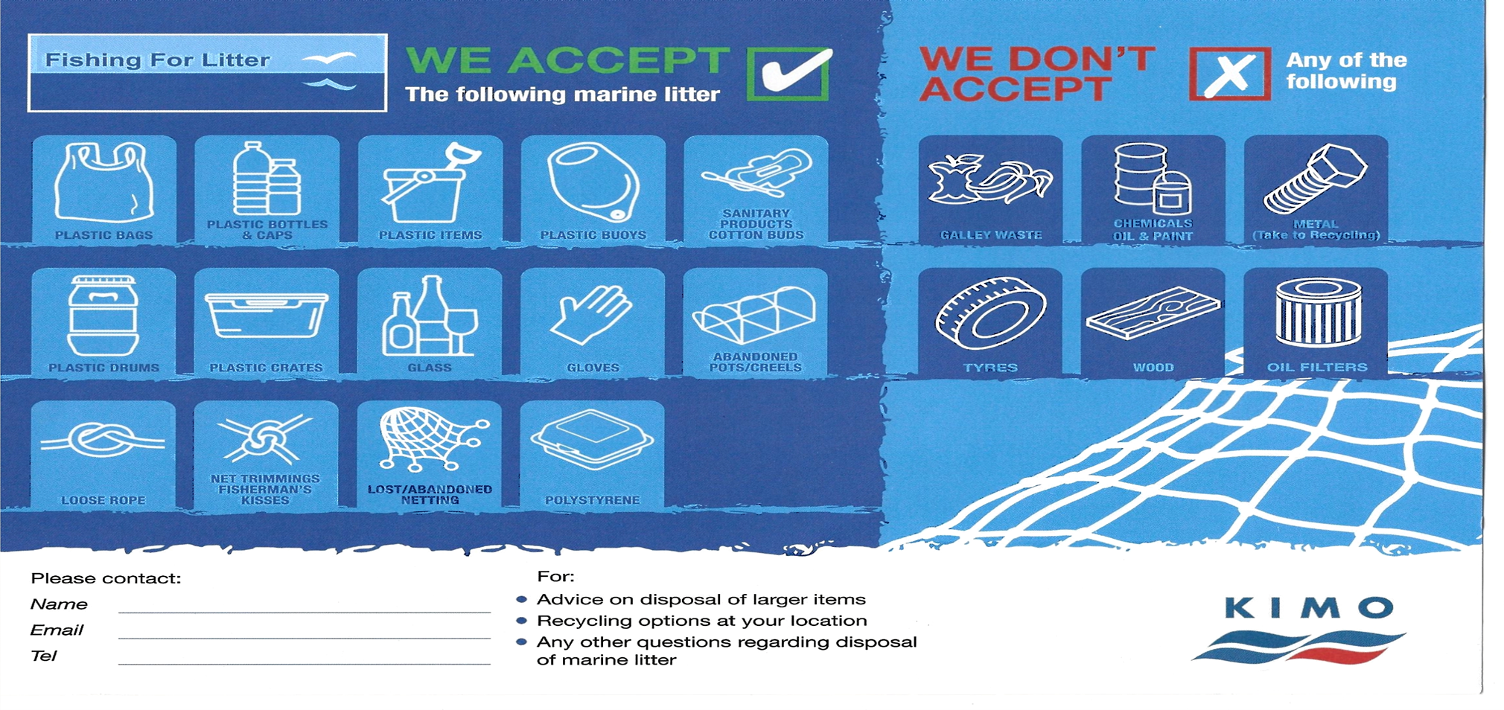
Provide Guidance to Fishermen
National/Devolved Government
Industry
Private Funders
Ports/harbours
Local authorities

Slide 18
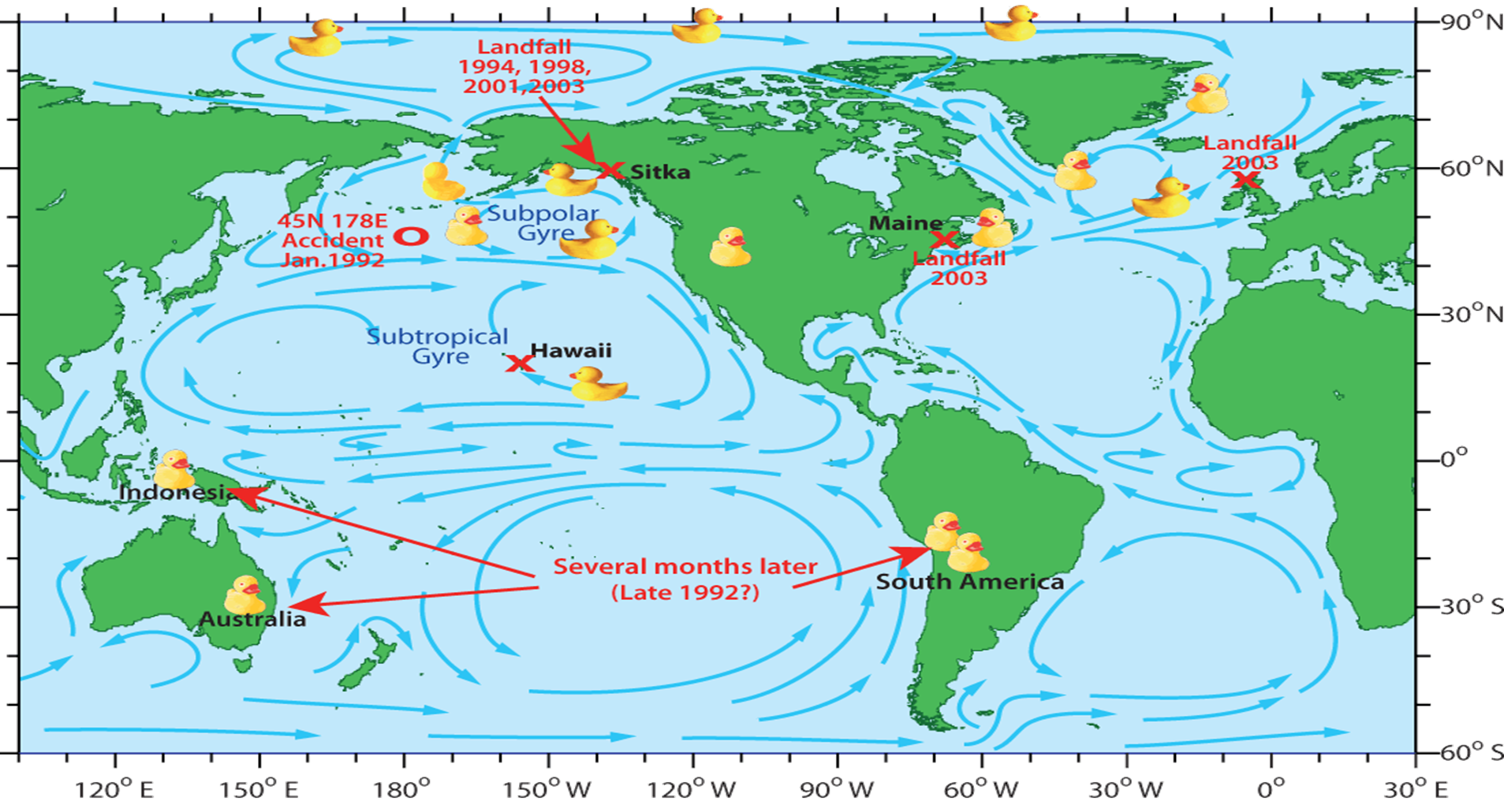
Provide Education Resources
For example, we tell children incidents of relating to marine litter e.g. to make them aware of the effects of currents:
In 1992 a cargo ship transporting bath toys from China to USA got caught in a storm. A shipping container fell overboard, and 29,000 plastic ducks were released into the sea! Over the years, due to currents, ducks have been found all over the World.
An exert from our resources is shown here:

Slide 19
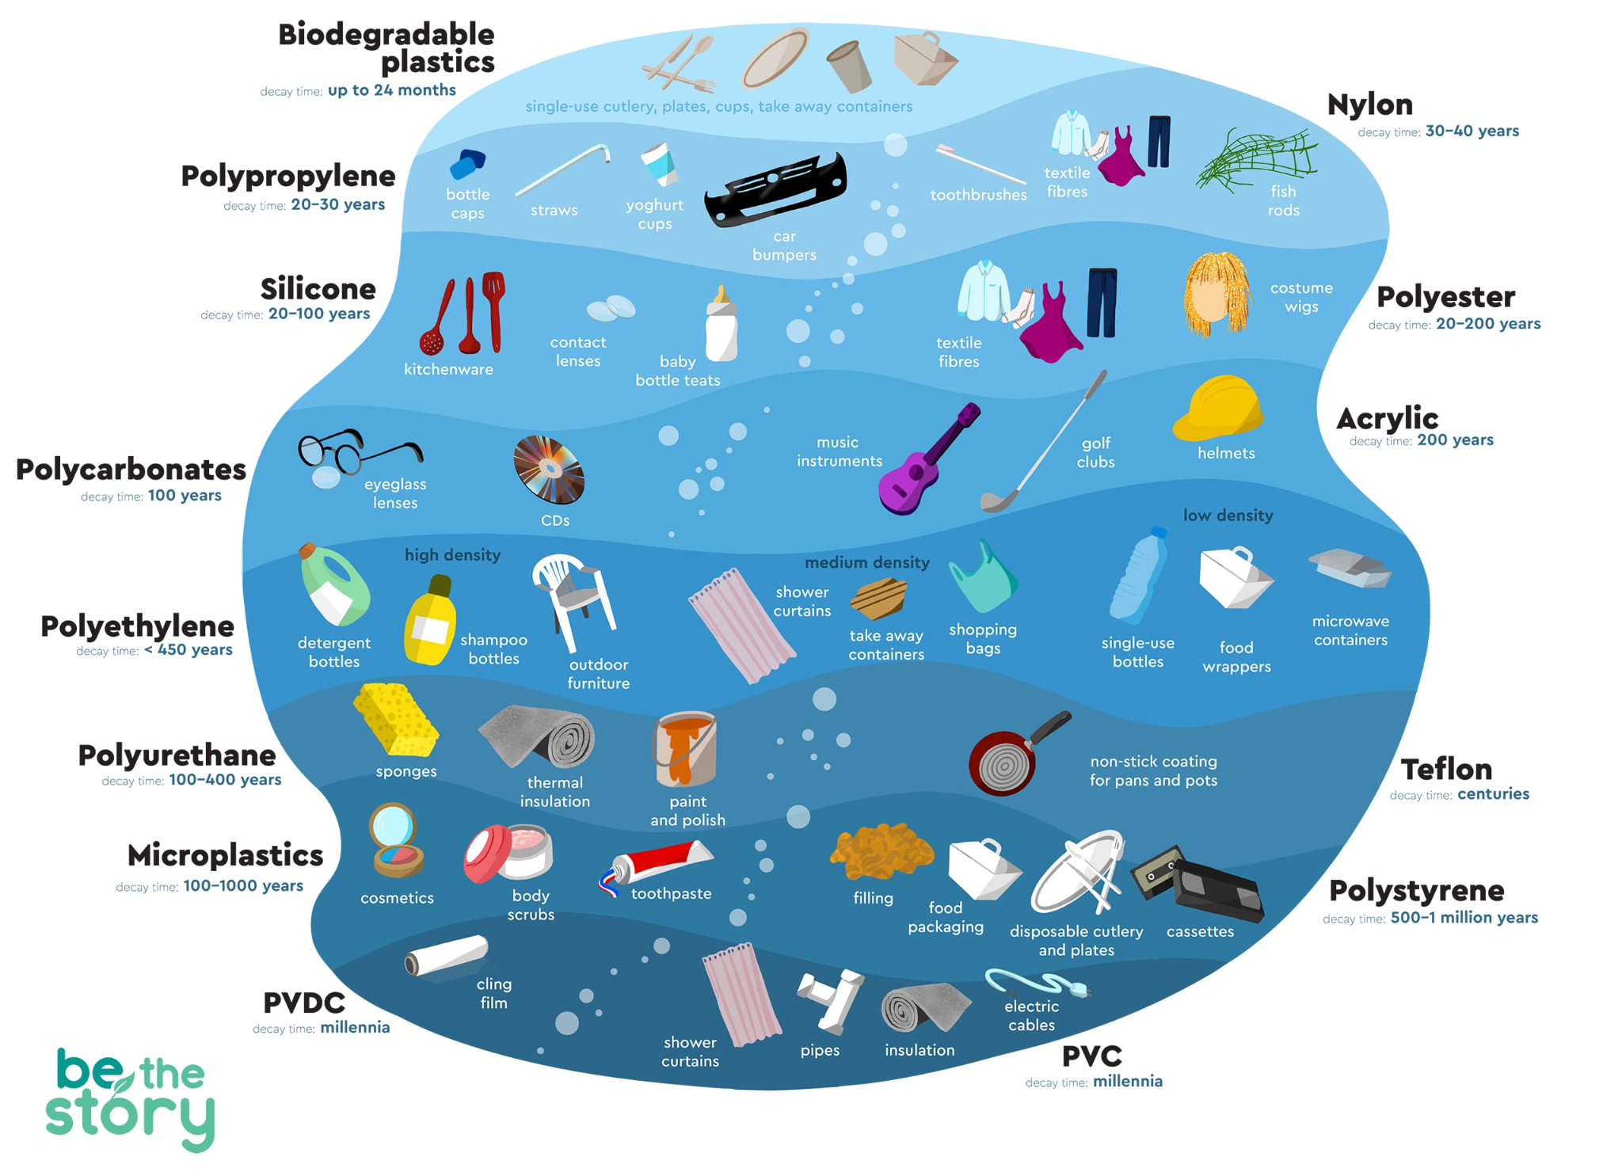
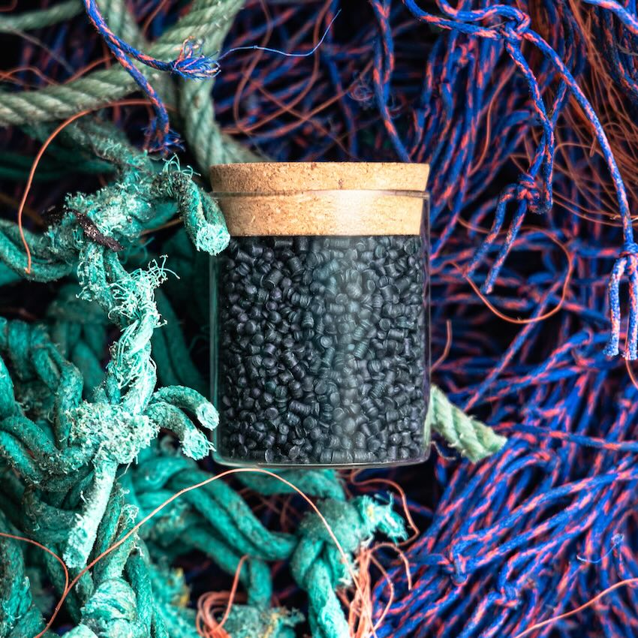
Recycling of marine litter is at the forefront of our research for 2026

Slide 20
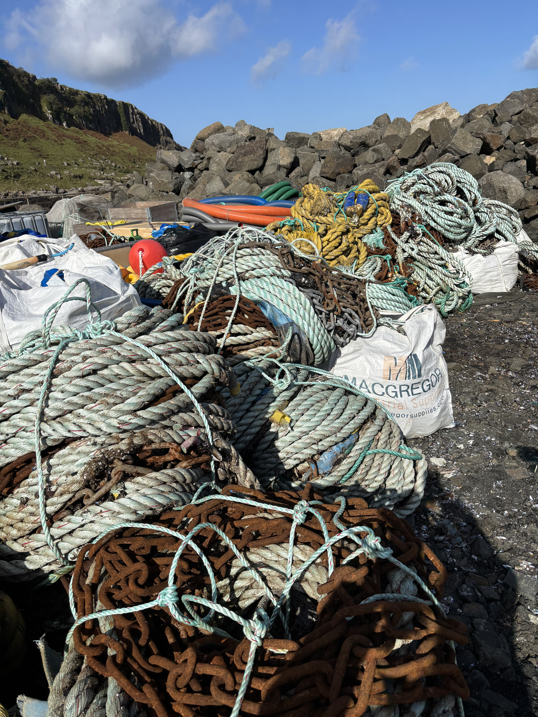
2025 FFL pilot: Isle of Skye Fisheries Recycling Coalition
Rope from fish farms, harbours and FFL bins
End of life rope sent to a marine recycler- Waterhaul
9 tonne recycled!
In May we will run another scheme
We believe the first scheme in UK to combine end-of-life rope recycling from different fishing industries

Slide 21
Fishing for Litter Netherlands
Since 2001, KIMO has been coordinating Fishing for Litter
Over past 25 years, removed nearly 9 tonne of waste from the North Sea.
Participating ports in the Netherlands:Delfzijl, Eemshaven, Lauwersoog, Harlingen, Den Oever, Den Helder, IJmuiden, Scheveningen, Vlissingen, Stellendam en Breskens.
We are investigating whether we can use the waste from the sea, recycled by waste processor Bek & Verburg, can be made into new materials, such as benches or bicycle racks.

Slide 22
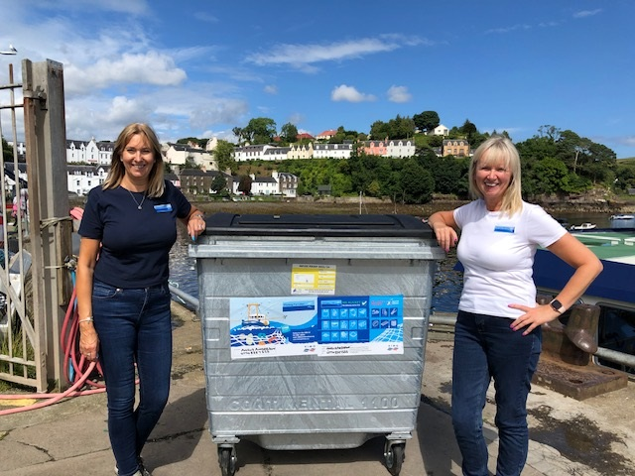



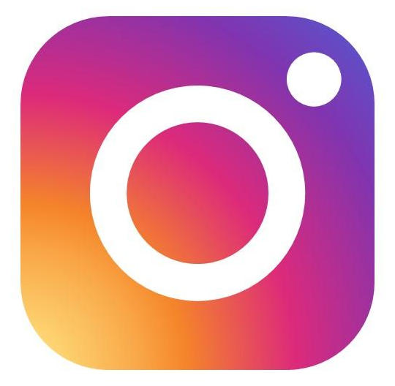

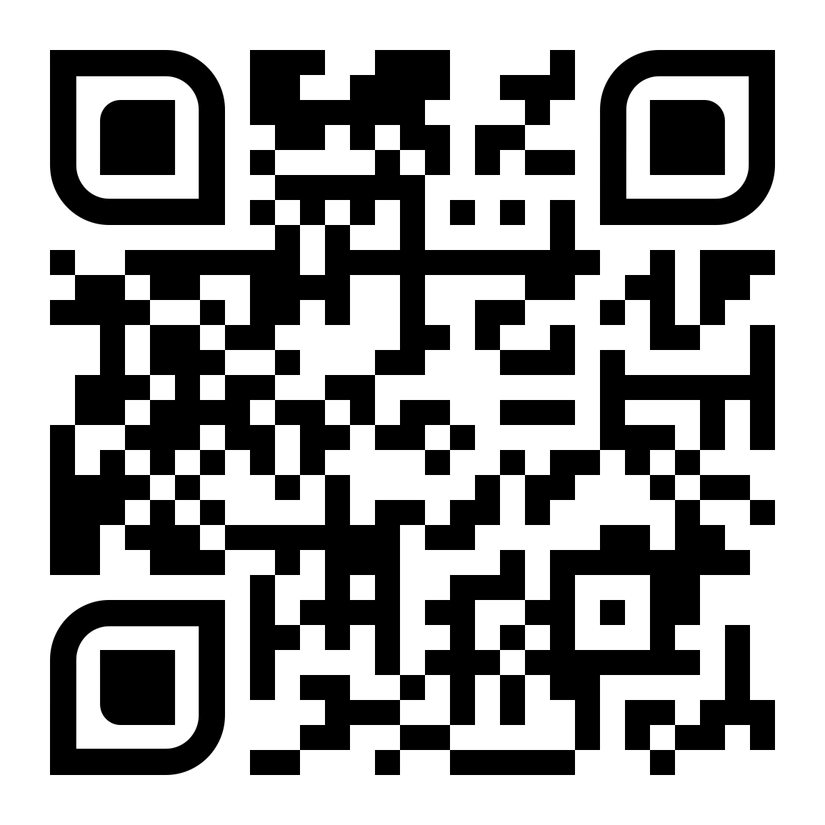
Thank you for listening!
@Fishing4Litter
Fishing For Litter
Fishing For Litter
@Fishing_for_litter_uk
fishingforlitter.org

