Slide 1

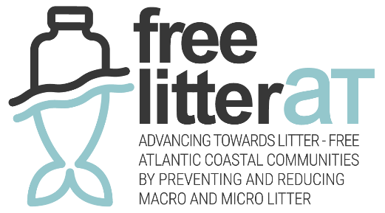
Main Challenges to implement waste incidentally fished management
The vision of the Port of Vigo
Alberto Jaraiz Gulias

Slide 2
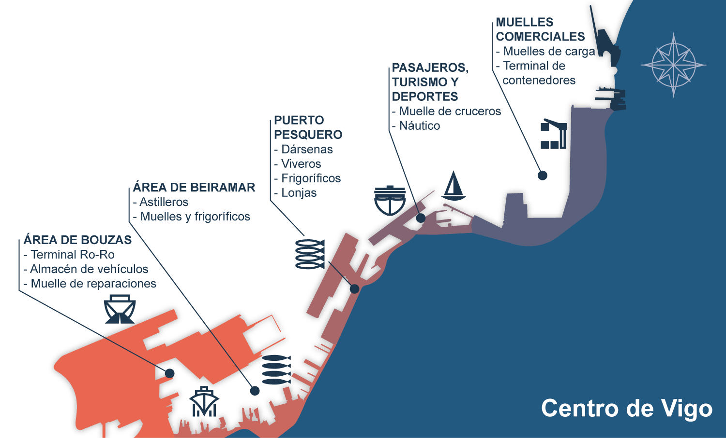

1
Port of Vigo
Around 15 km of total berth length
Drafts of up to 17 m.
More than 5 million tonnes of cargo per year.
City Center

Slide 3
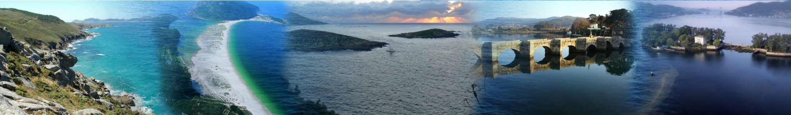



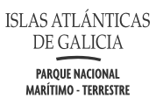
2
Adjacent environmental protection zones.
Costa de la Vela, Atlantic Islands National Park, Estelas Islands, A Ramallosa Inlet, and San Simón bay.
Natura 2000 Network: European ecological network for biodiversity conservation.
SPA (Special Protection Area): Areas designated for the protection of wild birds.
SAC (Special Area of Conservation): Areas designated to protect habitats and species.
OSPAR: Marine protected areas under the Convention for the Protection of the Marine Environment of the North-East Atlantic.

Slide 4
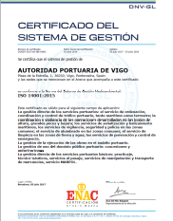
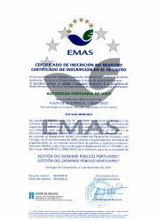
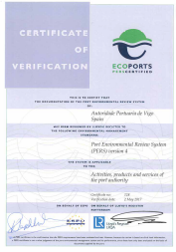
3
Certifications
The Port Authority of Vigo has renewed its environmental certification (ISO 14001) annually since its initial award in 2007, as well as its quality certification (ISO 9001) and Occupational Health and Safety certification (ISO 45001)
This management system has been adapted to comply with (EMAS III) since 2010.
In 2015, the Port Authority obtained the PERS (Port Environmental Review System) certification, awarded by ECOPORTS, the leading association of European ports.
Finally, in 2025, the Port Authority of Vigo obtained the ISO 50001 energy efficiency certification.

Slide 5

4
Blue Growth
In 2012, the European Commission’s Blue Growth Strategy was launched, with the main objective of sustainably promoting—above all—private investment and technological innovation in all areas related to the maritime economy, or Blue Economy (Rio+20 Conference, 2012).
It is an exercise in social and economic innovation based on the principles on which the European Union was founded: the principles of freedom, democracy, and respect for human rights and the rule of law; strengthening and convergence of its economies; promoting social and economic progress of peoples; and reinforcing cohesion and environmental protection (FAO Agreement, DG MARE and the United Nations).

Slide 6
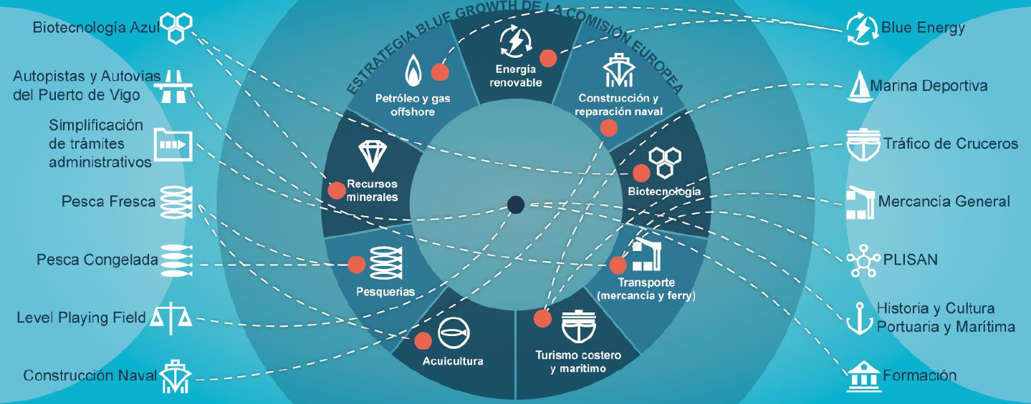
4
Blue Growth
Blue Growth Strategy of the Port Authority of Vigo
Based on the European Commission’s Blue Growth Strategy
A long-term sustainable economic development strategy based on the growth of the marine and maritime sectors as a whole, fostering investment and innovation in the marine domain.

Slide 7
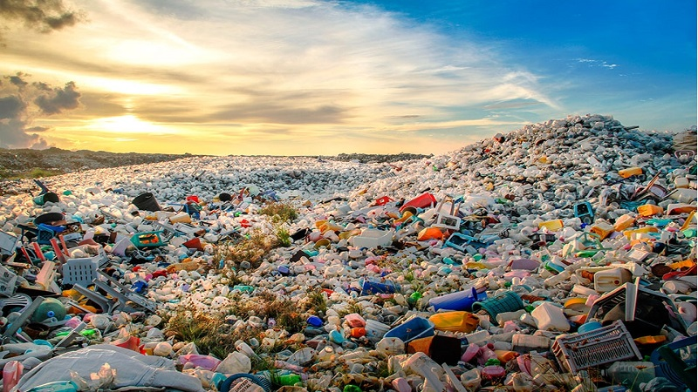
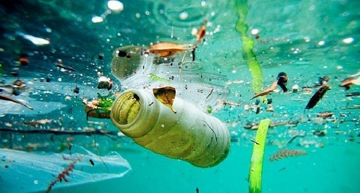

5
Origin of marine waste
The origin of marine litter is diverse. It is estimated that 80% of marine litter comes from land-based sources, mainly coastal tourism, stormwater drains, rivers, illegal dumping sites, and industrial areas. The remaining 20% comes from marine activities such as fishing and aquaculture, recreational boating, and maritime transport.”
The responsibility for solving the problem does not lie solely with the fishing sector; the joint effort of governments, administrations, and companies is essential.

Slide 8
6
Areas of action
Work on improving management systems and reception facilities derived from the obligations of the PRF Directive, through the design and construction of a new “Green Point”.
Awareness-raising initiatives for the general public, and especially for those working in the fishing sector, regarding the importance of caring for our sea
Promotion and participation in projects, such as those in which the Port Authority of Vigo has already participated and currently participates, including MLSTYLE, Nada pola, Pescal, and 3R FISH

Slide 9
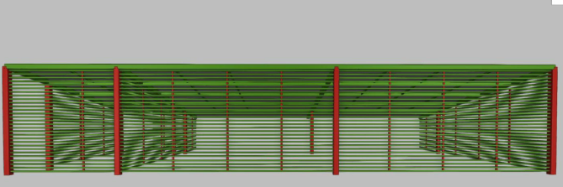
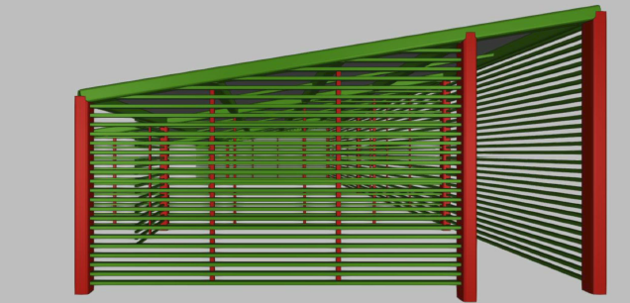
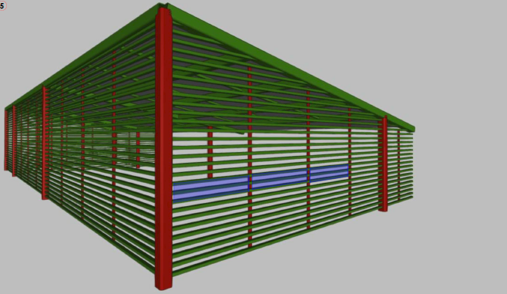
7
Improvement of reception facilities
In the near future, accidental fishing waste will be collected at the new “Green Point”, which is currently undergoing restructuring, so that this service can operate more efficiently
At this Green Point, fishing vessels will be able to deposit this waste in a much simpler and more efficient way.
At the same time, the on-quay collection service will continue for any vessel that requests the removal of accidentally caught waste.

Slide 10

8
Waste incidentally projects
The 3R-FISH project (Integrated management model for the recovery and recycling of solid waste generated by fishing and port activities) was carried out between 2009 and 2011 and was co-financed by the LIFE+ program.
The Nada pola Borda project was carried out between 2009 and 2011 and focused on the implementation of a protocol for the handling and integrated management of waste collected by small-scale and coastal fishing fleets.
Nada Pola Borda
The Pescal project was carried out between 2012 and 2014, and its objectives were:
To obtain information on marine litter in fishing grounds.
To carry out collection actions of fishing gear and waste by the fishing sector.
To study the effects of ghost fishing.”
PESCAL

Slide 11
8
Waste incidentally projects
The MLSTYLE project aimed to protect the sea and its resources and to promote the circular economy by reducing marine litter, designing an integrated waste management system for fishing ports (including food plastics, disused nets and gear, and marine litter collected by fishermen and shellfish gatherers), and studying the possibilities for the valorization and use of these materials
MLSTYLE
This demostrates the Port Authority of Vigo’s commitment to sustainable development, waste valorization, the cleaning and conservation of our seas, and support for new circular economy strategies.

Slide 12
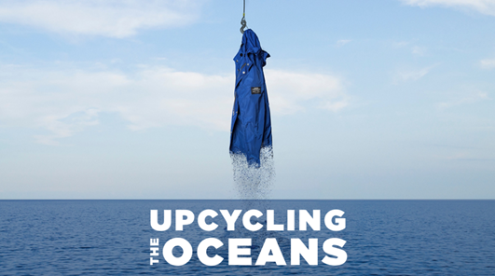
8
Waste incidentally projects
Agreement with Ecoalf and Ecoembes: In 2024, the Port Authority of Vigo signed an agreement with Ecoembes and Ecoalf, thereby joining the Upcycling Oceans project, which aims to recover waste that should never have ended up in the sea and give it a second life through recycling and the circular economy. To make this possible, the project relies on the commitment and collaboration of fishermen who, voluntarily, bring marine litter caught in their nets to shore so that it can be recycled, preventing its impact on the seabed.
In 2024, 43,17 tons of marine waste were collected (compared to 18,15 tons in 2023), all of which were sent for valorization

Slide 13
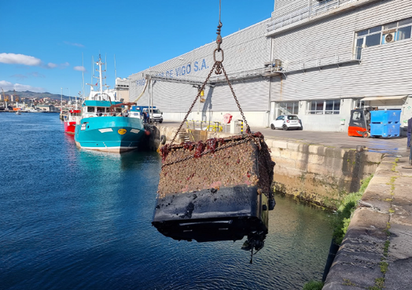
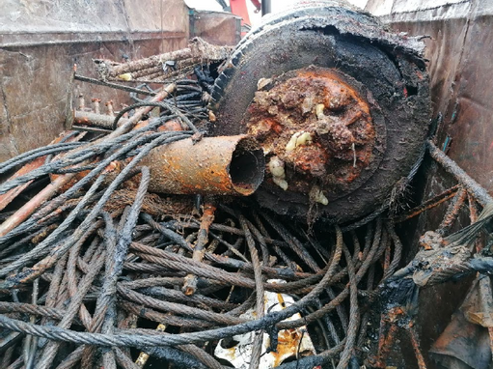
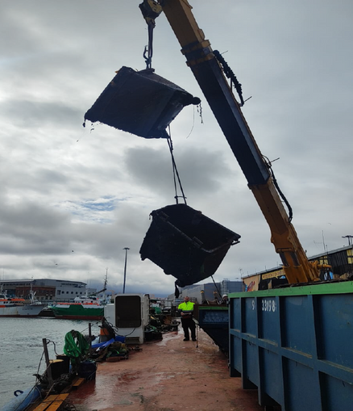
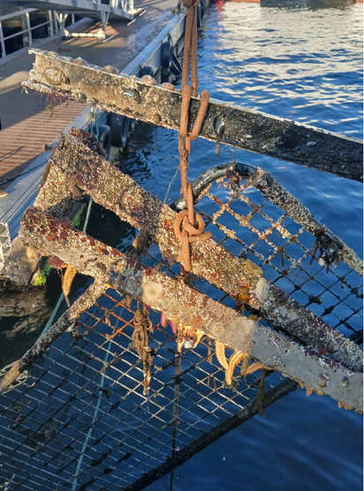
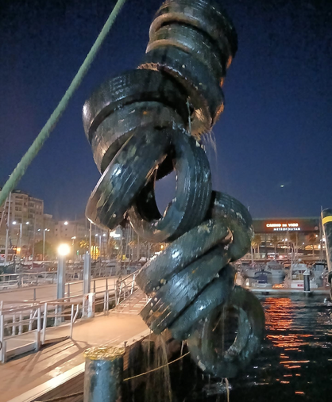
9
Cleaning of Dock Areas
Since 2020, more than 340,000 kg of waste have been collected, including tires, fenders, containers, fishing gear, ropes, metal and plastic sheets, engine parts, and more

Slide 14


9
Cleaning of Dock Areas
In 2025, the Port of Vigo collaborated with the Enaleia association on a new dock cleaning, achieving very positive results, removing 30 tons of waste from our docks.

Slide 15
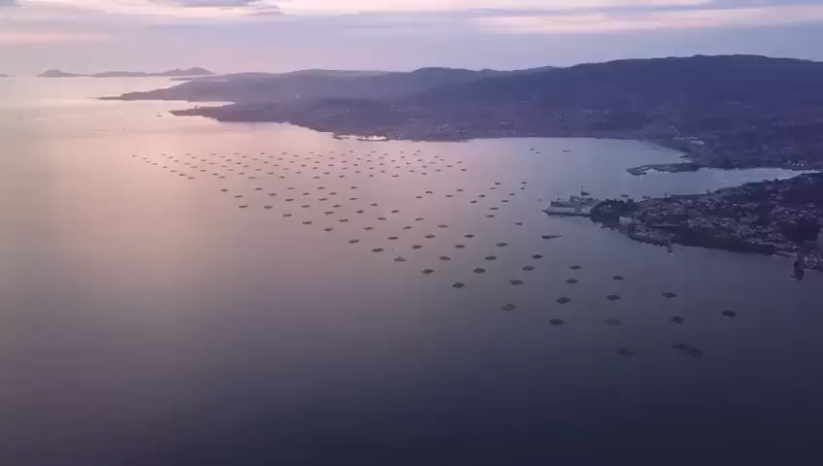

Slide 16
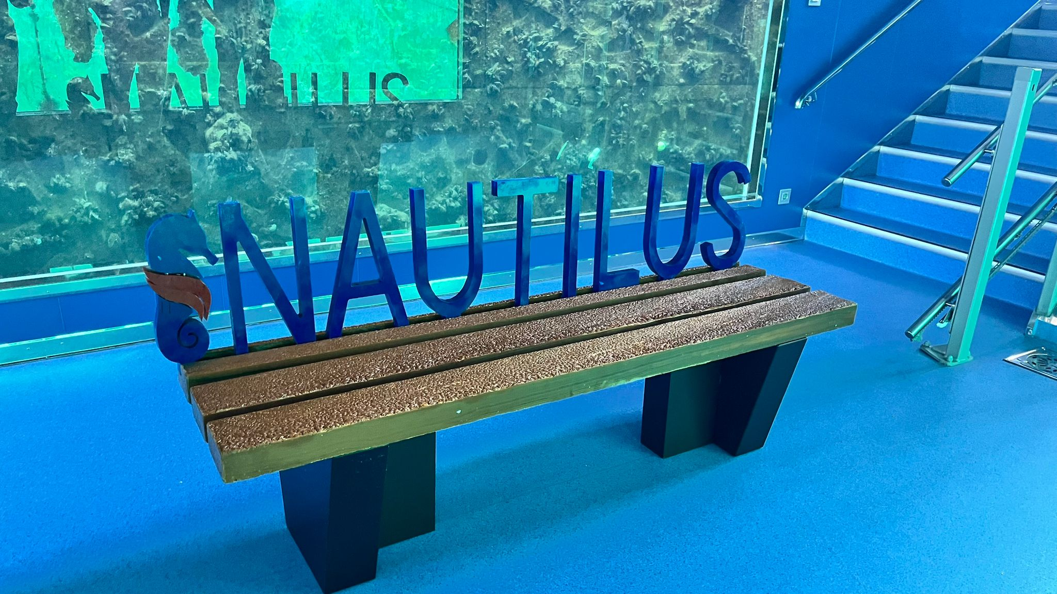
9
Cleaning of Dock Areas
All collected materials have been carefully sorted and handed over to specialized partners for recycling or reuse, thereby contributing to the development of the circular economy.
The collected marine plastic has been reused to manufacture benches like the one displayed inside the ‘Nautilus’ underwater viewing platform

Slide 17
10
Conclusions
We must continue our efforts to eliminate marine waste. In ports such as ours, this entails challenges related to waste treatment and management, securing financial resources, and raising awareness both among the general public and within the fishing sector
As a final conclusion, I would like to highlight that all these initiatives for the collection, treatment, and management of marine waste would be impossible without the selfless collaboration of the women and men of the fishing sector. Without them, we could not carry out the cleaning of our seas and, in many cases, protect our present and future livelihoods—for us and for generations to come

Slide 18
Thank you for your attention
Alberto Jaraiz, Head of Ecological Transition and Sustainability Division

