Slide 1

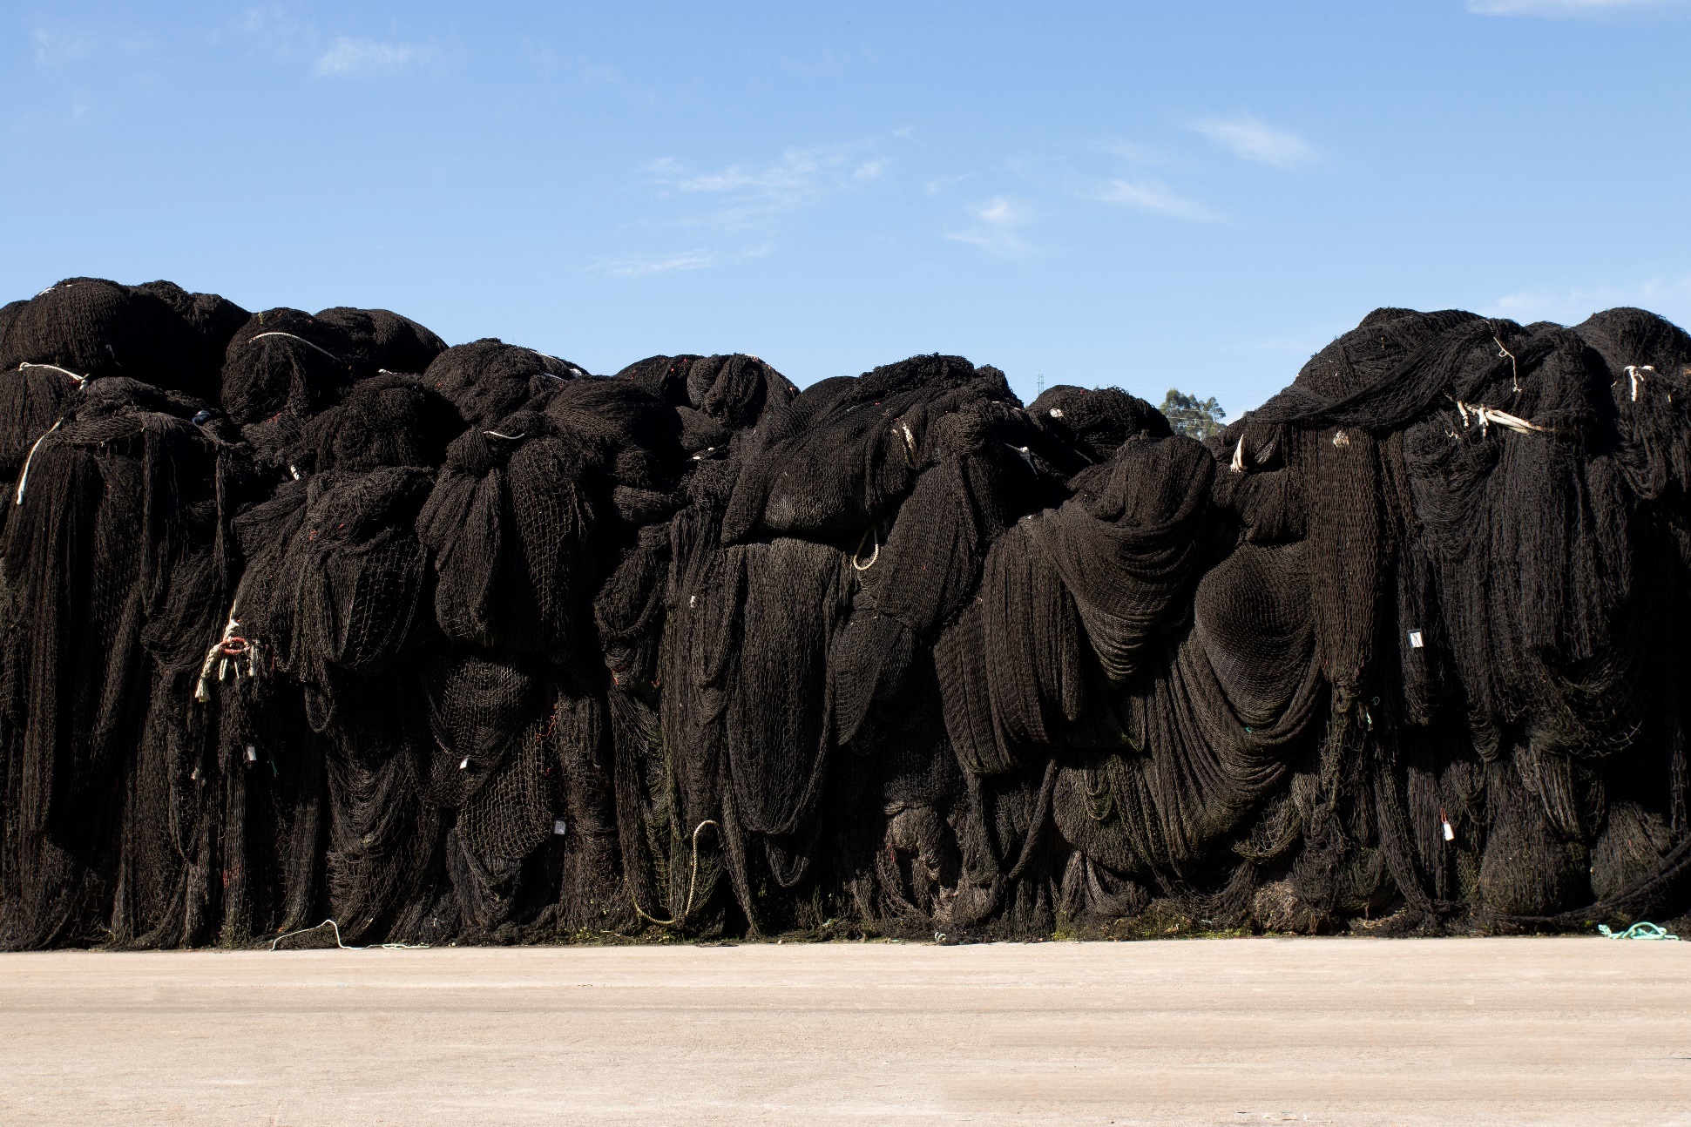
Nets that come back to life
DIVISIÓN RECICLAJE DE REDES

Slide 2
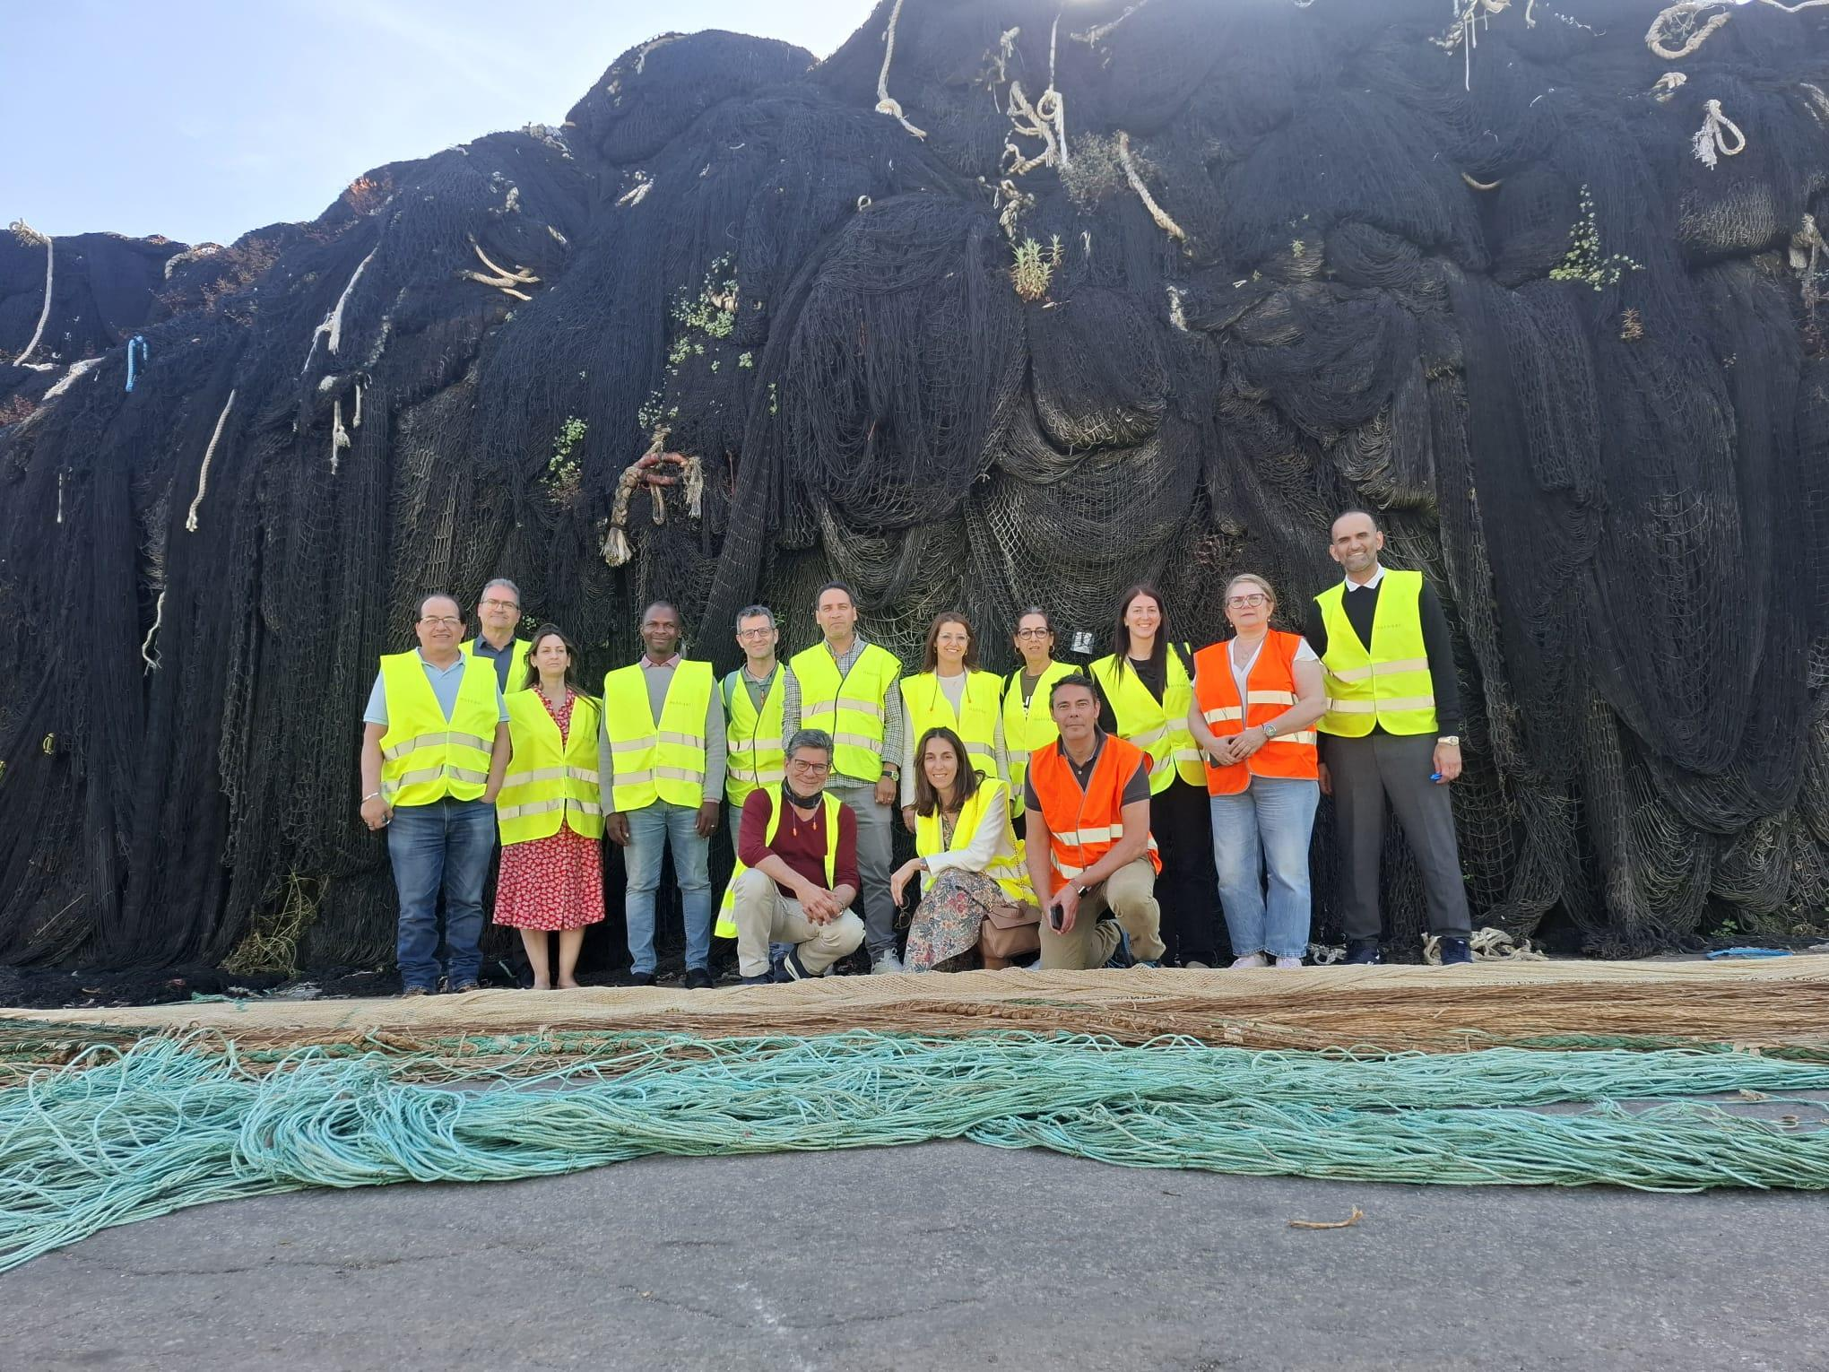
DIVISIÓN RECICLAJE DE REDES
The visit of an International delegation

Slide 3
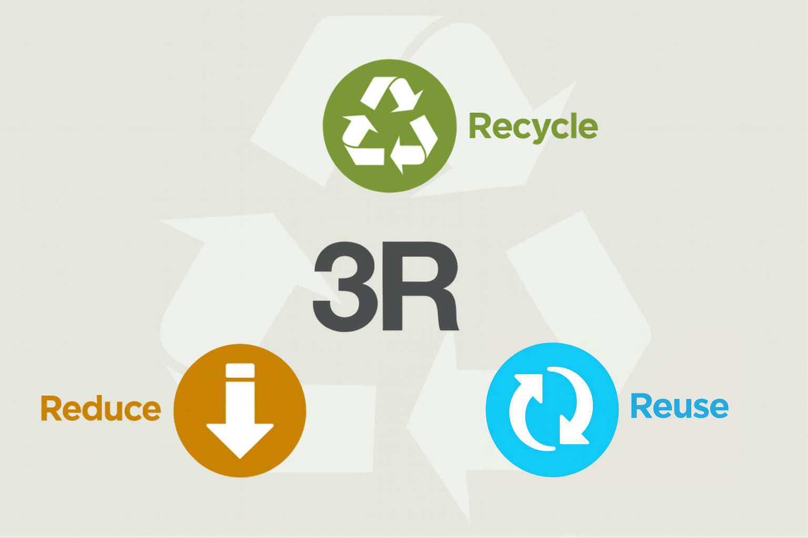


Slide 4
Mussel farming ropes

Slide 5
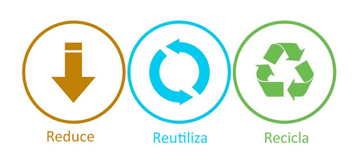
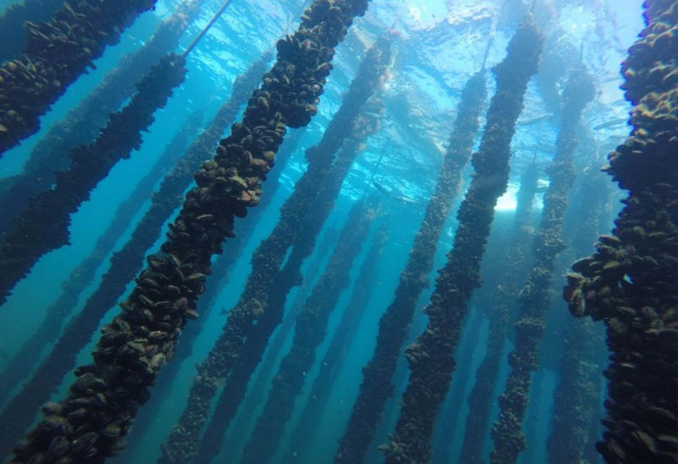
Mussel farming ropes

Slide 6
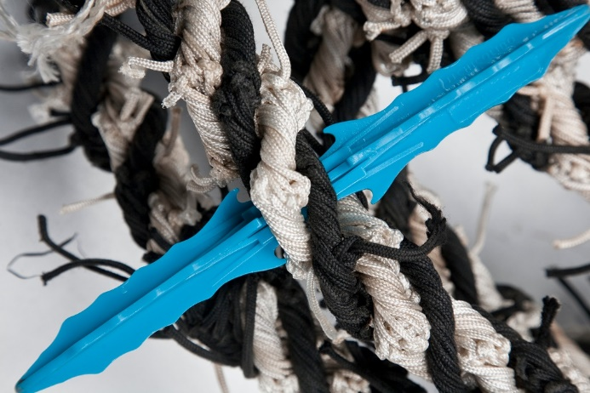
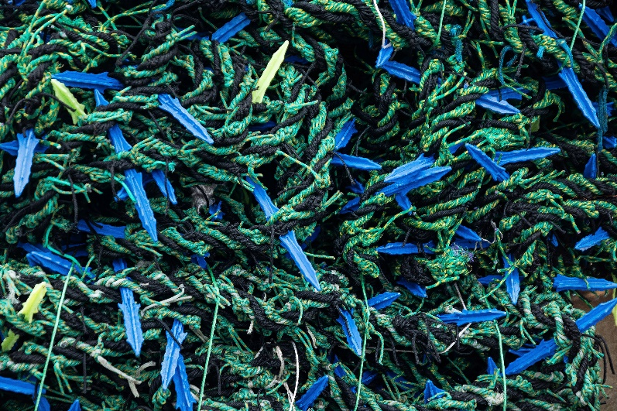
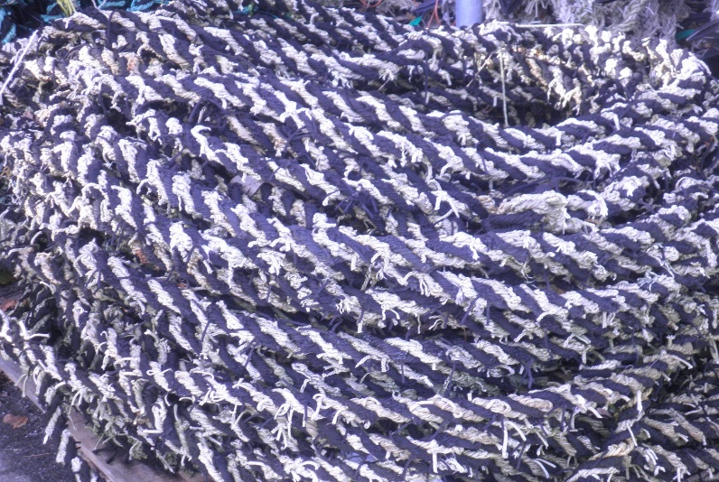
Mussel farming ropes

Slide 7
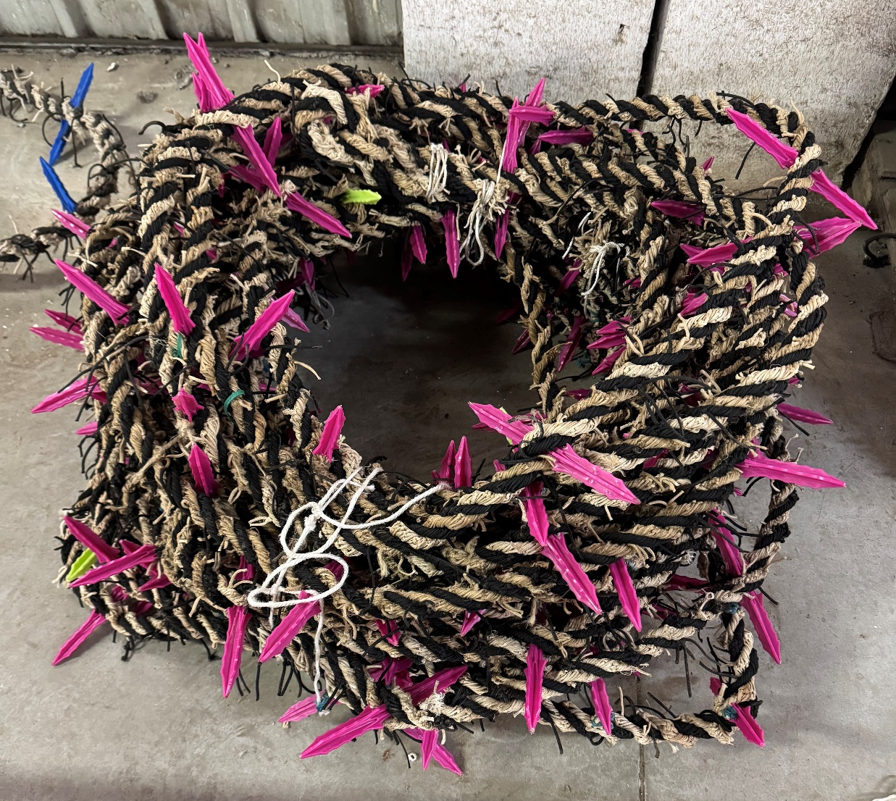
Mussel farming ropes

Slide 8

Mussel farming ropes

Slide 9
Decorative products

Slide 10
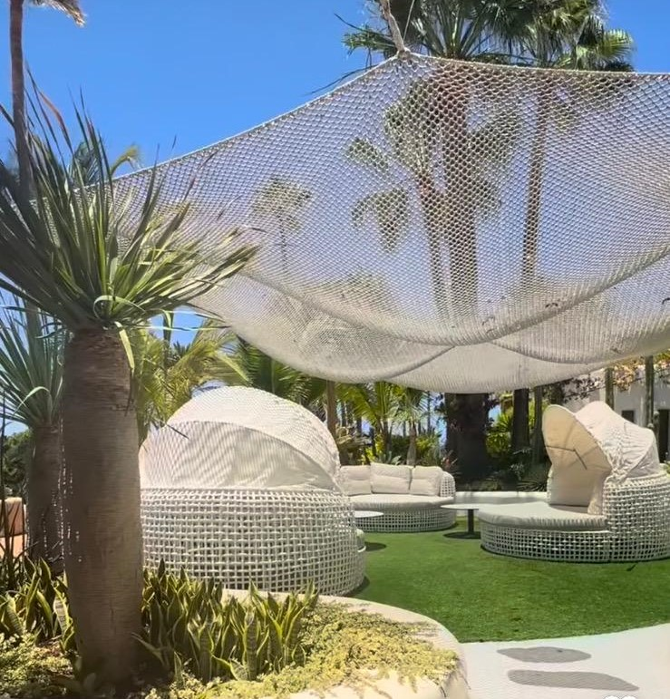
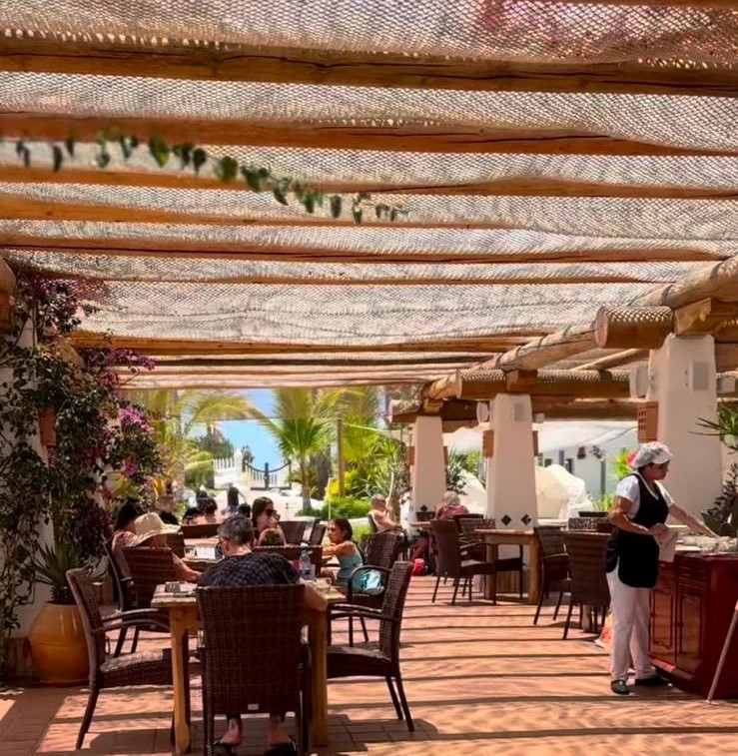
Decorative products

Slide 11
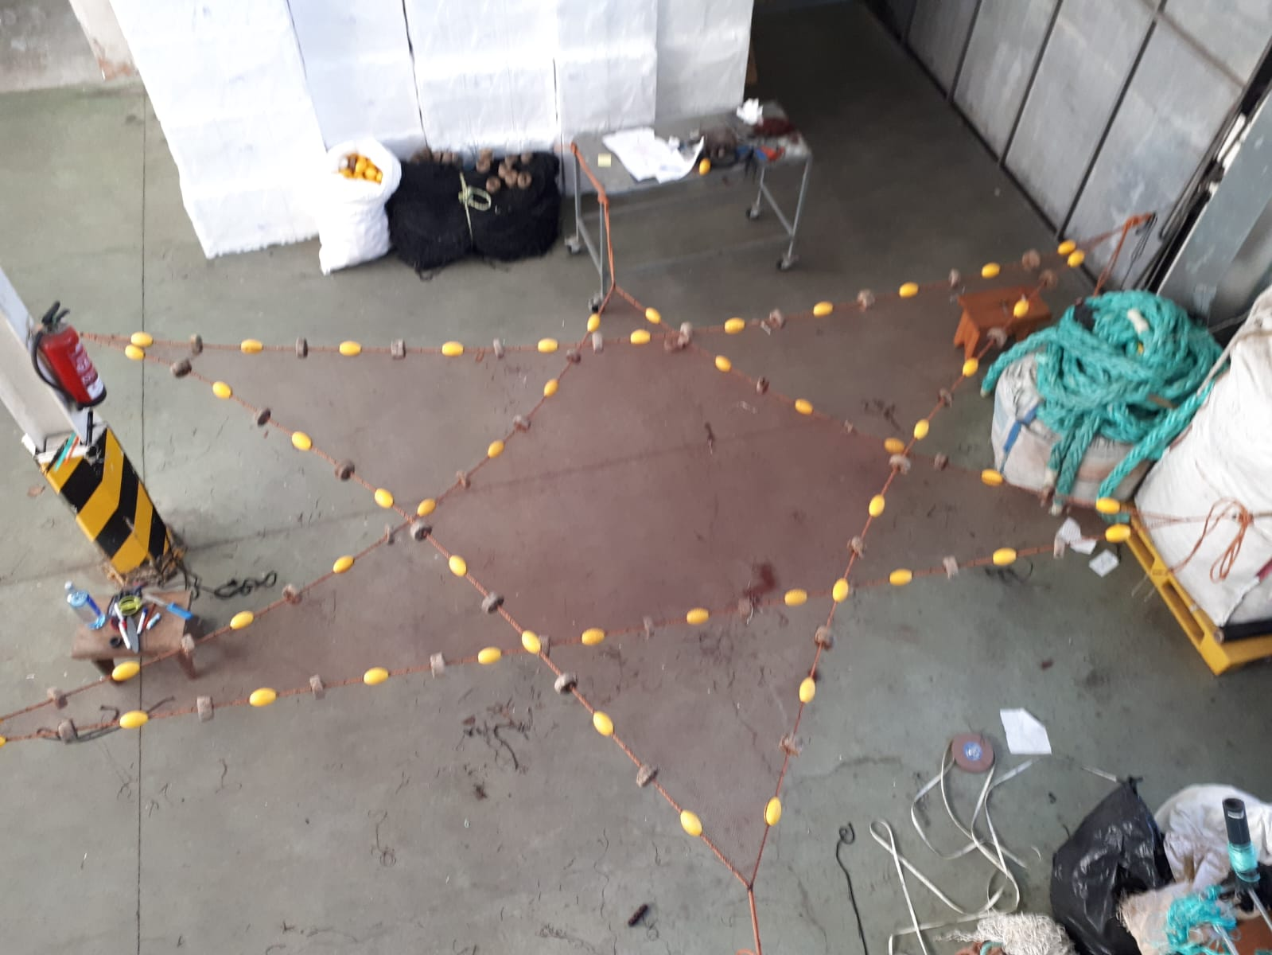
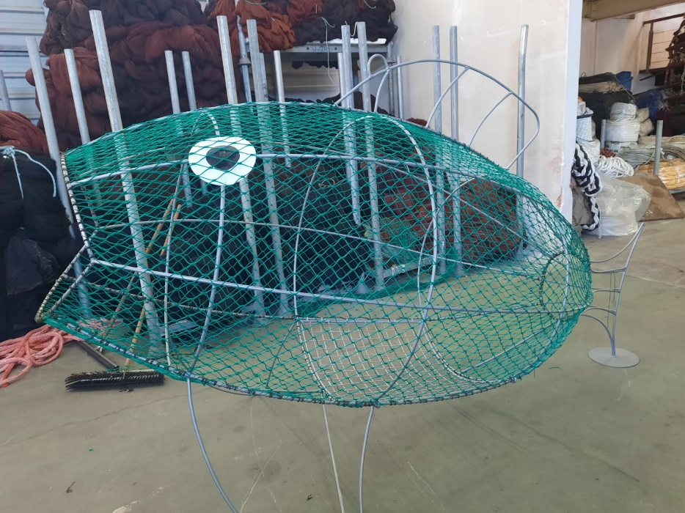
Decorative products

Slide 12
Art and design

Slide 13
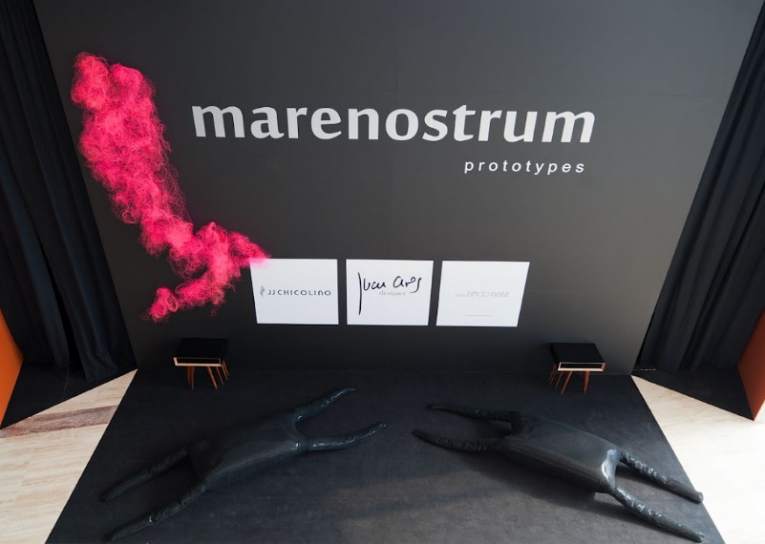
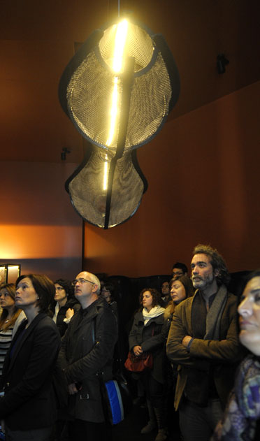
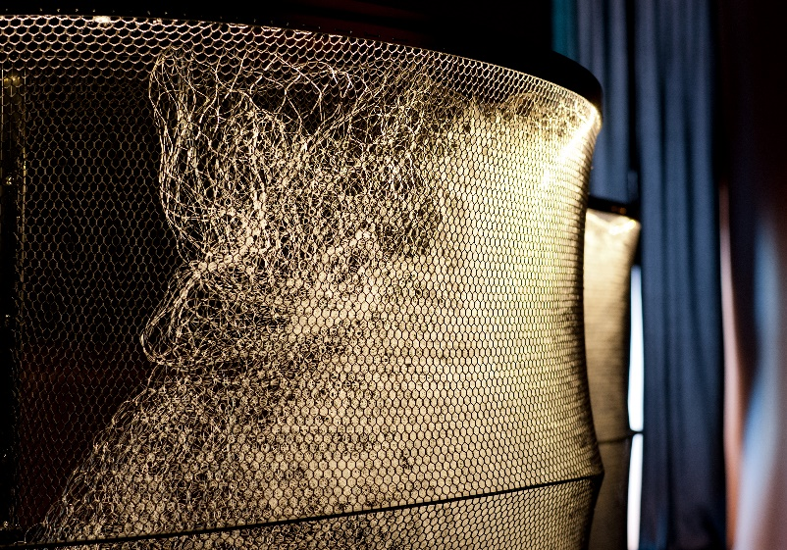
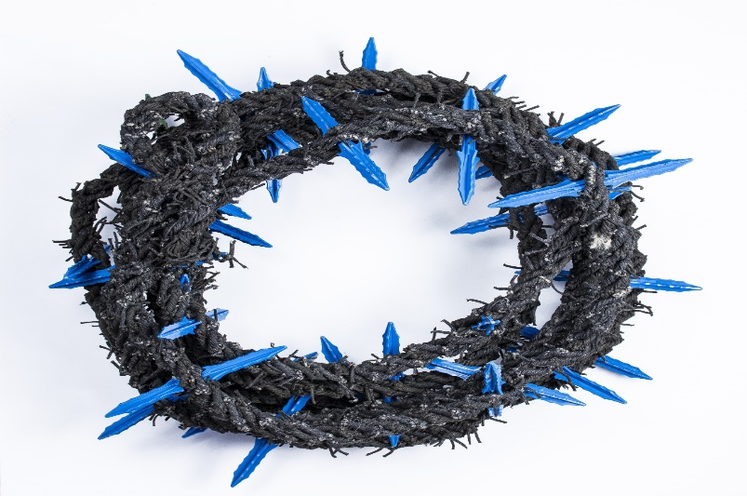

Art and design

Slide 14
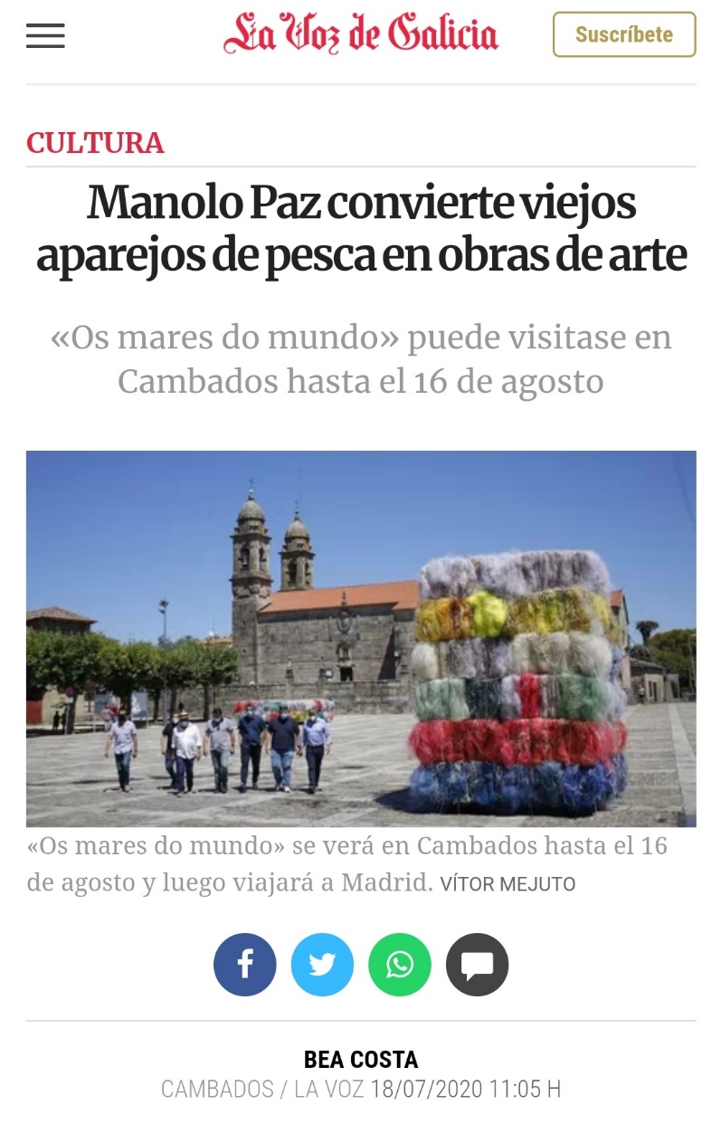
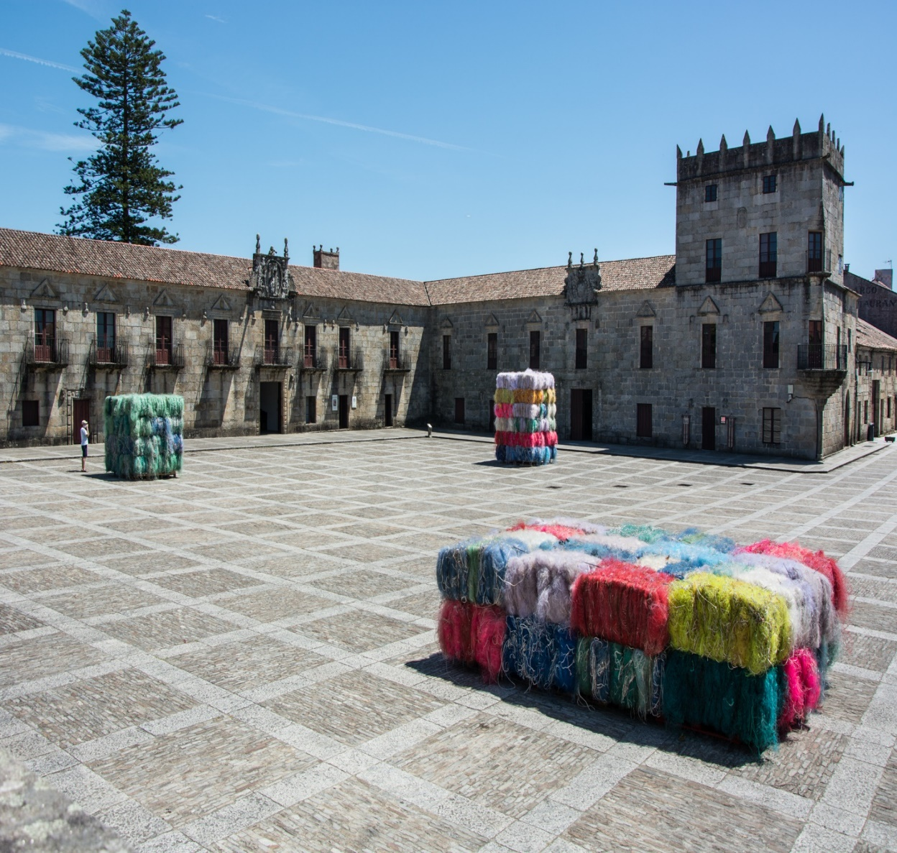
Art and design

Slide 15
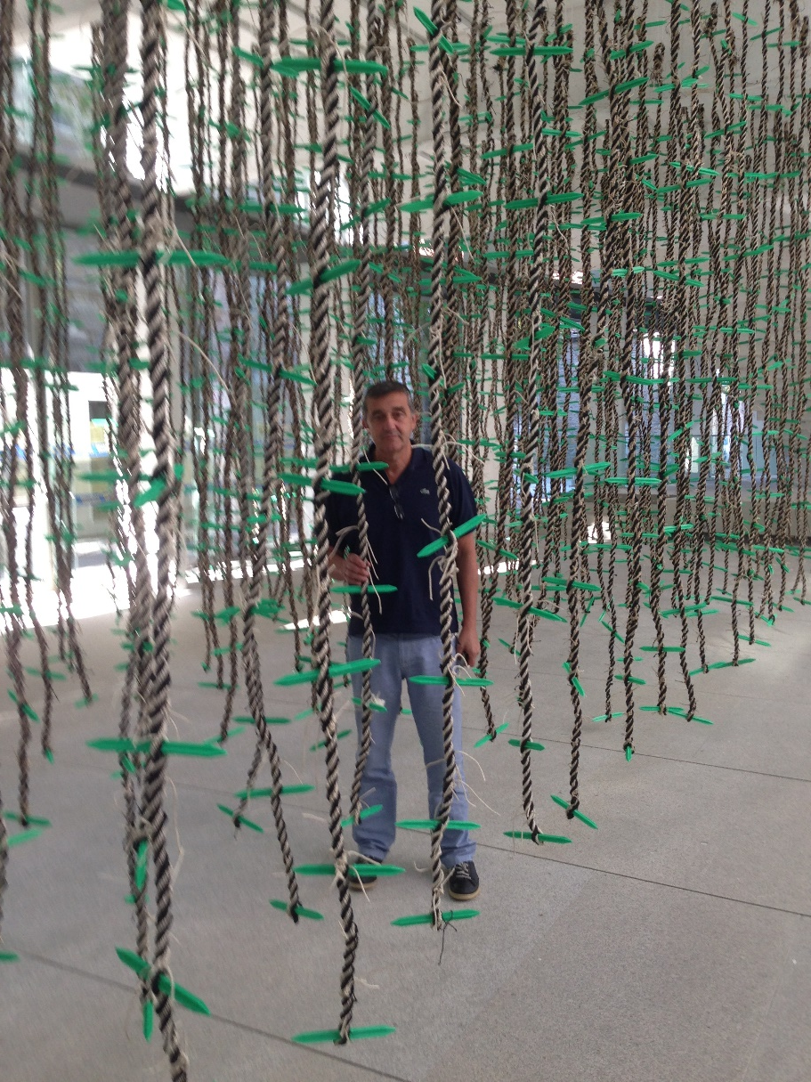
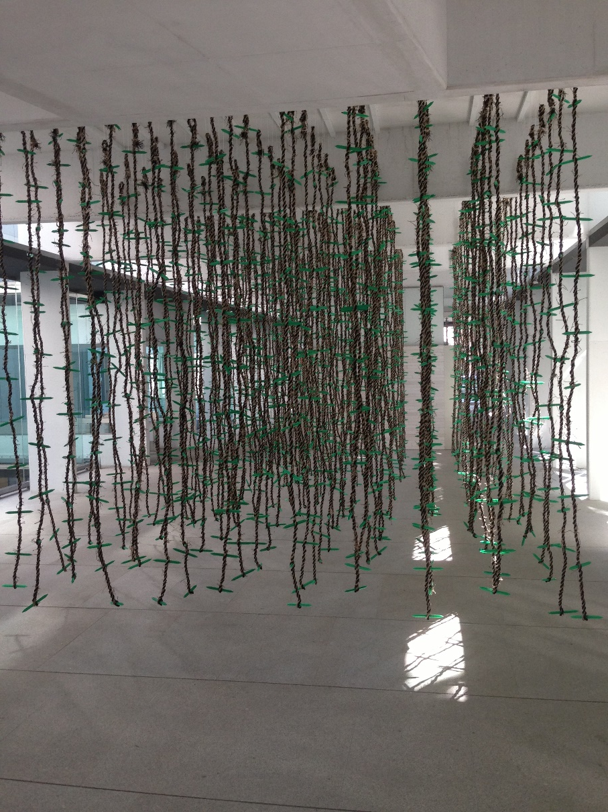
Art and design

Slide 16
The diversity of Fishing nets

Slide 17
THE ORIGIN OF THE FISHING NETS
Post industrial: There is very little quantity, these are remnents from the industrial manufacturing process.
Post consumer:
  Disused nets: because they can no longer be used for fishing again, either because this system of fishing has become obsolete or due to new regulations or because the fishing system is no longer suitable for the sea where these were used to fish.
  Nets which have already been used which are more expensive to repair than to replace with new ones.
  Pieces from repairs of the fishing nets in the harbours or net lofts.

Slide 18
COMPOSITION OF THE RAW MATERIAL (fibres) OF NETS AND ROPES IN FISHING NETS
Polyethylene, polysteel
  Monofilament
  Multifilament
Polyamide 6
  Monofilament
  Multimono
  Multifilament
Polyester
Dyneema
  Multifilament

Slide 19
Types of fishing gear
Coastal fishing nets: these are Gillnets that can be fixed or drifting.
Trawl nets
  Bottom trawl, for the capture of species on or near the sea bed.
  Semipelagic trawls, for fishing species which live a few metres above the sea bed.
  Pelagic trawls, for fishing species several metres above the sea bed. Also act on the bottom.
Surround netting for fishing sardines, horse makerel, makerel and others.
Surround netting for tuna and related species
Fishfarming nets
  With antifouling
  Without antifouling

Slide 20
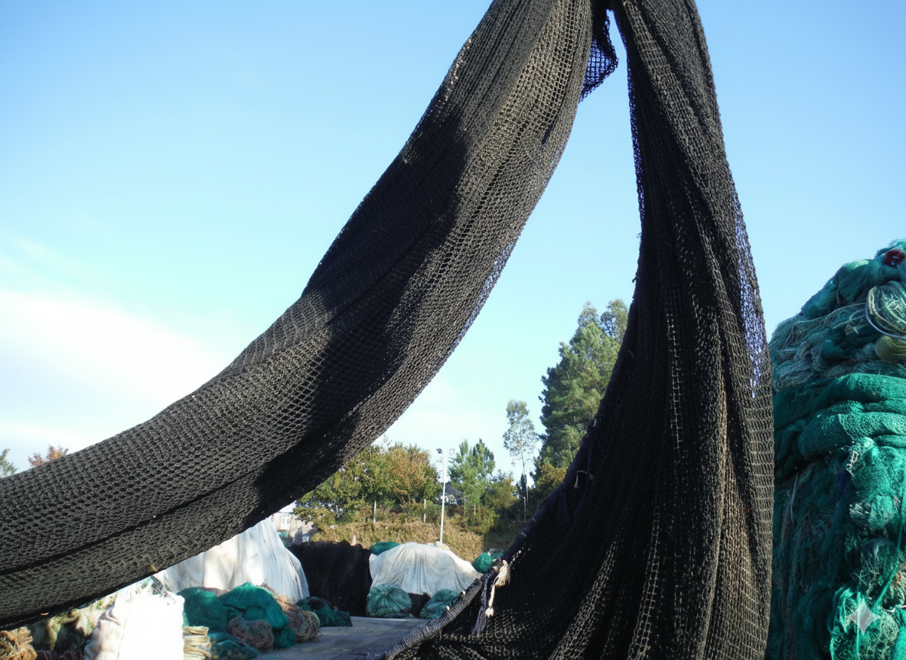

Slide 21
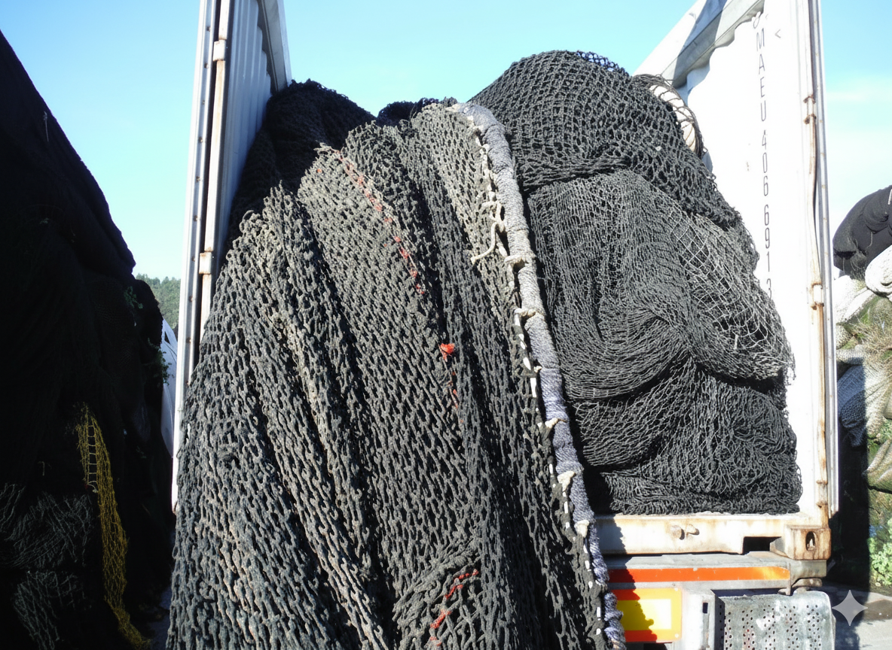

Slide 22
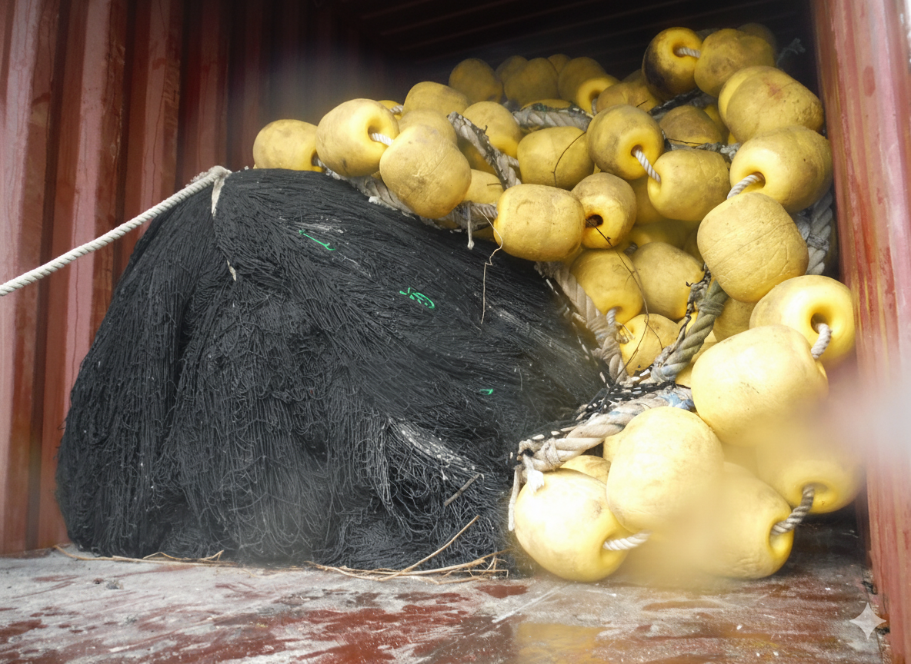

Slide 23
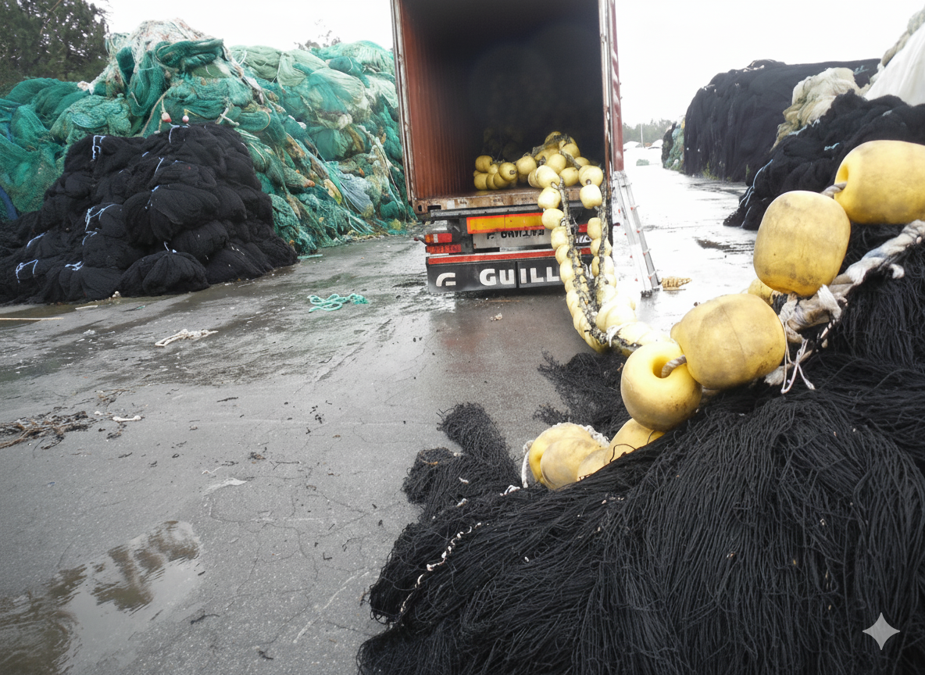

Slide 24
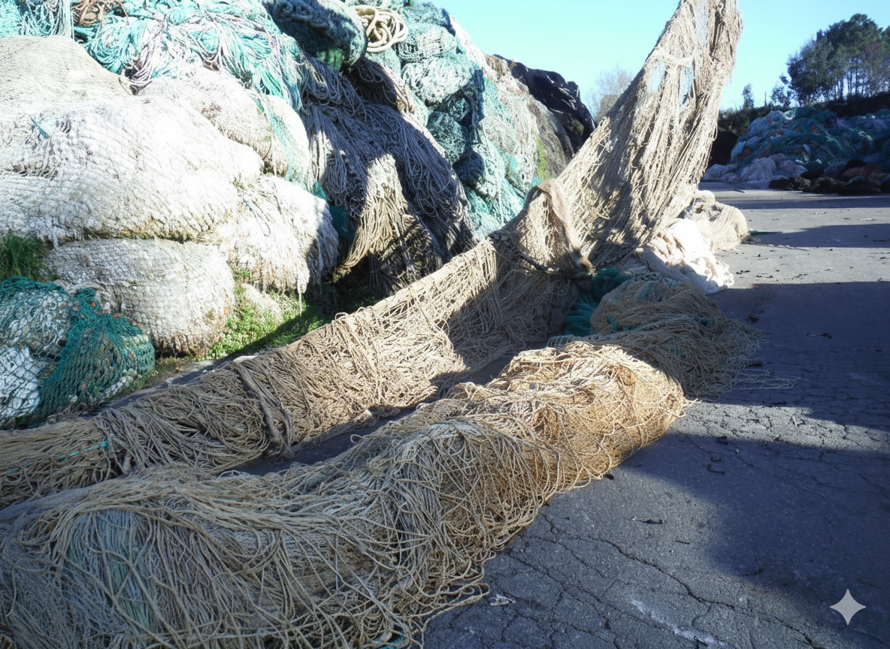

Slide 25
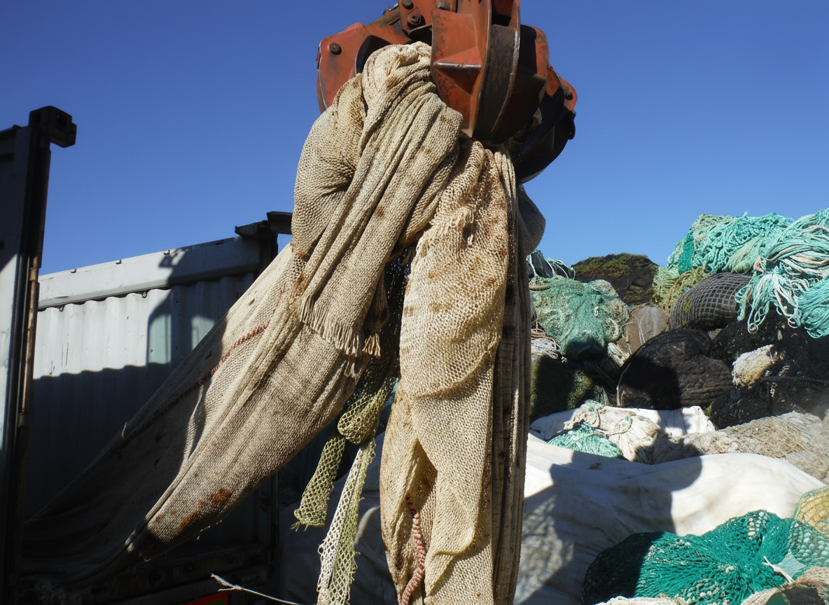

Slide 26
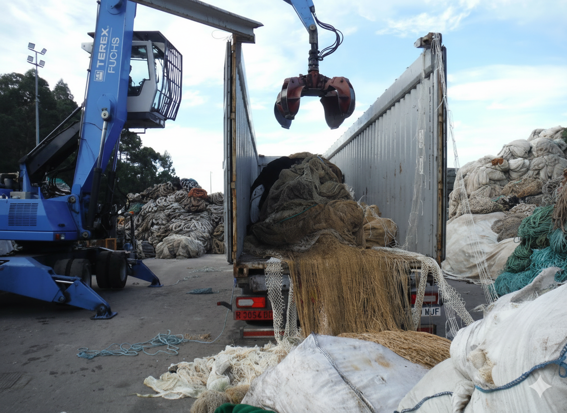

Slide 27
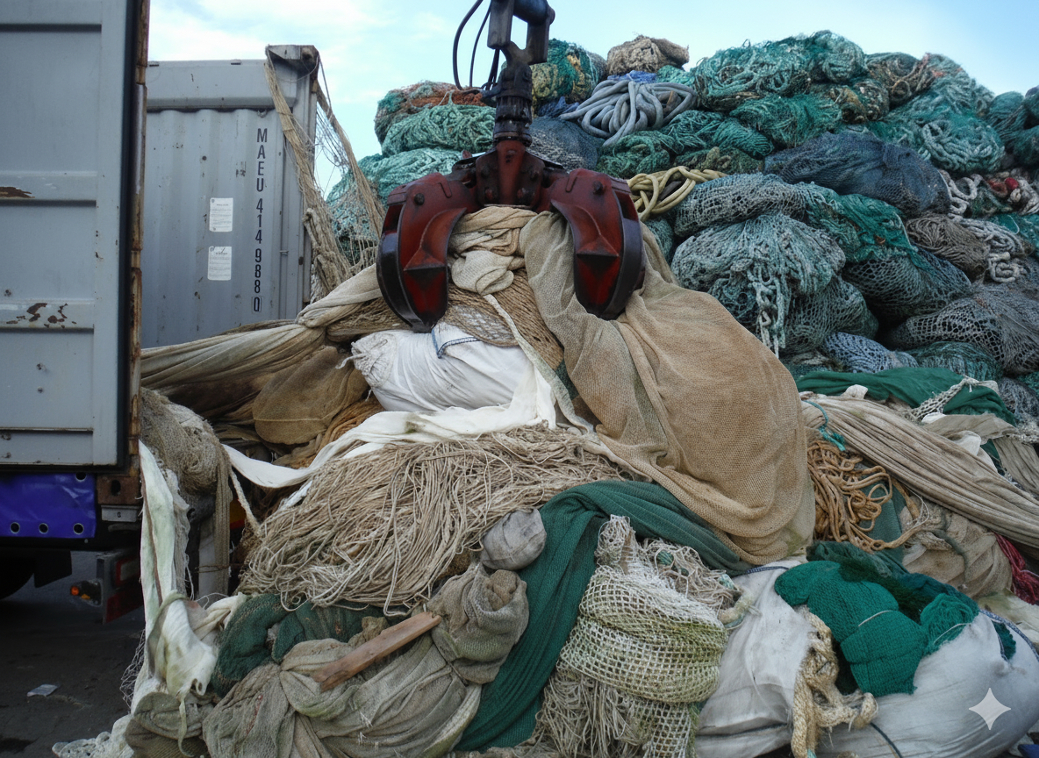

Slide 28
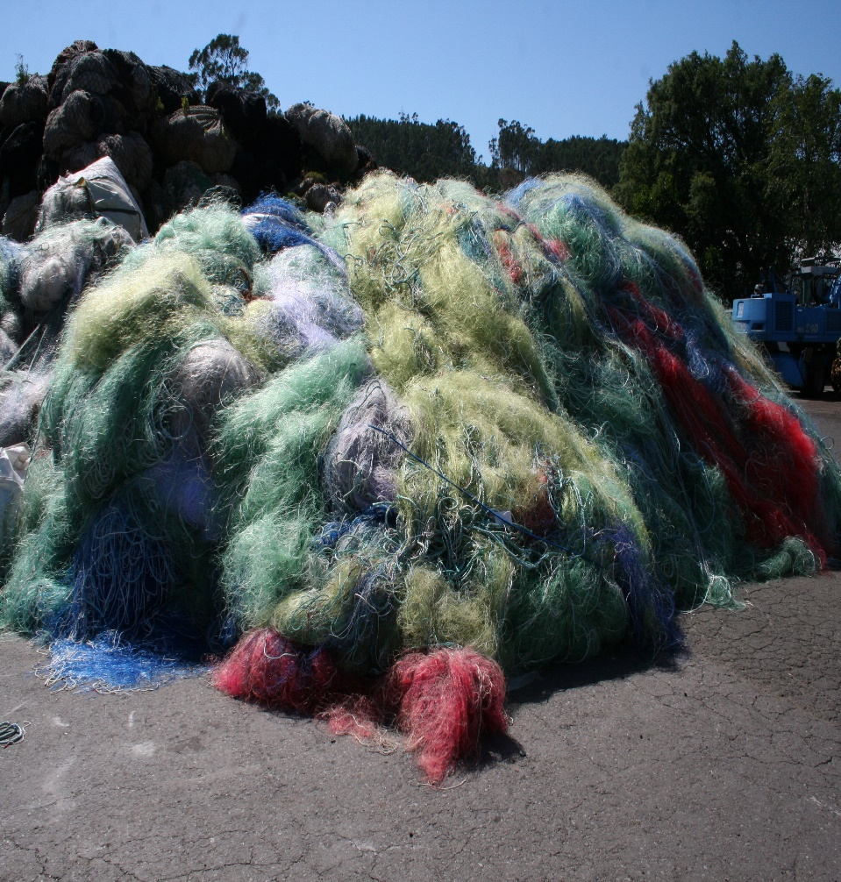
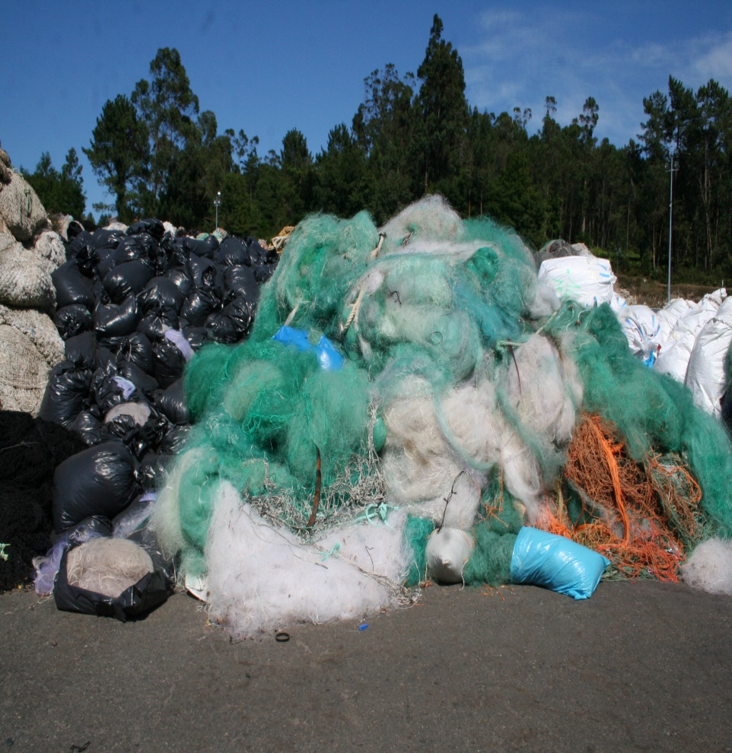
Coastal monofilament PA 6 nets and other parts

Slide 29
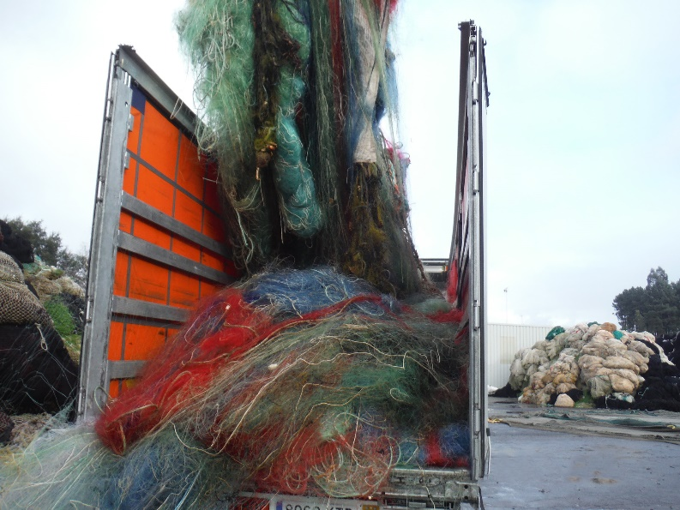
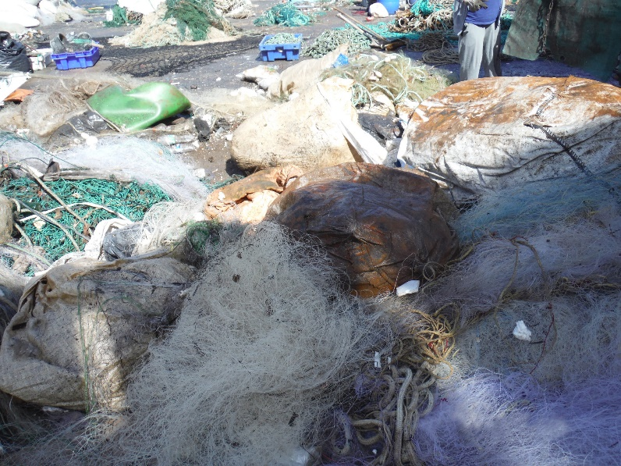
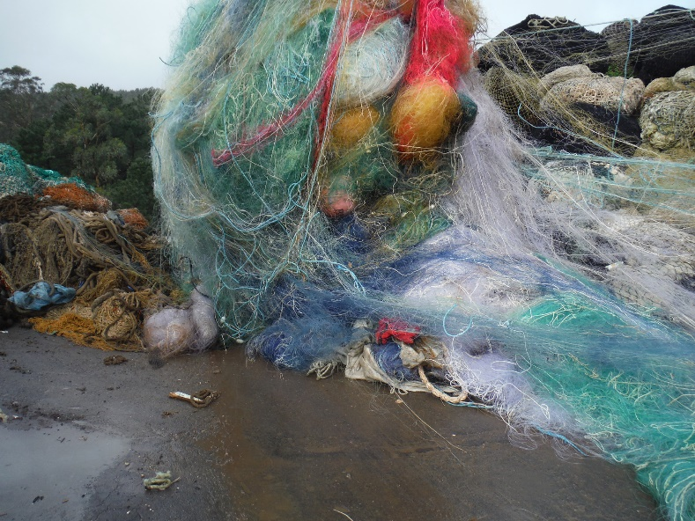
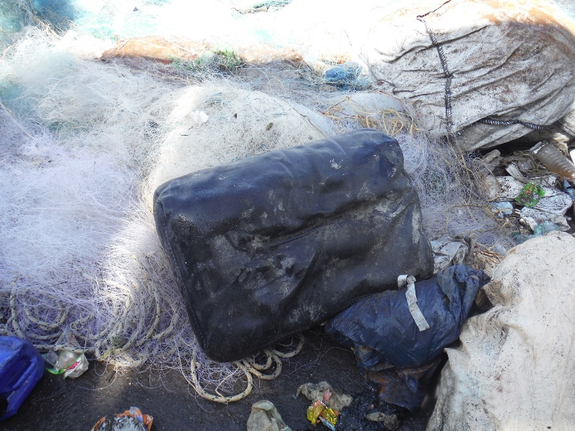
Coastal monofilament PA 6 nets and other parts

Slide 30
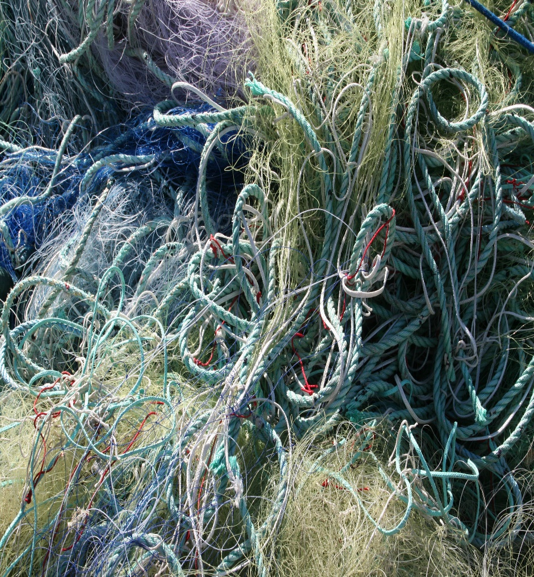
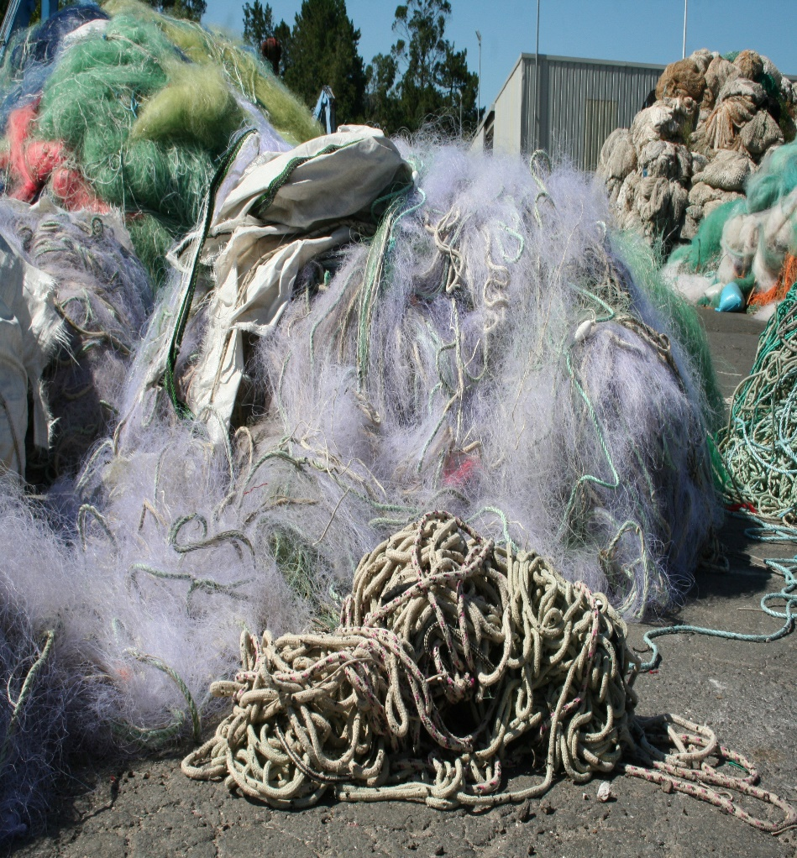
Coastal monofilament PA 6 nets and other parts

Slide 31
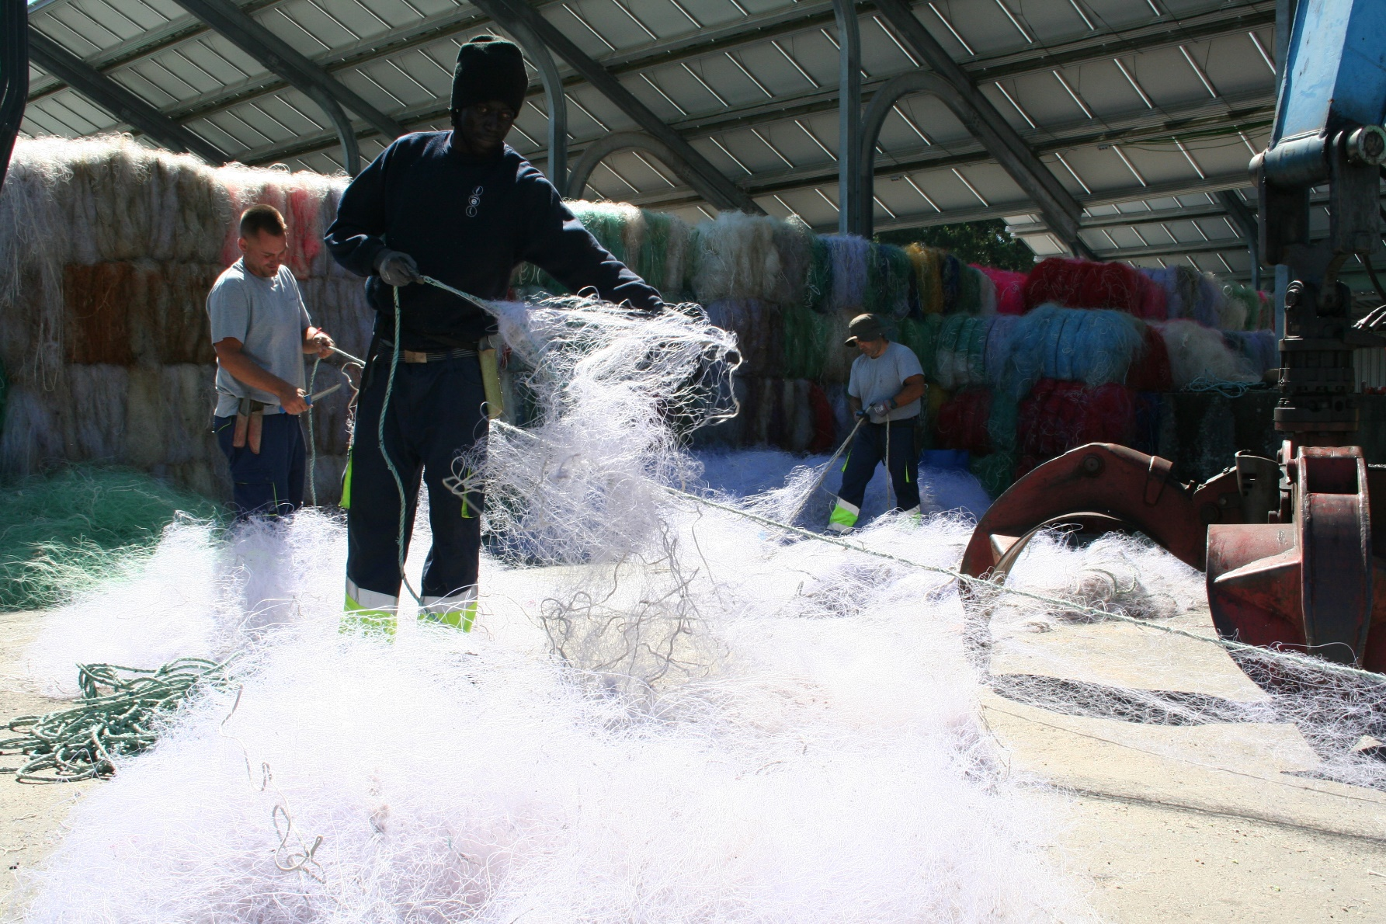
Coastal monofilament PA 6

Slide 32
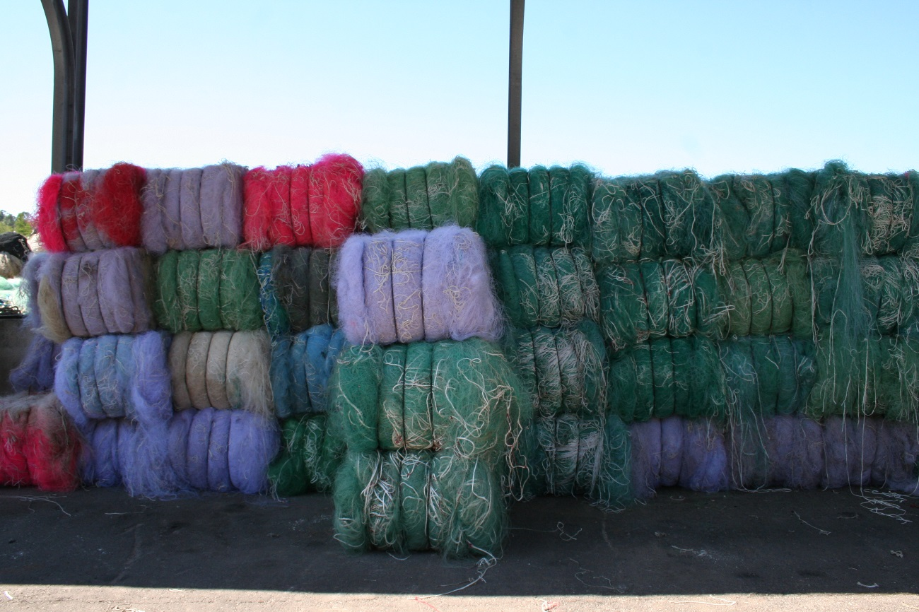
Coastal monofilament PA 6 – Semi cleaned for recycling

Slide 33
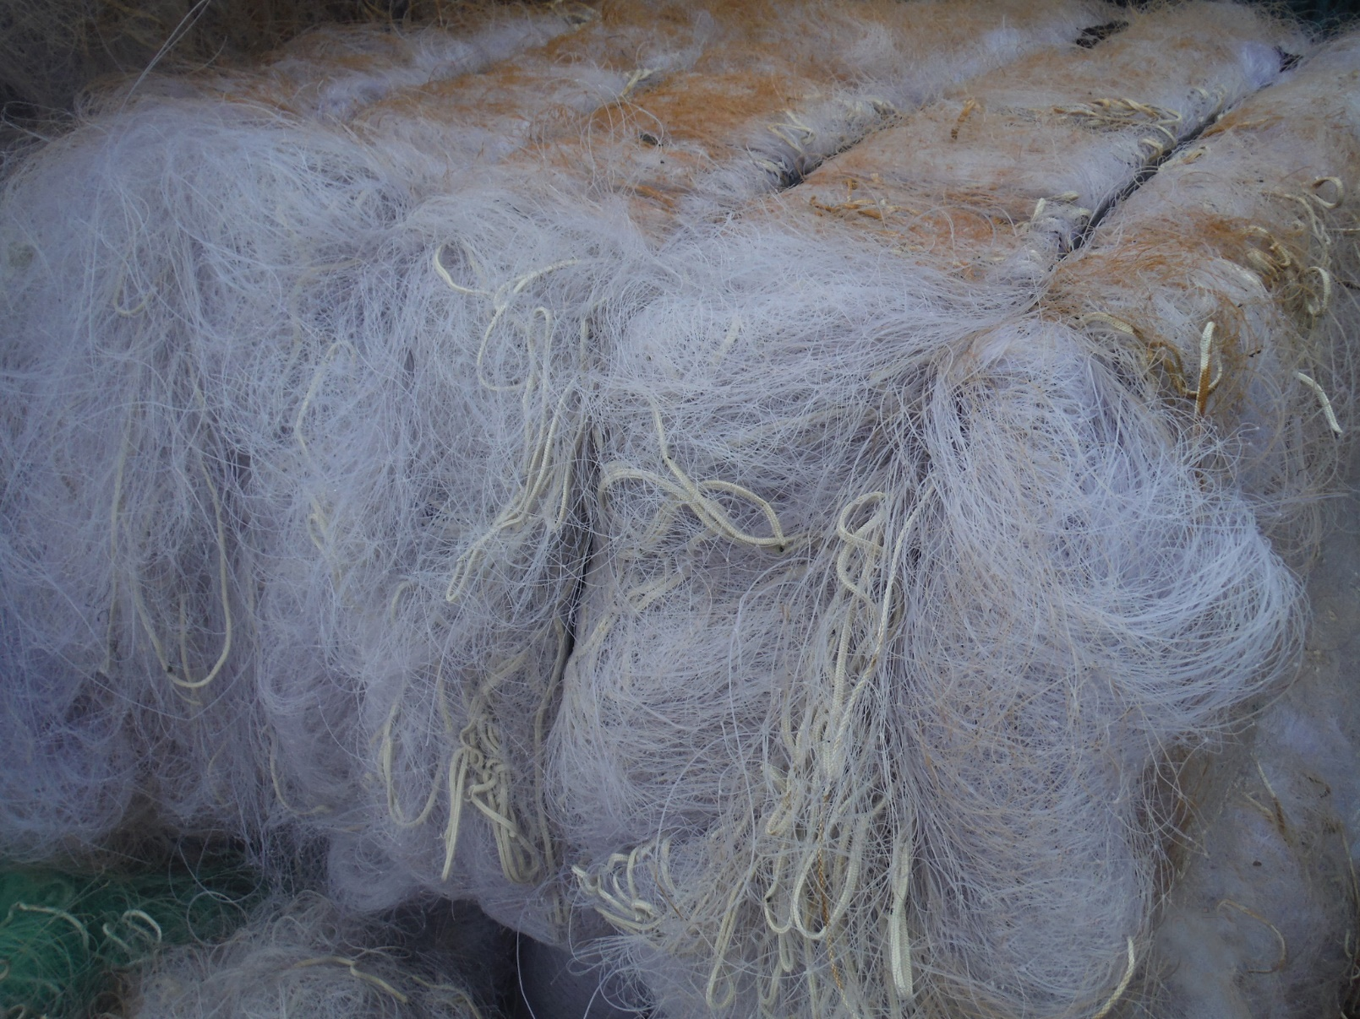
Coastal monofilament PA 6 – Semi cleaned for recycling

Slide 34
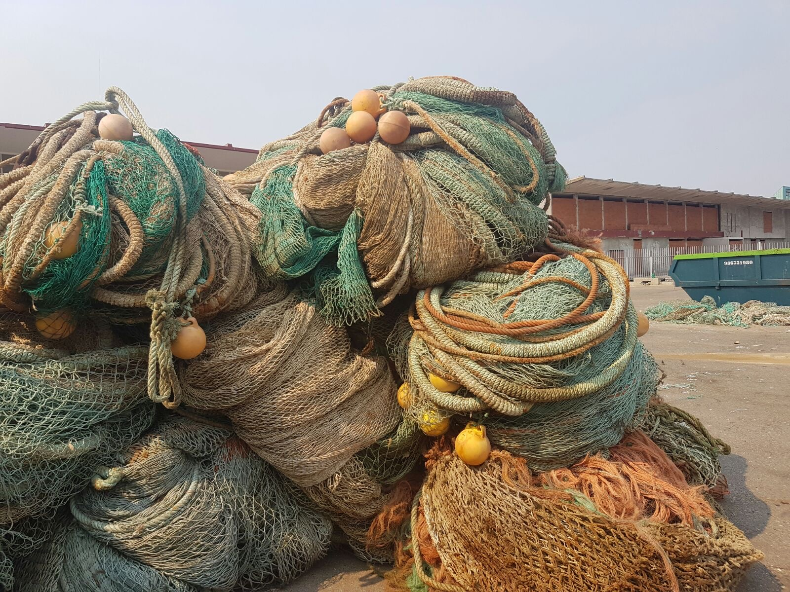
Complete trawl nets

Slide 35
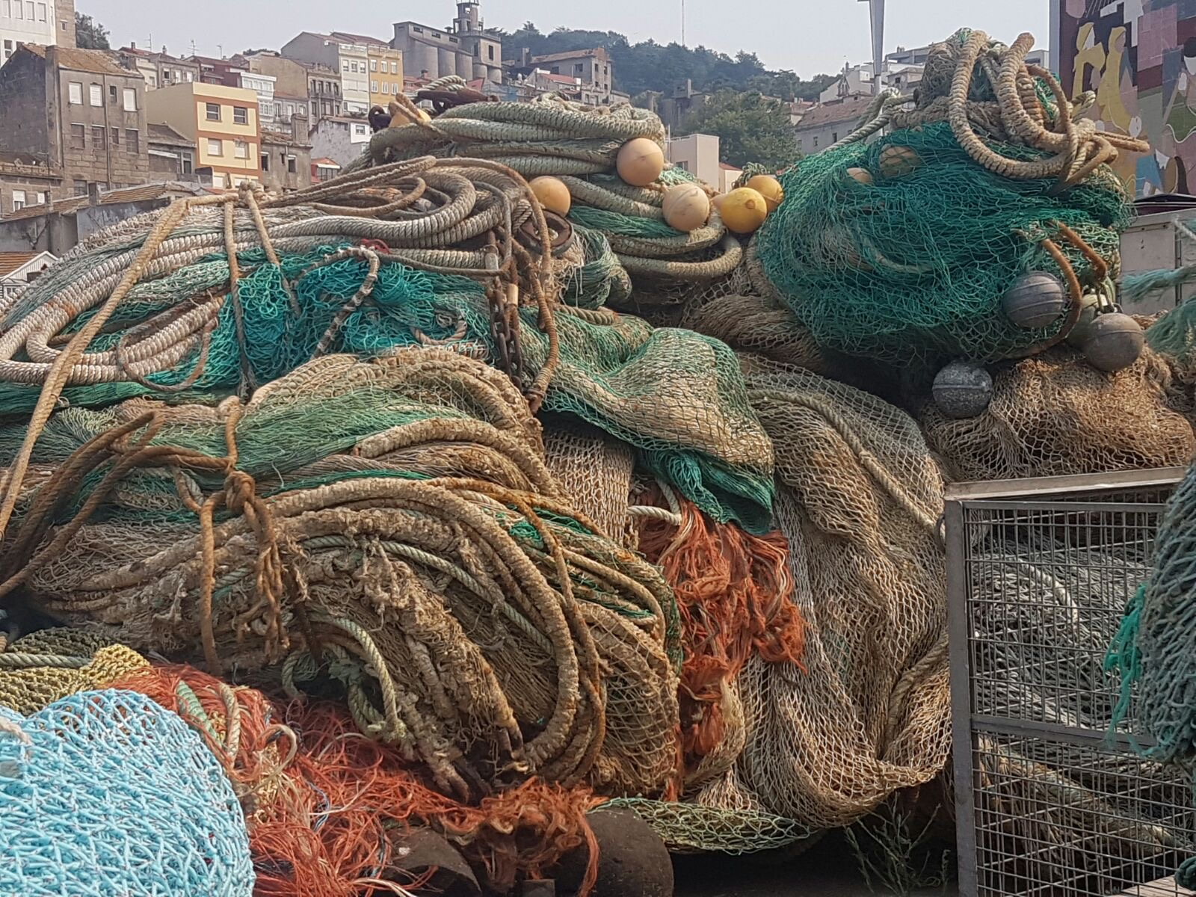
Complete trawl nets

Slide 36
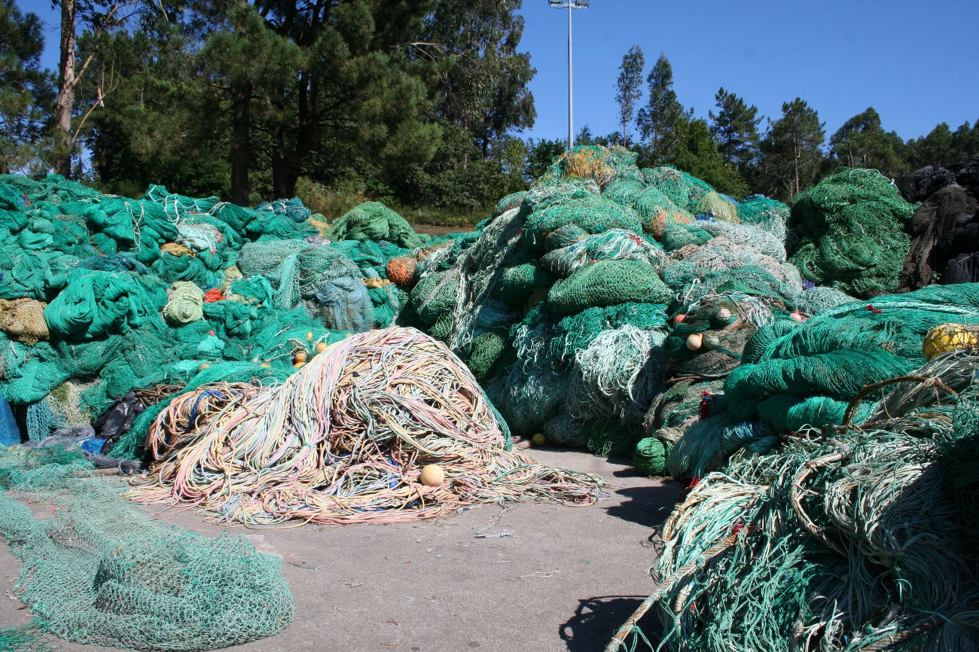
Complete trawl nets

Slide 37
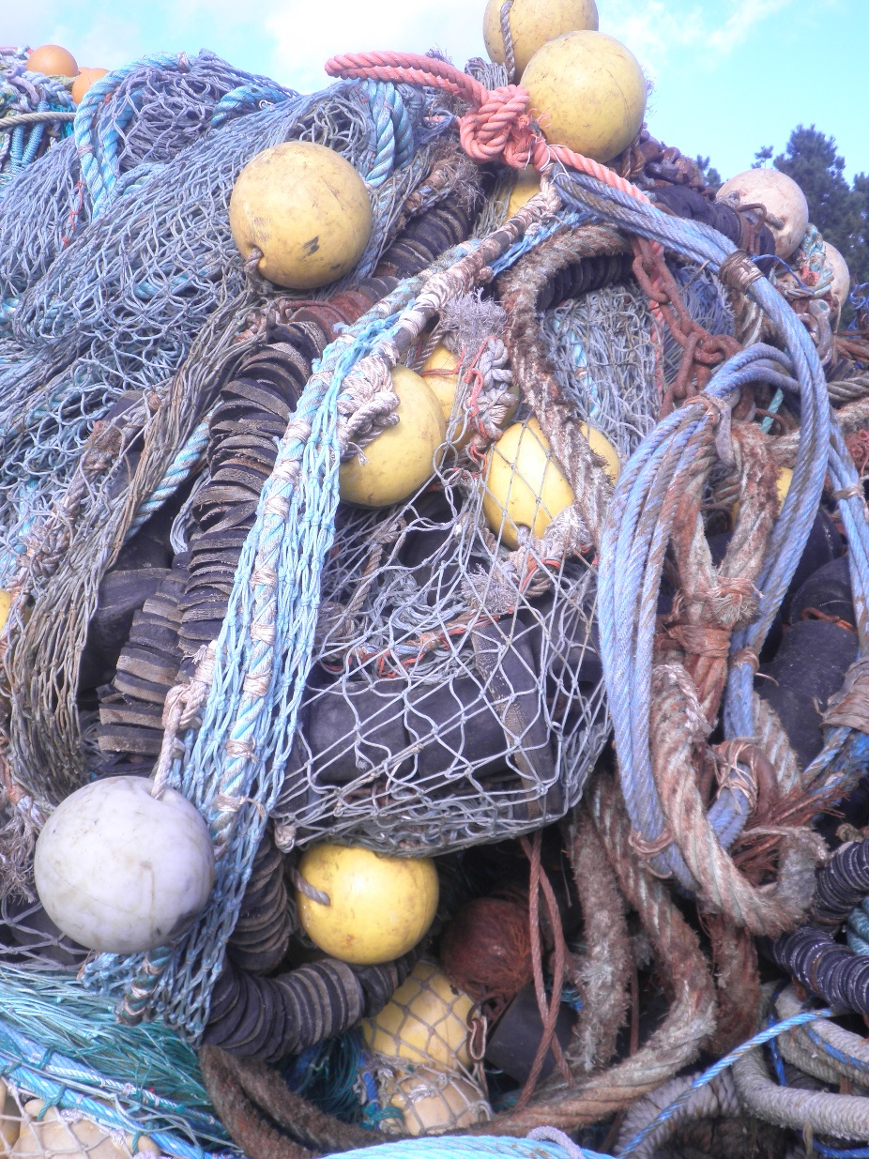
Trawl nets

Slide 38
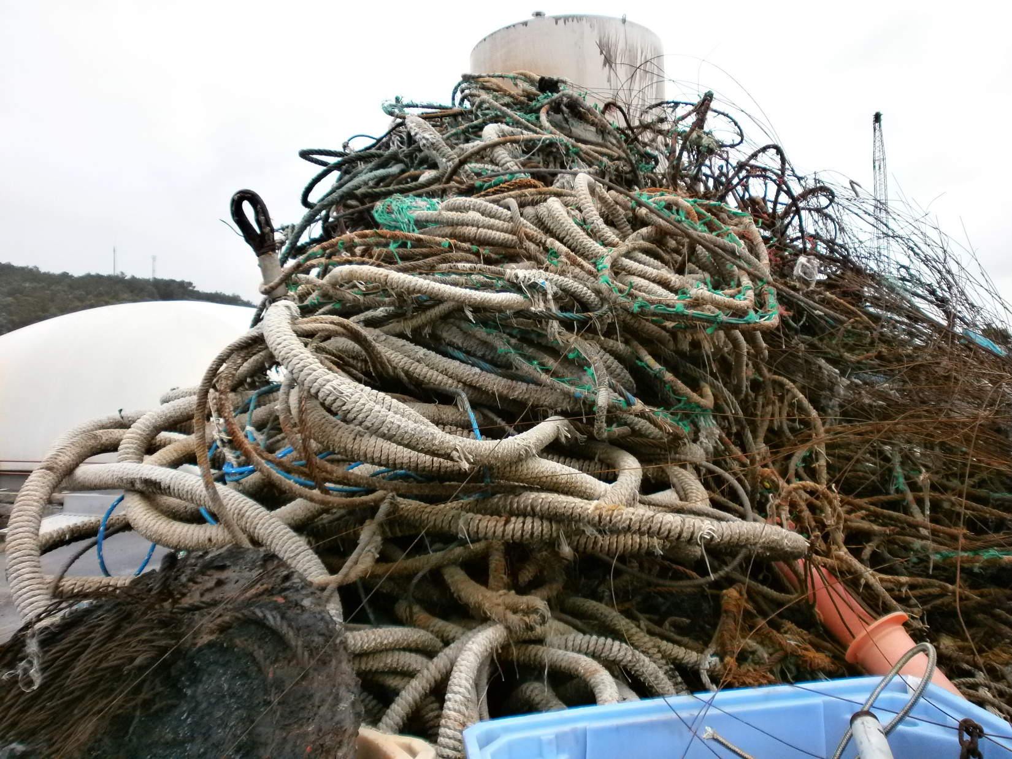
Trawl nets with “Malletas and Dolly ropes”
“malletas y burlones”

Slide 39
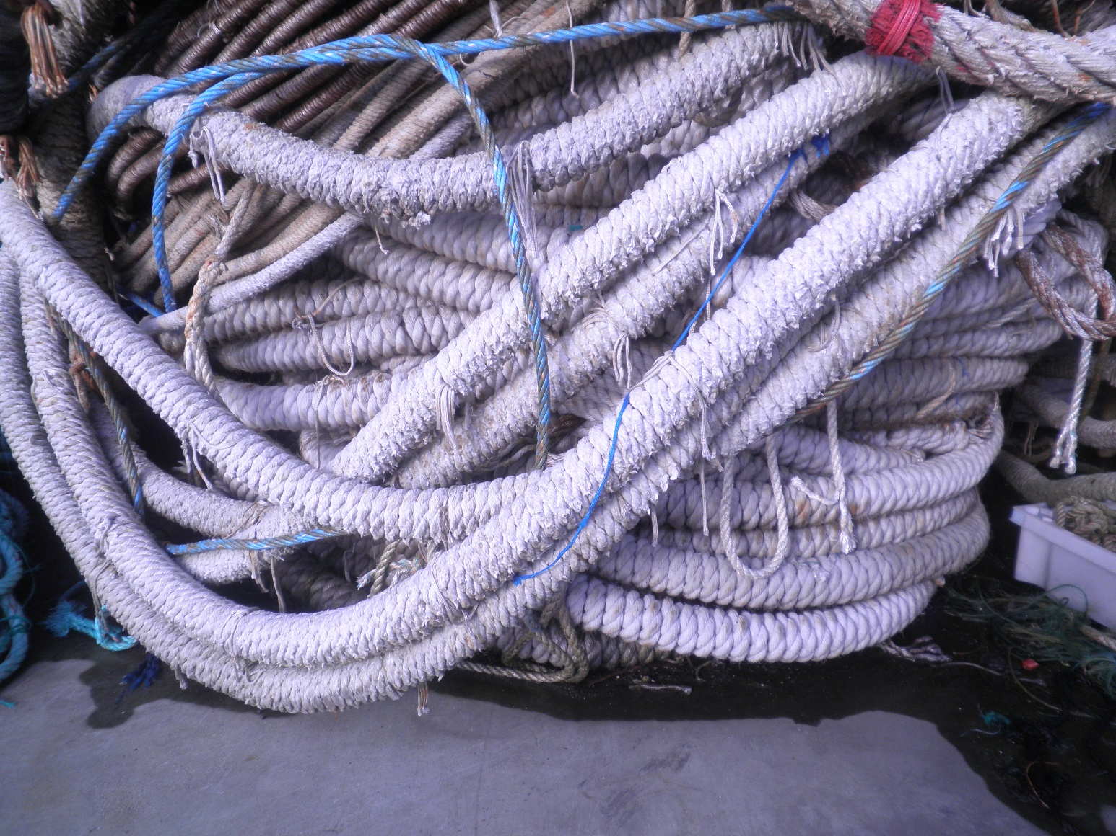
Trawl nets with “Dolly ropes”

Slide 40
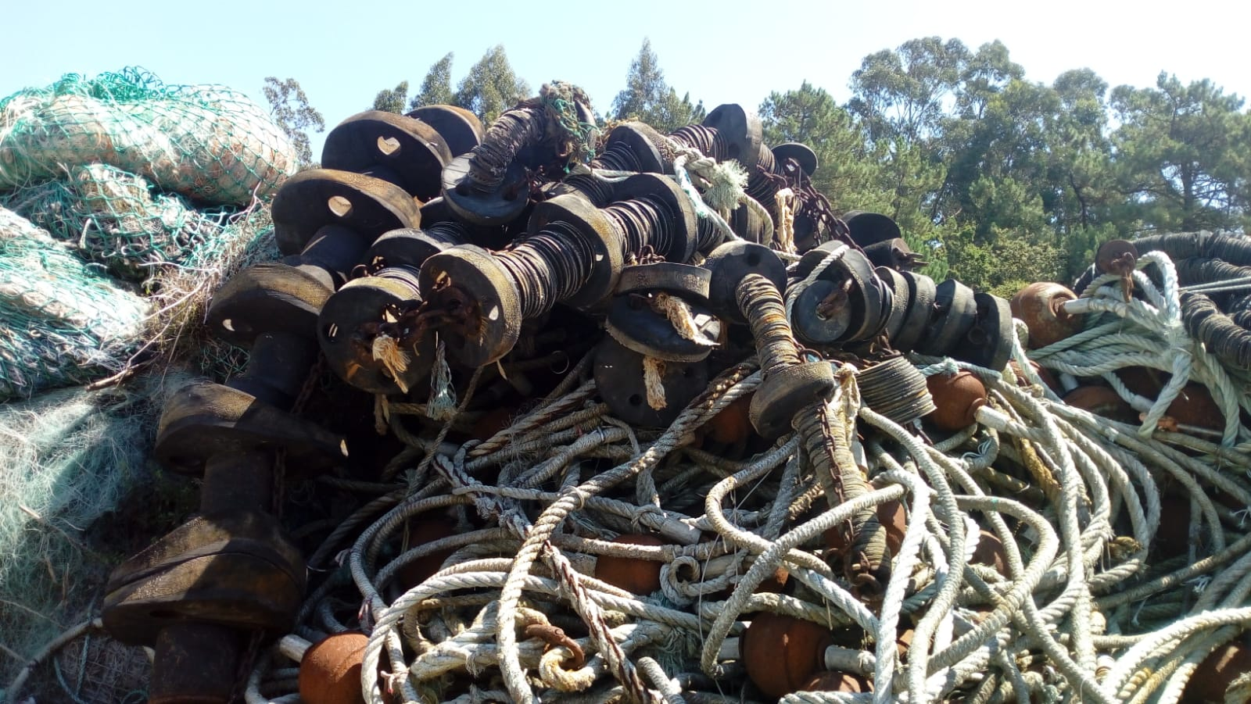
Rockhoppers

Slide 41
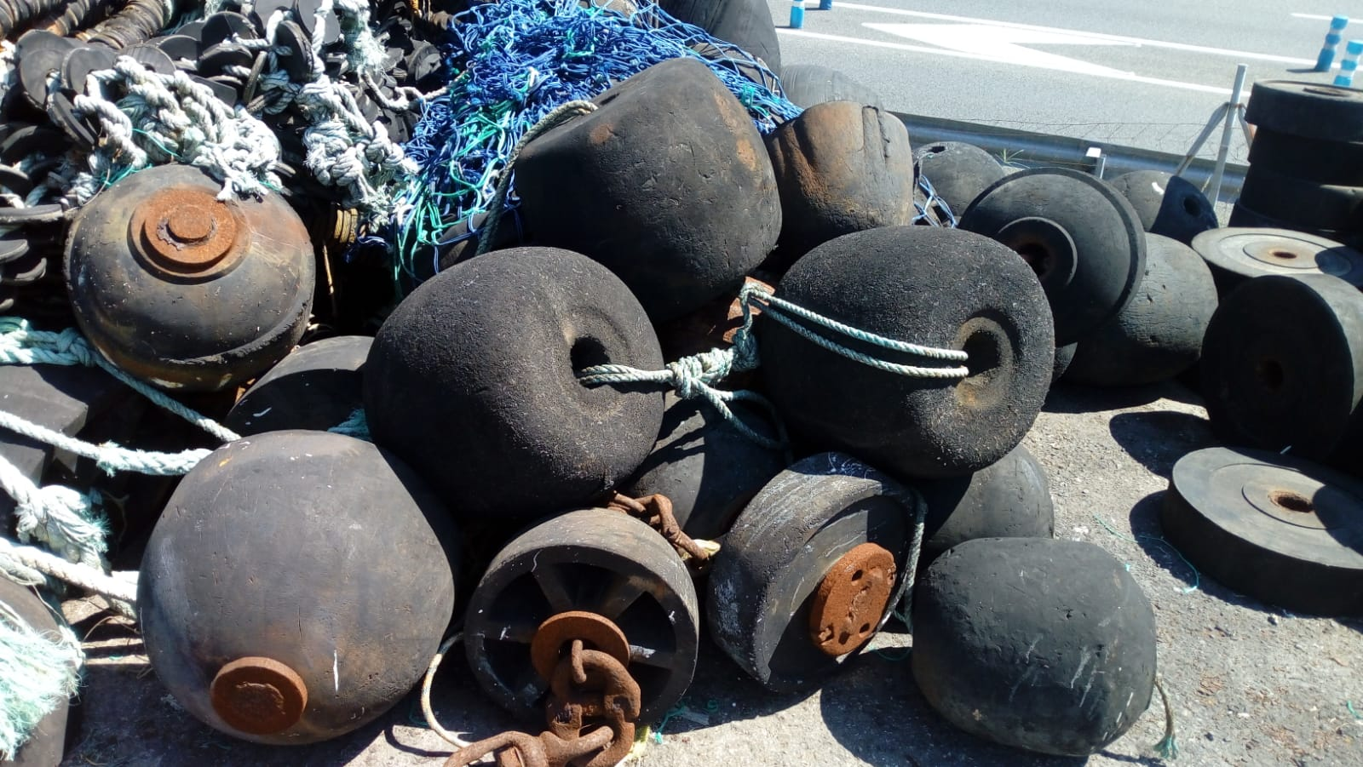
Rockhoppers

Slide 42
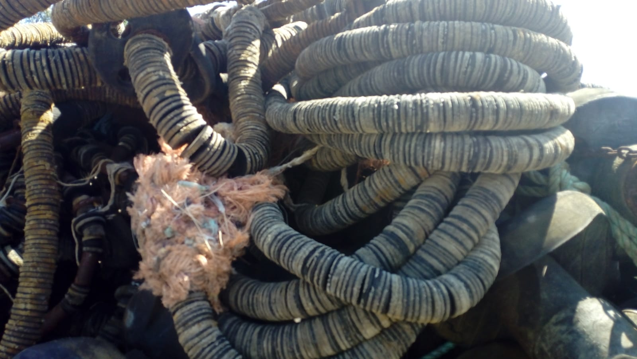
Rockhoppers

Slide 43

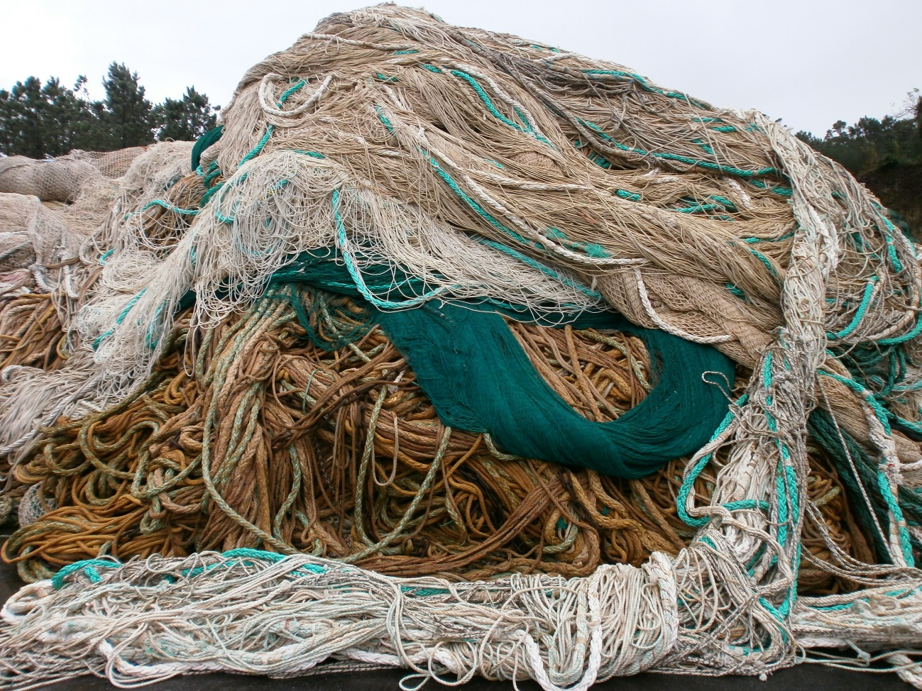




PE trawl netting – Cleaned and baled.

Slide 44

PA 6 trawl nets

Slide 45


PA 6 trawl nets

Slide 46

PA 6 trawl nets

Slide 47

Surround nets – Surround nets for sardine and mackerel. Typical in Spain.

Slide 48

Surround nets – Surround nets for sardine and mackerel. Typical in Spain.

Slide 49

Surround nets – Surround nets for sardine and mackerel. Typical in Spain.

Slide 50

Floats for sardine surround nets

Slide 51

Floats for sardine surround nets

Slide 52


Surround nets – From other countries.

Slide 53


Surround nets – From other countries.

Slide 54


Surround nets for tuna

Slide 55

Surround nets for tuna

Slide 56

Surround nets for tuna

Slide 57

Nets for fishfarming – with antifouling.

Slide 58

Nets for fishfarming – with antifouling.

Slide 59





Nets for fishfarming – with antifouling.

Slide 60




The problems with the separation of the nets

Slide 61

Nets for fishfarming – Polysteel ropes with antifouling and Polyamide twine.

Slide 62



Nets for fishfarming – Polyester or Polyamide rope with lead inside

Slide 63


Twisted and braided ropes

Slide 64


Twisted and braided ropes

Slide 65

Tuna floats

Slide 66
Problems with the collection of nets in the ports

Slide 67


Slide 68


Slide 69


Slide 70


Slide 71


Slide 72


Slide 73


Slide 74
Twisted ropes and braided ropes from merchant ships

Slide 75


Slide 76


Slide 77


Slide 78


Slide 79


Slide 80


Slide 81


Slide 82


Slide 83


Slide 84


Slide 85


Slide 86


Slide 87


Slide 88
TYPES OF RECYCLING
Mechanical
Chemical

Slide 89

Mechanical: consists in shredding the material, washing, drying y densifying to introduce it in an extruder and finally produce granules of recyclate for the production of chips or granules which will be transformed (extrusion, injection, etc).

Slide 90
Chemical:
By polymerization (it consists in returning the polymer into the state of the monomer by spliting it in specific places. The objective is therefore, to return the plastic to it’s original state through a process that the specialists call “from Plastic to monomer”), using a large amount of water the caprolactam is extracted which is then transformed into chips which are finally used to manufacture yarns to produce clothing amoungst other uses.

Slide 91
Challenges for recycling
Current situation:
Problems in the mix of diferente polymers and filaments.
Presence of other materials (metals, chains, floats,…).
Presence of organic remains, sand, salt, sediments, etc.
Which requires:
The need for separation and pre-treatment.
Therefore it is required:
That a mix of polymers is avoided to improve the recycling.
Government support for investment in mechanical or chemical treatment plants.

Slide 92
Products from recycling

Slide 93

Floats produced with granules from fishing nets

Slide 94
THANK YOU

